Slide 1
HES R/E/L Data Efforts
Tekisha Dwan Everette
Executive Director

Slide 2
Health Equity Solutions
Vision
For every Connecticut resident to obtain optimal health regardless of race, ethnicity, or socioeconomic status.
Mission
To promote policies, programs, and practices that result in equitable health care access, delivery, and health outcomes for all people in Connecticut

Slide 4
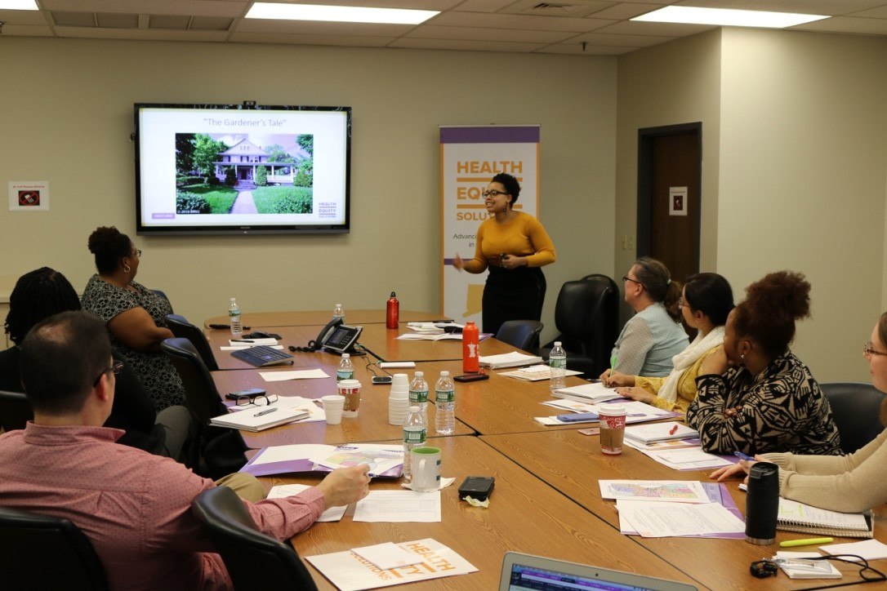
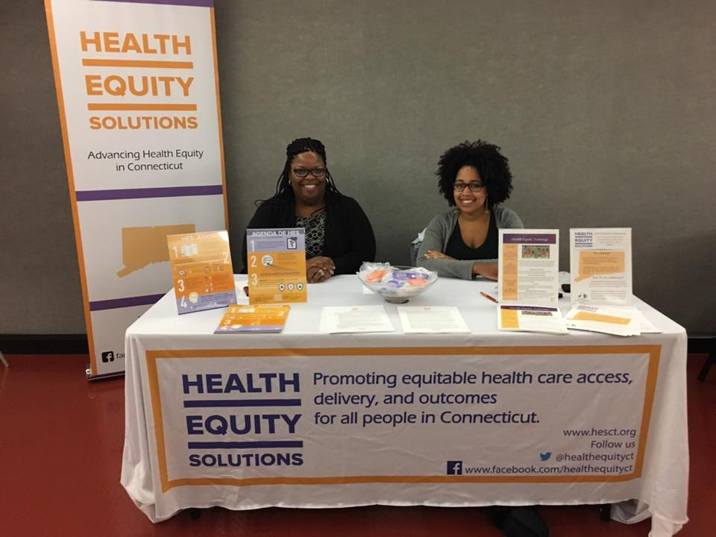
Education and Awareness Building
HES has developed and delivered 5 workshops centered around the necessity of incorporating health equity into everyday practices and policies. The workshops include:
  Health Equity – The Basics
  Social Determinants of Health
  Advocacy 101 & 102
  Asset Based Community Development
  Storytelling for Advocacy
All workshops can be modified to address the needs of the organization, community, or group of individuals requesting our training. HES has had the opportunity to provide workshops to nearly 1400 individuals across the state of Connecticut since January 2017.

Slide 5


Slide 6
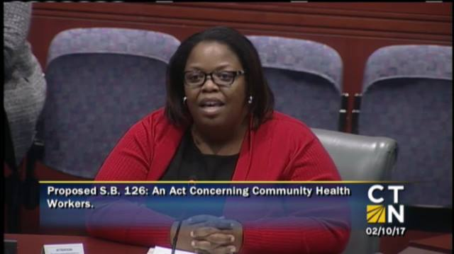

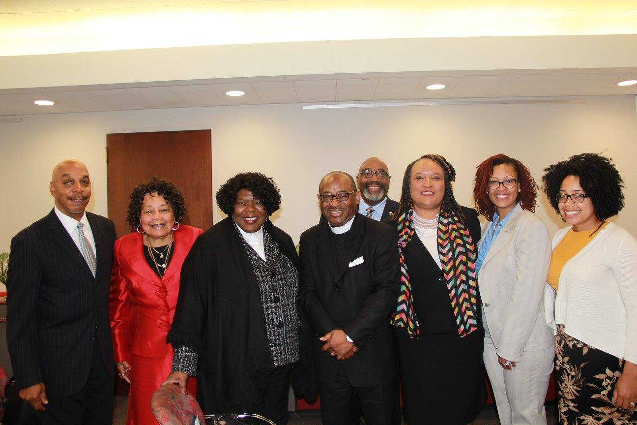
Policy and Advocacy
HES’ policy model:
1. Identify what works
  Source the best policy and programmatic solutions within Connecticut as well as nationwide.
  Conduct policy analyses and research to educate, as well as inform.
  Engage diverse partners to identify solutions.
2. Shape solutions for maximum impact
  Shape and influence policies and regulations.
  Monitor the implementation of legislation.
  Provide regulatory feedback.
3. Accelerate their adoption

Slide 7







Let’s Get R/E/L CT
Worked with a cross-sector group to identify challenges & opportunities re R/E/L data in the state
What’s a near term solution vs long term
Basic asks come down to:
  Outcomes data by R/E/L
  Disease burden data by R/E/L
  De-identified; Aggregated & disaggregated; publicly reported and available

Slide 8
Let’s Get R/E/L CT
Legislative Proposal:
  Standardization
  Expansion of categories
  Publicly Available

Slide 9
Let’s Get R/E/L CT: What Happened
Extreme opposition
Competing priorities for key individuals in power
Champions fearful of moving forward with such vocal opposition

Slide 10
Define Win or Lose?
We didn’t get our proposed or revised legislation passed, but what did we get:
  We stopped detrimental legislation to R/E/L data collection in education
  Changed the mind of a number of legislators
  Used the legislative process to elevate other important pieces of legislation (i.e. racial & ethnic impact statements)
  Made great in-roads with the Chief Data Officer (potential help w/data availability)
  Administration/Agency level support for the R/E/L (OHS, DPH)

Slide 11
What’s Next for R/E/L
Opportunities within SIM (HEDA; CCIP)
Opportunities with the Chief Data Officer (CT Data Plan)
Opportunities within the OHS
Work with CT Hospital Association
2019
  Reintroducing R/E/L data bill (pending)
  Administrative advocacy

Slide 12


www.hesct.org
175 Main Street | 3rd Floor | Hartford, CT
@HealthEquityCT
Facebook.com/HealthEquityCT

