Slide 1
Using Data Disaggregation to Drive Health Equity
Amina Ferati Senior Director of Government Relations & Policy, Asian & Pacific Islander American Health Forum January 24, 2019

Slide 2
About Us
The Asian & Pacific Islander American Health Forum (APIAHF) influences policy, mobilizes communities, and strengthens programs and organizations to improve the health of Asian Americans, Native Hawaiians, and Pacific Islanders.

Slide 3
Why Should We Care?
“Asians have the highest rate of insurance coverage of any listed race or ethnic group, at 92.5%.”
Yes but…
86.8% insured for Burmese
12.2% uninsured for Bangladeshis
“Asian and Pacific Islander men and women had lower rates of HPV-associated cancers than white men and women.”
Yes but…
5X rate of cervical cancer for Vietnamese women compared to white women
Notes:
Source: Healthy People 2020; Asian Community Survey 2017.
Source: Centers for Disease Control and Prevention. HPV is thought to be responsible for 90% of cervical and anal cancers. https://www.cdc.gov/cancer/hpv/statistics/race.htm
Source: Miller BA et al., Racial/Ethnic Patterns of Cancer in the United States, 1988-1992, 1996, available at: https://seer.cancer.gov/archive/publications/ethnicity/

Slide 4
Section Title
Description

Slide 5
The road to data equity
2016-2018
Revise OMB?
2015
NHANES AA Oversample
2010
Affordable Care Act
2014
NHIS NHPI Survey
2002
IOM Unequal Treatment Report
1997
OMB Revised Standards
2000
CLAS Standards
1986
Office of Minority Health

Slide 6
Federal Data Collection Standards

Slide 7
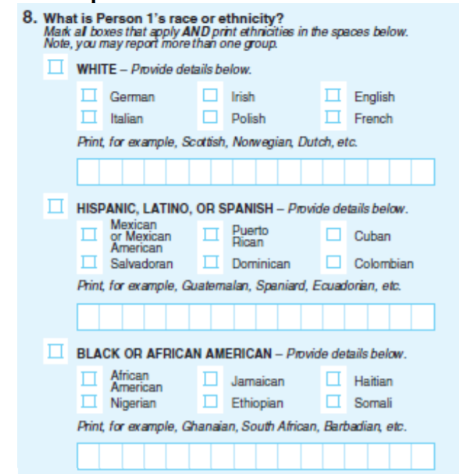
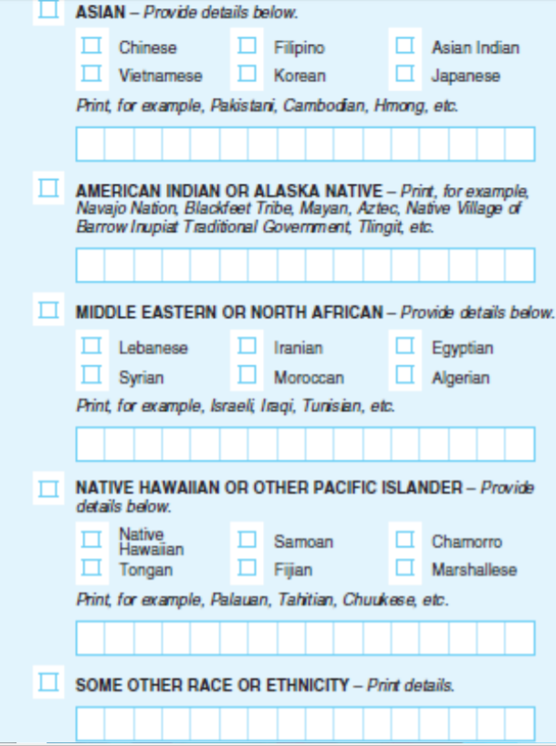
What could have been
National Content Test Recommendations that OMB declined to adopt
Combine race and ethnicity question
New MENA (Middle East and Northern Africa Category)
Checkboxes for subgroups for all races

Slide 8
Hope for 2019 and beyond
Census
2015 Certified Electronic Health Record standards
CDC Race & Ethnicity codes for 900 categories
International codes for spoken/written language
Ability to document sexual orientation & gender identity
Required in CMS Medicare Quality Payment Program (MACRA)
Health Equity & Accountability Act
Cross-racial Work

Slide 9
Amina Ferati aferati@apiahf.org (202) 466-3550 Follow Us Online: www.apiahf.org www.facebook.com/apiahf www.twitter.com/apiahf www.twitter.com/APIAHFpolicy http://www.youtube.com/APIAHF

