Slide 1
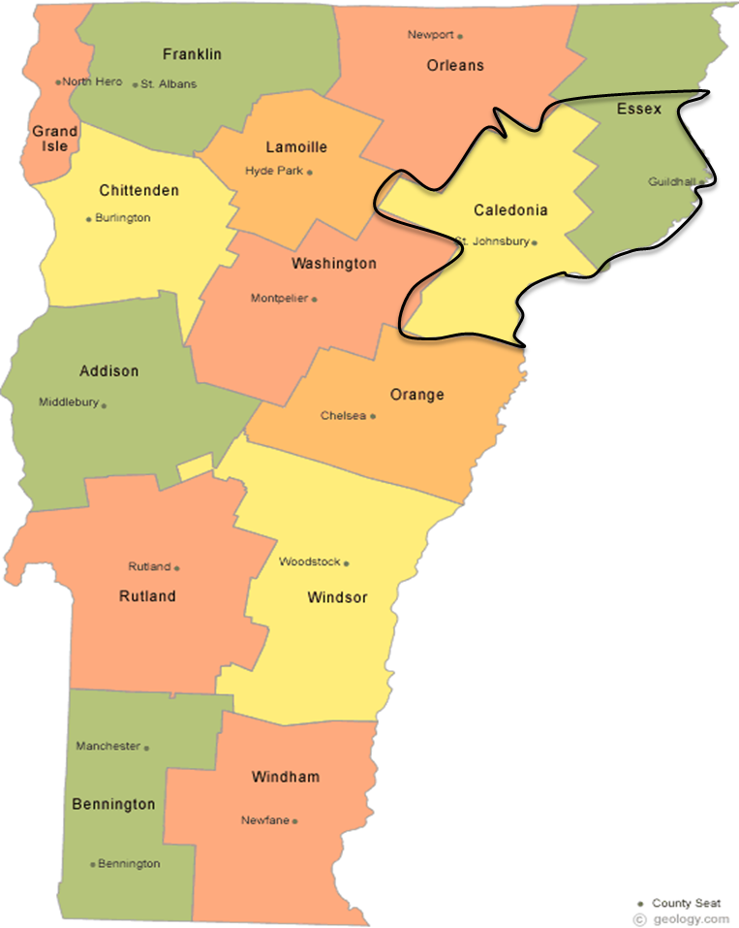
Sustainable Financing for CHW’s
The Vermont Blueprint for Health
Laural Ruggles, MBA, MPH
Families USA Health Action 2019 Washington DC January 25, 2019

Slide 2
Vermont Act 71; signed into law 2007
The director shall encourage the development of community based care coordination teams, which will provide local support to primary care providers in a community, particularly those serving as medical homes to patients with chronic conditions.
It is the intent of the general assembly that health insurers shall participate in the blueprint for health no later than January 1, 2009 and shall engage health care providers in the transition to full participation in the blueprint.

Slide 3
St. Johnsbury Area Community Health Team
Patient Centered Medical Homes
Community Health Team
Community
Community Based Services
Mental health
Addiction services
Council on Aging
Community Action
United Way
Foodbank
Employment services
Legal and law enforcement
Economic development
Physicians
Nurse Practitioners
Physician Assistants
Pharmacists
Certified Diabetes Educators
Nurses
Office Staff
Community Connections
Behavioral
Health
Specialist,
Care Coordinator
Community Based Team
Support and
Services at Home
(SASH)
Self Management & Prevention
Chronic disease workshops
DART
RPP
Tobacco cessation
Support groups
MAT* Staff: Nurse and
Counselor Case Management
Women’s Health Initiative
Physicians, CNMs, NP
Nurses, Office Staff, LNA, MSW
Broader Medical Community
Home Health & Hospice, Medical Specialties,
Hospital (Inpatient & Emergency), Long Term Care
*medication assisted treatment for opiate addiction

Slide 4
St. Johnsbury Area Community Health Team
Community Health Workers
Patient Centered Medical Homes
Community Based Services
OB/Gyn Providers
Broader Medical Community

Slide 5
Community Health Team paid by:
Medicare
Medicaid
Three Commercial Payers
Paid based on total unique patients in the
Patient Centered Medical Homes

Slide 6
Laural Ruggles
l.ruggles@nvrh.org
1-802-748-7590

