Slide 1
The CHW Movement in St. Louis, MO

Slide 2
Add BOL Video
Notes:
The WHY from Community (Ryan):
Appeal to the passion
Why are we doing what we’re doing
Leadership approach

Slide 3
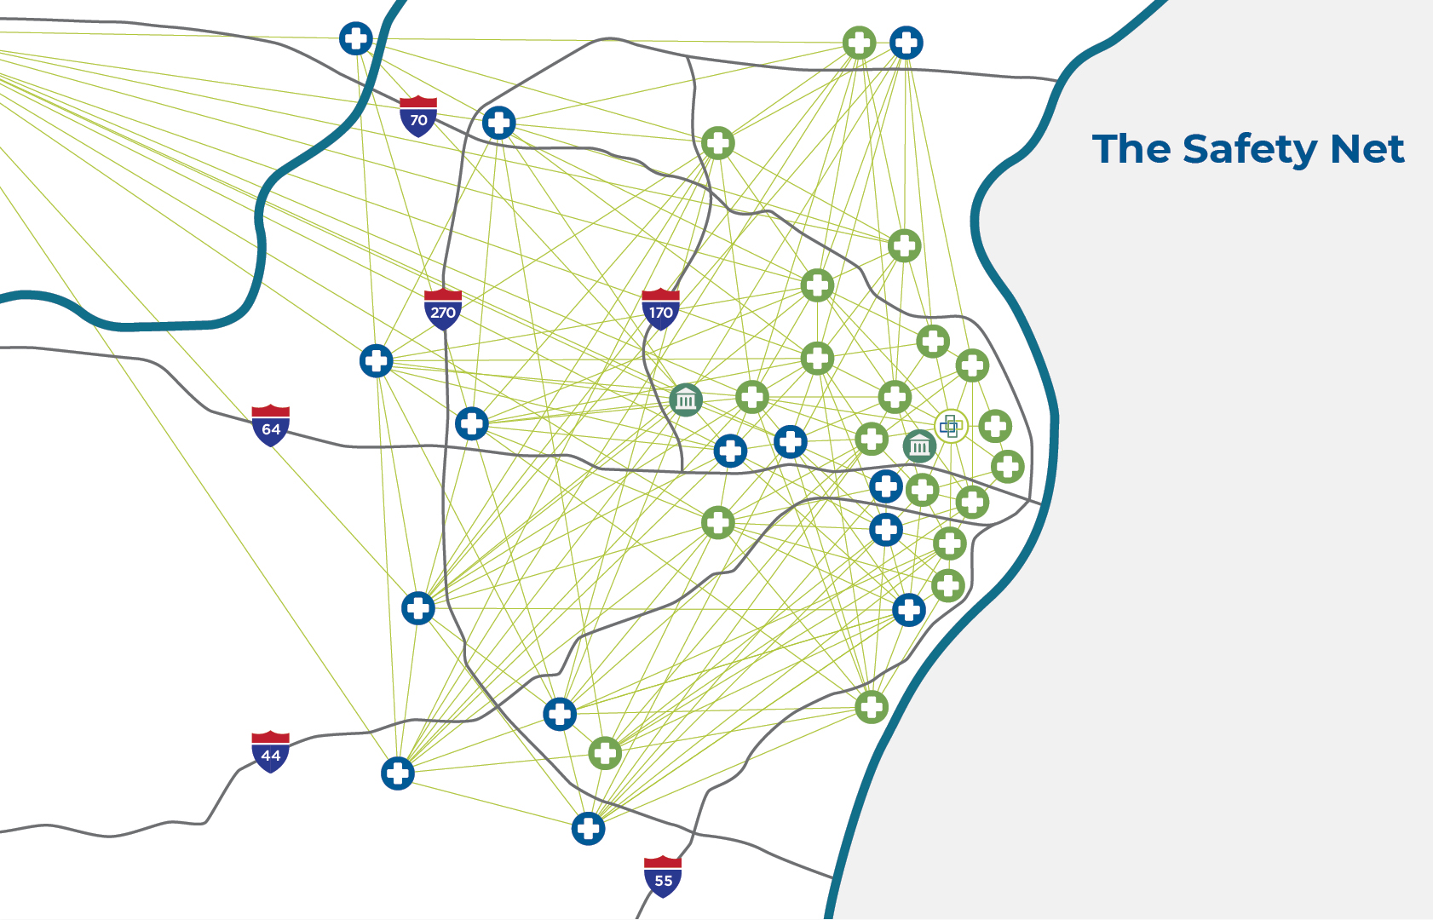
Integrated Health Network
Community Health Centers
Hospital Systems
Public Health Departments
Academic Institutions
Other Safety-Net Orgs
Notes:
The WHY from institutions (Jess):
Overview of IHN structure, purpose, and key priorities (convening, aligning functions)
Why CHWs? What did we see in helping to support them?

Slide 4
Align Local + Statewide Infrastructure
INTEGRATED HEALTH NETWORK
Healthcare
DEPT OF HEALTH
CHW ADVISORY COMMITTEE
VISION
Advocate for the full value of CHWs
GOAL
Scale and Sustain the CHW Workforce
STRATEGIES
Build capacity and formalize institutional CHW leadership
Advocate for CHW long-term sustainability
Develop a workforce strategy that supports training and career pipeline
Demonstrate the value of CHWs in the St. Louis region
MO CHW Sustainability Collaborative
Local community orgs
Associations/collaboratives
CHWs
Managed Care Organizations
State Departments
HEAL PARTNERSHIP
CHW Employers and Workforce Partners
Community Health Worker
Coalition
MISSOURI PRIMARY CARE ASSOCIATION
Notes:
The WHAT/HOW from IHN (Jess):
Key approaches (e.g. CHWs lead, not follow; partners as supportive allies, solutions focus)
Describe building partnerships regionally, state, and payers
Share process for forming the MO Sustainability Collaborative
Opportunities/challenges

Slide 5
MO CHW Sustainability Collaborative
Associations/
Collaboratives
Local CHW Employers
CHWs
Managed Care Organizations
State Departments
Leverage convening tables for buy-in, decisions, and direction
Build into strategic plan and public documents
Leverage convening tables
Pathways to reimbursement
Leverage knowledge of billing and documentation, EHR and data collection, staff considerations
Rural/urban representation
Leverage expertise around target populations and billing structure
Authorization from employer
Coaching and empowerment
Invitation to table and to lead
Focus on senior executive buy-in
Incentivized by strategies moving in the direction of value-based care, addressing SDOH, and MCO contracts
Being a good partner to community
Focus on senior executive buy-in
Collaboration and public engagement
Lowering the costs of healthcare
Being a good partner to community

Slide 6
St. Louis CHW Coalition
Employment
Criminal Justice
Domestic Violence
Substance Use
Grassroots Organizing
Advocacy
Health
Community
CHW Coalition
Board of Leaders
Notes:
The WHAT/HOW from the CHWs (Ryan):
Key approaches to building to coalition (e.g. leadership dev, elevating community into planning)
Describe purpose of the BOL and how it was formed
Describe function of the Coalition
Opportunities/challenges

Slide 7
Add BOL Video (choose one that feels like a “case study”)
Notes:
Ryan – final thoughts and close with the video

