Slide 1
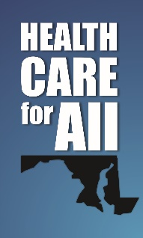
Health Insurance Down Payment Plan
Vincent DeMarco
Maryland Citizens’ Health Initiative
Maryland Health Care for All! Coalition
Twitter: @healthymaryland
Facebook: @mdhealthcareforall

Slide 2
The Problem
Federal tax bill ended federal enforcement of the individual market, effective:
  Coverage beginning January 2019
  Tax filing in 2020
Without enforcement:
  Premiums in Maryland’s individual market rise by 16%
  69,000 additional uninsured Marylanders:
    16,000 fewer people with Medicaid and CHIP
    10,000 fewer people with employer-sponsored insurance
    43,000 fewer people with individual-market coverage

Slide 3
Health Insurance Down Payment Plan
At tax time, Marylanders would be asked if they had quality health coverage in the past year. If they answer no, they have a choice: either pay a penalty to the state or instead use that money to purchase quality, affordable healthcare.
Additional exemptions from the personal-responsibility requirement, recognizing
  Religious convictions that prohibit health-care use
  The tight budgets of low-wage, working families
Enrollment incentives and auto-enrollment replaces mandate penalties, whenever possible
  If tax return data shows Medicaid eligibility, enroll the uninsured into Medicaid
  Let consumers convert penalty payments into “down-payments,” to help buy insurance

Slide 4
Benefits of the Proposal
Experts predict:
About 50,000 Marylanders could enroll in Medicaid who file tax returns but have not yet signed up for coverage.
About 78,000 Marylanders could purchase coverage for no more than the penalty combined with federal subsidies.
Young and healthy residents would purchase coverage, stabilizing the individual market and lowering premiums.

Slide 5
Benefits
Newly covered
14,300 children with Medicaid/CHIP
36,100 adults with Medicaid/CHIP
78,700 adults with exchange coverage
371.5
241.4
Source: Families USA analysis of 2016 ACS data and 2019 MHBE premiums. Notes: “FPL”= federal poverty level.

Slide 6

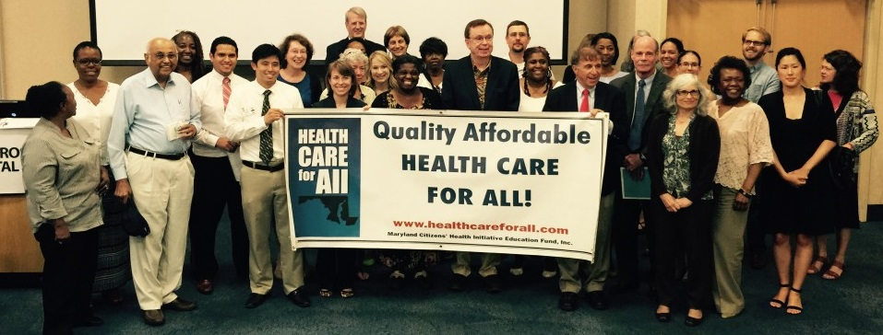
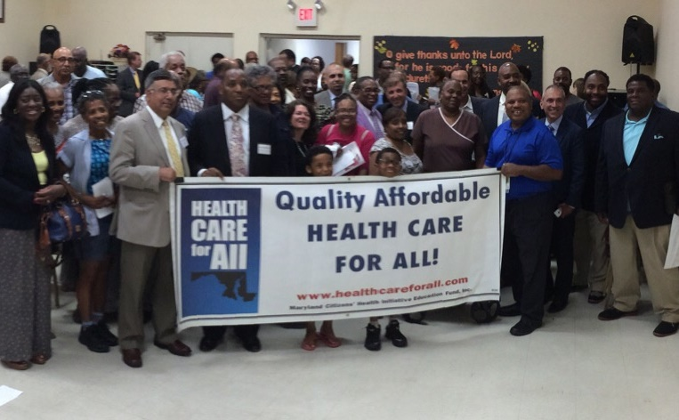

Public Support

Slide 7
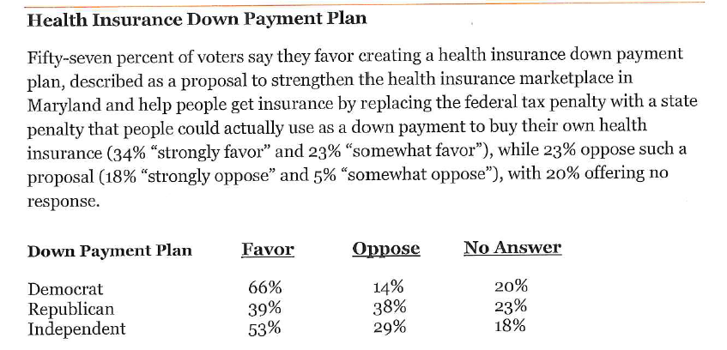
Public Support

Slide 8

Bipartisanship saved Md.'s Obamacare exchange for now; here's what we need to do next
“There are several steps state leaders can take …Maryland needs to enact its own version of the individual mandate, as Massachusetts has. That policy would compliment the reinsurance pool by bringing more customers into the system and driving down rates. Properly structured, it could serve to decrease the ranks of the uninsured rather than generate revenue for the government.

Slide 9
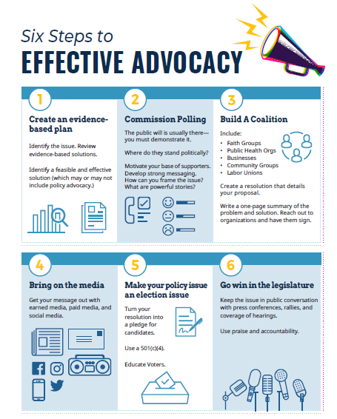

Slide 10
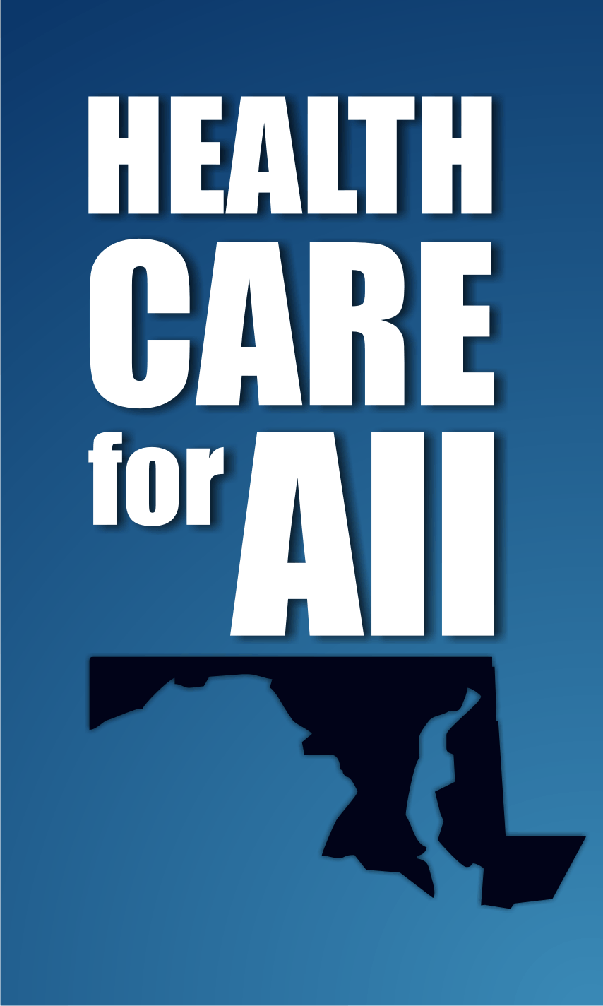
Thank you!
  Vincent DeMarco
  demarco@mdinitiative.org
  (410) 235-9000
  Maryland Citizens’ Health Initiative
  Health Care for All!
  2600 St. Paul Street
  Baltimore, MD 21218

