Slide 1
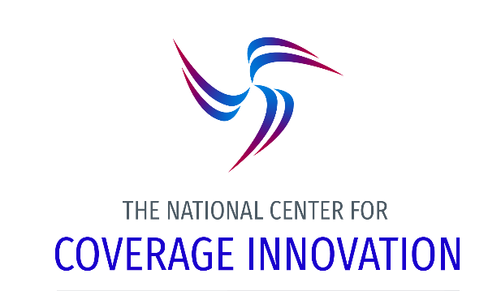
State Coverage Innovation in 2019: Roads, Walls and Ladders
Stan Dorn, Director of the National Center for Coverage Innovation at Families USA
Health Action Conference, January 25, 2019
Notes:
NOTE: Make sure that the Title slide does not have footer information (sources, FUSA logomark and page number). To turn off on this page, go to Insert > Headers&Footers and deselect Footer and Page number options > Apply to this page only. Also, select start page numbers at 0.

Slide 2

Popular Roads in State Capitols
Public options, including Medicaid buy-in
  More efficient purchasing, lower premiums for those ineligible for premium tax credits (PTCs)
    Particularly helpful in high-cost areas (often rural)
  Extending Medicaid’s core strategy
    Lower provider payment rates
    Much lower consumer costs
Reinsurance
  Original vision faded
    National risk adjustment covers members >$1 million in claims
    Carriers know markets now
  Still useful in cutting premiums
    MN, 20% savings
    MD, 30% savings
  Lots of federal matching money

Slide 3
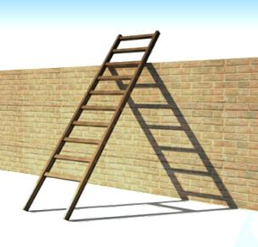
Walls and Ladders, Part 1: Public Options, Medicaid Buy-In
“You show me a 10-foot wall,
and I’ll show you an 11-foot ladder!”
Adding a lower-cost QHP option helps consumers ineligible for PTCs, mostly above 400% of FPL
PTC beneficiaries generally not helped, can be hurt! Here’s what PTC beneficiaries pay:
  For a “benchmark plan”—second-lowest-cost silver plan
    Beneficiary pays income-based amount
    Lower premiums = lower federal PTC, no change to what consumer pays
  For a plan less costly than the benchmark
    Beneficiary pays
      The income-based benchmark cost, minus
      Difference between the premium for benchmark and the consumer’s plan
    Lower benchmark premium can raise costs for PTC beneficiaries
      In 2019, >24% of healthcare.gov PTC beneficiaries buy plans less costly than benchmark

Slide 4
Scenario with PTC beneficiary who has $100 premium cost for benchmark plan; Medicaid buy-in raises this consumer’s costs
Cautionary note: lower-cost public option can reduce PTCs
x
 | Monthly premium | Benchmark/PTC |  | Cost of plan to consumer
 |  | No buy-in |  | No buy-in
Silver Plan A | $260 |  |  | $45
Silver Plan B | $315 | X, $215 |  | $100
Silver Plan C | $380 |  |  | $165
Bronze Plan D | $200 |  |  | Free
X=benchmark plan. The PTC amount is the difference between the benchmark premium and the consumer’s $100 income-based payment.
This slide shows what the world looks like without Medicaid buy-in, given a hypothetical set of qualified health plans (QHPs) and a particular PTC (premium tax credit) beneficiary.

Slide 5
Scenario with PTC beneficiary who has $100 premium cost for benchmark plan; Medicaid buy-in raises this consumer’s costs
Cautionary note: lower-cost buy-in option can reduce PTCs
x
 | Monthly premium | Benchmark/PTC |  | Cost of plan to consumer
 |  | No buy-in | Buy-in | No buy-in | Buy-in
Medicaid | $235 |  |  | n/a | $75
Silver Plan A | $260 |  | X, $160 | $45 | $100
Silver Plan B | $315 | X, $215 |  | $100 | $155
Silver Plan C | $380 |  |  | $165 | $220
Bronze Plan D | $200 |  |  | Free | $40
This slide shows how the world changes when a Medicaid buy-in option joins as a new, low-cost QHP option.

Slide 6
Scenario with PTC beneficiary who has $100 premium cost for benchmark plan; Medicaid buy-in raises this consumer’s costs
Cautionary note: lower-cost buy-in option can reduce PTCs
x
 | Monthly premium | Benchmark/PTC |  | Cost of plan to consumer
 |  | No buy-in | Buy-in | No buy-in | Buy-in
Medicaid | $235 |  |  | n/a | $75
Silver Plan A | $260 |  | X, $160 | $45 | $100
Silver Plan B | $315 | X, $215 |  | $100 | $155
Silver Plan C | $380 |  |  | $165 | $220
Bronze Plan D | $200 |  |  | Free | $40
Because the Medicaid buy-in option lowers the benchmark premium, PTC amounts decline. As a result, every QHP besides the buy-in becomes more expensive for PTC beneficiaries. This slide highlights Silver Plan C as an example.

Slide 7
Scenario with PTC beneficiary who has $100 premium cost for benchmark plan; Medicaid buy-in raises this consumer’s costs
Cautionary note: lower-cost buy-in option can reduce PTCs
x
 | Monthly premium | Benchmark/PTC |  | Cost of plan to consumer
 |  | No buy-in |  | No buy-in
Silver Plan A | $260 |  |  | $45
Silver Plan B | $315 | X, $215 |  | $100
Silver Plan C | $380 |  |  | $165
Bronze Plan D | $200 |  |  | Free
$55
Without a buy-in, there is a $55 difference between lowest-premium and benchmark silver plan. The PTC beneficiary’s cost for the lowest-premium silver plan is their $100 premium cost for the benchmark plan, minus $55 = $45.

Slide 8
Scenario with PTC beneficiary who has $100 premium cost for benchmark plan; Medicaid buy-in raises this consumer’s costs
Cautionary note: lower-cost buy-in option can reduce PTCs
x
 | Monthly premium | Benchmark/PTC |  | Cost of plan to consumer
 |  | No buy-in | Buy-in | No buy-in | Buy-in
Medicaid | $235 |  |  | n/a | $75
Silver Plan A | $260 |  | X, $160 | $45 | $100
Silver Plan B | $315 | X, $215 |  | $100 | $155
Silver Plan C | $380 |  |  | $165 | $220
Bronze Plan D | $200 |  |  | Free | $40
$25
With these plans, adding the buy-in option shrinks the difference between lowest- and second-lowest-cost silver plans to $25. The consumer’s cost for the lowest-premium silver plan is their $100 benchmark cost, minus $25 = $75. Because the “spread” between lowest- and second-lowest silver shrinks under buy-in, the cost for the lowest-premium silver plan rises for PTC beneficiaries.

Slide 9

Overcoming one barrier at a time
Solution: A 1332 waiver can change the rules. E.g.:
  Third-lowest silver plan, not the lowest, sets the benchmark
  Medicaid or other public plan automatically qualifies as a QHP, with lower out-of-pocket costs than other plans
Second barrier: federal deficit neutrality and federal pass-through amounts
  Calculated on an aggregate basis, under both Obama and Trump
  More enrollment means
    May not get waiver approved
    Pass-through payments may not cover additional enrollees, leaving state on the hook

Slide 10
The New Mexico Strategy for Deficit Neutrality
How deficit neutrality calculation works
  What is the federal cost under the “baseline,” the world without the waiver?
  What is the federal cost under the waiver?
  If B>A, waiver denied
Strategy
  Objective: waiver approval from a future administration that is more open to public options and Medicaid buy-ins
  “Pump up the baseline” – enroll as many PTC beneficiaries as possible, reducing the added federal cost of the waiver
  Add “pay-fors” to the eventual waiver, to offset costs and gain access to more pass-through resources
    Reinsurance, for pass-through + pay-for
    Employers offered lower-cost public coverage, for pay-for
An example from NM
 | PTC beneficiaries | Avg. PTC | Total PTC
Status quo baseline | 32,700 | $5,560 | $183.5 million
Medicaid buy-in | 100,000 | $4,489 (20% savings) | $448.9 million
Pumped-up baseline | 90,300 | $5,050 (10% savings) | $456.1 million
Adding reinsurance as waiver “pay for” | If it provides 10% premium savings off pumped-up baseline, $45.6 million in extra federal pass-through dollars

Slide 11
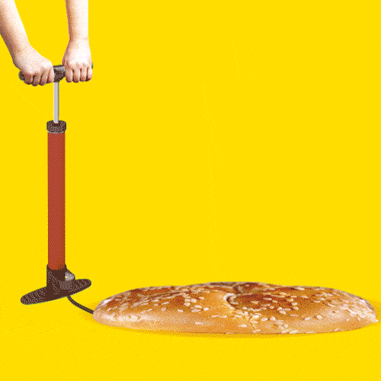
How do you pump up the baseline?
Add auto-enrollment to the Maryland down-payment plan
  Nationally, 4.2 million uninsured are offered zero-premium bronze plans
  Number higher if add down payment component
  Can add up-selling step to move from bronze to more valuable plans
Add supplemental affordability aid, borrowing page from MA
  Assures that auto-enrollment will yield ongoing returns
Provide additional application assistance and public education
Funding?
  Win-win assessments on providers and carriers

Slide 12

Walls and Ladders Part II: Reinsurance
Reinsurance lowers premium costs for people ineligible for PTCs, mostly over 400% FPL
How does reinsurance affect premium costs for PTC beneficiaries?
  Benchmark plans: not at all
  Plans less costly than benchmark: can go slightly up or down

Slide 13
People slightly above 400% FPL are among those with affordability challenges
 | 1. The % of potentially eligible adults who do not buy individual coverage and so are uninsured* | 2. The % of individually insured adults who delayed medical care because of cost during the past 12 months | 3. The % of individually insured adults who delayed filling prescriptions because of cost during the past 12 months
Under 200% FPL** | 62.7% | 12.2% | 16.6%
200-300% FPL | 56.0% | 12.4% | 14.6%
300-400% FPL | 48.1% | 11.9% | 9.3%
400-500% FPL | 40.1% | 15.5% | 12.2%
Source: Families USA analysis of 2017 American Community Survey (ACS) data is the source for column 1. Families USA analysis of 2016 National Health Interview Survey (NHIS) data is the source for columns 2 and 3. All results are for adults ages 19-64. FPL is federal poverty level.
*Potentially eligible adults have incomes above 138% of FPL and are either uninsured or enrolled in individual-market plans. Data did not let us identify people <400% FPL who are ineligible for PTCs because of employer coverage offers or immigration status.
**The lower income bound for column 1 is 139% FPL. For columns 2 and 3, it is 125%.

Slide 14
Most of those benefiting from reinsurance have incomes > 500% FPL
74% of enrollees with incomes too high for PTCs are over 500% FPL
Average income $198,000
Top 28% of U.S. income distribution
Source: Families USA analysis of 2017 ACS data for adults age 19-64. Note: Data did not let us identify purchasers of individual coverage <400% FPL who are ineligible for PTCs because of employer coverage offers or immigration status.

Slide 15
People over 500% FPL enrolled in the individual market face fewer affordability challenges than others do
 | 1. The % of potentially eligible adults not buying individual coverage* | 2. The % of individually insured adults who delayed medical care because of cost during the past 12 months | 3. The % of individually insured adults who delayed filling prescriptions because of cost during the past 12 months
Under 200% FPL** | 62.7% | 12.2% | 16.6%
200-300% FPL | 56.0% | 12.4% | 14.6%
300-400% FPL | 48.1% | 11.9% | 9.3%
400-500% FPL | 40.1% | 15.5% | 12.2%
Over 500% FPL | 25.1% | 7.9% | 5.6%
Source: Families USA analysis of 2017 ACS data is the source for column 1. Families USA analysis of 2016 NHIS data is the source for columns 2 and 3. All results are for adults ages 19-64. FPL is federal poverty level.
*Potentially eligible adults have incomes above 138% of FPL and are either uninsured or enrolled in individual-market plans. Data did not let us identify people <400% FPL who are ineligible for PTCs because of employer coverage offers or immigration status.
**The lower income bound for column 1 is 139% FPL. For columns 2 and 3, it is 125%.

Slide 16
Lifting the PTC income cap: More help to those who need it
Premium costs for a 60-year-old single person buying average-cost benchmark coverage: 2019
Annual income |  | Monthly premium costs |  |  | Monthly savings, compared to current policy
FPL | Dollars | Current policy | Robust reinsurance | Raise income cap | Robust reinsurance | Raise income cap
400% | $48,560 | $399 | $399 | $399 | $0 | $0
425% | $51,595 | $1,016 | $813 | $424 | $203 | $592
450% | $54,630 | $1,016 | $813 | $449 | $203 | $567
475% | $57,665 | $1,016 | $813 | $474 | $203 | $542
Source: Kaiser Family Foundation 2019. Notes: Robust reinsurance assumes sufficient reinsurance to provide a 20 percent premium reduction. Raising the PTC income cap assumes that, for the incomes shown, consumers continue to receive PTCs sufficient to lower their cost for benchmark coverage to 9.86% of income.

Slide 17
The state-level reinsurance challenge
1332 waivers provide significant federal pass-through dollars
State dollars are leveraged with federal funds for reinsurance more than with other policies. E.g. from New Mexico:
  Reinsurance
    $26.6 million in state dollars
    $53.6 million in federal pass-through dollars
    $80.2 million in total dollars
    20% reduction in unsubsidized premiums
  What else could the state buy for $26.6 million (net) or $80.2 million (gross)? (Very approximate costs follow)
    Cut premiums to $0 for people under 150% FPL: $6-8 million
      Now $49-$63 for benchmark coverage,
    Cut premiums to $55 for people at 150-200% FPL: $26-29 million
      Now $64-$132 for benchmark coverage
    Raise AV from 73% to 87% at 200-250% FPL: $16 million
    Raise AV from 70% to 87% at 250-300% FPL: $12 million
    Lift the PTC cap from 400% FPL to 450% FPL: $10.4 million
    Lift the PTC cap from 450% FPL to 500% FPL: $10.4 million
Hospitals gain $13.7 to $19.3 million in revenue
Hospitals gain $48.7 to $57.5 million in revenue
$77 to
$80 million

Slide 18

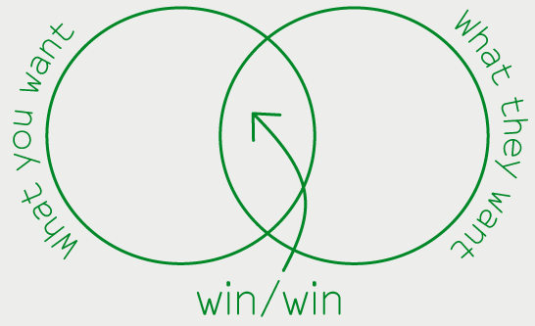
Hospital taxes to fund supplemental PTCs?

Slide 19

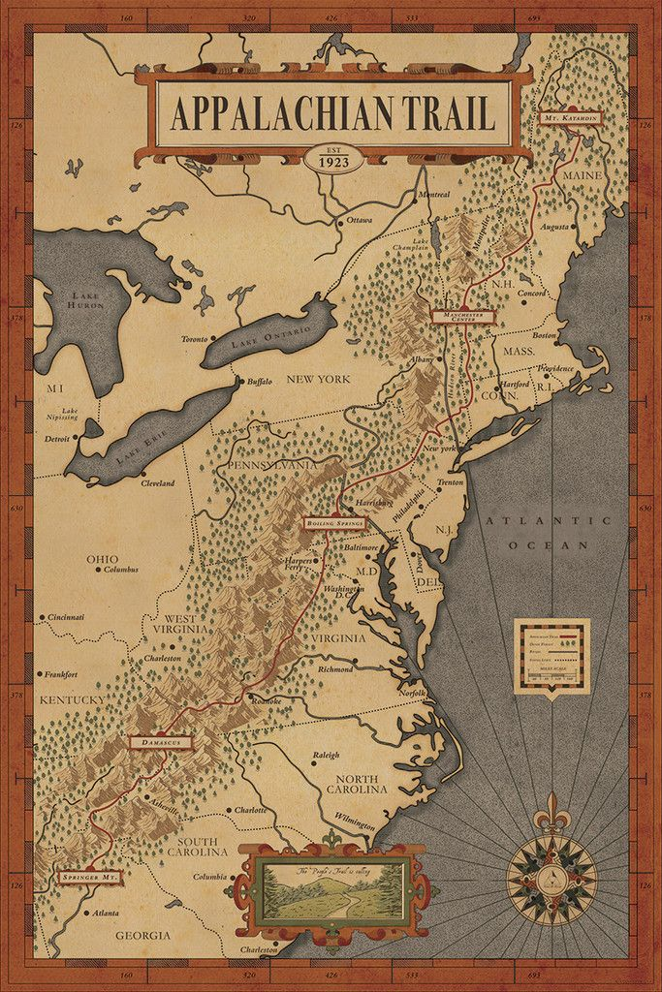

What’s the best path? It depends on where you start, what you have, and what you need
Human need
Policy imperatives
Political momentum
Political possibility

