Slide 1
Promoting Affordability
Perspectives from Massachusetts
AUDREY MORSE GASTEIER Chief of Policy and Strategy Massachusetts Health Connector
Families USA, Health Action 2019 | January 25, 2019

Slide 2
Health Connector Overview
The Health Connector is the state’s health insurance marketplace, offering Massachusetts residents and small businesses a way to understand their health coverage options, access affordability help, and compare and enroll in quality health and dental plans.
The Health Connector was created in 2006 as part of a set of state health reforms aimed at increasing access to health insurance in Massachusetts, and later adapted to incorporate the federal health reforms of the Affordable Care Act (ACA)
In addition to its role as a place to find and compare coverage, the Health Connector plays an active policy role in Massachusetts’ version of health reform, such as determining the policies that govern the Commonwealth’s requirement to have health insurance
Two of the key ways that Massachusetts promotes affordability for residents are through:
Our “wrap program” which uses state-financed subsidies on top of ACA subsidies
Creates “direct” affordability for enrollees, but also indirectly incentives lower premiums for unsubsidized individuals and small groups, too
Our state individual mandate

Slide 3
Health Connector Overview
The Health Connector's programs, outreach and public education efforts, and policies have helped Massachusetts lead the nation in coverage rates.
97%
More than 97% of Massachusetts residents are insured
¼ Million
More than a quarter million Massachusetts residents are served by the Health Connector
$332
The Health Connector has the second lowest silver benchmark plan in the country for three years running
$385
In 2018, the Health Connector had the lowest average individual premiums of any Exchange in the country, despite otherwise high health care costs

Slide 4
ConnectorCare: Our “State Wrap” Program

Slide 5
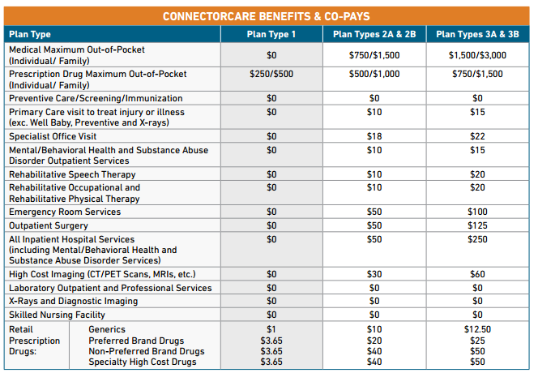
ConnectorCare: Our “State Wrap” Program
ConnectorCare leverages ACA subsidies, and “wraps” them with additional state subsidies to offer low monthly premiums and point-of-service cost-sharing.
For residents <300% FPL eligible for advance premium tax credits.
Enrollees are divided into 5 “plan types” based on income
Enrollees make per-member premium contributions based on their plan types, in base amounts ranging from $0 to $126/monthly for 2019
Plans have modest co-pays, but no deductibles or coinsurance
Makes coverage affordable and accessible for ~200K low and lower-middle income residents that may otherwise struggle to remain covered
2019 ConnectorCare lowest-cost premiums by plan type
Plan Types 1 & 2A 0-150% FPL | Plan Type 2B 150%-200% FPL | Plan Type 3A 200%-250% FPL | Plan Type 3B 250%-300% FPL
$0 | $44 | $85 | $126

Slide 6
ConnectorCare “Back-End” Design
Each ConnectorCare plan is built from a foundation of “ConnectorCare compatible” Silver plans that meet Health Connector specifications. These commercial plans are then enriched according to program standards.
Each selected carrier’s lowest-cost Silver tier plan is used as the base for ConnectorCare plans and is enriched with premium and cost-sharing subsidies from the state, in addition to federal advance premium tax credits.
The program incorporates multiple financial sources that must, in total, cover the full cost of coverage:
Premium = Federal premium tax credits + state premium subsidy + enrollee contributions
Cost Sharing = State cost-sharing reductions (CSRs) + enrollee copayments (prior to 2018, also federal CSRs)
State premium and cost-sharing subsidies are funded through our Commonwealth Care Trust Fund (CCTF), which gets funding from state tobacco tax, contributions from employers, and penalty revenue via the state individual mandate

Slide 7
Role of State Individual Mandate in Promoting Affordability

Slide 8
Individual Mandate & Affordability
Massachusetts’s 12-year-old state-level individual mandate plays a unique role in promoting widespread coverage, but also in promoting affordability.
Massachusetts established a state-level individual mandate as part of its 2006 health reform law.
While individual mandates are widely understood to promote coverage and ensure risk pool stability, they have other less-discussed, but important benefits related to affordability:
Creating ceilings on cost sharing
Ability to stem market traction of less robust/”gray market” plans that can leave consumers exposed
Outreach capabilities enabled by mandate administration, which in turn helps affordability for those who can be newly enrolled + overall risk pool

Slide 9
Individual Mandate & Affordability
The Health Connector plays a key policy role in multiple elements of the state mandate:
Minimum Creditable Coverage | Affordability Schedule
The Health Connector defines the types of insurance plans that are sufficient for individuals to meet minimum creditable coverage (MCC) requirements MCC standards include requirements on what services are covered and what levels of cost sharing are permissible A Massachusetts resident who can afford insurance must have an insurance plan that meets MCC standards or else face a tax penalty under state law | Under state law, adult residents must have insurance coverage if it is considered “affordable” The Health Connector annually establishes a schedule of amounts that would be considered an affordable amount to pay for health insurance, based on an individual’s income and household size

Slide 10
Individual Mandate & Cost Sharing
Minimum Creditable Coverage (MCC) allows the state to encourage an upper-bound on cost sharing for individuals complying with the state’s mandate.
In addition to requiring that MCC meets key benefits requirements (e.g., hospitalization, Rx, maternity care, etc.), coverage must also meet cost sharing requirements
MCC regulations prohibit annual benefit limits on core services and set out parameters for out of pocket spending
Compliant plans must cap deductibles at $2,000 for individual coverage and $4,000 for family coverage, with separate prescription drug deductibles capped at $250 for individual coverage and $500 for family coverage
The maximum out of pocket amount for a compliant plan may not exceed the maximum defined by the U.S. Department of Health and Human Services each year. (In 2019, this is $7,900 for an individual, and $15,800 for a family.)
These requirements effectively encourage our market (across market segments, payers, coverage types, etc.) to offer coverage with relatively modest cost sharing parameters

Slide 11
Individual Mandate & Cost Sharing
As states contemplate similar measures that protect against excessive out of pocket spending, they may consider that MCC standards can:
Help protect against medical debt and forgone care
Can have premium impacts
Make it difficult to design low AV/bronze plans

Slide 12
Looking Ahead in Massachusetts
Massachusetts’s goals in the coming years as it relates to affordability…
Preserving and strengthening our state wrap program
Rebolstering awareness of our state-level individual mandate through our #staycovered campaign
Intensifying efforts and focus on small business affordability
Creative thinking for unsubsidized population exposed to full premiums
Learning from other states and thought leaders around the nation

Slide 13
Appendix

Slide 14
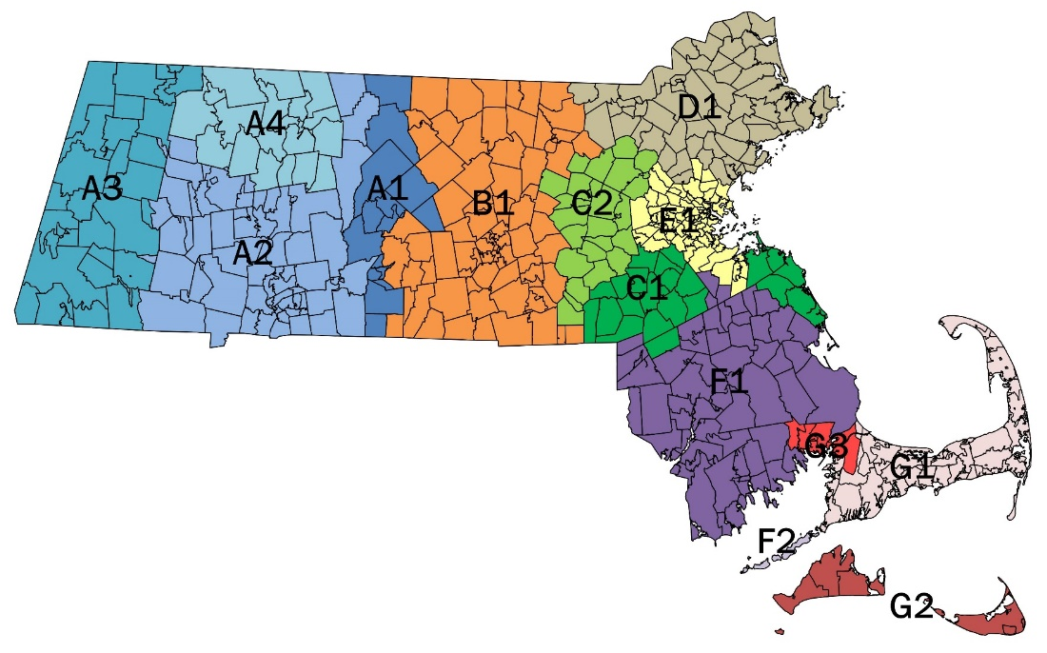
ConnectorCare Plan Availability
Enrollees can choose from up to 4 carriers, but may pay more based on the plan they select.
 | Region A1 | Enrollee Premium Contribution By Plan Type
 |  | 1 <100%FPL | 2A 100-150% FPL | 2B 150-200% FPL | 3A 200-250% FPL | 3B 250-300% FPL
1 | BMC | $0 | $0 | $44 | $85 | $126
2 | Tufts-Direct | $0 | $0 | $44 | $85 | $126
3 | HNE | $122 | $121 | $168 | $210 | $254
4 | AllWays Health Partners | $159 | $157 | $205 | $248 | $293
 | Region C2 | Enrollee Premium Contribution By Plan Type
 |  | 1 | 2A | 2B | 3A | 3B
1 | Tufts-Direct | $0 | $0 | $44 | $85 | $126
2 | BMC | $0 | $0 | $44 | $85 | $126
3 | Fallon | $72 | $74 | $119 | $160 | $201
4 | AllWays Health Partners | $195 | $190 | $238 | $278 | $321
 | Region F1 | Enrollee Premium Contribution By Plan Type
 |  | 1 | 2A | 2B | 3A | 3B
1 | Tufts-Direct | $0 | $0 | $44 | $85 | $126
2 | BMC | $0 | $0 | $44 | $85 | $126
3 | AllWays Health Partners | $211 | $210 | $257 | $299 | $344
 | Region F2 | Enrollee Premium Contribution By Plan Type
 |  | 1 | 2A | 2B | 3A | 3B
1 | AllWays Health Partners | $0 | $0 | $44 | $85 | $126
 | Region A2 | Enrollee Premium Contribution By Plan Type
 |  | 1 | 2A | 2B | 3A | 3B
1 | BMC | $0 | $0 | $44 | $85 | $126
2 | Tufts-Direct | $0 | $0 | $44 | $85 | $126
3 | HNE | $122 | $121 | $168 | $210 | $254
 | Region G1 | Enrollee Premium Contribution By Plan Type
 |  | 1 | 2A | 2B | 3A | 3B
1 | Tufts-Direct | $0 | $0 | $44 | $85 | $126
2 | BMC | $0 | $0 | $44 | $85 | $126
 | Region A3 | Enrollee Premium Contribution By Plan Type
 |  | 1 | 2A | 2B | 3A | 3B
1 | Tufts-Direct | $0 | $0 | $44 | $85 | $126
2 | HNE | $72 | $116 | $165 | $208 | $251
 | Region A4 | Enrollee Premium Contribution By Plan Type
 |  | 1 | 2A | 2B | 3A | 3B
1 | HNE | $0 | $0 | $44 | $85 | $126
 | Region B1 | Enrollee Premium Contribution By Plan Type
 |  | 1 | 2A | 2B | 3A | 3B
1 | Fallon | $0 | $0 | $44 | $85 | $126
2 | Tufts Direct | $0 | $0 | $44 | $85 | $126
3 | BMC | $0 | $0 | $44 | $85 | $126
4 | AllWays Health Partners | $156 | $157 | $205 | $246 | $291
 | Region D1 | Enrollee Premium Contribution By Plan Type
 |  | 1 | 2A | 2B | 3A | 3B
1 | Tufts-Direct | $0 | $0 | $44 | $85 | $126
2 | BMC | $0 | $0 | $44 | $85 | $126
3 | AllWays Health Partners | $168 | $168 | $215 | $256 | $300
 | Region G2 | Enrollee Premium Contribution By Plan Type
 |  | 1 | 2A | 2B | 3A | 3B
1 | AllWays Health Partners | $0 | $0 | $44 | $85 | $126
 | Region C1 | Enrollee Premium Contribution By Plan Type
 |  | 1 | 2A | 2B | 3A | 3B
1 | Tufts-Direct | $0 | $0 | $44 | $85 | $126
2 | BMC | $0 | $0 | $44 | $85 | $126
3 | AllWays Health Partners | $195 | $190 | $238 | $278 | $321
 | Region E1 | Enrollee Premium Contribution By Plan Type
 |  | 1 | 2A | 2B | 3A | 3B
1 | Tufts-Direct | $0 | $0 | $44 | $85 | $126
2 | BMC | $0 | $0 | $44 | $85 | $126
3 | AllWays Health Partners | $224 | $221 | $267 | $308 | $349
 | Region G3 | Enrollee Premium Contribution By Plan Type
 |  | 1 | 2A | 2B | 3A | 3B
1 | Tufts-Direct | $0 | $0 | $44 | $85 | $126
2 | BMC | $0 | $0 | $44 | $85 | $126
3 | AllWays Health Partners | $235 | $276 | $323 | $366 | $413
14

Slide 15
ConnectorCare Financing: 2018-2019
Premium Makeup
Cost-Sharing Makeup (AV)
Total Premium: $326
99.6%
State CSR
(-06)
~95%
State CSR
(-05)
~95%
State CSR
(-05)
94%
Federal CSR
(-06)
94%
Federal CSR
(-06)
~92%
State CSR
(-04)
~92%
State CSR
(-04)
87%
Federal CSR
(-05)
73%
Federal CSR
(-04)
70%
Base Silver
(-01)
70%
Base Silver
(-01)
70%
Base Silver
(-01)
70%
Base Silver
(-01)
70%
Base Silver
(-01)
Plan Type 1
<=100% FPL
Plan Type 2A
100%-150% FPL
Plan Type 2B
150%-200% FPL
Plan Type 3A
200%-250% FPL
Plan Type 3B
250%-300% FPL
Notes:
Illustrative rates for a 42-year old in Boston in 2019, with FPL of 75%, 125%, 175%, 225% and 275%
Applies maximum APTC and selects lowest-cost plan

