Slide 1
Confronting Health Consolidation and Its Costs
January 2019
Anthony Wright Executive Director @AEWright @HealthAccess
www.health-access.org

Slide 2
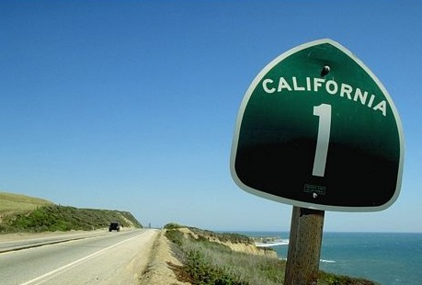
CALIFORNIA UNDER THE ACA
Millions with new consumer protections; financial assistance
4+ million Californians with new coverage already
Biggest drop in uninsured rate of all 50 states
GOVERNOR NEWSOM PROPOSES:
Requesting federal permissions for “Medicare for All”
Expanding affordability assistance in Covered California
Instituting a state-level individual mandate
Extending Medi-Cal to undocumented young adults
Pooling state prescription drug purchasing
Creating a California Surgeon General
And more…
If we can prevent ACA repeal,
stop Medicaid cuts, and resist attacks
how can California drive forward?
Notes:
…and we made big strides with coverage of immigrants. We are one of only a few states go beyond federal Medicaid rules to cover recent legal immigrants & the DREAM Act students in our program—and this year, in the budget just signed by Governor Brown a few weeks ago, we affirmed such coverage for immigrants granted “deferred action” under the President’s executive order, and an expansion to all children without regard to immigration status. We are not just implementing—we are improving.

Slide 3
#Care4All Legislative Priorities Aspirational & Achievable Without Federal Approval
PROTECT PATIENTS FROM FEDERAL SABOTAGE OF OUR HEALTH SYSTEM
COVER ALL CALIFORNIANS, INCREASING UNIVERSALITY AND AFFORDABILITY
REDUCE HEALTH CARE PRICES, IMPROVING QUALITY & EQUITY THROUGH ACCOUNTABILITY

Slide 5
Building Upon the ACA Fight and CA’s Progress
California launch of the Health Care for America Now (HCAN) Campaign to win what became the Affordable Care Act, with Mayor Gavin Newsom, highlighting Healthy San Francisco as a model, July 2008.

Slide 6
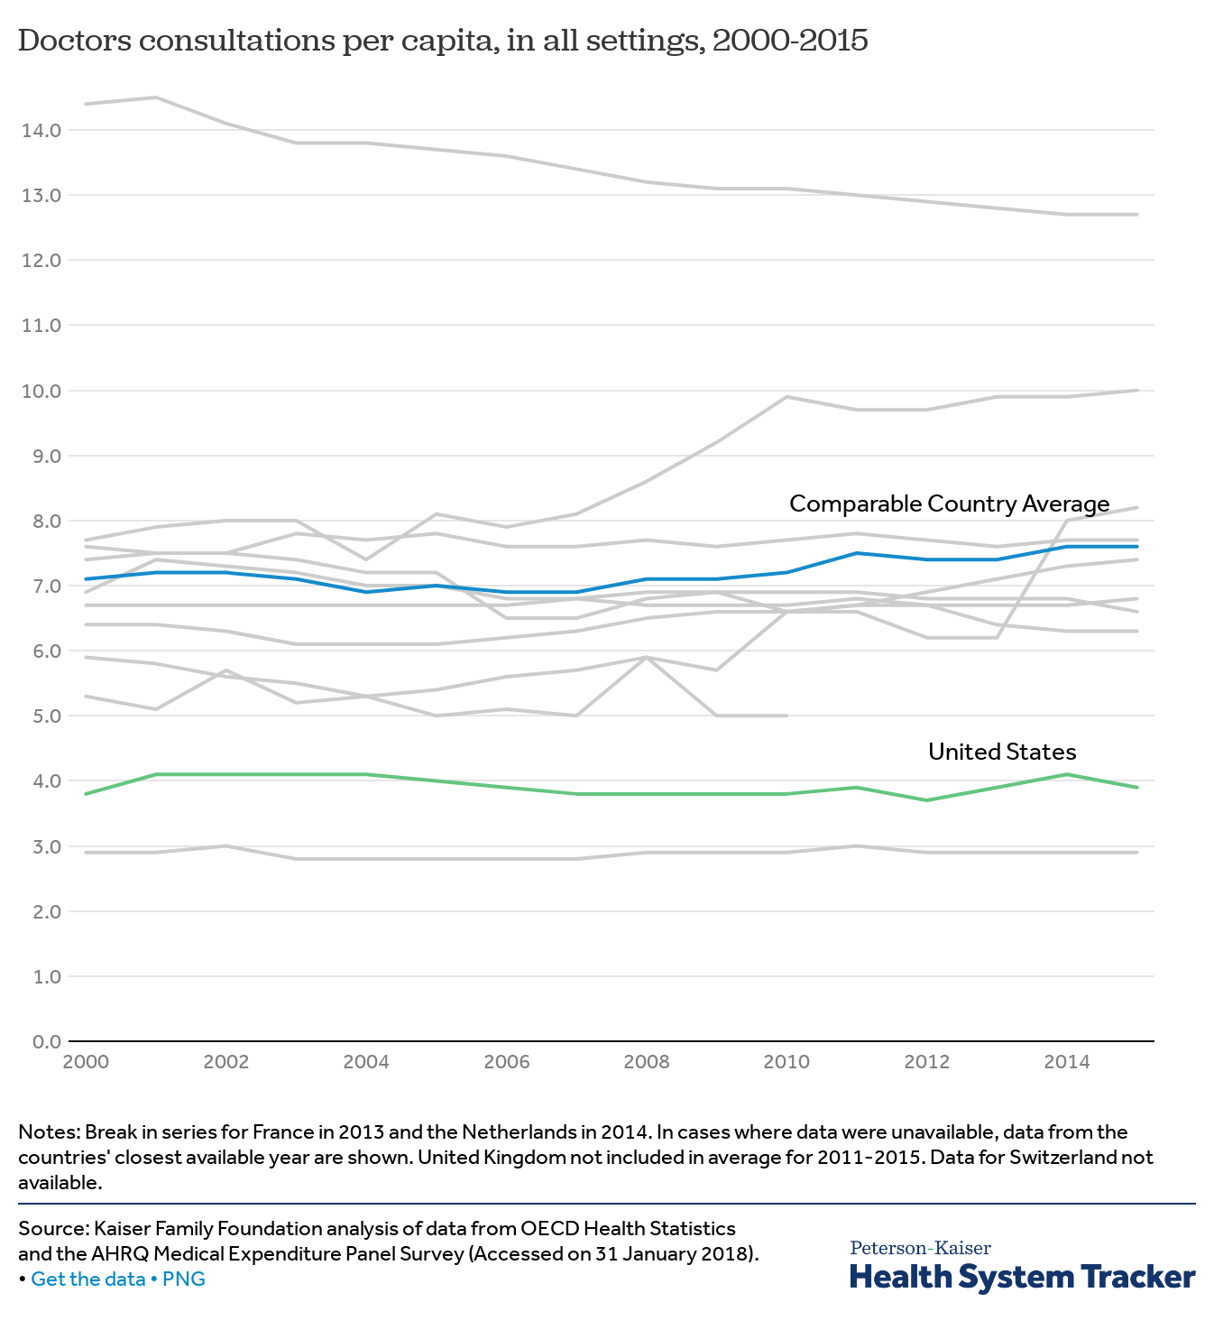
United States: Costs More, Less Care

Slide 7
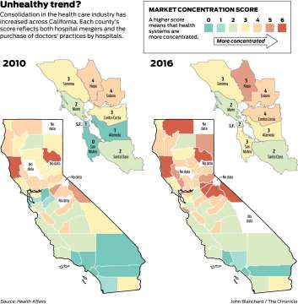
Why Health Costs Are So High
Employer-sponsored health care went up 234% from 2002-16.
83% of 2017-18 large group increases is price inflation—only 16% utilization.
75% of premium dollars to doctors and hospitals (+ another 16% on drugs)
Average in-patient procedures 79% higher in NorCal’s concentrated market; Hospital prices 70% higher; Physician prices 25-65% higher.

Slide 8
Consumers Largely Don’t Experience Health Care Choice & Competition
Limited ability to say “no” or to comparison shop
Little price transparency, notice—pricing often only appears after treatment
Consolidation in the industry
Rural/smaller/underserved areas that simply can’t sustain too many plans, hospitals, or providers
Trend to integrated care tends to correlate with consolidation
As a result, health care prices are largely determined not by the cost to provide the care, or quality, or outcomes—but the relative monopoly power of a plan or provider. Incentives drive even more consolidation.

Slide 9
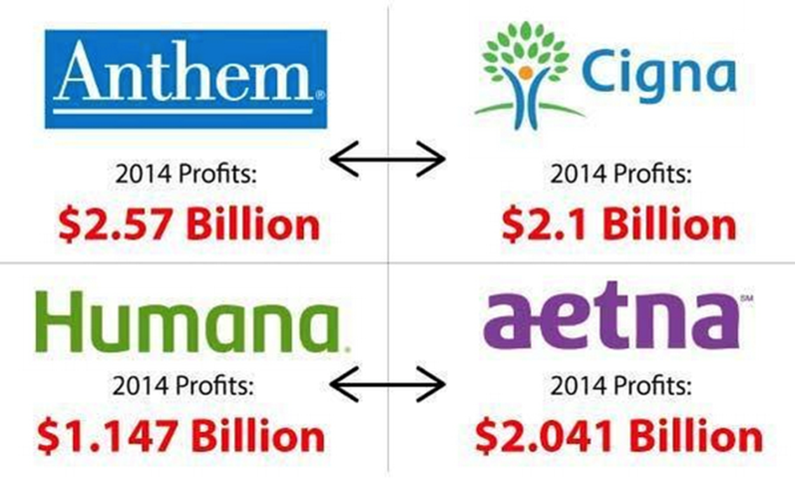
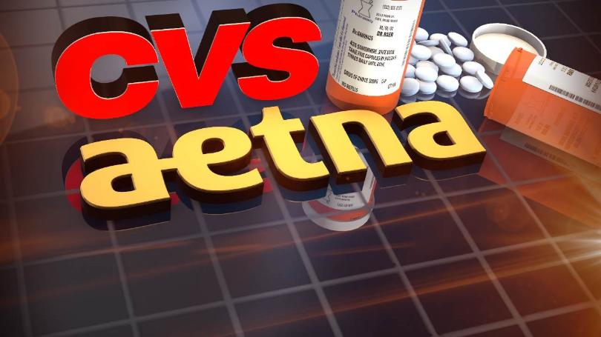
MergerWatch: Consumer Concerns
It’s Our Money!
Signal of Excess Reserves
Could Have Gone To Reduce Premiums;
Investments in Quality/Equity
Reduced Choice/Competition
Anti-Trust Analysis
Concentration Concerns Can Lead to Higher Costs
Corporate Behavior
Anti-Competitive
Consumer Protections & Customer Service
If They Want to Get Bigger, They Must Get Better

Slide 10
State Administrative Authority & Actions
Governor Signed AB 595 (Wood) to Increase DMHC Authority over Health Plan Mergers
Explicit Ability to Approve, Reject, or Impose Conditions
Requires Hearing, Health System Impact Analysis for Major Mergers
Attorney General Becerra Sued Sutter Health For Anti-Competitive Practices
Related bill on unfair contract provisions, SB 538 (Monning), stalled

Slide 11
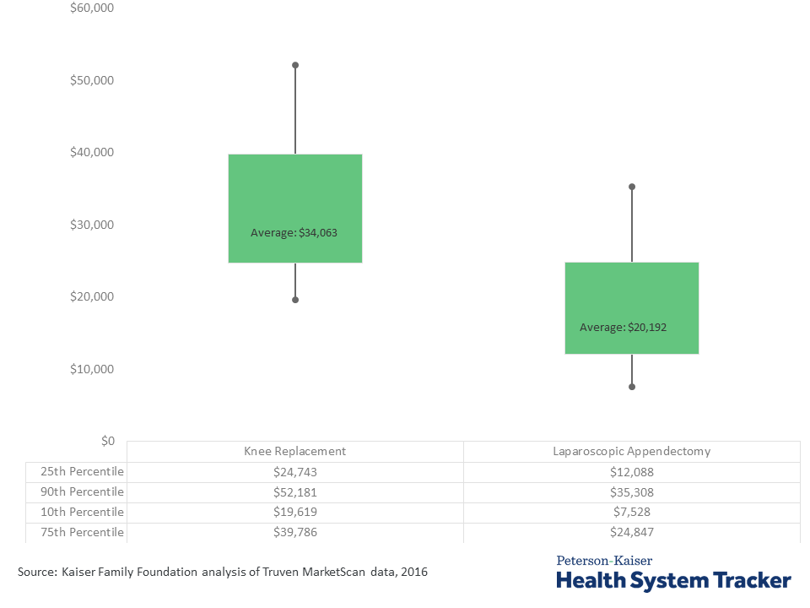
Huge Price Variation

Slide 12
AB 3087 (Kalra): CA Health Care Price Relief Act
Proposal in 2018 would have created a Health Care Cost, Quality, and Equity Commission, to set prices paid to hospitals, doctors, health plans, etc.

Slide 13
AB 3087 (Kalra): It’s the Prices, Stupid.
The California Health Care Cost, Quality & Equity Commission
Members appointed by Governor, Assembly, Senate, with anti-conflict rules
Advisory Committee would have representation from health industry, purchasers, consumers. (Proposal includes a consumer participation program.)
Would Set a “Benchmark” Price as a % Higher than Medicare
Medicare Advantage would be benchmark for health plans & insurers.
Insurers, Hospitals, Doctors Could Appeal to Charge Above Benchmark
Factors could include innovations, geographic & population health, equity, quality
Global Budgeting
AB 3087 passed Assembly Health Committee; Author held to negotiate.

Slide 14
Strong Industry Response
LA TIMES: An ambitious California bill would put the state in charge of controlling prices in the commercial healthcare market
By MELANIE MASON
APR 09, 2018 | 12:05 AM
| SACRAMENTO
Dr. Theodore M. Mazer, a San Diego ear, nose and throat specialist who is president of the California Medical Assn., called the bill a "poorly conceived, unprecedented threat to patient access to health care.“
"This dangerously flawed legislation would result in government-sanctioned rationing of care and higher out-of-pocket costs for patients.. It would also likely cause an exodus of practicing physicians, which would exacerbate our physician shortage and make California unattractive to new physician recruits.“
Focus group participant: “Sounds like someone making a lot of money off the current system.”

Slide 15
Health Care Focus Group & Polling
Funded 50/50 by Health Access California and SEIU California
David Binder & Associates
Focus Groups Each in: Los Angeles (Southern California)
Fresno (Central Valley),
Walnut Creek (Northern California)
Mixed Phone/Online Poll. Demographics:
54% female, 46% male
46% Democrat, 27% Republican 23% NPP
54% White, 22% Latino, 3% Black, 8% API; 5% Mixed
39% Progressive/Liberal; 29% Moderate; 25% Conservative
22% under 35; 29 % 35-54; 18% 55-64; 24% 65+
10% HS or less; 27% some college; 27% college; 34% postgrad+

Slide 16
Broad Support for Oversight on Health Prices

Slide 17
Focus Groups Supportive of Price Controls
“We do need to regulate it, just a cap would be good. You can’t really shop around.” –Republican Female, Fresno
“If it was regulated, more people would be able to afford it.” –Latina, Fresno
“Somebody has to do it—oversight of all these insurance companies and health providers, and provide transparency.” –Asian Male, Walnut Creek.
“Everybody deserves to make money, but there’s a point where they’re making a killing.” –White Male, Walnut Creek
“If the government didn’t regulate utilities, guess how much money you’d pay for a gallon of water.” –Latino Male, Los Angeles
“Never seen a utility go bankrupt, and those executives make a lot.”-LA male
“We need to do something.” -Multiple

Slide 18
Broad Support for Government Action
 | Total Agree | Total Disagree | Don’t Know
The government should act as a check on health care providers to get costs under control | 72 | 25 | 3
The government needs to step in and put limits on what health care providers can charge | 67 | 30 | 3
Health costs are lower when everyone has coverage, so we should make sure everyone has coverage they can afford | 63 | 32 | 5

Slide 19
Earlier Health Access California Legislation Regulating Prices
Hospital Fair Pricing Act (AB 774, Chan, 2006)
Prevent the overcharging of the uninsured/underinsured (under 350% FPL)
For qualified, hospitals can only collect Medicaid or Medicare rates.
Health Insurance Rate Review (SB 1021, Leno, 2010, etc.)
Not prior approval, but actuarial review for individual/small group premiums
Purchasers/patients notices about unretracted unreasonable rate findings
Different review efforts for large group coverage (SB 546, Leno)
Physician Surprise Medical Bills (AB 72, Bonta/Wood/etc., 2016)
Prevent bills from out-of-network doctors in in-network facilities
Uncontracted payments 125% of Medicare with dispute resolution process
Prescription Drug Price Transparency (SB 17, Hernandez, 2017)
Require justification for price hikes above 16% cumulative over 2 years

Slide 20
Potential Other Ideas for 2019
AS A REGULATOR:
Coming Back on Plan & Provider Price-Gouging
Hospitals, Doctors, Medical Groups; Learning from Maryland, Massachusetts, Montana
Enhanced Rate Review
How much do insurers pay as a % of Medicare?
Overseeing Out-of-Network ER
Balance billing/Surprise medical bill protections (Examples include infamous ZSFGH bill)
Capping out-of-network ER—preventing inflationary leverage
AS A PURCHASER
Prescription Drug Purchasing Pool --across agencies and payers
Continued Medi-Cal Managed Care Accountability
CoveredCA Purchasing Power for value, for cost, quality, and equity, and for simplification.
(Model contract, Attachment 7)

Slide 21
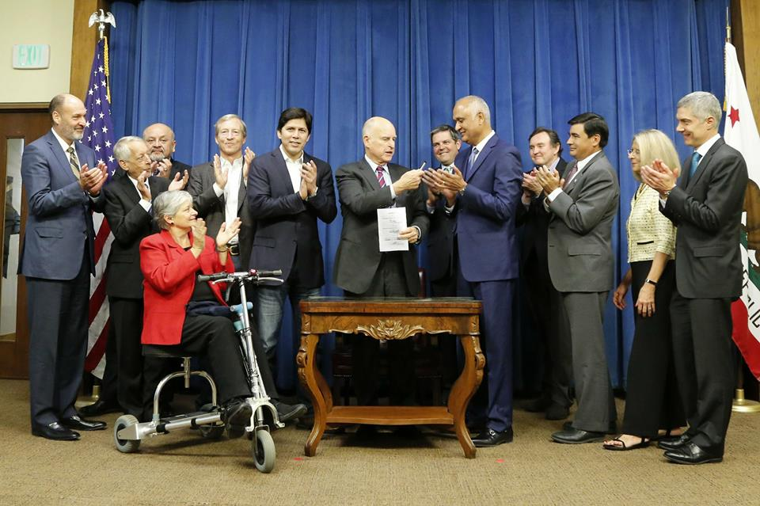
For More Information
Website: http://www.health-access.org
Blog: http://blog.health-access.org
Facebook: www.facebook.com/healthaccess
Twitter: www.twitter.com/healthaccess
Health Access California
1127 11th Street, Suite 925, Sacramento, CA 95814
916-497-0923
Other Offices in Oakland and Los Angeles areas

