Slide 1
State Efforts to Make Prescriptions Affordable
January 25, 2019

Slide 2
Transparency and Price Gouging
Justin Mendoza
State Partnerships Manager,
Families USA
@justindmendoza

Slide 3
Agenda
Introductions
Background on High Drug Prices
State Options
Examples from Connecticut
Examples from Illinois
Group Activity
Discussion

Slide 4
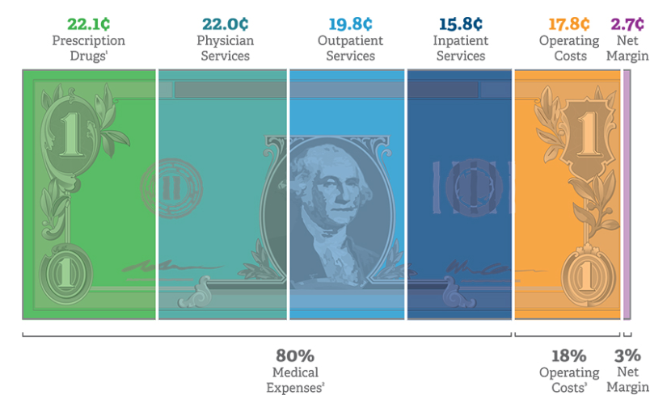
Consumers Bear the Cost
One in four people who take prescription drugs have difficulty affording them
One in eight report that they or a family member have cut pills in half or skipped doses due to high drug costs
Health plans attribute 22 percent of premium costs to prescription drugs
Data: America’s Health Insurance Plans, Where Does Your Premium Dollar Go? (AHIP Center for Policy and Research, March 2, 2017).

Slide 5
Current Climate
Prescription drug spending is a concern for both political parties.
62 percent of Americans think there is not as much regulation as there should be when it comes to limiting the price of prescriptions.
86 percent of Americans support requiring drug companies to release information to the public on how they set drug prices.
78 percent of Americans say that drug companies making too much profit is a “major reason” why people’s health care costs have been rising.

Slide 6
Venues for Reform
Federal
Can achieve a broader scope, fewer limitations in what policies can achieve
State
May achieve enactment faster than at federal level
Can provide relief and protection to people across the the entire country at once
Can set a positive example for the federal government and urge them to take broader actions by enacting state policy
Notes:
Ex re: policy that is limited at state level: monopoly terms
Exciting time for bipartisanship at the federal level
States can also look at their individualized needs based on their populations and tailor their approaches accordingly

Slide 7
State Mechanisms for Addressing Rx Prices
Transparency
Pharmacy Benefit Managers
Anti-Price Gouging
Review Boards

Slide 8
All Payer Rate
Setting

Slide 9
Rate Setting
Goal: Set a state-wide reimbursement rate, harnessing negotiation power to bring down overall costs.

Slide 10
Rate Setting
Drug Price negotiation?
Kind of – sets an upper limit or “payment rate” for payers in a state, down to consumer level.
Doesn’t stop payers from negotiating concessions.
Who sets the rate?
A drug cost review commission/board
An advisory board
Based on common rate setting practices that already exist, just with more market power

Slide 11
Price Gouging

Slide 12
Price Gouging Legislation
Goal: Prevent drastic price increases for prescription drugs.

Slide 13
The most recent
Price Gouging Legislation
Brand Name Drugs - limitations
Price controls were shot down in BIO V District of Colombia, Patents pre-empt states’ ability to regulate price.
Maryland - pending
Passed an anti-price gouging bill in 2017 which grants the Attorney General authority to hold pharmaceuticals accountable for “unconscionable” price increases in generic, off-patent drugs.
Was challenged in court for violating the Dormant commerce clause, which bars a state from regulating the price of goods in another state.
Attorney general has appealed to Supreme Court.

Slide 14
Next Steps
Price Gouging Legislation
Wait for potential supreme court challenge to proceed:
It’s possible the Maryland bill could be re-instated and states would be granted free reign to pursue similar legislation.
Pass an alternative approach:
A tax on profits earned on a price beyond inflation (similar to Medicaid Drug Rebate Program)
Medicaid currently requires manufacturers to compare an inflation-adjusted price for a medicine and the current price, and then award the program a rebate based on the difference.
Expanding that same metric, states could impose a tax on excess profits above inflation.
With careful design, this could avoid the legal pitfalls that the Maryland Law is facing.

Slide 15
Price Gouging Legislation
Tax/Rebate {
Tax/Rebate {

Slide 16
Transparency

Slide 17
Transparency
Goal: Make high introductory drug prices and price increases understandable to payers, policy makers, and ultimately the public.

Slide 18
State Examples
Transparency
California (SB-17, 2017)
Oregon (HB 40005, 2018)
What drugs?
Cost more than $40 for 30-days supply
Price increase of 16% over two years
Specialty drugs
What’s reported?
60-day advance notice
Publicly available data on research costs, marketing, acquisition costs, marketing plan, launch prices (for specialty drugs)
Challenges?
Is publicly available information enough?
What Drugs?
Cost $100 or more
Price increase of 10% in one year
Specialty Drugs
What’s reported?
Production costs
Marketing costs
Research Costs
Clinical efficacy/rationale for increase
Challenges?
First reporting July 2019 (after next legislative session)
Determining what is and isn’t a trade secret (for exclusion)

Slide 19
Priorities and Options for Consumers
Transparency
Advance Notice:
CO legislation in 2018 included 90-days advance notice
What drug price?
Wholesale Acquired Cost = the list price
Rebate sizes and information on the negotiations with PBMs and other parties can be helpful
Net Price and what these things mean for consumers’ out of pocket and premium costs

Slide 20
Considerations
Transparency
How do folks hear about it?
Current laws include a website posting by agencies (OR, CA) or manufacturer (VT)
Summary of benefits could include price increase notifications
Prescribers or pharmacists could give out information
For which drugs is reporting required?
Thresholds range from all those drugs over $40 per 30-day supply – to top 15 most costly for the state.
To reach the maximum number of consumers, as low a threshold as possible on which drugs count.
Considerations include the monthly price, the overall financial or health impact of a drug, the size of the price increase, and the introductory prices.
Who gets what data?
Notes:
Want to avoid information overload – balance to consider on.
Sorting question = researchers have access to all info, consumers some

Slide 21
Pharmacy Benefit Managers

Slide 22
Pharmacy Benefit Managers
Goal: Ensuring PBMs are not driving up prices in their role as “middlemen” between pharma companies and health plans/ pharmacies

Slide 23
Gag Rules
Pharmacy Benefit Managers
Banning Gag rules is still important
Patient Right to Know Drug Prices Act – Federal law that prohibits PBMs and insurers from restricting a pharmacy’s ability to provide an enrollee information on a drug’s price depending on whether it is purchased with the plan or without.
Does not require that pharmacists disclose prices.
Does not count costs for out-of-plan purchases towards out-of-pocket caps or deductibles.
CA AB 315, AB 2863:
Bars gag clauses.
Requires disclosure from pharmacists if there’s a difference between the cost-share amount and the retail price of a drug.
Requires any sale to count as the cost-share and toward OOP caps.

Slide 24
PBM Registration
Pharmacy Benefit Managers
Registration alone is not our end-goal.
Can include transparency and reporting about:
Rebates given for pharmaceuticals purchased.
Revenue share taken by PBM as a part of negotiated rebates.
Price used to calculate cost shares for consumers.
Can create a fiduciary duty for PBMs, so they are legally obliged to serve consumers/payers.

Slide 25
State Efforts to Make Prescriptions Affordable
Jill Zorn, MBA
Senior Policy Officer,
Universal Health Care Foundation of Connecticut

Slide 26
State Efforts to Make Prescriptions Affordable
Rep. Will Guzzardi
Illinois State Representative,
39th District

Slide 27
Group Activity

Slide 28
Group Activity
For the next 15 minutes, you’ve joined a brand new team.
Group up (into small groups)
Introduce yourself and organization.
If you’re working on a drug pricing issue, tell the group about it.
Identify barriers to achieving your reform:
Political
Budget
Public Opinion
Financial Resources

Slide 29
State Mechanisms for Addressing Rx Prices
Transparency
Pharmacy Benefit Managers
Anti-Price Gouging
Rate Setting

Slide 30
Group Activity
Identifying questions/discussion
Out of the identified barriers – which do we know the least about?
Were there pieces of Will, Jill, or Justin’s presentations that could speak to any of the barriers or issues you’ve identified in your group – and would more context help?
Do you have questions about the policy or about the opposition that might need to be addressed here?

Slide 31
Contact
JMendoza@FamiliesUSA.org
www.familiesusa.org
@FamiliesUSA

