Slide 1
Addressing Outrageous Prescription Drug Prices in Connecticut
Families USA Health Action 2019 Conference
Jill Zorn
Senior Policy Officer
Universal Health Care Foundation of Connecticut
jzorn@universalhealthct.org
universalhealthct.org

Slide 2
Addressing Outrageous Prescription Drug Prices In Connecticut
Overview
Universal Health Care Foundation of Connecticut
Focus on affordability: prices
Evolution of work and resulting legislation in 2017 and 2018
Looking ahead

Slide 3
Universal Health Care Foundation Mission Statement
To serve as a catalyst that engages residents and communities in shaping a democratic health system that provides universal access to quality, affordable health care and promotes health in Connecticut.
We believe that health care is a fundamental right and that our work is part of a broader movement for social and economic justice.

Slide 4
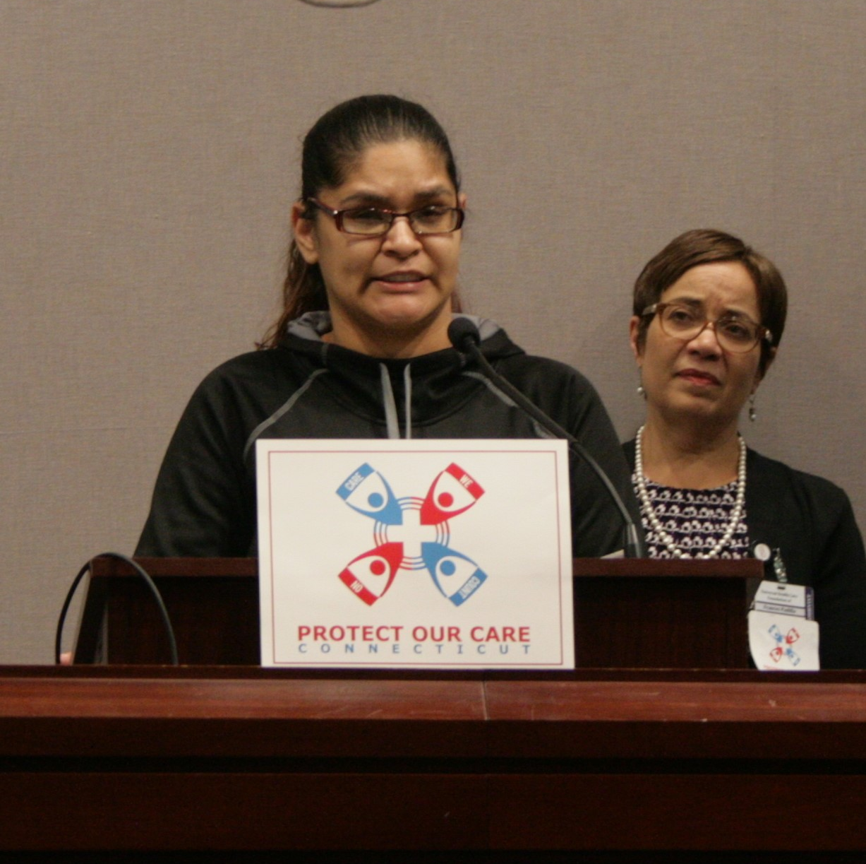
Universal Health Care Foundation of Connecticut
Who We Are And What We Do
501(c)3 non profit “activist philanthropy”
Conversion foundation
Program
Advocacy (inside and outside)
Public policy monitoring, research, and development
Public education and engagement
Communications
Grantmaking

Slide 5
Connecticut
One of the highest median incomes in the US: $73,433
ACA implementation
Expanded Medicaid
State-based marketplace
Low rate of uninsurance
BUT…

Slide 6
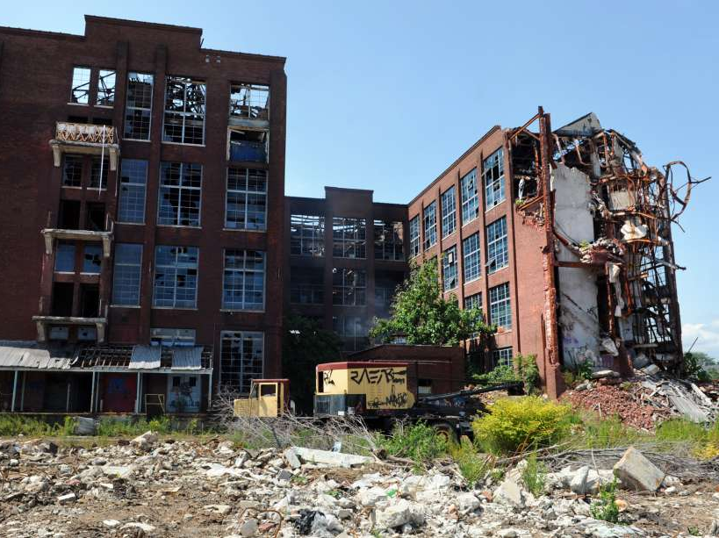
Major Affordability Challenges
Extreme income inequality
Top 1 %: $2.4 million
Bottom 99%: $56,445
(Average household income)
40% of Connecticut households fall under the income threshold for meeting basic needs (ALICE)
Increasing disparities in health and longevity by income, race, and ethnicity
Large state budget deficits

Slide 7
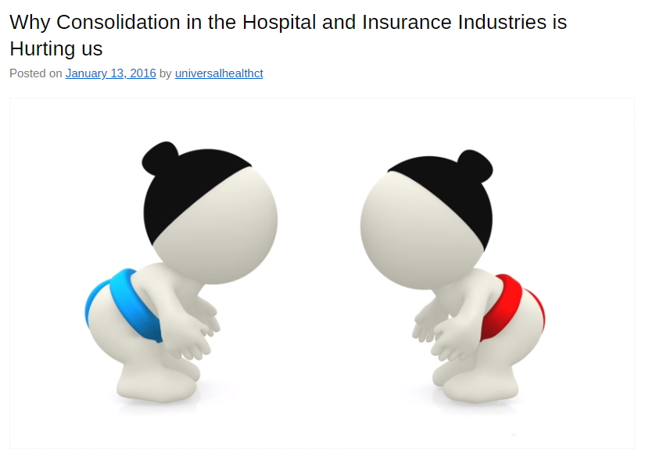
“It’s the Prices, Stupid” *
Focus on Prices and Monopoly Power
Hospital systems
Consolidation
market power to raise prices
Responsiveness to community
Community Health Needs Assessments, implementation plans, community benefit
Certificate of Need reform
Rate setting and reference pricing (in the future)
Health insurers
Mega-mergers
Rate review process
*Uwe Reinhardt, Health Affairs, Vol. 22 #3 2003
Hospitals
Insurers

Slide 8
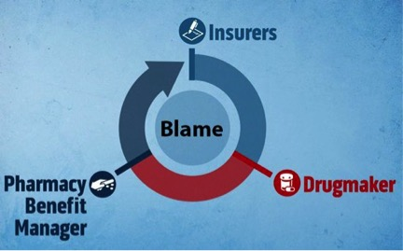
Focus on Prices and Monopoly Power: Prescription Drugs
2015
Martin Shkreli
2016
EpiPen
CT AG starts lawsuit against generic manufacturers
High deductible health plans, co-insurance, tiering
Hospitals
Insurers

Slide 9
Prescription Drugs: 2017 and 2018 Legislative and Regulatory Goals
Stop price gouging
Promote price transparency throughout the “supply chain”
Relief for consumers from unaffordable out-of-pocket costs
Consumer protection from opaque system
Focus on the big three
Pharmaceutical corporations
Pharmacy Benefit Managers (PBMs)
Health insurers

Slide 10
Passing Prescription Drug Legislation
2017: Partners and Policy
Identified and connected with interested groups and legislators
Convened key stakeholders and solicited public hearing testimony
Paper with Yale Global Health Justice Partnership and National Physicians Alliance: Curbing Unfair Drug Prices, A Primer for States
Health Care Cabinet study begins January 2017
Tracked work in MD, CA, NV, OR, other states, NASHP model legislation

Slide 11
Prescription Drug Legislation: 2017
2017: PA 17-241, An Act Concerning Contracts Between a Pharmacy and a PBM
Started with two concept bills on price gouging and transparency and one more comprehensive bill from State Comptroller
Bipartisan support from Senate President and Minority Leader but no out-in-front champion
Ended with consumer protection legislation banning gag clauses and clawbacks

Slide 12
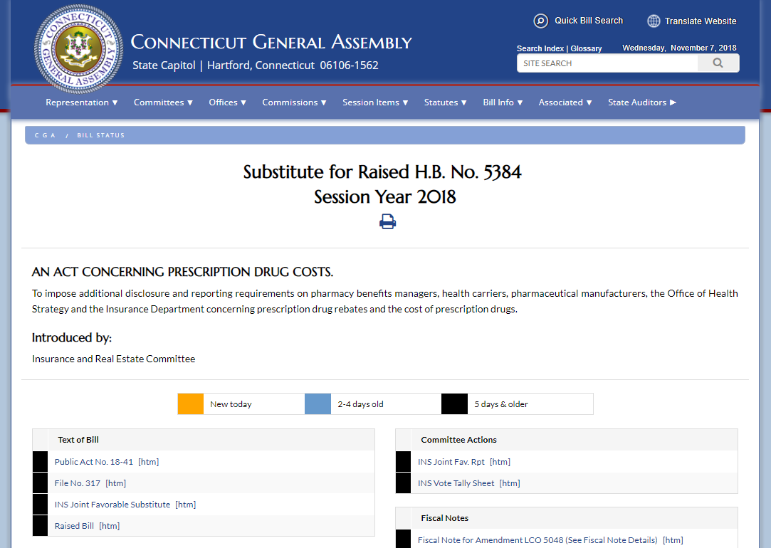
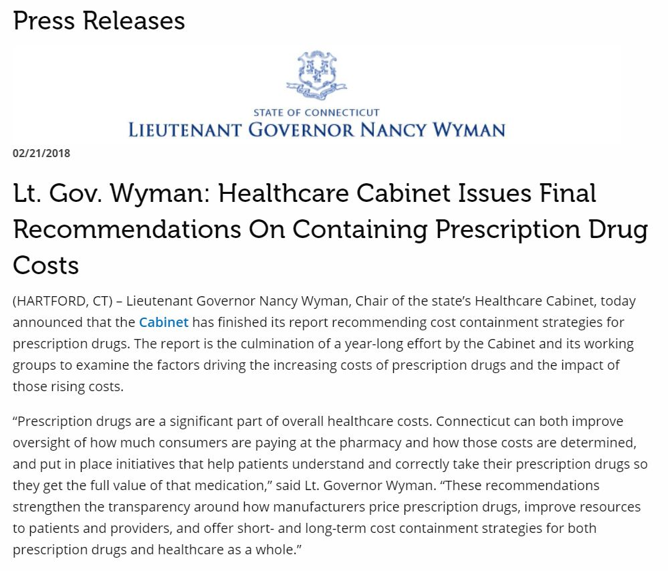
Passing Prescription Drug Legislation
2018: Turning Recommendations into Action
Cabinet issues report with recommendations
New legislative champion emerges
Poll, communications, advocacy and organizing

Slide 13
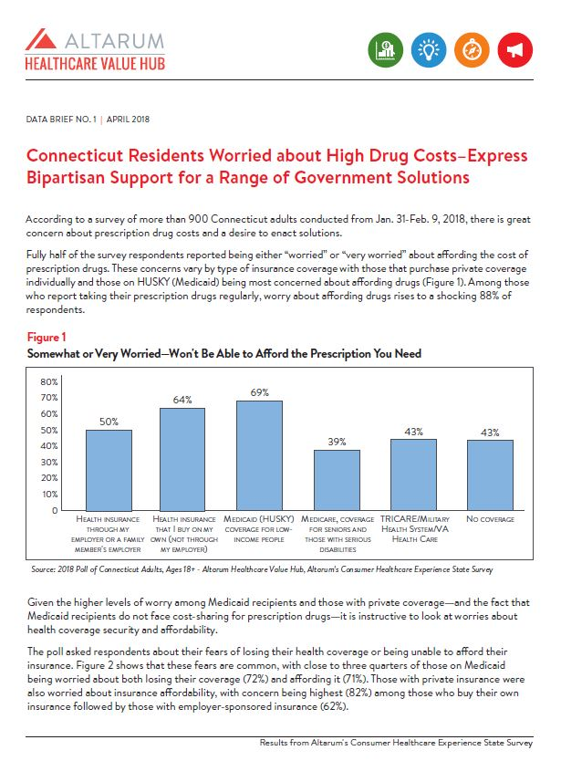
Poll
Raising Consumers’ Voices
Survey conducted in February 2018
Brief published in April shows widespread concern and
strong support for action across party lines
Connecticut Residents Worried about High Drug Costs–Express Bipartisan Support for a Range of Government Solutions
one page summary

Slide 14
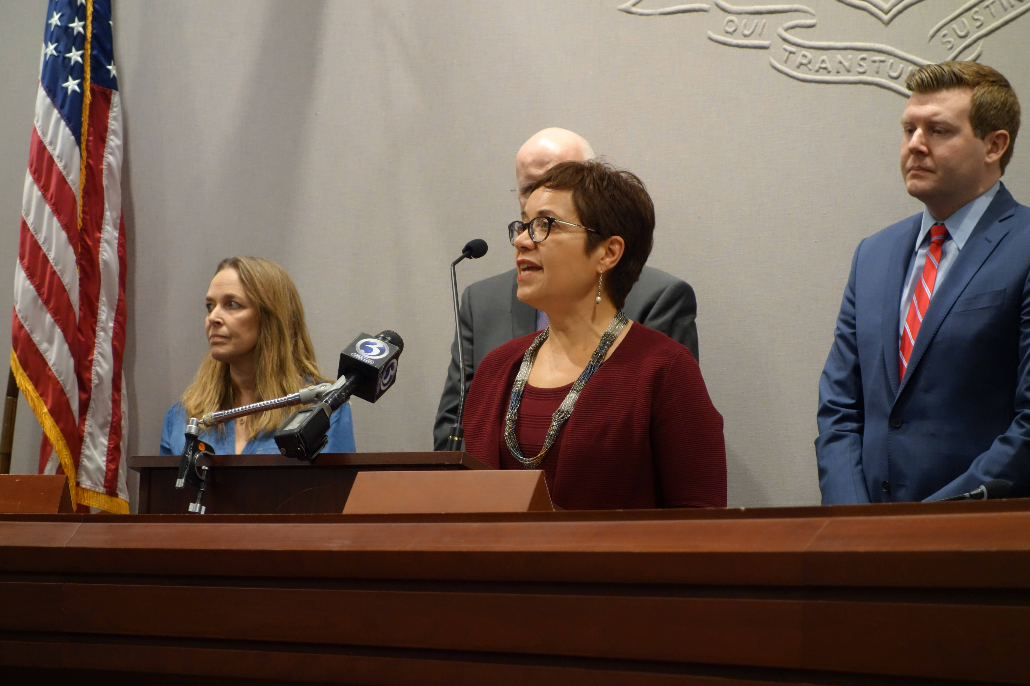
Amplifying Poll
Press Conference, Social Media
Press conference at legislative office building
Frances Padilla, UHCF president
Public officials from both parties
Patient advocate, National MS Society, National Physicians Alliance

Slide 15
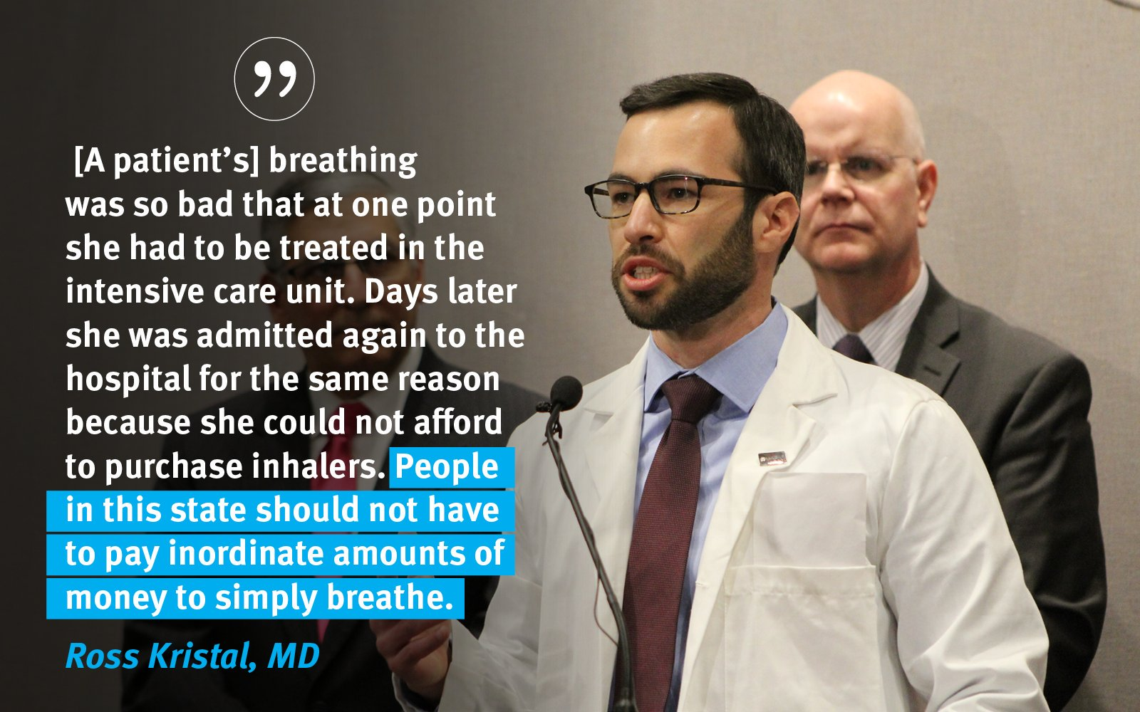

Slide 16
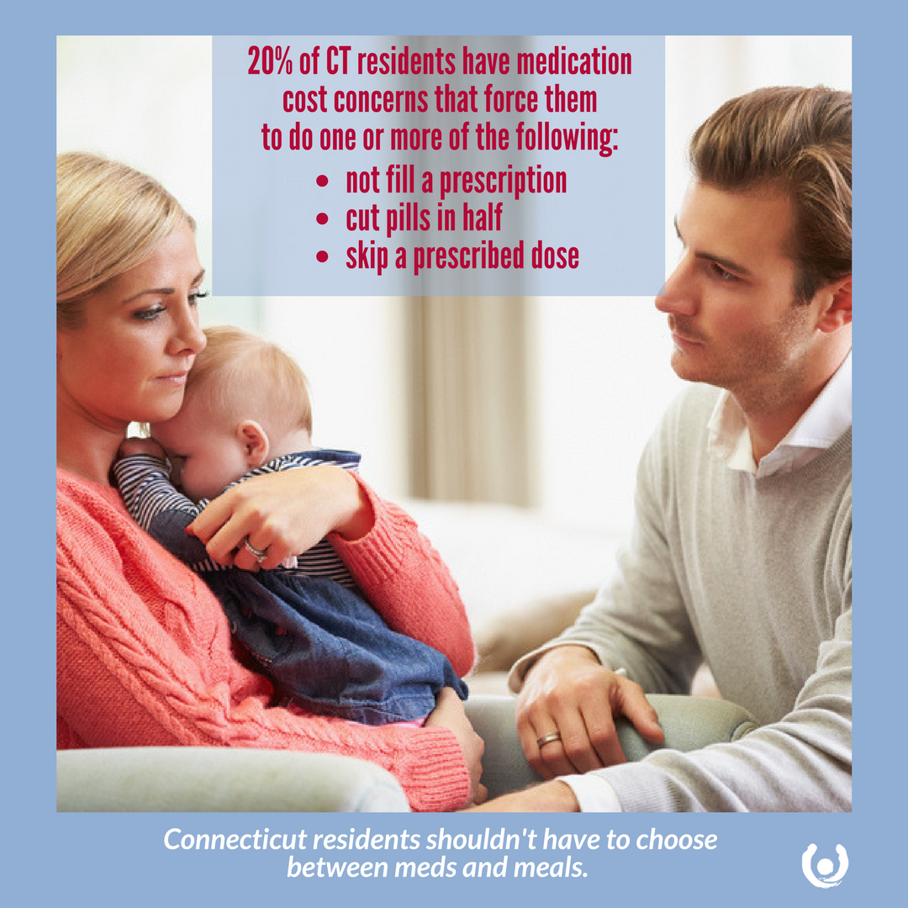

Slide 17
Communications
Fact sheets
Messaging
Stories, photos* of real people, infographics posted on Facebook, Twitter and Instagram
Web page
Blog
Emails to key organizations
Emails to legislators
*Story and photo courtesy of Patients for Affordable Drugs

Slide 18
Advocacy and Organizing
41 Supporting Partner organizations and 1,300 individuals
Evolved to focus more on state offense and defense, after focusing on ACA defense in 2017
Prescription drug legislation was a top priority during 2018 session; lobby day in April
Along with UHCF, other partners, used social media and emailed action alerts to generate emails and phone calls to legislators

Slide 19
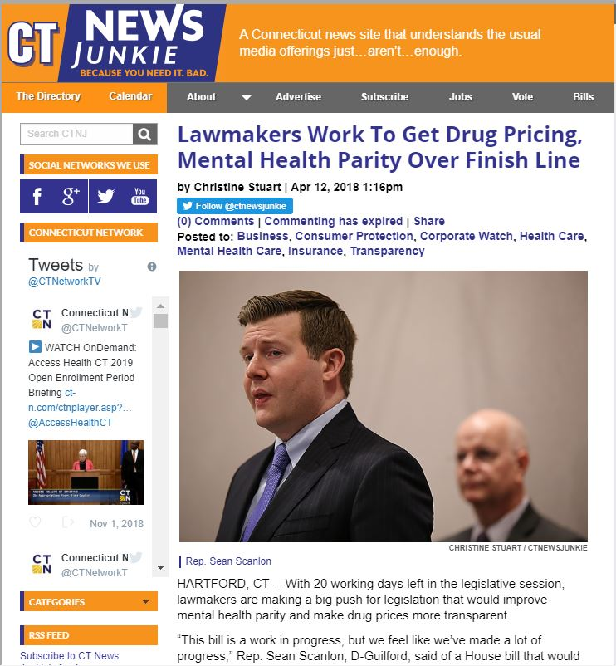
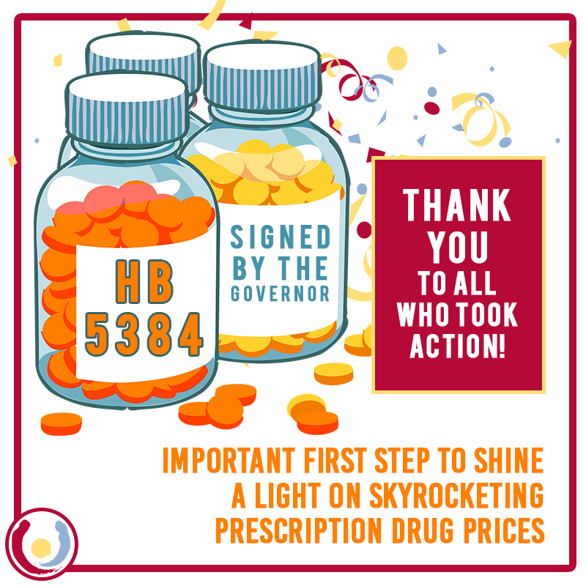
Result: Connecticut General Assembly
Passed Bill Unanimously!
PA 18-41 An Act Concerning Prescription Drug Costs,

Slide 20
Transparency Legislation 2018
Pharmaceutical corporations
Ten drugs provided at substantial cost to the state/critical to public health, with price increases of 20% in last year or 50% in 3 years
Provide justification for increases
CA and OR bills have lower thresholds and stronger reporting requirements
PBMs
Report rebates collected and what was passed along to insurers to Insurance Commissioner

Slide 21
Transparency Legislation 2018
Health insurers
The 25 most frequently prescribed drugs
The 25 highest cost drugs
The 25 drugs that experienced the greatest year-over-year cost increase
Room for improvement
No price gouging authority
Weak data requirements for justifications
High reporting thresholds
Cut at last minute: passing rebates through to customers paying out-of-pocket
Unclear if PBMs owned by insurers must report (or insurers owned by PBMs)

Slide 22
Looking Forward
2019 Legislation
SB 4: An Act Concerning the Affordability and Accessibility of Prescription Drugs
Out of pocket caps (see CA SB 1021)
Price gouging
Drug review board for Medicaid (see NY A03007)
Ban pharma cable TV advertising?
Importation?
Regulate mid-year formulary switches

Slide 23
Looking Forward
State Advocacy and Organizing
Continue work with key stakeholders and find new ones (new T1 International Chapter in CT)
Education and engagement of consumers
Journalist working on article on pharma lobbying expenses in CT
Monitoring what is happening: Families USA Prescription Drug Pricing Collaborative, FUSA-Public Citizen Drug Organizing Table and listserv, NASHP State Legislation Tracker

Slide 24
Looking Forward
Administrative Policy
Meet with newly elected AG
Comptroller and new governor: maximizing purchasing power of state agencies
State employee health plan RFP for new PBM contract
New Office of Health Strategy with mandate to coordinate state health policy across agencies; APCD reporting now possible

Slide 25
Looking Forward
Thinking Big
Prescription drug affordability is tied to the larger effort to achieve universal health care
State-based public option
Medicaid buy-in
State employee plan buy-in
Federal policy
Major prescription drug bills in Congress
Medicare for All

