Slide 1
Making a Movement:
Social Media as an Advocacy Tool
Presentation Name
Presented by Presenter Name, Title
Speakers:
Amy Cotton, Children’s Dental Health Project
Laura Packard, Health Care Voter and Voices of Health Care
Moderator:
Jonny Yao, First Focus

Slide 2
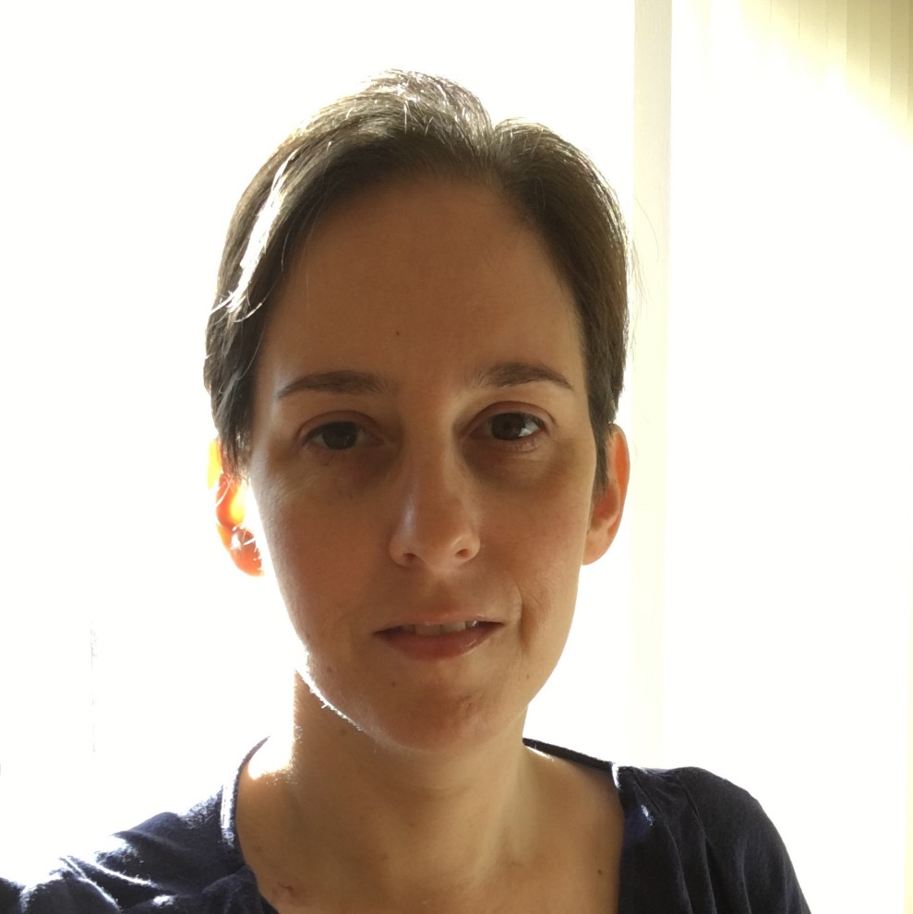
Laura Packard
Co-Chair, Health Care Voter Founder, Voices of Health Care
Twitter: @lpackard

Slide 3
Advancing your policy priorities with social media
Making a Movement: Social Media as an Advocacy Tool
Workshop at Families USA Health Action Conference 2019
Amy Cotton, Policy Communications Manager u January 24, 2019

Slide 4
Children’s Dental Health Project
No family should be held back from their dreams because of dental disease. We’re working to make systems of care work better for everyone by advancing policy solutions to ensure:
Oral health meets families where they live, learn & work
Better health & quality of life drive oral health care
Race, income & geography do not determine a family’s oral health
Notes:
[10 mins allowed for intros]
In 1997, Children’s Dental Health Project was created to advance policy solutions so no child would suffer from tooth decay, a preventable chronic disease. CDHP’s first policy target was fixing the lack of dental coverage in the Children’s Health Insurance Program. And, today, protecting dental coverage remains one of our top priorities while we have also broadened our vision and approach.
CDHP focuses on how to make systems of care work better for families – not only so children don’t suffer from pain and infection, but also to eliminate poor oral health as a barrier to daily activities and to end inequity in oral health. Dental disease can interfere in a child’s ability to learn. It can impede their parent’s ability to succeed in the workplace. And overall, by posing barriers to financial security and good overall health, poor oralhealth can derail a family’s dreams for the future. We’re working to realign systems to focus on families, where they live, work and play.

Slide 5
Using social media strategically
5 tips to leverage stories, data, and relationships
Notes:
[15-20 mins]
Like individuals, our coalitions and organizations can use social media to advance our policy priorities. Whatever platform you’re using – whether its Twitter, Facebook, Linked In or others out there – you can broaden your base of supporters who care about your issue and will act on it.
As Laura just talked about stories, I’ll also start there. I’ll also also share some other ways to humanize or bring to life other key information to elevate your priorities. They’re fairly simple but can help you effective.

Slide 6
Tip 1
Tip 1: Frame your story for your audience
CDHP research on effective messages about oral health
Why should they care? What’s your viewpoint? Would someone outside your field understand?
Notes:
Stories can be powerful tools, whether they are embedded in a news article you may already be reading, come from your grassroots constituency, or if you are aiming to build a story with data, you want to consider your audience. What you share about the story needs to be placed in the right context for your audience – using messages that will move them.
As a policy institute, one of the audiences CDHP seeks to influence includes policymakers. We have done research in the last 2-3 years on what messages would move them to prioritize oral health policy. Through focus groups and interviews, the data we gathered affirmed that policymakers don’t just want to know about prevalence data – stats -- like 25% of all kids 2-5 have had tooth decay. They need to hear WHY that number matters – what’s really the consequence of this chronic disease. So we have to think about why they should care. One reason is that kids have lower grades when they have poorer oral health than their peers. And in adulthood, dental disease may limit the jobs a parent can get, and wages they may earn to care for their family.
Other research from a firm called the Frameworks Institute shows that its important to lead with values, like advancing equity in oral health. We also want to encourage policymakers and other stakeholders to hear that attaining good oral health isn’t always easy to do because of systemic barriers. Our system isn’t set up to help all children or families prevent tooth decay, whether those barriers look like hurdles to accessing care, gaps in dental coverage, or attendent barriers, like limited public transportation to where dental care is offered. We can package stories in frames that speak to these deeper problems.
In the oral health space, we apply this kind of knowledge to our social media plans and how we lift up personal stories. You want to not just share what’s happening, but why it matters, and why it matters to you.
You also want to be sure to check your jargon – so your message is conveyed in a way someone would “get” if they aren’t in the weeds of your job every day. EXAMPLE ON NEXT SLIDE.

Slide 7
Tip 1
Tip 1: Frame your story for your audience
Place people at the center. Example: CHIP & Jessica’s family
Pull a good quote
Notes:
Here is one example sharing a personal story on Twitter.
CDHP was able to gather a personal story at an event where families impacted by the uncertainty of the CHIP funding fight (2017-18) would be speaking. (organized by First Focus.) While we are not a grassroots organization and don’t have the infrastructure to build a story bank, attending the event gave us a chance to connect with a family and get their permission to interview them. Mom Jessica spoke about what CHIP and its dental coverage meant to her family. CDHP was able to craft a blog sharing their narrative, placing people at the center of the issue, which we then leveraged on social media as part of our CHIP advocacy strategy. Sharing first-person quote from stories can make for compelling posts.
You can also use this tip when sharing news article. Rather than just sharing the headline of a piece, grab a compelling quote or reference a personal story cited in the article – perhaps “moms like Jessica…” or similar. That’s one way you can still center people harmed by the current system, even if you’re not a group with capacity to story bank.
That’s tip one – when using stories, you want to frame them for your audience to advance your message.

Slide 8
Tip 2
Bring your solutions & data to life
Quotes
Photos
Infographics
Notes:
Tip 2 – There are other ways to use social media to bring your ideas and evidence to life.
Quotes (from personal story or in own blogs/content) – and creating compelling images that spotlight key quotes

Slide 9
Tip 2
Bring your solutions & data to life
Quotes
Photos
Infographics
Notes:
Tip 2 – There are other ways to use social media to bring your ideas and evidence to life.
Quotes (from personal story or in own blogs/content) – and creating compelling images that spotlight key quotes
Using photos to literally put a human face on your issue and any data you’re sharing

Slide 10
Tip 2
Bring your solutions & data to life
Quotes
Photos
Infographics
Notes:
Tip 2 – There are other ways to use social media to bring your ideas and evidence to life.
Quotes (from personal story or in own blogs/content) – and creating compelling images that spotlight key quotes
Using photos to literally put a human face on your issue and any data you’re sharing
Infographics to make data understandable, appealing, and help convey a problem you want to solve, a solution you’re advancing or an action people can take on your issue

Slide 11
Tip 2
Bring your solutions & data to life
Online design tool
Canva.com
Free, publicly available images
Pixabay.com
Unsplash.com
Notes:
For folks in the room who may not have the capacity to hire a graphic designer – there are some free tools that can help you create your own, visually appealing social media posts.
Canva is one design tool that has both a free and paid version, and the free version is pretty robust. It offers templates and layouts for different types of communications products including many social media platforms, as well as a variety of photos, illustrations, backgrounds, and fonts.
There are also sources online where you can find free photos that are safe for nonprofits to use without running into licensing problems.
Pixabay has a variety of image types (photos, illustrations, and vector graphics)
Unsplash has photos including some curated albums.
Each of these tools can help you develop sharable images to help bring your policy ideas to life, and help you illustrate a story with data you want to share.

Slide 12
Tip 3
Build and nurture relationships
Leverage existing partnerships. Example: ACOG (29.3K followers)
Make it easy for allies to share your content
Online events
Notes:
Offline outreach – Another important tip to remember is that it can require some relationship building in real life, with current and potential partners.
You may work in coalition with partners for whom sharing resources could be mutually beneficial. You can help each other get your messages and material in front of different audiences. CDHP’s policy team was deepening our relationship with the provider group, ACOG, as oral health is an important aspect of prenatal care, but many people who count on Medicaid face barriers to getting dental care in pregnancy. We produced a brief on improving oral health during pregnancy, a topic that we felt would be of interest to OB-GYNs and other health and policy stakeholders, as well as reporters who may look to them as a trusted source. Like us, they may be continuously seeking out fresh ideas to weave into their updates. We worked with our policy colleagues to send ACOG our brief, asking if they could share it from their social media account. To make it as easy as possible, we included sample posts that were tailored to their constituency, with framing and messaging we preferred. Just 2-3 messages can go a long way in encouraging others to share your material with their audiences. Among other things, giving sample content shows you respect their time.
Similarly, if you want to host an online event, you’re going to want to develop some sample messages. Online events on Twitter are particularly valuable in getting your messages in front of new audiences, and elevating the profile of your oranization.
It’s a good idea to do some online and offline research to get a sense of when regularly scheduled events might be, so you can join or plan your own around them, see who participates, and develop new partnerships through your participation. CHATS VS. STORMS ON NEXT SLIDE

Slide 13
Tip 4
Engage in events to grow support
Tweet chat
Q&A led by moderator and coordinated with invited respondents
Draft questions and sample answers
Takes more capacity, especially in live-time
Tweet storm
Open forum on topic
Sample messages promote engagement
Easier to pre-schedule
Tool for scheduling
Tweetdeck.com: Track & preset messages
Notes:
Two common events on Twitter are tweet chats and tweet storms. They vary slightly in the capacity it takes to plan, coordinate and join them. Once again, both can help you advance and cultivate interest in your priorities, elevate your profile as a leader, and build your base of support.
They both revolve around a unique hashtag – MomsRising does #WellnessWed chats, for example, and our partners at Oral Health America have an annual week in the fall where they hold a tweet storm around their advocacy priorities, called #FallForSmiles.
When planning, you want to give enough lead time to create materials, like a message guide, and have time to advertise. Like any other event, it can help participation if you have time to build awareness and invite groups to participate.
When participating, take the opportunity to share links to your resources, like things other groups say, even if after the fact, and consider retweeting. It’s a chance to lift up your priorities and perspective, but you don’t want it to be a one-sided relationship.
Tweetdeck.com is a good tool to use to preschedule tweets if you need to, easier to do for tweet storms or in your day-to-day. You can track hashtags and activity happening in different Twitter accounts. It is free.

Slide 14
Tip 5
Use hashtags to your advantage
Generally limit to 1 or 2
Do your homework
Tool to track reach
Tweetreach.com: Gauge the impact of your tweets. Complete report is $20.
Notes:
Echo key points from Laura?
Good practice to limit hashtags to 1-2.
Do some research, even if briefly, to see what hashtags people are using to talk about your issue, and who is using what hashtag. ** EXAMPLE IF TIME: Using #MEPOLITICS to be seen by legislators; one state legislator responded to a thread on closing gaps in Medicaid dental benefits.**
Homework includes spell checking – don’t forget to spellcheck when you tweet, or you could lose the ability to track the reach of a message.
If you’re on LinkedIn, you’ll see that users also use hashtags there.
Tracking tool – Tweetreach is a decent tool to see how far your messages traveled – gauging the size of the audience who could have seen your tweets, who interacted with you, among other metrics. In the free version, you can set up your analysis to include mentions of your handle, specific hashtags, a date range and other parameters. You do have to pay a fee for a full analysis.

Slide 15
Tips 1-5
Strategies for success
Frame your story for your audience
Bring solutions & data to life
Build & nurture relationships, in real life
Engage in events to grow your supporters
Use hashtags to your advantage
Useful tools: Canva.com, Pixabay.com, Unsplash.com,
Tweetdeck.com, Tweetreach.com

Slide 16
Thank You!
Amy Cotton
Policy Communications Manager
Children’s Dental Health Project
202-417-3602
acotton@cdhp.org
Follow CDHP on social media:
Twitter: @Teeth_Matter
Facebook: @childrensdentalhealth
LinkedIn: /cdhp-oralhealth

Slide 17
Q & A– Ask the Experts!
Laura Packard (@lpackard)
Co-Chair, Health Care Voter
Founder, Voices of Health Care
Amy Cotton (@Teeth_Matter)
Policy Communications Manager, Children’s Dental Health Project
Jonny Yao (@joyao)
Director of Digital Strategy, First Focus

Slide 18
Now You Try!
How can we improve them/make them more effective?
What additional resources do we need?
Activity Time
What resources do we have?

