Slide 1
Responding to Rural Health Challenges
Ellen Albritton
Senior Policy Analyst
Notes:
NOTE: Make sure that the Title slide does not have footer information (sources, FUSA logomark and page number). To turn off on this page, go to Insert > Headers&Footers and deselect Footer and Page number options > Apply to this page only. Also, select start page numbers at 0.

Slide 2
Compared with urban areas:
Responding to Rural Health Challenges is a Health Equity Issue
Higher overall mortality rates
Higher rates of suicide for youth and veterans
Higher rates of uninsured
Higher rates of smoking
AND greater disparities for people of color living in rural areas
Development and advancement of patient-centered health system transformation policies designed to reduce racial, ethnic, and geographic inequities
Notes:
child with Duchenne and is eligible for a clinical trial, but because he lives in rural Nebraska, and the closest hospital that can administer the trial is in Chicago, they’re forgoing the trial.
Tracy, Erwin, TN
Tracy works for a small, local nonprofit that does not provide insurance. For many years, she went without insurance, and when the marketplaces opened, she chose to enroll in coverage for the first time, choosing a plan that she says was very affordable. While Tracy likes her plan, she lives in northeast rural Tennessee, and the specialists that she needs simply aren’t in the area, forcing her to travel long distances to get care. Her doctors say that she has an unspecified autoimmune disorder, but because her specialists and the necessary testing are so hard to get to, she’s been unable to get a proper diagnosis and appropriate medications.

Slide 3
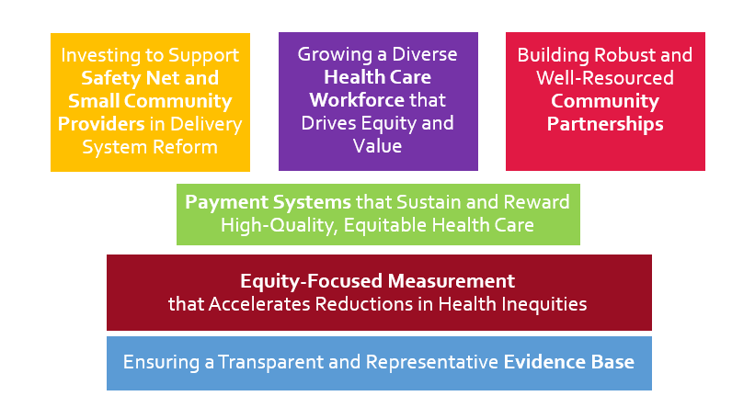
Policy Domains for Achieving a Transformed, High-Value, Equitable Health Care System

Slide 4
Policy Domains for Achieving a Transformed, High-Value, Equitable Health Care System
Payment Systems: use risk adjustment that accounts for the social risk factors present
Safety Net Providers: expand funding & technical assistance for providers to transform care delivery
Community Partnerships: resource infrastructure necessary to enable seamless coordination
Evidence Base: incentivize studies that are representative of rural communities
Measurement: collect social risk factor data
Workforce: address rural workforce shortages (physicians, midlevel providers, and community care team members)

