Slide 1

Families USA
Responding to Rural Health Challenges

Slide 2
The National Rural Health Association
NRHA is a national nonprofit membership organization with more than 21,000 members, made up of a diverse collection of individuals and organizations, all of whom share the common bond of ensuring all rural communities have access to quality, affordable health care. Our mission is to provide leadership on rural health issues.

Slide 3
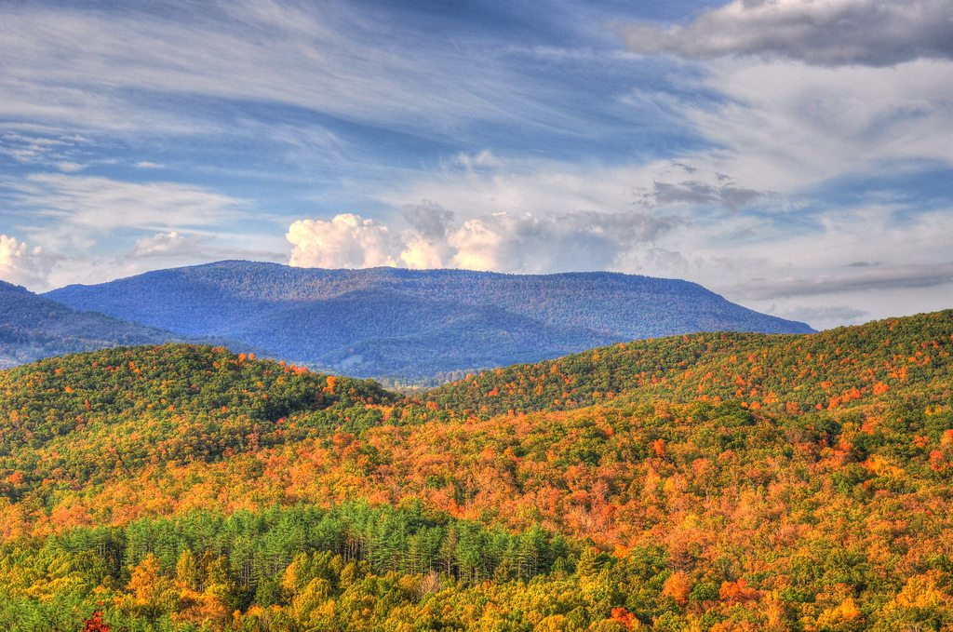
The continuing challenges in rural America…
Workforce Shortages
Vulnerable Populations: older, poorer, sicker
Chronic Poverty
Geography
More Uninsured

Slide 4
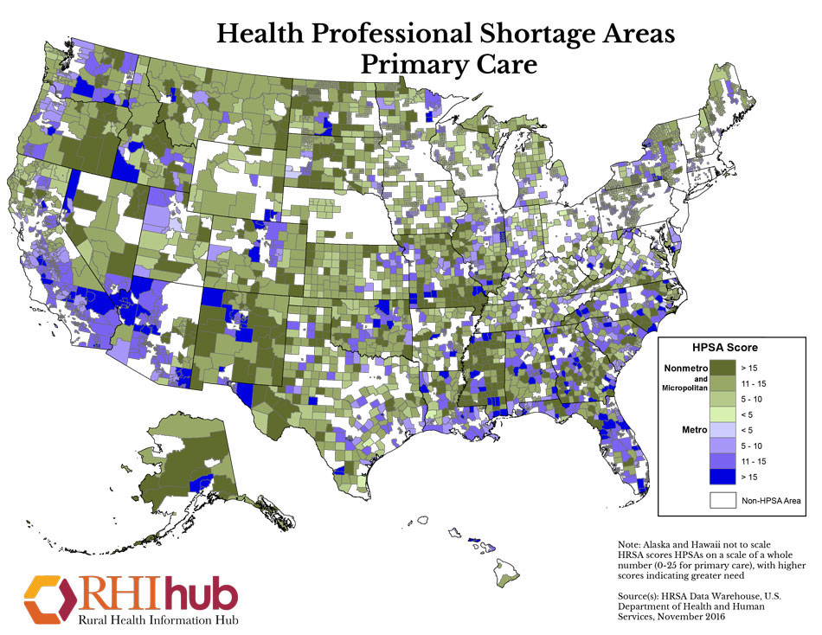
6,000 areas in the U.S. are primary care health shortage areas;
4,300 areas are dental health shortage areas; and
3,500 areas are short of mental health shortage areas.

Slide 5


Rural Mortality Rates:
A Rural Divide in American Death
Center for Disease Control January, 2017 Study:
“The death rate gap between urban and rural America is getting wider”
Rates of the five leading causes of death — heart disease, cancer, unintentional injuries, chronic respiratory disease, and stroke — are higher among rural Americans.
Infant mortality rates are 20% higher than in large urban counties.
Mortality is tied to income and geography.
Minorities, especially Native Americans die consistently prematurely nation-wide, but more pronounced in rural.
Startling increase in mortality of white, rural women. Causes:
  Risky lifestyle (smoking, alcohol abuse, opioid abuse, obesity)
  Environmental cancer clusters
  Suicides
January 2017

Slide 6
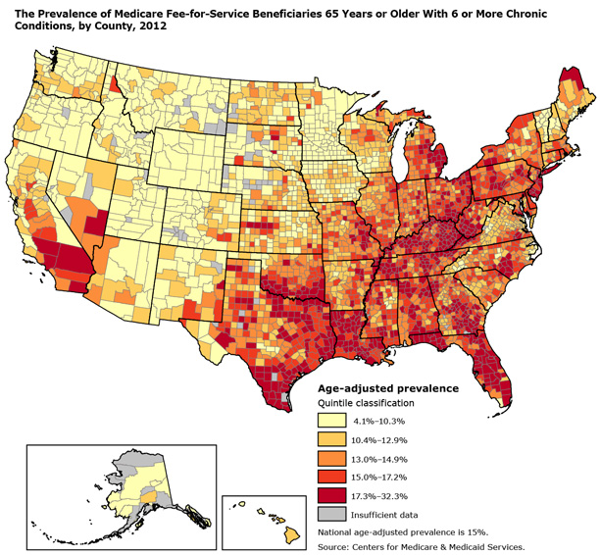
Prevalence of Medicare Patients with 6 or more Chronic Conditions

Slide 7

The Rural Opioid Crisis

Slide 8
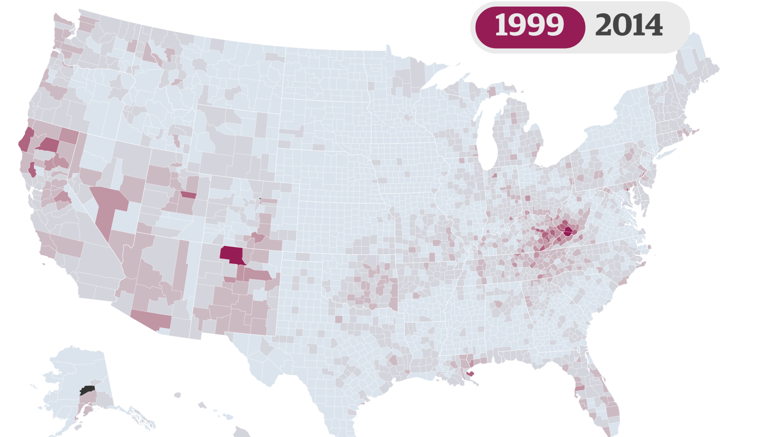
Mapping the Opioid Crisis

Slide 9
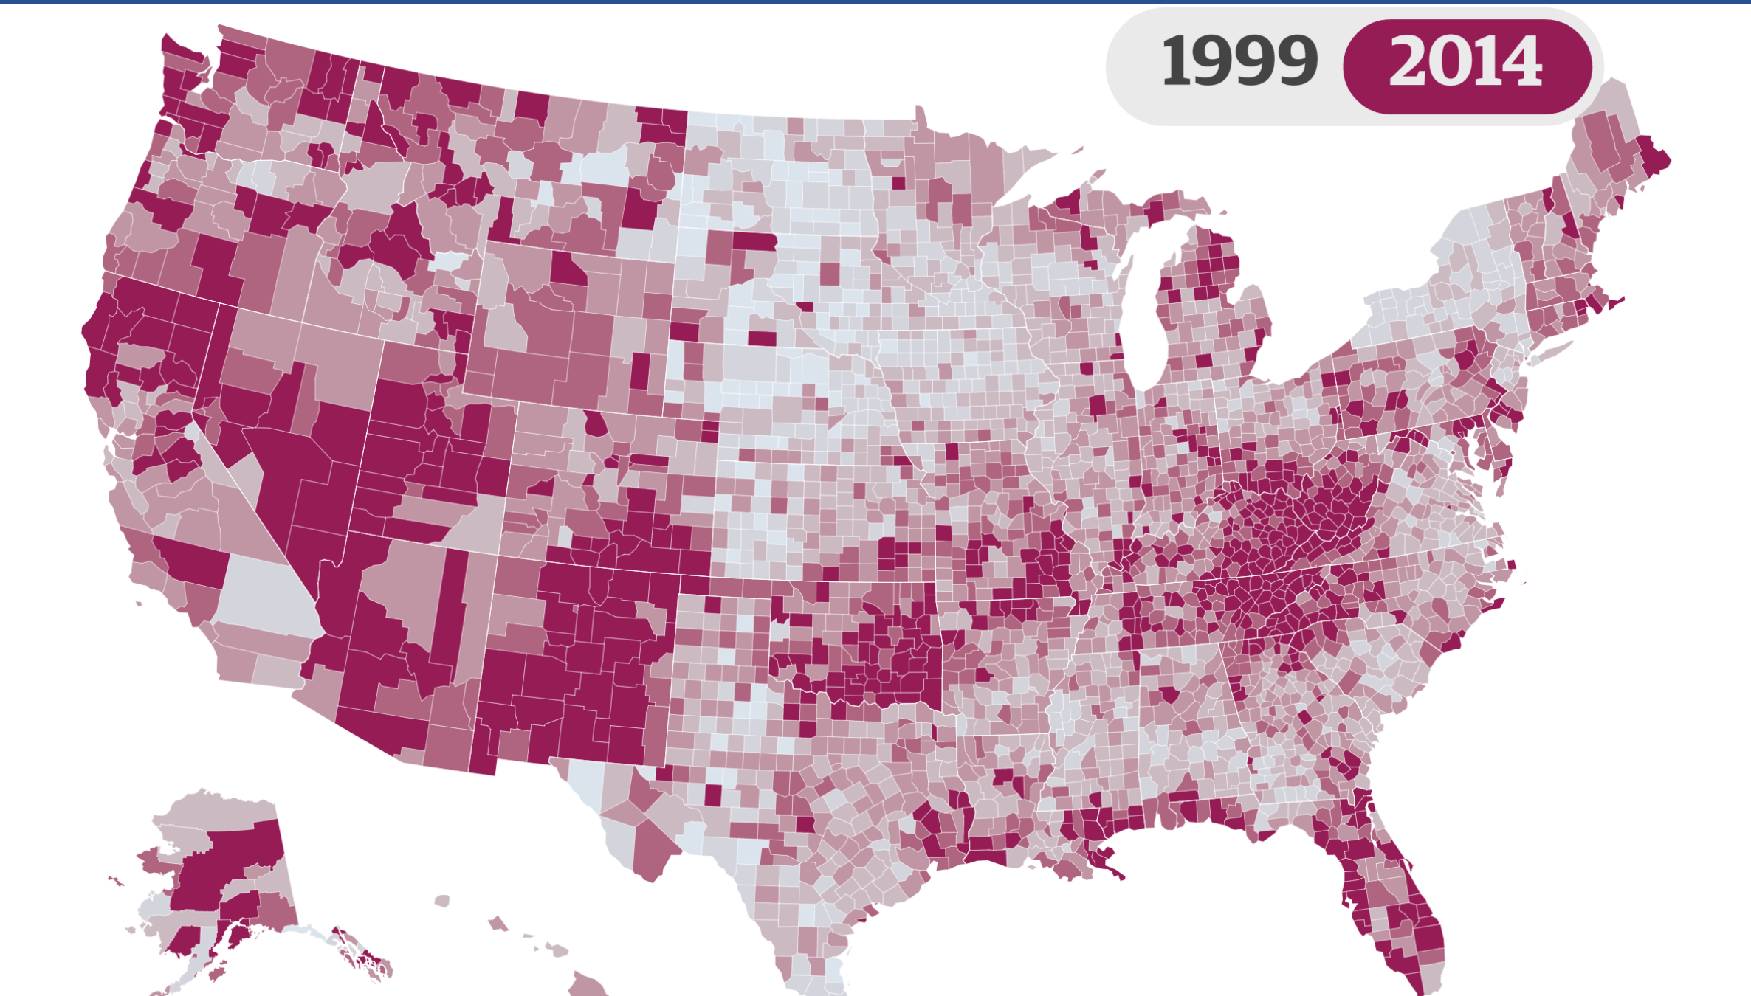
Deaths per 100,000 residents

Slide 10
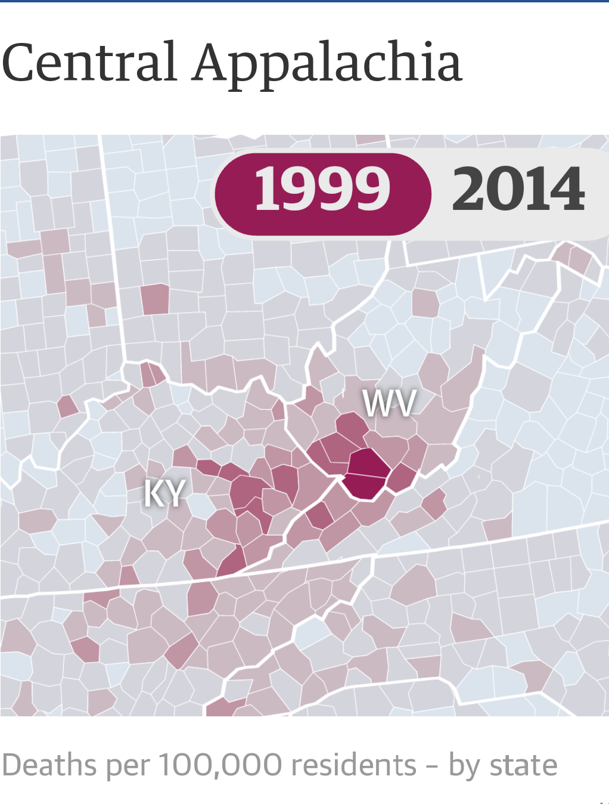
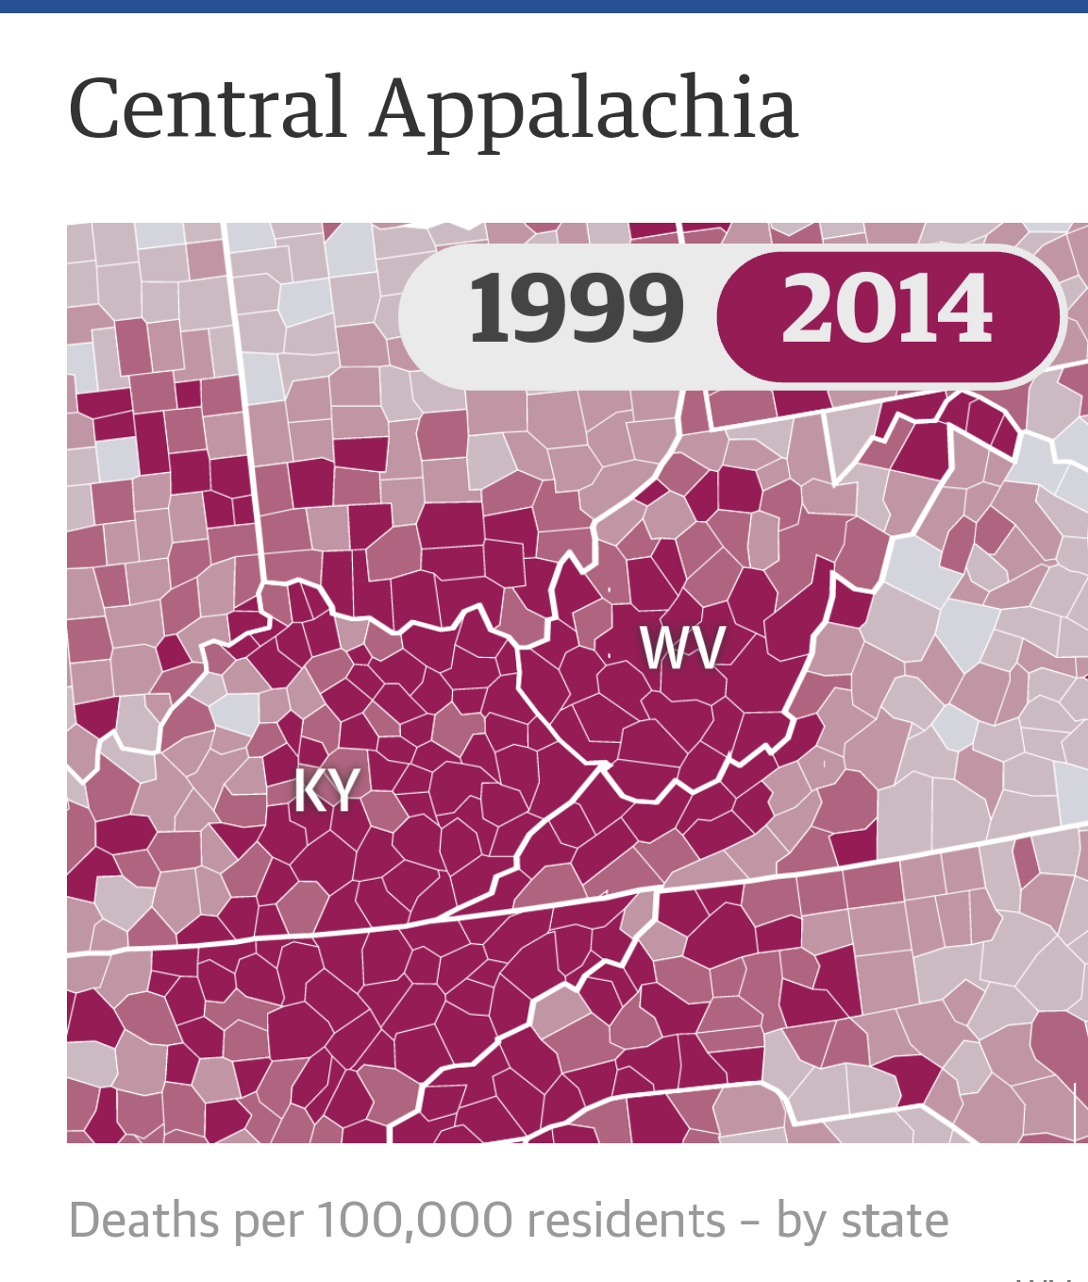
Deaths per 100,000 residents

Slide 11
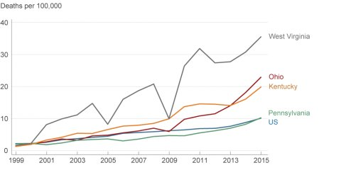
States at Greatest Risk
Rural states at greatest risk of overdose deaths:
  West Virginia (52.0 per 100,000)
  Ohio (39.1 per 100,000)
  New Hampshire (39.0 per 100,000)
  Pennsylvania (37.9 per 100,000)
  Kentucky (33.5 per 100,000)

Slide 12

Opioids Ravage Rural America
197 deaths each day.
Up 30% in 2017 from 2016.
In rural America opioid death rates quadrupled among those 18-25 years old and tripled for females.
Death rate is 45% higher in rural counties.
“Forgotten people” of opioid epidemic – Native Americans and Alaskan Natives – 30% under-reported.

Slide 13
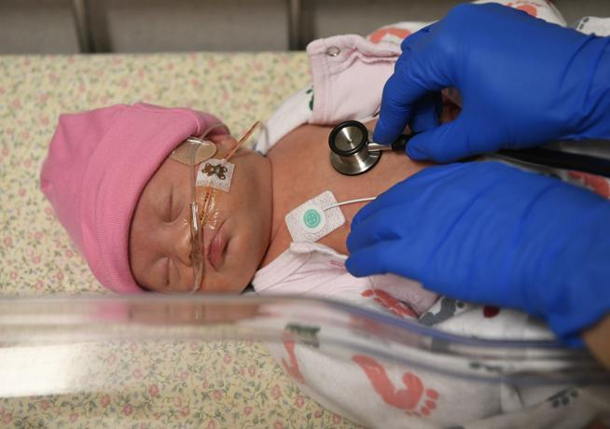
Most vulnerable are at risk
Every 15 minutes a baby is born with opioid withdrawal syndrome.
The number of babies who were exposed to opioids in the womb rose by more than five-fold in the last four years, according to a new analysis of Medicaid data.
Dr. Stewart Patrick, Vanderbilt University Medical Center before an April, 2018 Senate Help Hearing

Slide 14
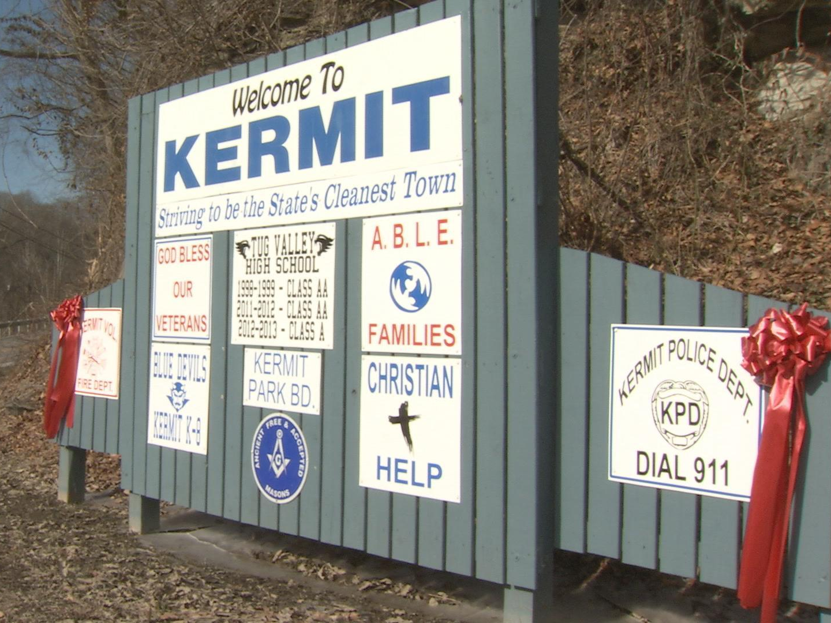
Focus is on pill dumping…
Kermit, West Virginia town of 3200 flooded with 21 million prescription painkillers, a state where more people have overdosed than any other.

Slide 15

"I want you to feel shamed in your roles, respectively, in all of this," David McKinley (R-WV)
May 8 – Energy and Commerce Oversight Hearing.
Drug manufactures blame physicians for over-prescribing
Two Family Discount Pharmacy locations in Mount Gay-Shamrock, population 1,779, and Stollings, population 316, received more than 20 million doses of hydrocodone and oxycodone between 2006 and 2016. The two pharmacies are just 3 miles apart.
Just one drug manufacturer supplied nearly 6 million pills to the Mount Gay-Shamrock location between 2008 and 2012. That means the manufacturer shipped an average of 3,561 pills every day to this single pharmacy for four years, the House panel said.

Slide 16
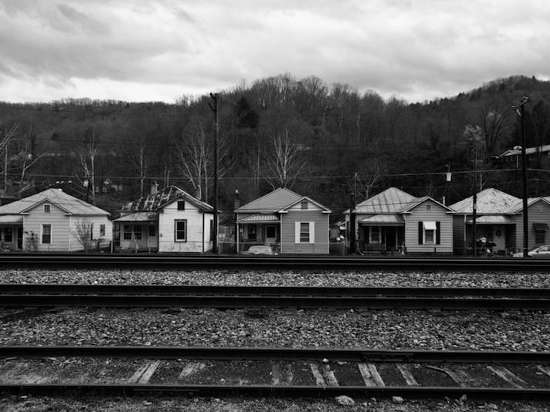
Poverty in Rural America
In 1980, 70% of rural Americans living in poverty were working.
Today, less than half of the rural poor are working.

Slide 17
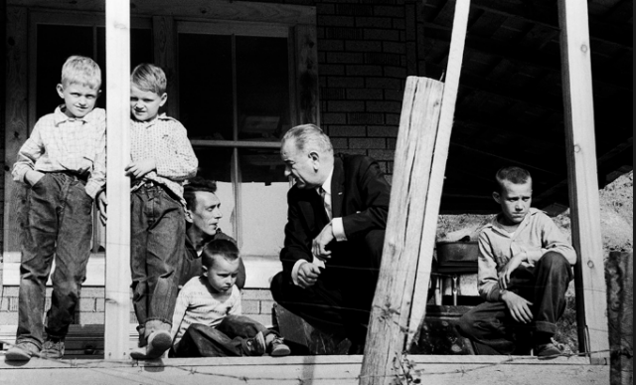
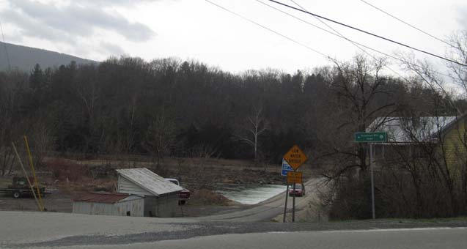
Was the War on Poverty Lost?
Persistent Poverty in West Virginia
Despite economic growth, West Virginia was one of just two states to see its poverty rate increase from 2016 to 2017. US. Census Bureau.
336,301 West Virginians lived in poverty in 2017, for a total poverty rate of 19.1 percent - an increase of 1.2 percentage points from 2016.
West Virginia's poverty rate was 5.7 percent higher than the national average, and the state had the fourth highest poverty rate among all 50 states.
The Mountain State's poverty rate has not declined since the end of the Great Recession.
“Rural poverty skyrockets as jobs move away,”
The Hill, December 5, 2017

Slide 18
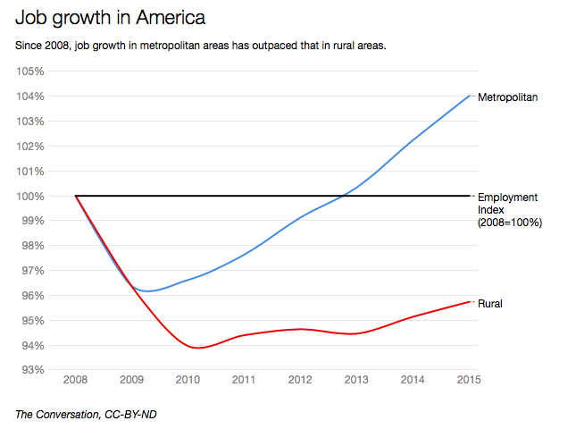

Slide 19
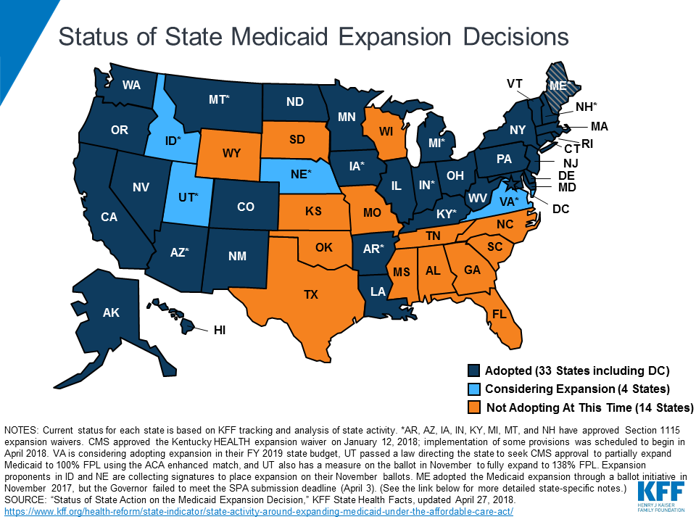

Slide 20
Medicaid Work Requirements – Arkansas
More than 17,000 Arkansans could lose Medicaid over work requirements
Could be the first state to lose coverage under rules that took effect in June.
New rules condition Medicaid enrollment on employment or community engagement. Arkansas is the only state enforcing such a requirement.
The state has been criticized over its requirement that hours be reported online.

Slide 21


“Health Advocacy Groups unite to push for Medicaid expansion”
"It's hard to look at people in the face and tell them to pull themselves up by their bootstraps when they can't afford boots," said Rebecca Jolley of Rural Health Association of Tennessee.
Jolley said 18 to 22% of people in rural Tennessee communities are uninsured. She said that's not the only problem they face.
"We have seen eight hospital closures in the recent past," she said. "Travel times increase for everyone. For people in cases of emergency, it can be a matter of life and death literally. If you want to see a small town not thrive, close its hospital. We have a lot more in peril of closing. A lot of our rural hospitals are surviving on bare bones, negative margins."

Slide 22
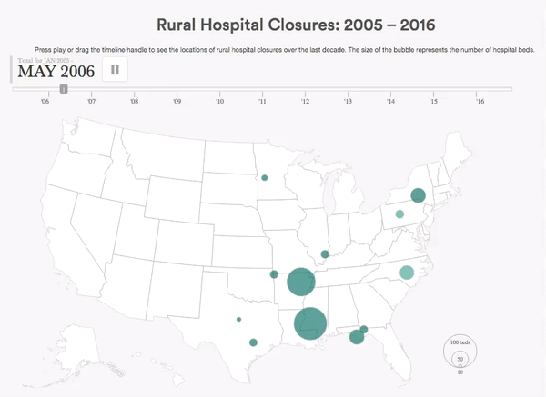
Hospital Closure Crisis

Slide 23
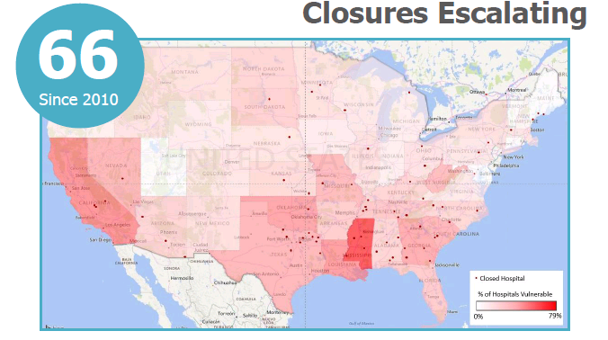
Rural Hospital Closures and Risk of Closures
95
X
Percent Vulnerable
35%

Slide 24
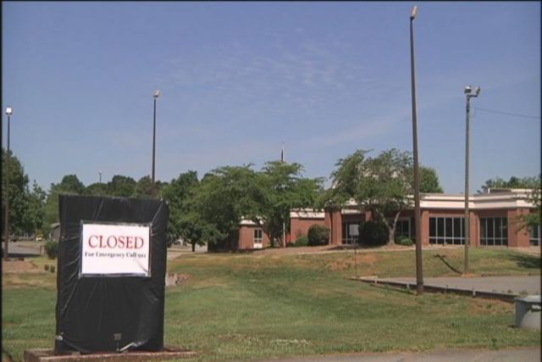
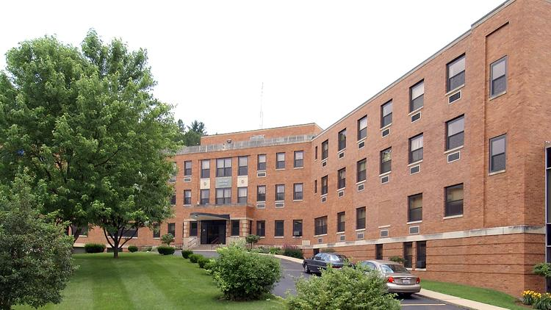
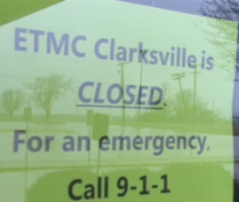
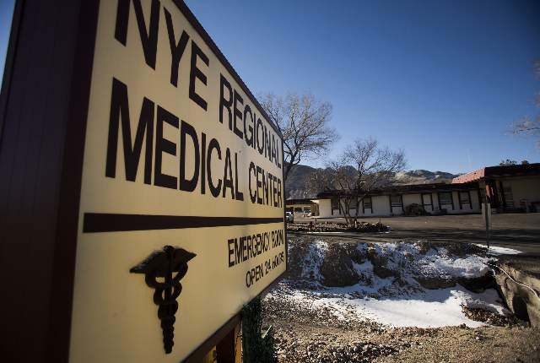
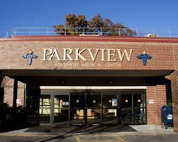



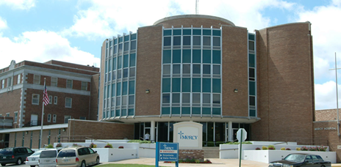
Rural Hospital Closures Continue…

Slide 25
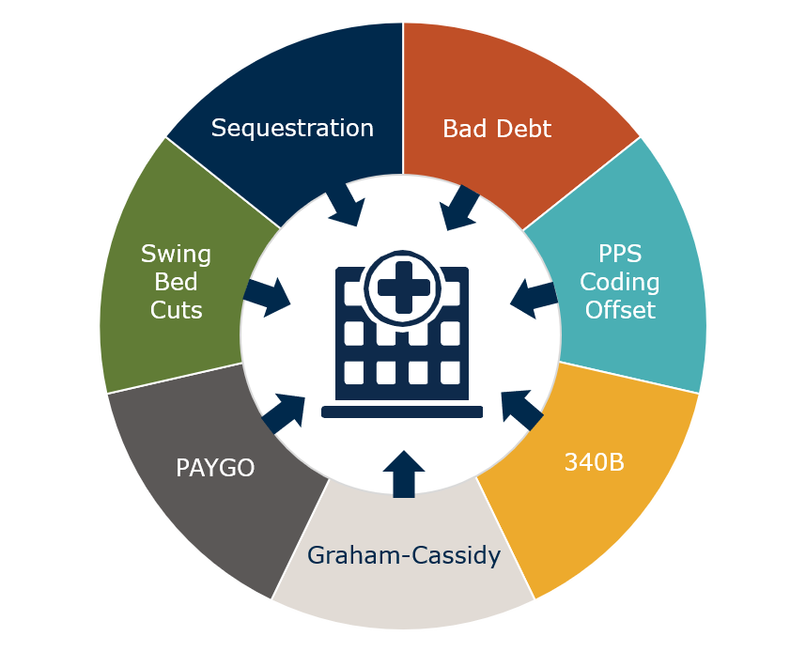
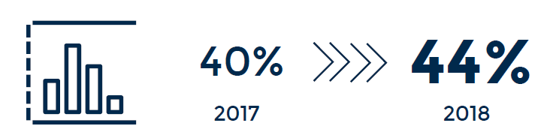

Rural Health Safety Net is Under Fire Pressure
Current and Pending Health Policies Negatively Impact Rural Providers
Total Rural Hospitals Operating in the Red Jumped Four Percentage Points Since Last Year

Slide 26

Why are hospitals losing money?
RURAL PROVIDERS ARE SUBSIDIZING CARE.
Impact of Bad Debt
  Medicare and Medicaid bad debt has increased by nearly 50% since the ACA was signed into law.
  Bad debt cuts cause $3.8 billion over 10 years to be lost.
  Sequestration cuts are also forcing doors to close.

Slide 27
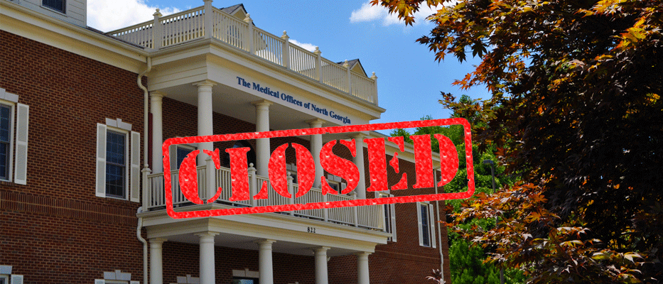
State snapshot: Georgia
Over half of Georgia’s rural hospitals are losing money.
6 have closed since ACA was signed into law (2010).

Slide 28
“If you want to watch a rural community die, kill its hospital”
Sept. 22, 2017, HuffPost
GLENWOOD, Ga. ― After the Lower Oconee Community Hospital shut down in June 2014, other mainstays of the community followed. The bank and the pharmacy in the small town of Glenwood shuttered. Then the only grocery store in all of Wheeler County closed in the middle of August this year.
On Glenwood’s main street, building after building is now for sale, closing, falling apart or infested with weeds growing through the foundation’s cracks…
The hospital’s closure eliminated the county’s biggest health care provider and dispatched yet another major employer. Glenwood’s mayor of 34 years, G.M. Joiner, doubts that the town will ever recover.
“It’s been devastating,” the 72-year-old mayor said, leaning on one of the counters in Glenwood’s one-room city hall. “I tell folks that move here, ‘This is a beautiful place to live, but you better have brought money, because you can’t make any here.’”
Rural hospitals are in danger across the country, their closures both a symptom of economic trouble in small-town America and a catalyst for further decline.

Slide 29

Maternity Care is Disappearing in
Rural America
In 1985, 24% of rural counties lacked OB services. Today, 54% of rural counties are without hospital based obstetrics.
More than 200 rural maternity wards closed between 2004 and 2014.

Slide 30

Rural Obstetric Factors
Rural areas have higher rates of chronic conditions that make pregnancy more challenging, higher rates of childbirth-related hemorrhages and higher rates of maternal and infant deaths.
Half of rural women in rural communities live more than the recommended 30 minutes from a hospital offering maternity services.
Workforce shortages and medical liability costs.

Slide 31

Rural Minority Mothers and Babies
Rural counties with higher percentages of African American women were more than 10 times as likely as rural counties with higher percentages of white women to have never had hospital-based obstetric services and more than 4 times as likely to have lost obstetric services between 2004-2014.
University of MN Rural Health Research Center

Slide 32

The politically powerful are listening…
“If we’ve learned nothing from the last election, it’s that we can’t listen to rural America enough.” Senate Minority Leader Chuck Schumer

Slide 33

Rural Victories: Appropriations
First time in more than a decade, a L-HHS Bill has been approved by Congress.
Unprecedented Funding for:
  Rural Health Safety Net;
  Opioid prevention funding;
  National Institute of Health.
Remember also operating off of 2-7ear budget bill that passed in February, which included significant rural funding.

Slide 34

Opioid Funding Bill. Huge amounts of spending.
Changes funding formula for states to receive funds - - will help rural states with most significant problem.
Expands Medicaid Inpatient Coverage.
Technical Assistance and Grants for Tribes
First Responder Training –allows first responders to administer a drug or device, like naloxone, to treat an opioid overdose.
Health Providers Shortages Areas – Allows National Health Services Corps (NHSC) to provide services in schools and with mental health professional shortages.
Loan Repayment for Substance Abuse Treatment Providers – modifies NHSC for behavioral health providers practicing in substance use disorder treatment facilities in mental health professional shortage areas through NHSC.
Grants for Communities Building Programs.
Expanding Medication Assisted-Treatment (MAT) for Recovery from Addiction
Eliminates Certain Site Requirements for Telemedicine under Medicare.
Improving Access to Telemedicine – allows use of MAT through the use of telemedicine.
Neonatal Abstinence Syndrome (NAS) - Provides support for NAS care in residential pediatric recovery centers and for services to mothers and caretakers under Medicaid. (Like Lily’s Place in WV).
Huge SMHSA and Centers for Disease Control Research increases.

Slide 35

More Rural Victories:
New Rural Health Title in bill
Rural Health Liaison
Farer Suicide Prevention
Loan Assistance Program
USDA conducting Series of roundtables on how to improve economic development and health in rural farm communities.

Slide 36
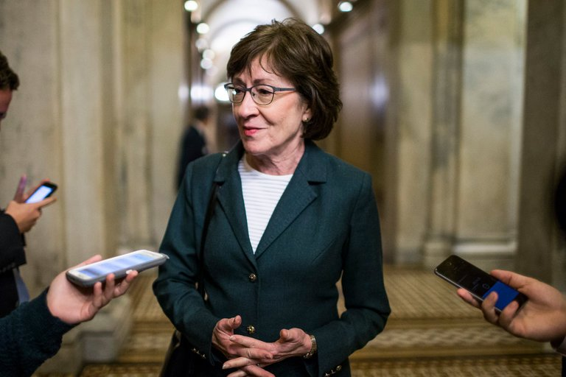
And, the power of rural helped stop the Senate from turning Medicaid into block grants.

Slide 37
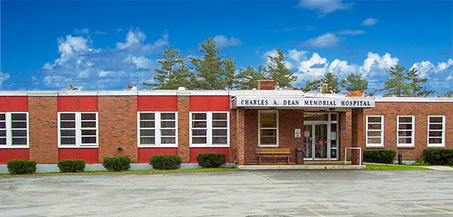
“If Medicaid is cut, that hospital will not survive. It’s the biggest employer in town. It has 180 good-paying jobs. So not only would people lose access to health care that they need, it would be a devastating blow to the community. You could go all over the state and find that would be true.”
            Senator Susan Collins speaking about rural hospital in Greenville, Maine.

Slide 38

How to meet these challenges: Empower Rural America
Keep the doors open
  Stop Medicare cuts
  Expand Medicaid
Invest in rural America
  Improve workforce shortages
  Invest in broadband and telehealth
Support stable funding
  (appropriations)
Create a sustainable new payment model

Slide 39

Thank you. NRHA looks forward to continued collaboration with Families USA
Maggie Elehwany, VP of Government Affairs

