Slide 1
The Center for
Health Innovation
New Mexico’s Public Health Institute

Slide 2

SW CHI Program Areas
Prevention and
Community Collaborations
Workforce
Research and
Development
Susan Wilger
Marisol Diaz
Holley Hudgins
Susan Wilger
Alisha Herrick
Administration
Lucinda Tecca
>16
FTE
Staff
in
Dona Ana
Grant
Hidalgo
Luna
Santa Fe
Counties

Slide 3







Collaboration – Workforce
Office of Community Health
Area Health Education Center

Slide 4

Primary Care and Psychiatric
Physician Workforce Development in
New Mexico
Charlie Alfero, Executive Director- SWCHI and New Mexico Primary Care
Training Consortium (NMPCTC)
John Andazola, MD- President, NMPCTC

Slide 5
Primary Care Physician Shortages:
National and State Levels
By 2025, the Association of American Medical Colleges estimates a shortfall of between 14,900 and 35,600 primary care physicians.¹
New Mexico has the oldest physician workforce in the nation.
  Nationally, the percentage of physicians over 65 years of age:
    2008 = 23.4% compared to 2012 = 26.5% (12% increase)
Healthcare drives yearly job growth. Healthcare created more jobs than any other sector in 2016, helping to drive total annual job growth to 2.2 million, according to data from the Bureau of Labor Statistics. In 2016, the healthcare industry grew by 35,000 jobs per month on average.²

Slide 6
Primary Care Physician Shortages:
National and State Levels
New Mexico various demand / recruitment perspectives
  Doña Ana County: recruiting 80 PCPs ³
  New Mexico Health Resources: recruiting 235 PCPs with limited focus ⁴
  HSD: “Assuming no redistribution of the current workforce, an additional 139 PCPs would enable New Mexico to meet the national benchmark (0.79 per 1,000 population) in all counties.”⁵ (We believe this is understated)
  Presbyterian Health Care Services: recruiting 35-40 PCPs in 2017 ⁶

Slide 7
The CDC reports 43.4 million adults suffered from some sort of behavioral health issue including mental illness, substance abuse, or other psychiatric condition in 2015 alone.
Access To Care
65% of Non-Metropolitan counties in the U.S. don’t have a single psychiatrist
47% of Non-Metropolitan counties in the U.S. don’t have a single psychologist
June 2018 Study - American Journal of Preventive Medicine
Psychiatric Physician Shortages:

Slide 8
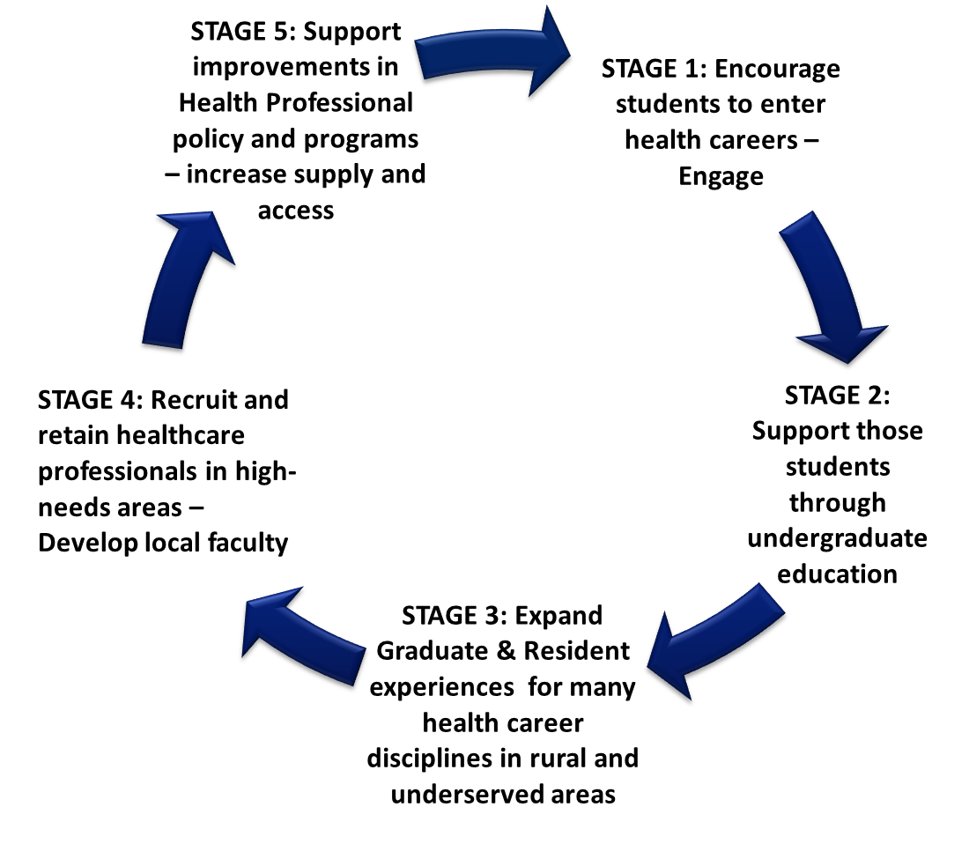
Pipelines and Pathways- Preparing Our Own Rural Workforce
FORWARD NM AHEC
Health Careers Support
Internships – Rotations
Residencies

Slide 9
New Mexico
Primary Care Training Consortium (NMPCTC)
Mission
“The New Mexico Primary Care Training Consortium improves the quality of essential health services by supporting existing and developing new training opportunities to increase primary care workforce in New Mexico.” Revised 2018
Vision
For New Mexico to be an innovative leader in training family medicine physicians and other primary care providers working in the most underserved populations in high quality, integrated primary care health systems.

Slide 10

Collaborations Creating Solutions

Slide 11




NMPCTC CONSORTIUM MEMBERS
UNM FMRP- Albuquerque
Southern NM FMRP – Las Cruces
Champion FMRP - Alamogordo
CHRISTUS St. Vincent FMRP - Santa Fe
Hidalgo Medical Services FMRP - Silver City
ALBUQUERQUE: UNM Office of Community Health
LAS CRUCES: Burrell College of Osteopathic Medicine (BCOM)
ROSWELL: Former – Eastern NM Family Medicine Program

Slide 12
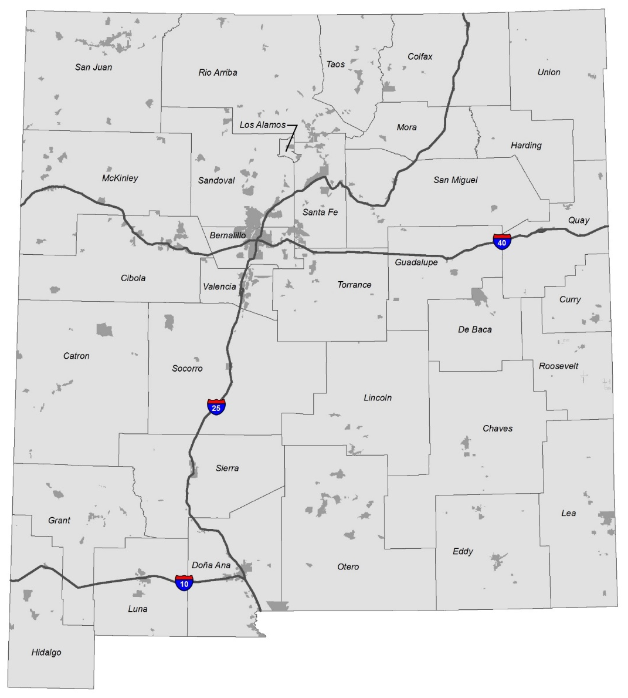
Current Family Medicine Residencies
Santa Fe
4 Residents
Family Medicine Residency Development
Per Year Number of Residents
Current Residents: 25
Albuquerque - UNM
13 Residents
Silver City
2 Residents
Psychiatric Residency Program- under development with Doña Ana County
Las Cruces
6 Residents

Slide 13
Shiprock IHS
2-4 Residents
Santa Fe
1 Resident
Gallup
4 Residents
Family Medicine Residency Development
Annual Number of Residents
Current Residents: 25
Phase II (Short Term 2-4 Yrs.): +20-25
Phase III (2021 – 2022): 11 Residents
Total: 61 Residents
Additional Medicaid Costs
Phase II (2018 – 2022): <$937,500
Phase III (2021 – 2022): $412,500
Total: $1,350,000
Albuquerque
3+ Residents
(Other)
Los Lunas
2-4 Residents
Alamogordo
3 Residents
Las Cruces 6 Residents-under development
Potential Shorter-term
Family Medicine Development

Slide 14
Financing Health Careers and FM/Psych Development - SCAN
Physicians are the only professions that require significant additional training after completion of an academic health professional degree: Accredited Residency programs.
Since 1965 Medicare has been the predominant payer of physician education
The rule for paying for Graduate Medicate Education (GME) are complex and favor large urban academic medical centers and teaching hospitals.
Residency program that do not generate significant hospital revenues – Primary Care – are underappreciated in favor of Invasive and Other Subspecialty medical specialties
Primary Care training is a health equity and access issue

Slide 15
Problems in GME payments for Rural Areas
Urban Hospital get paid on a DRG basis which can accommodate GME payments as additions to Revenue
In this model the more revenue you generate, the more GME you make. This encourages expensive care so +/- 80% of physicians being trained in the US are not trained to serve rural or frontier areas due to the cost of care and the lack of volume to support it.
Medicare rules often exclude rural hospital participation or even GME growth in small urban areas proximate to rural places.
Rural Hospitals and FQHC as paid on a PPS basis which complicates them benefitting from GME provision.
Medicaid has more flexibility than Medicare in GME payment models

Slide 16
Summary of Recommended
Medicaid GME Changes in New Mexico:
IME - Make all PPS/DRG hospitals with approved residencies eligible for IME, not just those with more than 125 residents. – Done
Direct GME - Combine Rural and Primary Care residencies into one rate
Set Payment rate at $75,000 for PC and Rural and $50,000 for “Other” which are the subspecialties. We are recommending that HSD set the ratio of DGME to 40.4% for “other” and 59.6% for rural and primary care training to limit Medicaid growth in Subspecialties for future distribution of GME support.
Create an administrative fee of $75,000 DGME fixed rate for rural and primary care residencies as a contract between state and rural / PC providers to support the full cost of care.
HSD is requiring identification of funding for FQHC-based training but not hospitals. This is a disincentive for residency development financially and creates a less secure financing environment for FHQCs and hospitals.

Slide 17
Contact
Southwest Center for Health Innovation
New Mexico Primary Care Training Consortium (NMPCTC)
FORWARD NM AHEC
301 West College Ave; Suite 16
Silver City, NM 88061
Charlie Alfero, Executive Director
Email: calfero@swchi.org
Cell: (575) 538-1618
Holley Hudgins, Director of Workforce Programs
Email: Hhudgins@swchi.org
Cell: (575) 956-5051

Slide 18

Southwest Center for Health Innovation
New Mexico’s
Public Health Institute

Slide 19
What is a Public Health Institute?
Nonprofit, independent from state government and institutions.
Leaders for population health improvement through innovative partnerships.
Leverage community and population strengths and assets
Address current and emerging health issues through research, policy, system transformation, communications.
Notes:
44 PHIs in 35 states
WHAT DOES A PHI OFFER?
Non-partisan entity, stable throughout administration turnover
Population-based health program delivery
Health policy and policy analysis through an equity lens
Training and technical assistance
Research and evaluation
Health informatics
Health communications
Fiscal/administrative management and program support
Collaborative leadership

Slide 20
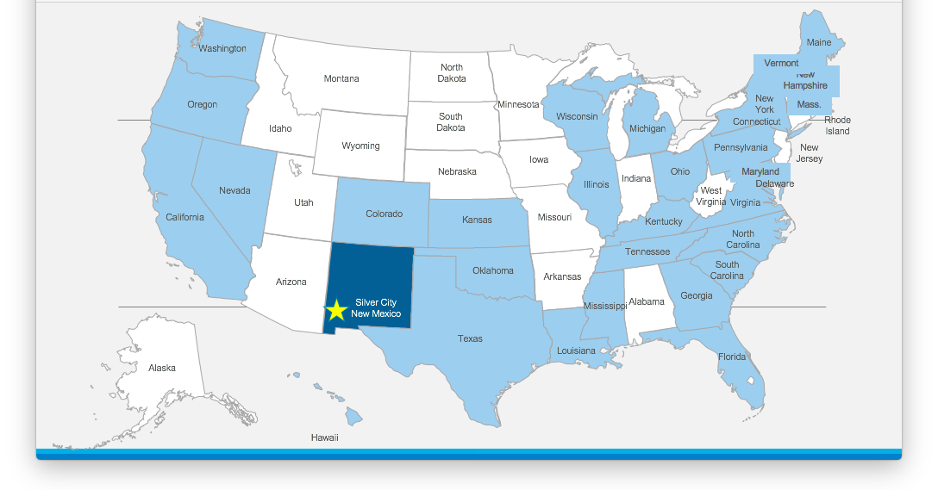

Slide 21
Why New Mexico?
Governmental public health services alone cannot address public health needs
Need and desire to address the economic, environmental and social determinants of health.
Collaboration needed to address prevention, social inequities economic disparities and preparedness.
A leader in addressing emerging issues as communities of color and other populations, such as the elderly, increase.

Slide 22
Why Southwest Center for Health Innovation?
Non-partisan entity, stable throughout administration turnover
Process
Requirements
  Staffing
  Partnerships
  Budget
  Competencies:
    Population-based health program delivery
    Health policy and policy analysis through an equity lens
    Training and technical assistance
    Research and evaluation
    Health informatics
    Health communications
    Fiscal/administrative management and program support
    Collaborative leadership
Notes:
Over the course of three years, the New Mexico Public Health Institute NMPHI Leadership Team has been very deliberate in their process to ensure a meaningful statewide conversation with varied stakeholders to grow a stakeholder group from the community up.
In early 2017, the NMPHI Leadership Team, while being incubated under the SWCHI umbrella, submitted an application to become a provisional member of the National Network for Public Health Institutes. The NNPHI expressed positive energy for this new institute joining its ranks and that SWCHI already functioned as a full public health institute as it is defined by NNPHI.
Requirements, and has the capacity, and the breadth and depth of work that is required to fulfill this role including the following:
This Leadership Team represents broad geographic regions in New Mexico and many professional sectors and areas of knowledge, including health equity, governmental public health, rural hospitals and community engagement.
We hope that you will agree that the current SWCHI activities, functions and leadership position us well for continued success. We at the Southwest Center for Health Innovation believe our work is of great value and will continue to improve the health and well-being of all families in New Mexico.

Slide 23
NMPHI Vision and Mission
Vision: Health equity is achieved: Social and health issues continue to be prioritized through evidence, policy, civic engagement and social justice.
Mission: To challenge the status quo by creating an environment in which social and health conditions allow individuals, families and communities to thrive

Slide 24
Contact
Southwest Center for Health Innovation
NM Public Health Institute
Charlie Alfero, Executive Director
Email: calfero@swchi.org
Cell: (575) 538-1618
Alisha Herrick
Email: aherrick@swchi.org
Office: (575) 597-0031
Cell: (682) 667-8848

Slide 25
Southwest Center for Health Innovation
2019-2020 Legislative Request

Slide 26
Southwest Center for Health Innovation
2019-2020 Legislative Request

