Slide 1
Drug Pricing, Innovation, and the Cycle of Greed
Stan Dorn, Senior Fellow, Families USA
Health Action Conference, January 24, 2019
Notes:
NOTE: Make sure that the Title slide does not have footer information (sources, FUSA logomark and page number). To turn off on this page, go to Insert > Headers&Footers and deselect Footer and Page number options > Apply to this page only. Also, select start page numbers at 0.

Slide 2

Symptoms of major policy disorder
Extortionate prices charged to desperate patients
Innovation gone awry
  78% of patents from 2005 through 2015 involved changes to existing drugs, not new drugs (Feldman 2017)
  Only 9% of new drugs between 2000-2013 offered clinical benefit over existing treatment (La Revue Prescrire 2016)
Enormous profits
  Both generic and name-brand manufacturers among the most profitable industrial sectors
  Stock market growth for large drug companies significantly faster than the S&P 500

Slide 3
Root cause: funding drug development through government-protected monopoly profits
(After the public spends “seed money” for foundational research)
Public funding supports basic research
Company develops drugs based on likely profits
Company obtains patent, charges monopoly prices
Company games patent system to lengthen monopoly
After patent expires, efforts to preserve monopolies by limiting competition

Slide 4
Example of innovation failure: Killer Superbugs
Every year in the U.S., superbugs
  Infect 2 million people
  Kill 23,000 people
World-wide, annual deaths projected to skyrocket by a factor of 14, rising from 700,000 to 10 million by 2050. More fatalities than from cancer, diabetes, or auto accidents.
  $100 trillion a year in economic harm

Slide 5
Voters favor bold action on drug prices, so long as those miracle cures keep coming
Source: POLITICO/Harvard T.H. Chan School of Public Health 2018.

Slide 6
Why does the public care so much about innovation?
Personal stake: “No one should ever get the kind of cancer that killed my Mom!”
Reason:
“Miracle drugs save lives. They are worth the money.”
Rage abates:
“Maybe drug companies aren’t monsters. Their high prices fund research.”

Slide 7
Improving drug R&D while cutting prices
Don’t pay high prices for worthless drugs
Reform the patent process to prevent abuses
  Limit opportunities for drug companies to obtain patents and marketing exclusivities that turbocharge corporate profits without improving health
Corporate reforms to ensure that this industry segment operates more in the public interest
Build drug development pathways based on human need, not corporate greed. For example:
  Every few years, the National Academy of Sciences identifies top priorities for drug development, based on health needs going unmet by drug corporations
  A new federal agency
    Contracts with researchers to take drug development through pre-clinical trials
    Retains patent rights
  When a drug reaches the final trials, the new federal office conducts competitive bidding to find a firm or non-profit that will do that work, in exchange for the most favorable binding commitments on price and other key metrics
    Bidders compete to exceed a specified floor
  Prizes a possible alternative to grant funding

Slide 8
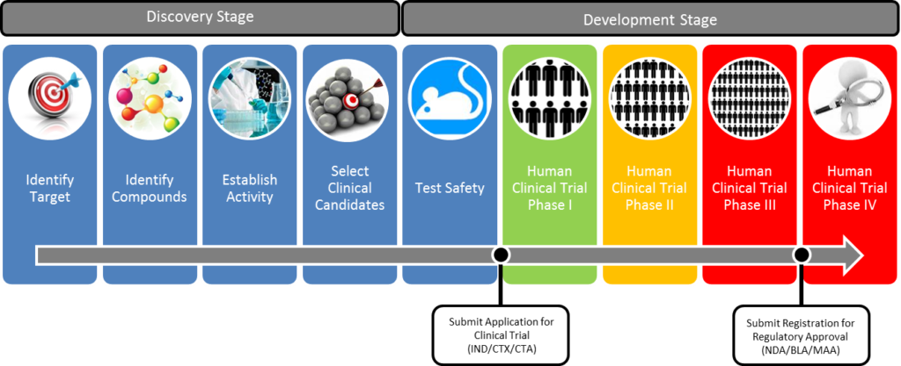
The drug development pathway
1
2
3
Government already funds this through NIH and DoD (taxpayer funded research)
Potential Points for government funding intervention, with conditions.

Slide 9

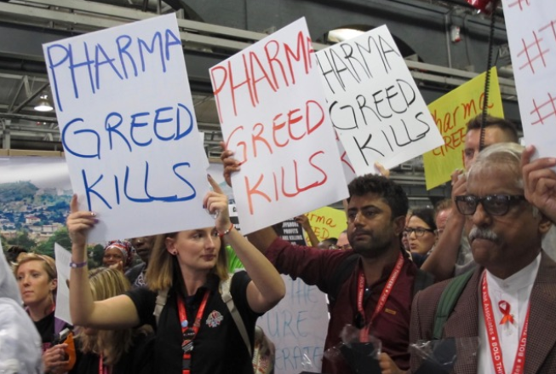
Conclusion
Extortionate prices
Failed innovation
Robber-baron profits
Innovation matters
  Intrinsically
  Strategically
Needed: a campaign for better medicine for fair prices
  Policy
  Public education
Fruit of the same poisonous tree:
A broken prescription drug system

