Slide 1
Prescription drug prices: Recent trends and opportunities for change
Leigh Purvis, Director, Health Services Research
AARP Public Policy Institute

Slide 2
Overview
Why are prescription drugs getting so much attention?
Why is this issue so important?
How has the current Administration engaged on this issue?
What’s next?

Slide 3
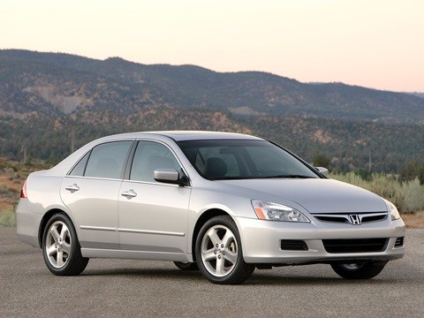
Jaw-dropping prices
$10,000 per year $1,000,000 per year

Slide 4
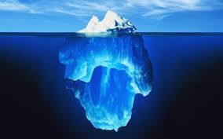
Tip of the iceberg
Increased manufacturer focus on orphan drugs, biologic drugs, personalized medicine.
Translation: products that can command high prices.
Specialty drug approvals have exceeded traditional drug approvals since 2010.

Slide 5
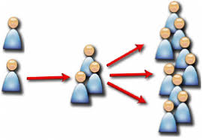
More people are using expensive drugs
Specialty drugs are now being used to treat conditions that affect millions of Americans.
Expanded indications for specialty drugs that are already on the market.
***In other words: more expensive drugs are coming, and more people are using the ones that are already here***

Slide 6
As if all of that wasn’t bad enough…
Prices continue to grow after drugs come on the market
Retail prices for widely used brand name drugs increased by an average of 8.4% in 2017.
Annual cost of therapy would have been more than $4,600 lower ($2,178 v. $6,798) had price changes been limited to inflation between 2006 and 2017.
Not just a few bad actors: almost all of the manufacturers studied increased their prices faster than inflation.

Slide 7
Overview
Why are prescription drugs getting so much attention?
Why is this issue so important?
How has the current Administration engaged on this issue?
What’s next?

Slide 8
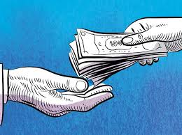
Taxpayer-funded programs are under increasing pressure
Medicare Part B prescription drug spending more than doubled from $12 billion to $29 billion between 2005 and 2016.
Beneficiaries are responsible for 20% of their costs.
Total Medicare Part D spending is approaching $150 billion
Enrollees have out-of-pocket limit but...
Medicaid program is also under considerable stress, which isn’t helping state budgets

Slide 9
Private insurance is also being affected
An increasing number of employer-sponsored plans have a fourth or even higher tier of drug cost sharing.
Average copayment for a fourth-tier drug is $105 and the average coinsurance is 31%.
High deductibles can create financial hardship.
Enrollees benefit from out-of-pocket maximums ($7,900/single, $15,800/family) but…

Slide 10
Patient assistance programs are not a cure-all
While helpful, programs can be less than generous.
Each company has its own qualifications, forms, processes for refills, and rules for re-qualifying.
Manufacturers tout increased spending on these programs but begs the question—why not just drop the price??

Slide 11
High drug prices affect everyone
The problems created by high prescription drug prices are not limited to people who are actually taking prescription drugs.
Spending increases driven by high and growing drug prices will eventually affect all Americans in some way.

Slide 12
Overview
Why are prescription drugs getting so much attention?
Why is this issue so important?
How has the current Administration engaged on this issue?
What’s next?

Slide 13
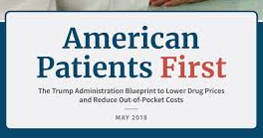
“The Blueprint”
Does a great job of describing the problem…
Touches on large number of potential solutions but unclear how they would be implemented or when.
Some would require legislation.
Does not address manufacturer pricing behavior.

Slide 14
International Pricing Index Model for Medicare Part B Drugs
Possible demonstration program that would:
Replace ASP + 6% with a flat fee.
Allow private sector vendors to negotiate with drug makers.
Phase down Medicare payment for selected Medicare Part B drugs to more closely align with international prices.
Fits with larger narratives of “free-riding” and “fairness.”

Slide 15
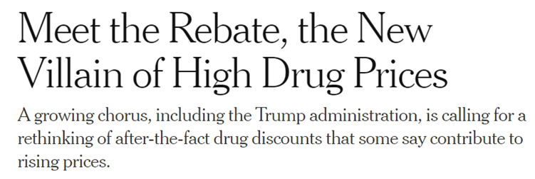
Focus on rebates
Drug companies provide rebates to secure preferential spot on plan formularies.
Administration concerns:
Creates incentive for manufacturers to raise list prices to maintain their profits and offer even bigger rebates.
Health plans and PBMs could be less inclined to negotiate effectively if they profit from rebates.
A few approaches in play:
Point-of-sale rebates under Medicare Part D.
Eliminate rebates entirely.

Slide 16
Overview
Why are prescription drugs getting so much attention?
Why is this issue so important?
How has the current Administration engaged on this issue?
What’s next?

Slide 17
Some things are pretty much guaranteed…
More Congressional hearings
Continued bad behavior as manufacturers return to business as usual
Issue will likely continue to get attention as more and more people become unable to afford necessary medications

Slide 18
What if nothing changes?
The costs associated with prescription drugs are not sustainable for patients or payers.
Efforts to reduce costs could save taxpayer-funded programs like Medicare and Medicaid billions of dollars.
More and more patients will be unable to afford their prescription drugs if current price trends continue.
***Medical innovation is meaningless if no one can afford to use it***

Slide 19
Leigh Purvis Director, Health Services Research lpurvis@aarp.org AARP Public Policy Institute www.aarp.org/ppi Twitter:@leighdrugwonk www.Facebook.com/AARPpolicy Blog: www.aarp.org/policyblog

