Slide 1
Federal legislative action: hope and challenges
Afton Cissell, Senior Counsel
Office of Rep. Lloyd Doggett (D-TX)
Chairman of the House Ways & Means Health Subcommittee

Slide 2
Key Congressional Priorities
Two buckets: “low-hanging fruit” and larger system changes
Low-hanging fruit
Pay-for-delay
Access to samples
Importation
Transparency
System changes
Medicare negotiation and Part D program changes
Patent reform
Access to meds in trade agreements
Taxpayer protection rights

Slide 3
Medicare Negotiation and Part D Reform Priorities
HHS must have negotiating authority on all drugs
HHS must have adequate bargaining power
Beneficiaries must directly feel the impact

Slide 4
Patent Reform: Realigning Incentives
From 2005 to 2015, 74% of new drug patents were awarded to existing drugs.
The world’s best-selling drug, Humira, has 247 patent applications delaying competition for 39 years.
Nearly half of these applications were filed after 2014– 12 years after its initial FDA approval and more than 20 years after the initial research began.
Total spending on Humira increased by 266% for Medicare and Medicaid between 2012 and 2016.
If Humira were a standalone company, it would be larger than many Fortune 500 companies, including Visa, General Mills, and Monsanto.

Slide 5
Access to Meds in Trade Agreements
The moment we tie our hands in a trade agreement, any shot of reform is gone.
Issue-spotting:
Patent standard language that allows for abuse
Secondary patenting for “new use, new method of using a known product, or new process of using a known product”
Establishing and extending monopolies through “exclusivity” periods
Linking patent expiration to market approval
If using evidence of prior approval for the brand-drug, the reviewer must provide notice and judicial or administrative proceedings for the brand-drug to challenge
Disincentivizes challenges to the merits of the patent

Slide 6
Taxpayer Protection Rights: Getting our ROI for real innovation
The federal government funds prescription drug innovation through a variety of grants and tax credits.
Of the 210 new drugs approved between 2010 and 2016, every single one relied on federally funded studies.
Current law allows the government to protect taxpayer investments by issuing a competitive license to ensure generic competition on a taxpayer-funded invention.
The NIH has refused every request to utilize this authority.
Taxpayer investments should be paired with transparency and reasonable pricing and access requirements.

Slide 7
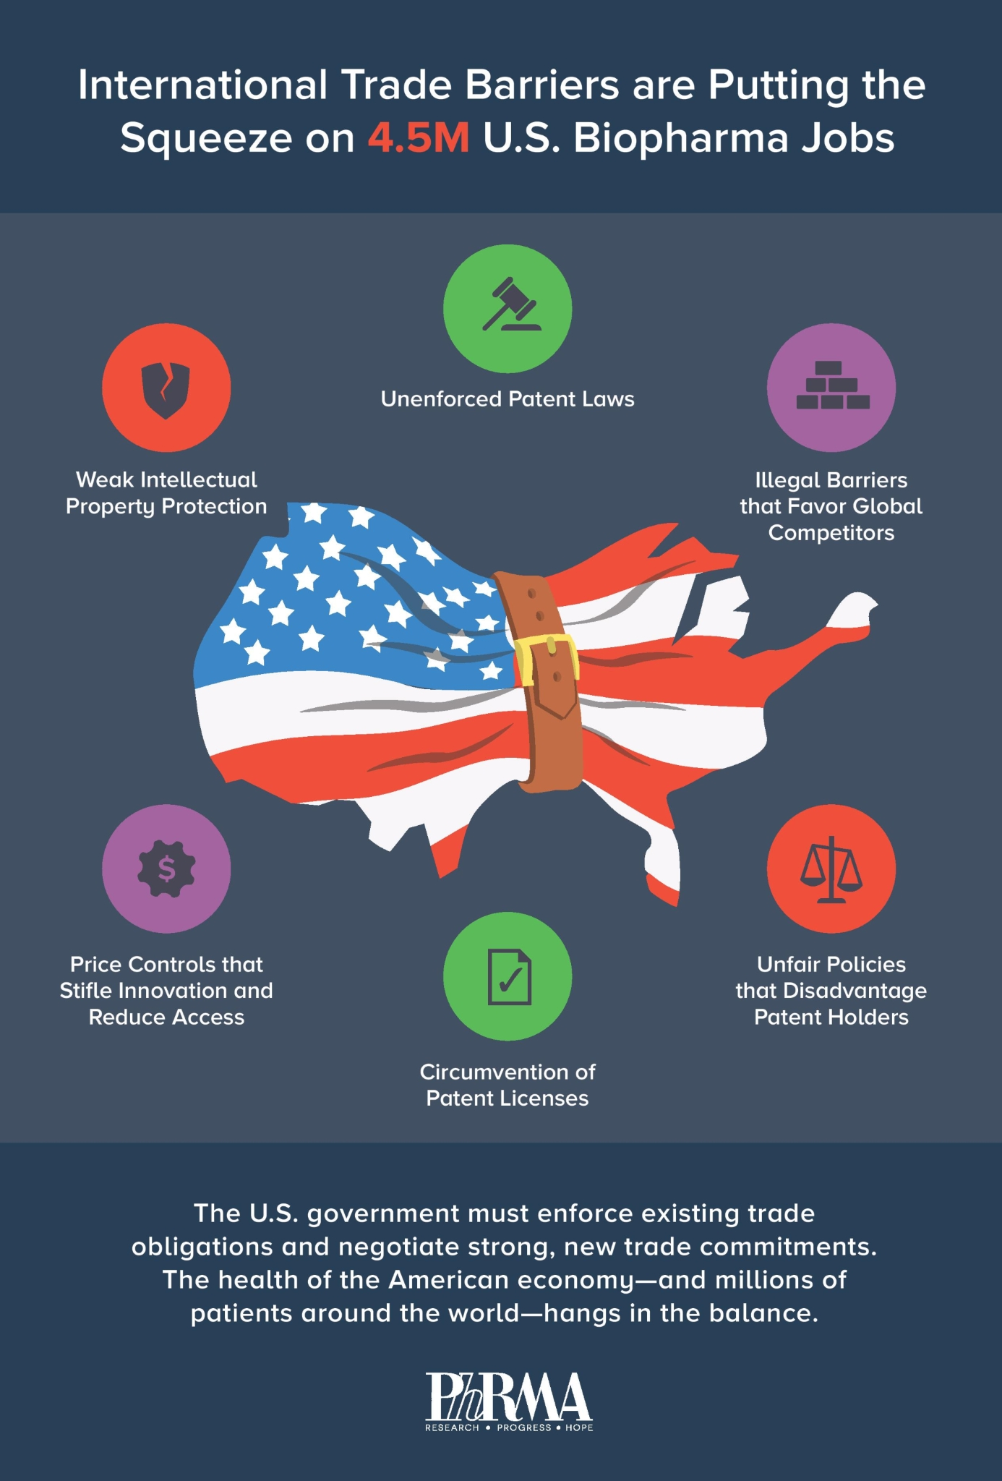
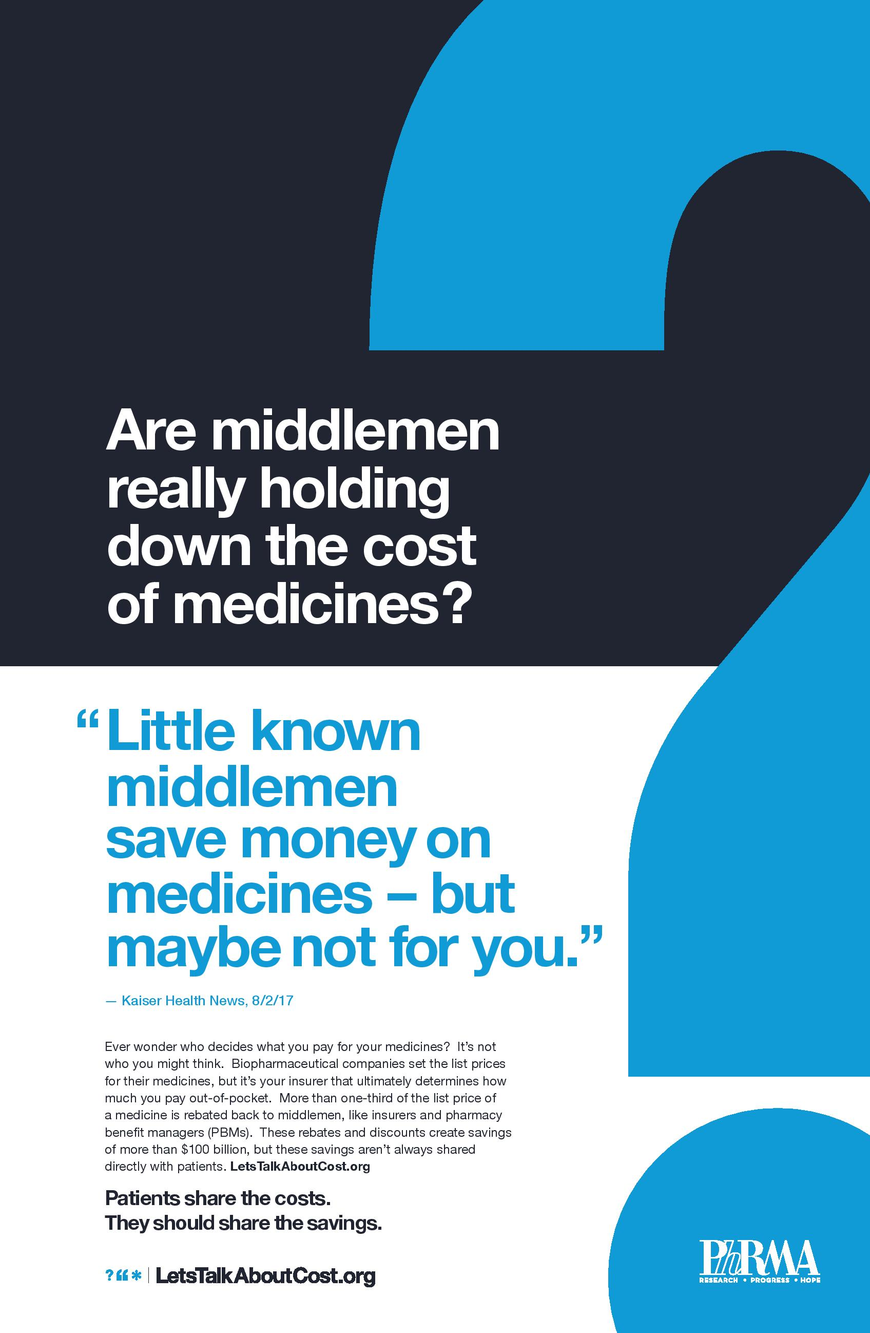
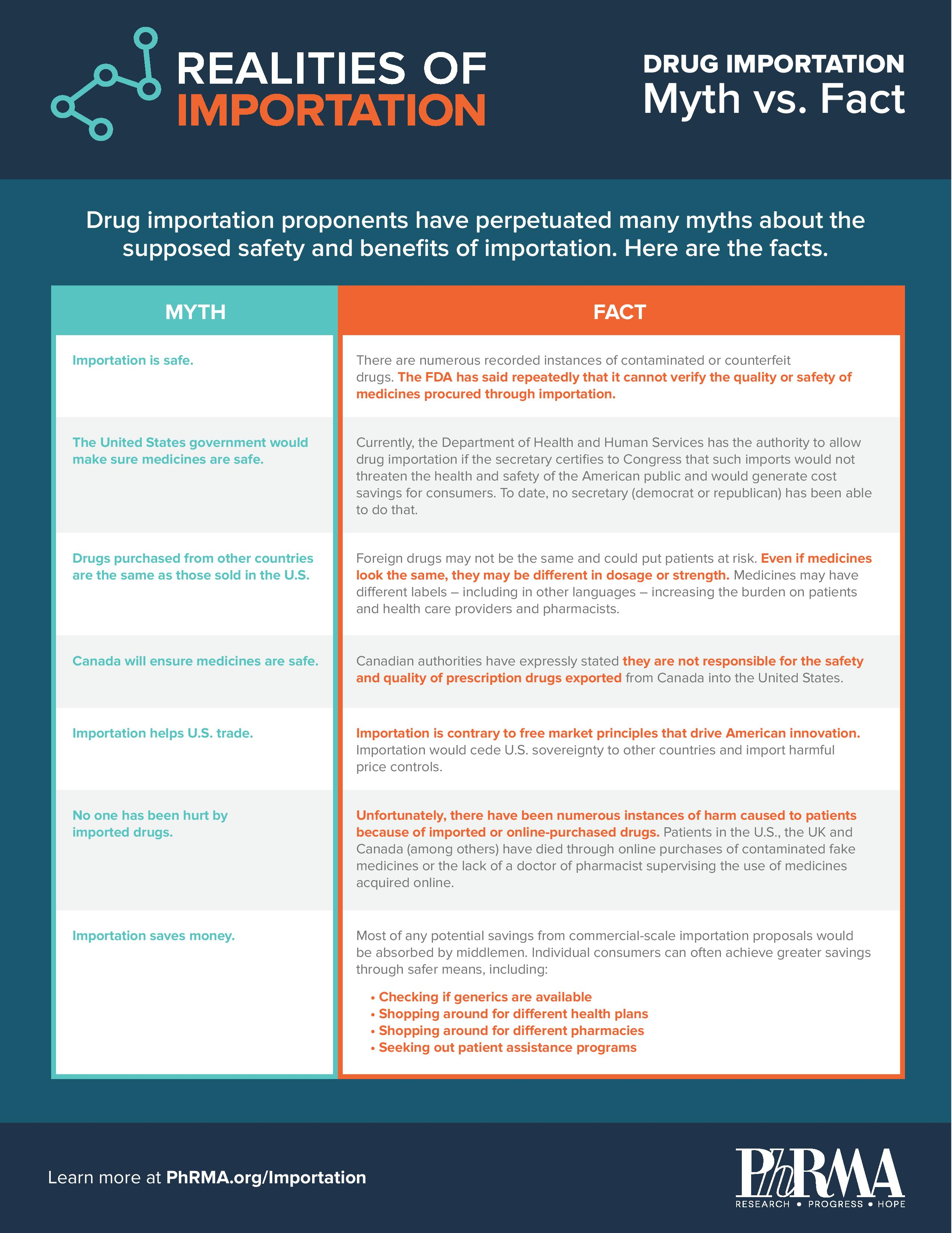
Challenges

Slide 8
