Slide 1
Health Action 2019 Outreach, Enrollment & Patient Navigation in Today’s Climate
Notes:
Summary: Ongoing changes to the health care landscape mean that consumers and patients need continual help navigating coverage and care. Panelists will discuss new efforts they’re implementing to continue meeting essential needs of their communities.
Speakers:
Molly Moffett, Community Health Council of Wyandotte County
Shelli Quenga, Palmetto Project
Lisa Chan-Sawin, MHA, Transform Health
Moderator: Heather Bates, Transform Health

Slide 2
KANSAS ASSISTERS NETWORK
Supporting Assisters in an Ever-changing Landscape

Slide 3
Bi-county coalition
Coordinated by Community Health Council of Wyandotte County
Primary function: support assisters with open enrollment
Secondary function: provide linkages to resources and care
Began in Wyandotte in Open Enrollment 1
Notes:
KAN began as Enroll Wyandotte in 2013 to assist residents with Marketplace enrollment. We trained 58 University of Kansas students as CACs and used the WyCo health department as an enrollment center. We also partnered with several organizations with connections to underserved communities. Since then, we’ve expanded to Johnson County and assist consumers with resource connection, linkage to care and health insurance literacy

Slide 4
2017 Success
Increased # applications in 2017
Increased coalition participation
Johnson County + 657
Johnson County hospitals
Pooled funding with Cover KC to produce TV commercial
Canvassed areas with 100-400% FPL and high uninsured rates
Developed website and literacy materials www.ksassisters.org
Successful sites: health departments, social service agencies, Safety Net Clinics and hospitals
Unsuccessful sites: food pantries, libraries, homeless shelters and churches
Better as outreach site than direct enrollment
Notes:
2017, I felt, was successful despite efforts to discourage enrollment. Wyandotte County only had a decrease of 130 applications and Johnson County actually saw an increase of 657. We knew Marketplace commercials wouldn’t be aired and TV is still the #1 source of entertainment so thanks to the generosity of our funders and an amazing collaboration with Cover KC, we were able to create a commercial that aired 70 times and a social media campaign that was seen but over 2 million people. We also created hot spot maps overlapping neighborhoods with 100-400%FPL income levels and high uninsured rates and used volunteers to canvass those areas.
Over the last 5 years, we’ve learned the best enrollment sites are where consumers already are and need to be established. New sites never do as well as sites continued from year to year with the exception of the hospital this year and you have to go where people are. One of our sites fell through so we had to work out of a church and enrollment was low at that location. Same with locations that served individuals with extremely low incomes like food pantries and homeless shelters.

Slide 5
Funding
REACH Healthcare Foundation
Health Care Foundation of Greater KC
Wyandotte Health Foundation
Latino Health for All
Kansas Association for the Medically Underserved
Notes:
Since 2014, we’ve been funded through several sources including the Kansas Association for the Medically Underserved who was a recipient of Federal Navigator funding. After the 2016 elections both REACH and HCF stepped up and provided more funding because of the lack of federal support. Latino Health for All received CDC funding to support access to care. This money no longer exists. KAMU has been able to maintain federal Navigator funding, however KAN did not seek funding because of continued support from REACH and HCF. We are incredibly fortunate to have such wonderful support from both REACH Healthcare Foundation and Health Care Foundation of Greater KC. Without them, our efforts would cease!

Slide 6
Why Success
Support staff & partners
COMMUNITY TRUST
ASSISTER FOCUSED
Build capacity of others in and outside of organization
Clients, staff, partners and funders
Single purpose and paid $19 hrly
Notes:
We have amazing funders who trust and support the work we do because we focus on assisters which makes us successful. We don’t work in silos and use our resources to build the capacity of other organizations whose primary work may not be Marketplace. Because of our strong partnerships we have trust and social capital among the community. We are the known go to for Marketplace questions and this creates more opportunities for growth. None of this would be possible, however, without our amazing assister team. We aim to create a valuable work experience and pay $19. Seasonal assisters ask to return every year so we’re able to pick from the best.

Slide 7
Why WE pay more
Difficult but important work
Complex scenarios
Ever-changing landscape
Client trust
Knowledgeable
Desire to come back!
Notes:
Experienced assisters are a commodity and should be treated as such. They have to become both Marketplace and insurance experts overnight. If they screw-up an application it would have dire consequences for a consumer. They have to understand all the rules and tricks of the application process. Like, sometimes the call center gives you wrong information but you can only gain that knowledge through experience. Most applications are cut and dry but every once and a while you get a scenario where someone lives in another country and only claims half a child while living off disability in two states half the year. Also, most things change every year and assisters need to be able to adapt. Once they learn plans, its over and time to learn all the changes. If assisters aren’t knowledgeable and consumer focused, it can create distrust in clients. We’re always available to help newer employees and use messaging apps so assisters can get answers to questions quickly. This is hard work so we pay well and because of this seasonal employees always want to come back which is the key to our success. They get better every year. This is why I don’t recommend using volunteers or staff members with other jobs that may get pulled in multiple directions.

Slide 8
Knowledgeable support
Assister Input
Adequate Compensation
HAPPY ASSISTERS
Notes:
Supervising staff HAS to be knowledgeable or direct contact with someone who is and shouldn’t be expected to do other jobs. Local clinic given federal funding paid their Navigator $11 an hour (used the remaining money to help fund the clinic), couldn’t answer questions (so she called me), and had her doing multiple unrelated jobs. The assister reported to me it was the worst job she’d ever had and wasn’t coming back the next year. Seasonal assisters shouldn’t be used as an extra employee for an organization. They need to focus on application assistance to build up knowledge and experience in the one area they’re intended for.

Slide 9
How we pay more
Organization Capacity
Grants used for enrollment, not operations
Less than 5% for indirect
Staff & Marketing
Local funding for daily operations
REACH core operating grant: rent and utilities
Board member dues: ED salary
2 FTE – director and coordinator
2 seasonal – pay more, hire less
Small funding for partners’ operations
Notes:
We’re very lucky to have funders who pay for yearly operations so we use little indirect from enrollment grants. Most of our money goes to staff and marketing which we share with our partners to increase capacity. This year we had less seasonal staff but because of their previous experience, can do the work of 2 new assisters and require less training.

Slide 10
future
Medicaid Expansion
New Governor pro-expansion
Assisters collected Medicaid Gap stories for Kansas Association for the Medically Underserved (KAMU) and the American Cancer Society
Providing consumer experience to advocates
Non-profit Brokerage Organization
Assist with disability applications
Notes:
Moving forward, Governor Laura Kelly stated that Medicaid Expansion was one of her main goals. REACH has asked how best they can advocate for consumers on this subject and we hope to share the experience of assisters in that process. Since the beginning we’ve helped expansion advocate groups, KAMU and American Cancer Society collect gap stories. If and when Medicaid is expanded we will help consumers with applications and connecting to providers. We’re also looking into becoming a brokerage site for sustainability like one of the other presenters. Finally, we’ve noticed a huge need in our community for assisters to help with disability applications because they’re long and complicated.

Slide 11
Molly Moffett
Program Director
mmoffett@wycohealth.com
913-371-9298 x3
www.ksassisters.org

Slide 12
35 yo statewide nonprofit
Focus areas: healthcare and access to care; families, youth, and schools; community engagement; civic participation
Navigators since 2013

Slide 13
Insure SC
Coverage for every South Carolinian
Consumer-focused
One-stop shop
Still non-profit
Supports our programs
Free in-person or phone assistance 1-888-998-4646
Notes:
Why we did it
Consumer Focus
Comprehensive Services
Social Impact - revenues

Slide 14
Resource Specialists
Licensed insurance agent
Salaried

Slide 15
Lessons Learned
Consultative approach
Social worker-ish
License grants access
No wrong door still matters
Medicare: It’s complicated
Notes:
No wrong door – special pops, referral pathways
Medicare is complicated for enrollment but it also expands our opportunity for advocacy.

Slide 16
Company branding
More special pops
New partners
New services
Notes:
Differentiate our brand of service delivery
Broaden special pop outreach
Opioid treatment
Mental health treatment
Re-entry programs
Meal delivery programs
Prescription assistance programs
New partners: SC community bank
Expand service offerings
SSI/SSDI applications
Tax prep

Slide 17
Questions?
Contact:
Shelli Quenga
Director of Programs
squenga@palmettoproject.org

Slide 18
How We’re Different
Full-Service
Mission-Driven
Customized Solutions
Outcomes- Based
Nationally certified women and minority owned business (MWBE).
Notes:
Lisa, Who is Transform Health (brief, 20 seconds)
We are nationally certified as women and minority owned full service health care consulting firm
We work with leaders in the public and private sectors to drive solutions that promote efficiency, value, and access to care, in order to address key social determinants of health to improve health outcomes

Slide 19
Our Full-Service Approach:
Solving Big Problems are Our Purpose
Strategy
Policy
Services
Notes:
We work collaboratively with you to come up with a plan that we execute together that incorporates strategic advice, research, policy analysis, communications support, technical assistance, stakeholder engagement, and capacity building to further your goals.

Slide 20
Federal &
State Policy
System Transformation
Payment
Reform
Practice Transformation
Technical Assistance
Outreach & Enrollment
Our Areas of Expertise
Notes:
Only flip through briefly (5 seconds max), say will be avail offline but that this slide gives you a sense of what we are passionate about and the work we do! We are here today to talk about an outreach and enrollment project that also fits squarely under a health system transformation model. But in fact, it also touches on all of the critical aspects that Transform Health deems as essential to systems change and that is our Whole Person Care pilot.

Slide 21
Agenda
Whole Person Care:
Social Determinants of Health
National Models:
What’s Trending
Sacramento’s Pilot:
Health + Housing
Notes:
Today, we are focused on one of our projects, a Medicaid waiver pilot known as Whole Person Care.
LCS: be sure to give a nod to the landscape of Sacramento, population size, homeless numbers, opioid crisis, that these same problems are relatable in cities and small towns across America and we are no different.

Slide 22
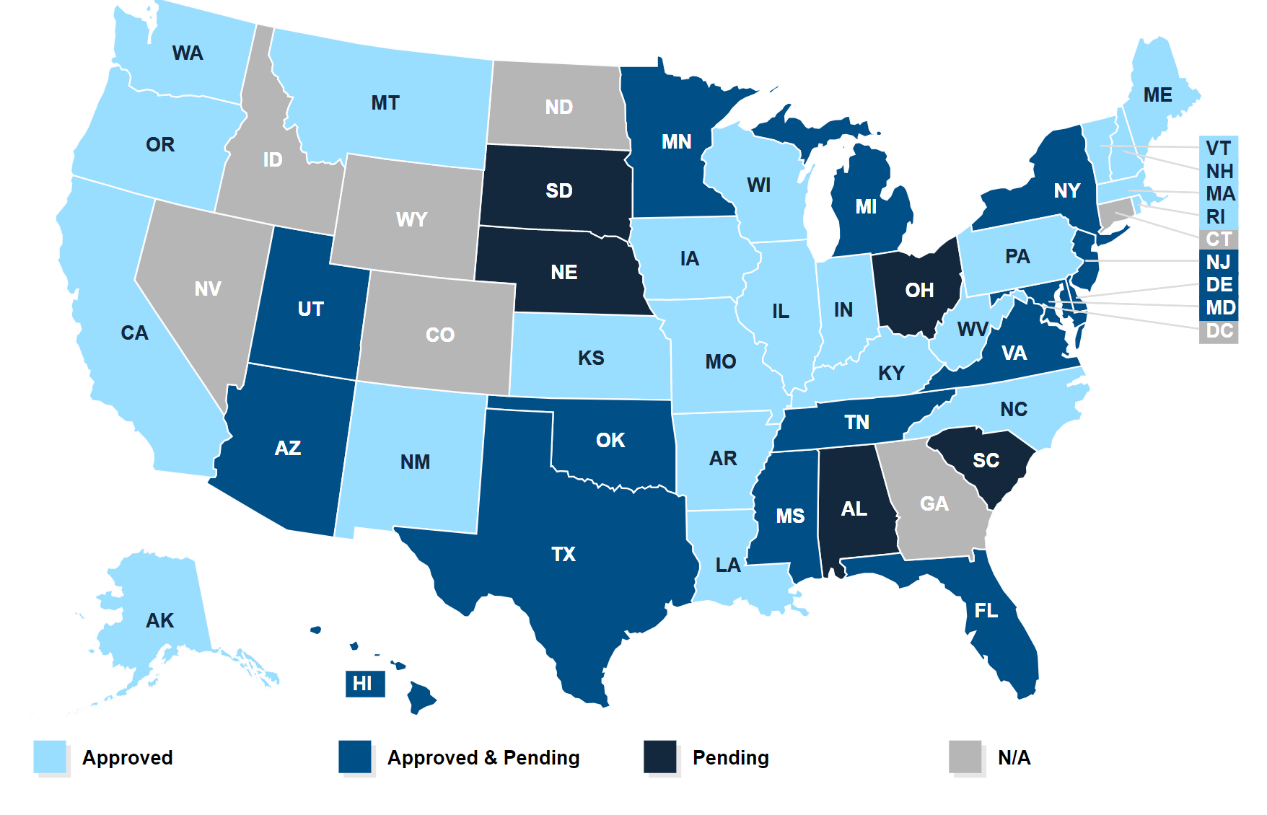
A Brief History of Medicaid Waivers: Hint, They Aren’t All Alike!
Source: Kaiser Family Foundation
Notes:
Before I get into the details of our pilot, I want to acknowledge that not all waivers look alike. They can be used to expand coverage or frankly, reduce coverage and services such as the case now in a select number of states. We know there is a concurrent session now addressing how waivers are being used to negatively impact consumers and what advocates can do about it. But the reverse is also true, you can explain how waivers can be used to effect critical change in peoples lives for good so we think it is important to help advocates and others understand examples of waivers being used for good.

Slide 23
Status of Delivery System Reform Waivers
Source: Kaiser Family Foundation
Notes:
A brief nod to this.

Slide 24
What is California’s Whole Person Care Program? It Begins with Outreach & Enrollment…
Five*-year Medicaid 1115 waiver pilot program authorized by CMS and administered by DHCS for high-risk Medi-Cal beneficiaries who are frequent users of multiple systems and have poor health outcomes
Provides flexible federal funding to improve health outcomes and more efficiently and effectively use health care resources
Pilots identify target populations, assess health and housing needs, coordinate care in real-time, and evaluate outcomes
Promotes deeper collaboration and coordination between providers by requiring pilots to form partnerships and share data
Whole Person Care
Collaborative Leadership
Coordination of Services Across Sectors
Shared Data
Financial Flexibility
Targeted Populations
Patient Centered Care
* Round One pilots run for five years. Round Two pilots run for four years.
Notes:
-add enrollment and outreach focus

Slide 25
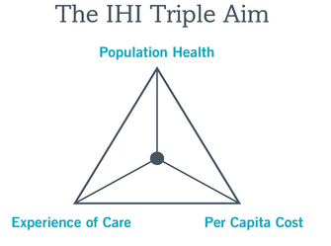
Whole Person Care
Collective Impact Model
Source: California DHCS
http://www.ihi.org/Engage/Initiatives/TripleAim/Pages/default.aspx#
Notes:
Briefly define Whole Person Care, what it means, what it seeks to address, the root causation and the overall approach to solving the problem.

Slide 26
Outreach & Enrollment: Our Most Vulnerable
https://q13fox.com/2018/07/19/seattle-city-officials-work-with-sacramento-based-group-to-combat-homeless-crisis/
Notes:
We have been looking at models to address health and housing across the country.

Slide 27
From Outreach & Enrollment to Navigating Care in the Community
Outreach to enroll people in quality, affordable coverage is an important first step.
Once enrolled, the patient experience makes each person a critical stakeholder in health system transformation.
Whole Person Care seeks to specifically address our highest users of the most expensive care: the emergency room.
The lessons learned by tackling the health and social determinants of health needs for our most vulnerable can be adapted across a continuum of care to serve those greatest and least in need.
Notes:
Set the table for what type of outreach and enrollment project this is.

Slide 28
Whole Person Care:
It takes a village!
1 Outreach/Enrollment CBO Lead Agency
Outreach, Enrollment, Post-Enrollment Navigation (CHWs)
Data Management Entity
3 Hubs, FQHCs
2 Housing Support Services providers
5 Health Plans (Medicaid managed care)
4 Hospital Systems
2 Homeless Shelters
10+ Additional CBOs
2 Emergency Service Organizations (Police & Fire)
+ Data Sharing Agreements Across All
Notes:
Drilling down to the Sacramento Whole Person Care pilot as an example of a waiver being put to good use to serve the homeless, our project is known as Pathways to Health and Home and is a pilot out of the City of Sacramento – a good example of how local governments who do not run Medicaid programs, can get engaged in Medicaid programs!
You can see it takes a village. This gives you a brief rundown of stakeholders at the table but there is so much more to it.
While we work nationally, specifically in Sacramento, we lead and organize a collaborative effort with the City of Sacramento to implement this Medicaid waiver model to tackle health and housing.
Mission: To improve the health, quality of life, and housing stability for Sacramento’s most vulnerable individuals experiencing or at-risk of experiencing homelessness through an integrated system of care.
Vision: A city where all individuals have a home and access to adequate health care.
Target Population: High utilizers of health and EMS systems that are homeless or at-risk of homelessness
And! We have data sharing agreements with all of these partners, no easy feat!
Note that Whole Person Care means outreach/field-based, high touch services, for a high need population such as: appointment accompaniment, transportation, goal setting, housing services, and other supports necessary to improve health and housing outcomes.
Core to our mission is to ensure the intersectionality of addressing social determinants of health and care coordination based on treatment goals & needs of client, including creating and updating shared care plan, organizing and facilitating routine care coordination meetings, and arranging for expedited access across health, behavioral health, social services, and housing sectors, and seamless transitions between settings via cross-system workflows and case conferencing.

Slide 29
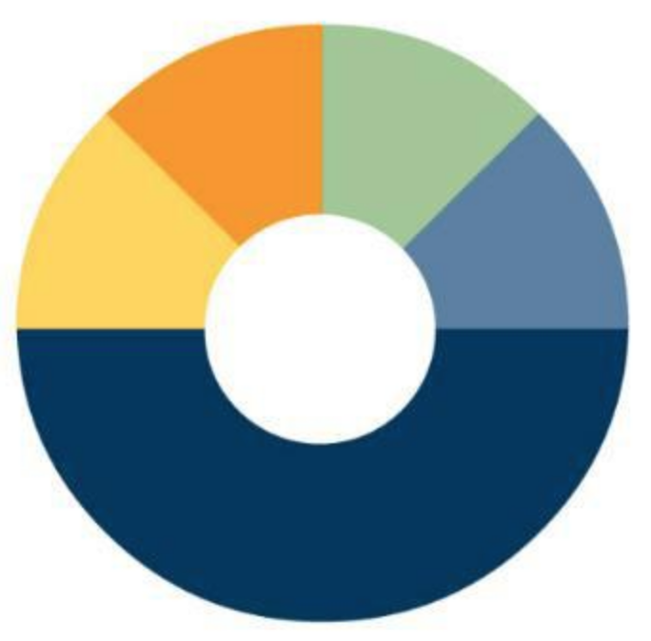
Overview of Model
Winter Triage Shelter
Impact Team
Sac Fire
HMIS
Hospitals
Clinics
Health Plans & IPAs
ICP and ICP +
Homeless Services
Shelters
Individuals are Determined Eligible and
Engaged to Enroll
Enrollees are Stabilized and Graduate
Specific Organizations Refer Individuals
Pathways Care Teams Connect Enrollees to
Needed Services
Enrollees are Activated and Motivated by CHW/Navigators
Supported by data sharing infrastructure enabling
a shared care plan across service providers
Notes:
GUIDING PRINCIPLES
No Wrong Door, Whatever It Takes, for as Long as It Takes
Field-based, not clinic centric – “meet patients/clients where they are”
Evidence-based practices, including employment of staff with lived experience
Data driven, quality improvement
Systems Change – working to better align, coordinate, and integrate current capacities and services
Multiple interdisciplinary teams with caseloads of ~125 (high & low intensity case mix)
Cross-sector partnerships to improve communication, coordination, and data sharing
Collective impact, collective accountability
Whole person care through bundled payments

Slide 30
Patient Experience - Four Intervention Phases
Outreach & Enrollment
1
Stabilization
3
Less intensive (frequency & duration) of Care Coordination and Service Supports & Navigation
Graduation & Disenrollment
4
Graduation: Client achieves stability and self-sufficiency
Activation & Engagement
2
Eligibility verification & enrollment
Initiate engagement, care planning and goal setting
Health, MH, SUDS, & social service supports
Care coordination and follow-up across
Outreach through identification & referral pathways
Disenrollment: at client request, move out-of-county, death, etc.
Housing services for participants
Notes:
Goals for self-sustainability:
Train for self-management in health & housing
Support enrollee entry into future workforce opportunities: Advocate, CHW
Explore family reunification, diversion, assisted resolution
Involve everyone in the process

Slide 31
http://www.p2hh.com/-/media/P2hh/Files/Committee-Info/January_2019_Update/City-DB-Nov1--Dec14-rev.pdf?la=en
Notes:
Our latest dashboard, only go over briefly! They can dig into these via our website and contact us.

Slide 32
Source: Sac Bee
Notes:
Press coverage, CLIENT STORIES are critical to our success, storybanking is key. (say – storybanking is critical)

Slide 33
Lessons Learned: 2018 Outcomes, Accomplishments
Thousands of Stabilizing Services Provided to the Most Vulnerable
183 Enrollees Housed
Successful Launch of a Collective Impact Model
Over 40 Critical Partnerships
Unprecedented Cross-Sector Data Sharing in Sacramento
Notes:
Lisa you can add the DHCS data point as TPs during this slide if allowed to share here.

Slide 34
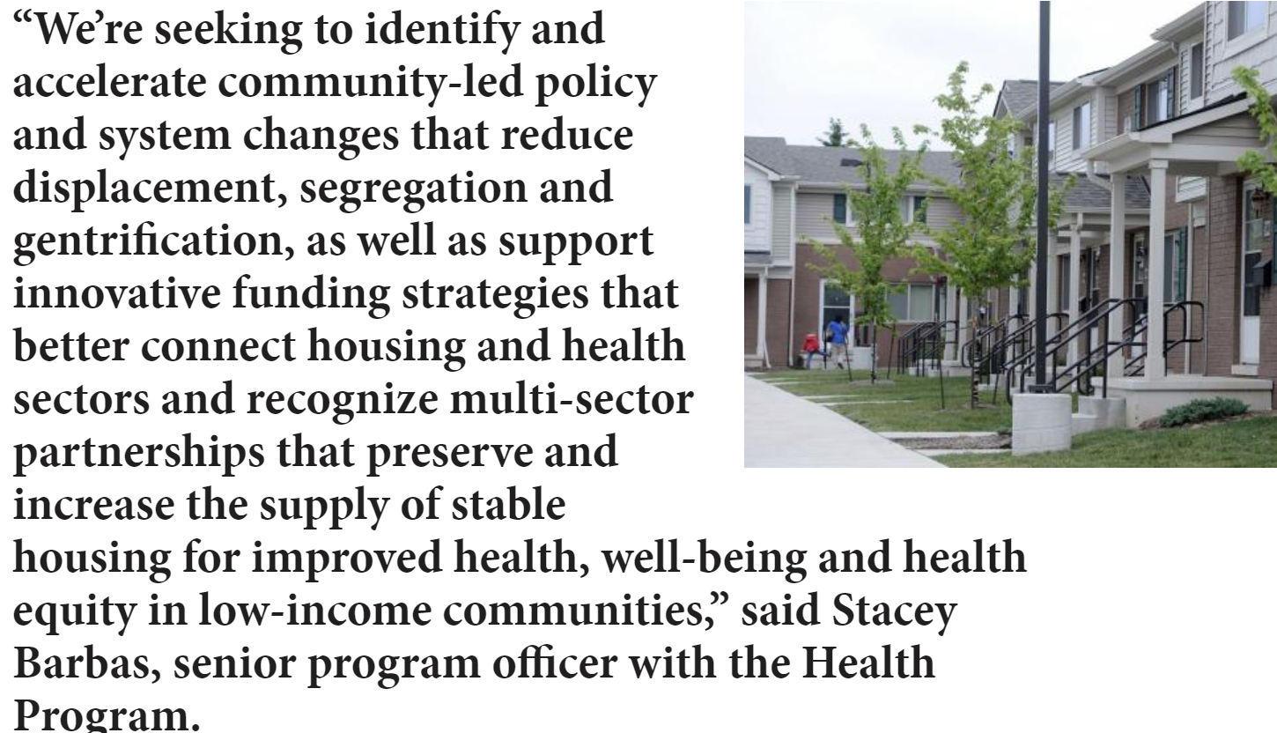
National Trend: Health + Housing Come Together to tackle Social Determinants of Health
Source: Health Affairs, Kresge Foundation, JAMA, Modern Healthcare
Notes:
In closing, the national trends are pointing to the recognition that permanent, affordable housing is a critical and obvious piece to being able to achieve delivery reforms. Hospital readmission rates are a telltale indicator of this issue.

Slide 35
Contact Us
Lisa Chan-Sawin, CEO
Transform Health
lisa@transformhc.com
Heather Bates, COO
Transform Health
heather@transformhc.com
Liz Hagan, Federal Policy Consultant
Transform Health
liz@transformhc.com
@TransformHC
www.transformhc.com

