Slide 1
Fight Power with Power:
Organizing Campaign Strategy Tips
I Vote 4 Health Care
Universal Health Care Foundation of Connecticut’s Grant Program & Campaign
January 24, 2019
Rosana Ferraro
Policy & Program Officer
Universal Health Care Foundation of Connecticut
universalhealthct.org

Slide 2
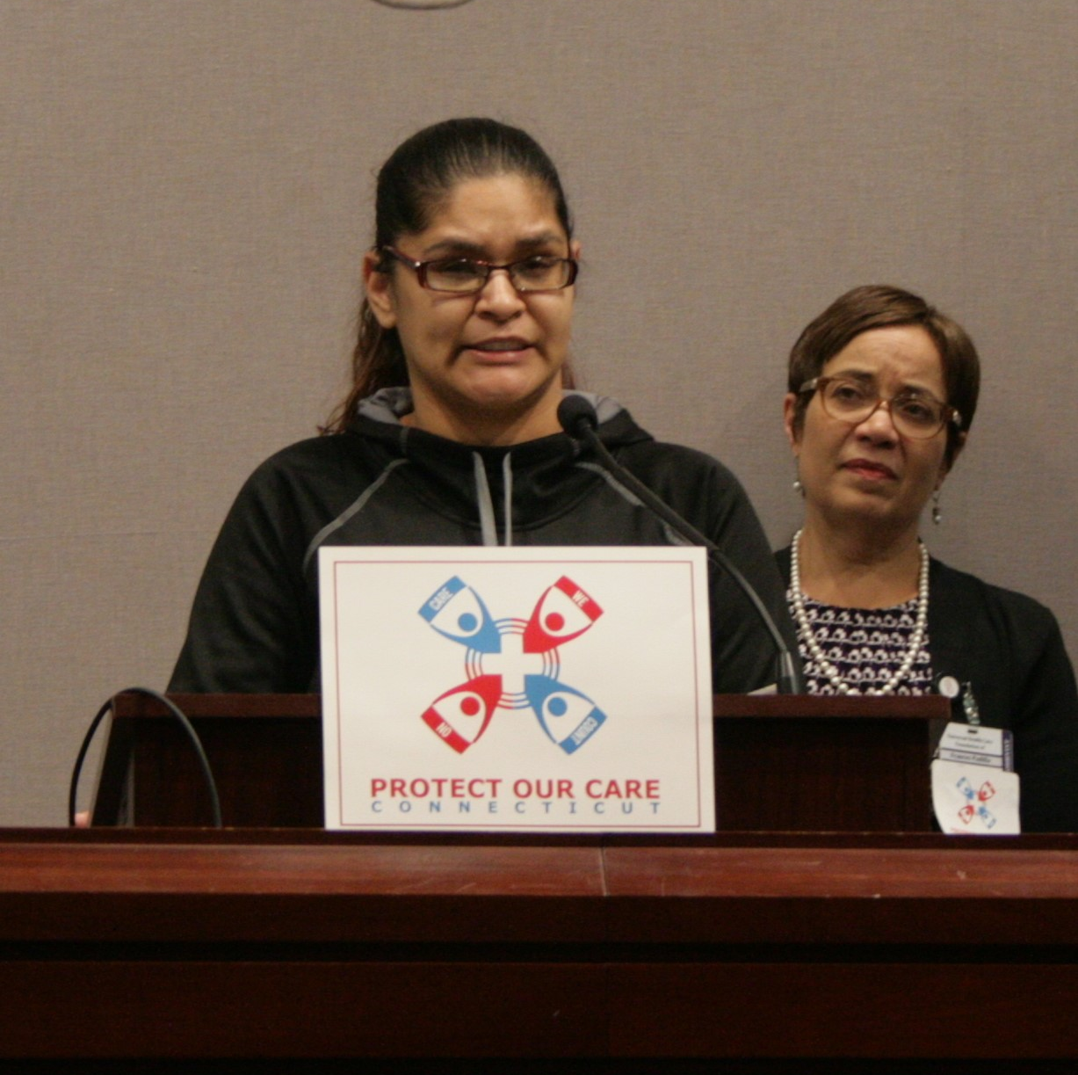
Universal Health Care Foundation of Connecticut
501(c)3 non profit “activist philanthropy”
Conversion foundation
Program
Advocacy (inside and outside)
Public policy monitoring, research, and development
Public education
Communications
Grantmaking
Development
Mission: To serve as a catalyst that engages residents and communities in shaping a democratic health system that provides universal access to quality, affordable health care and promotes health in Connecticut.
We believe that health care is a fundamental right and that our work is part of a broader movement for social and economic justice.

Slide 3
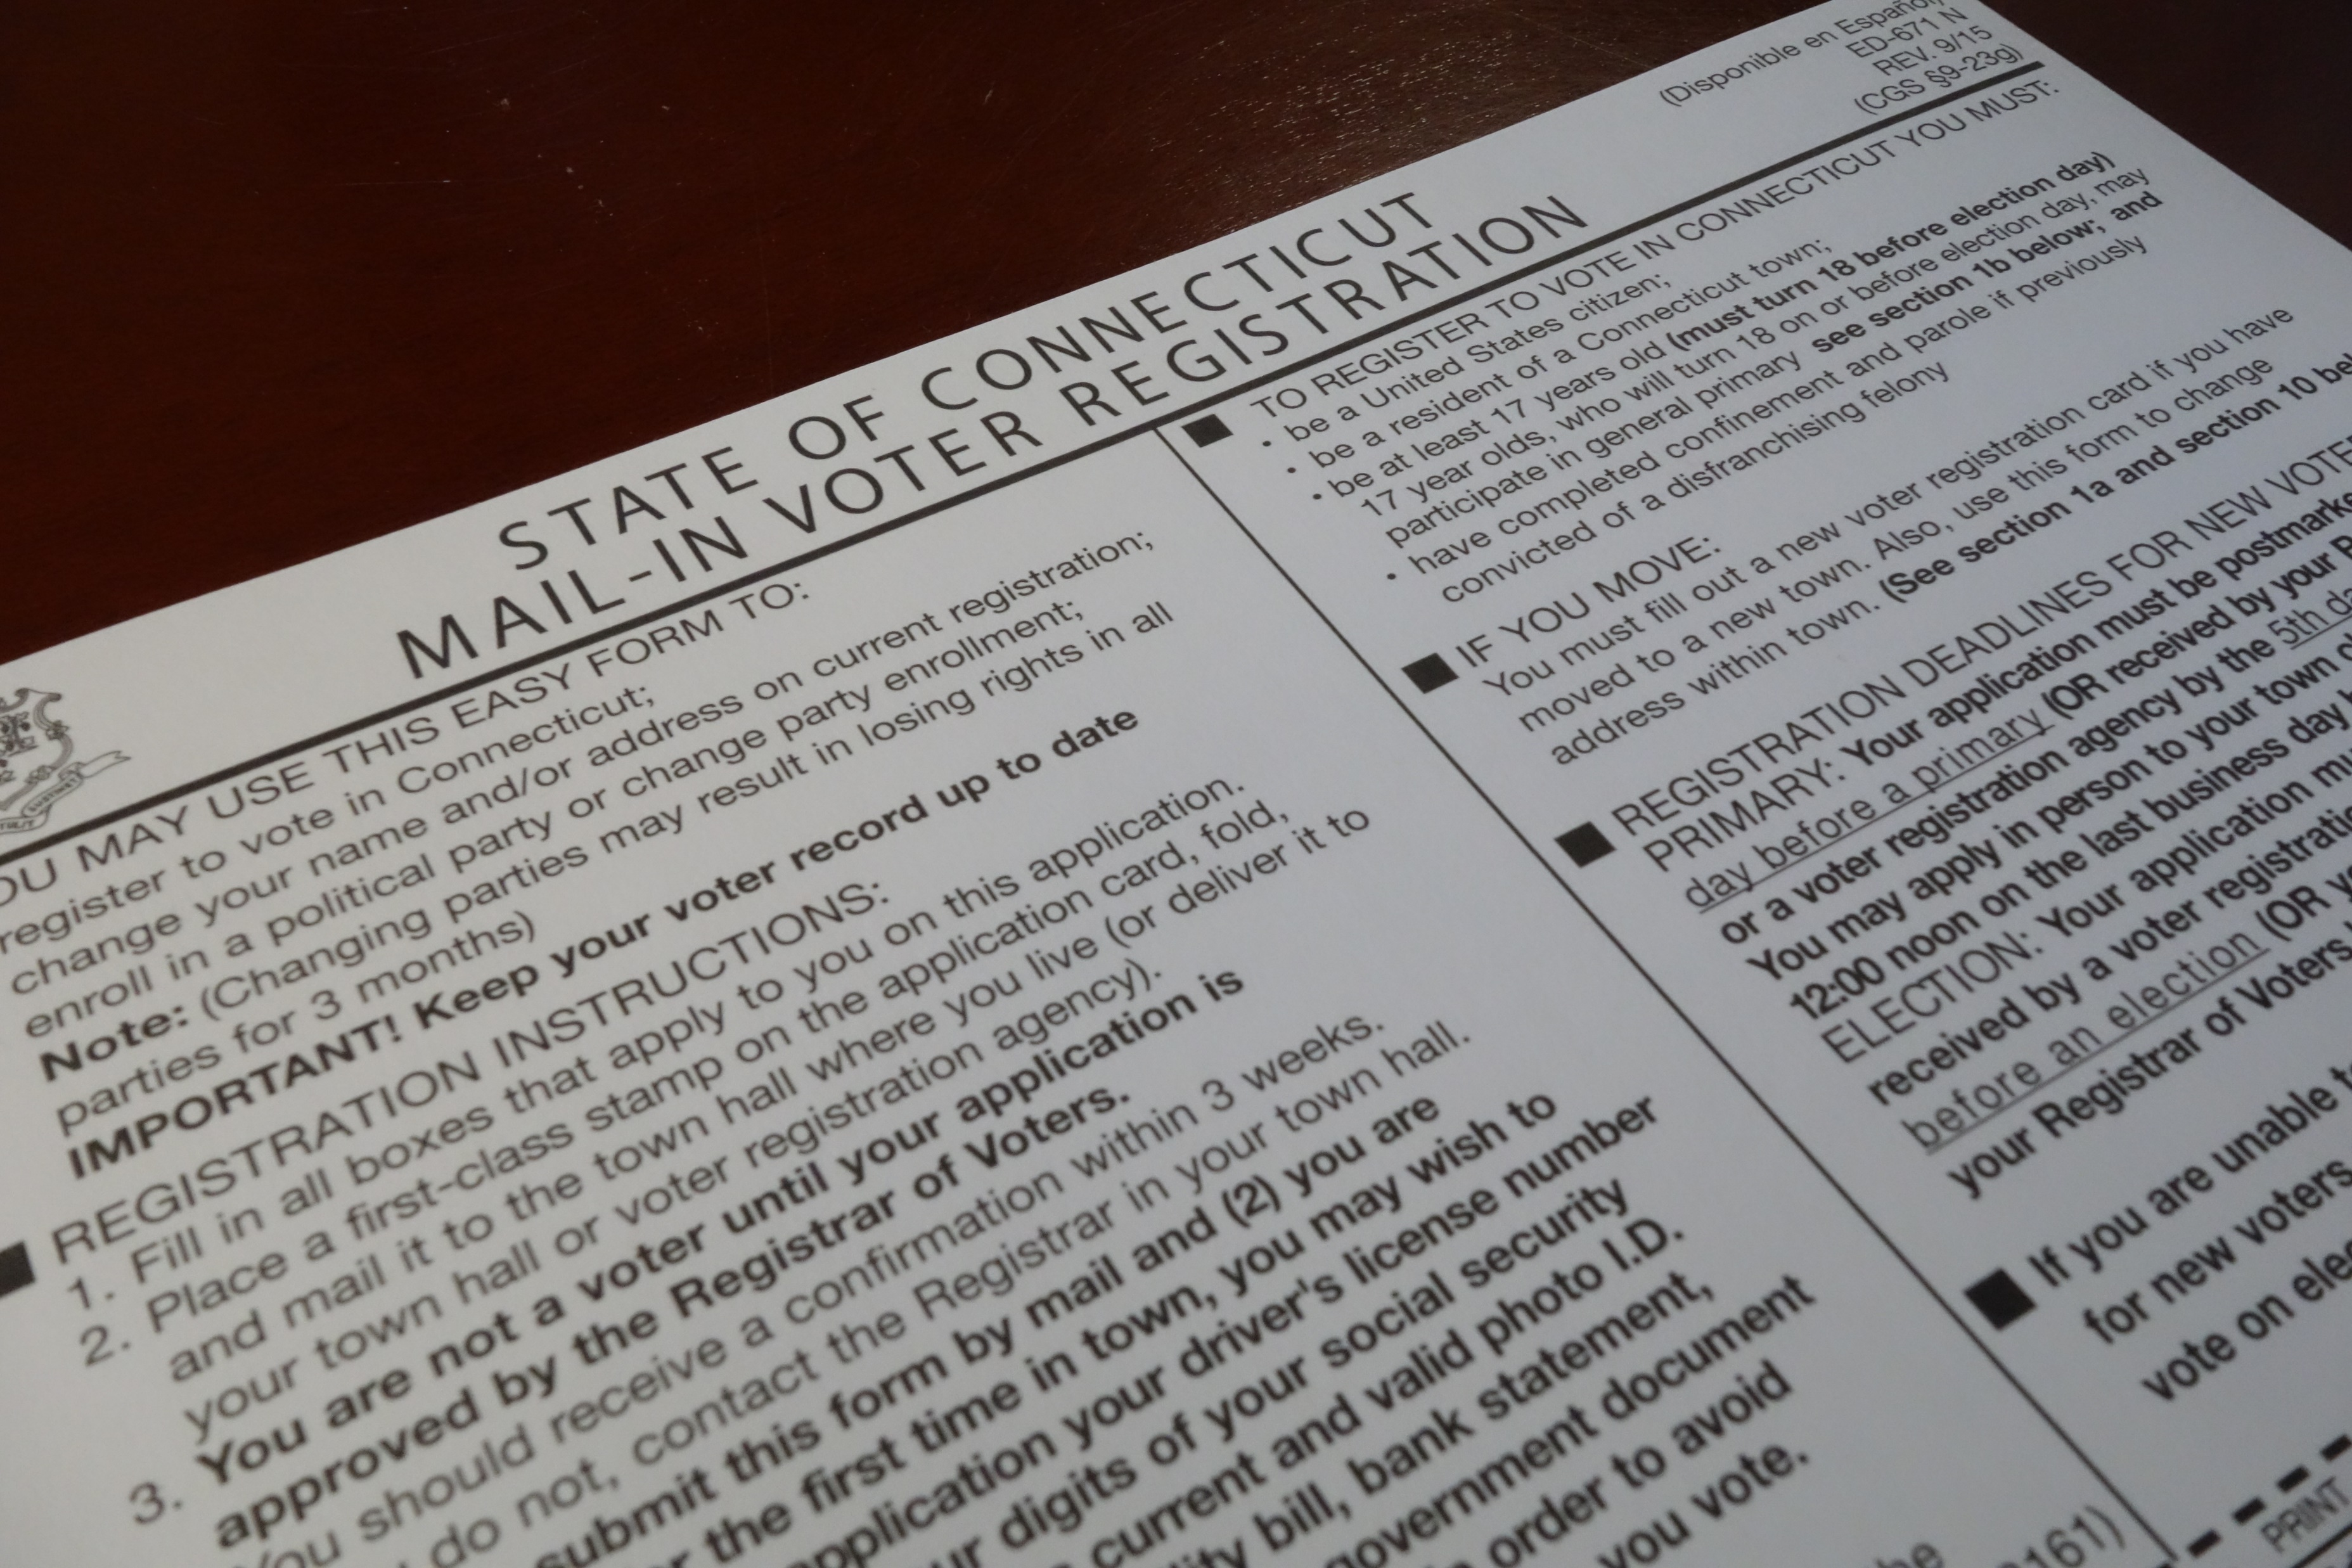
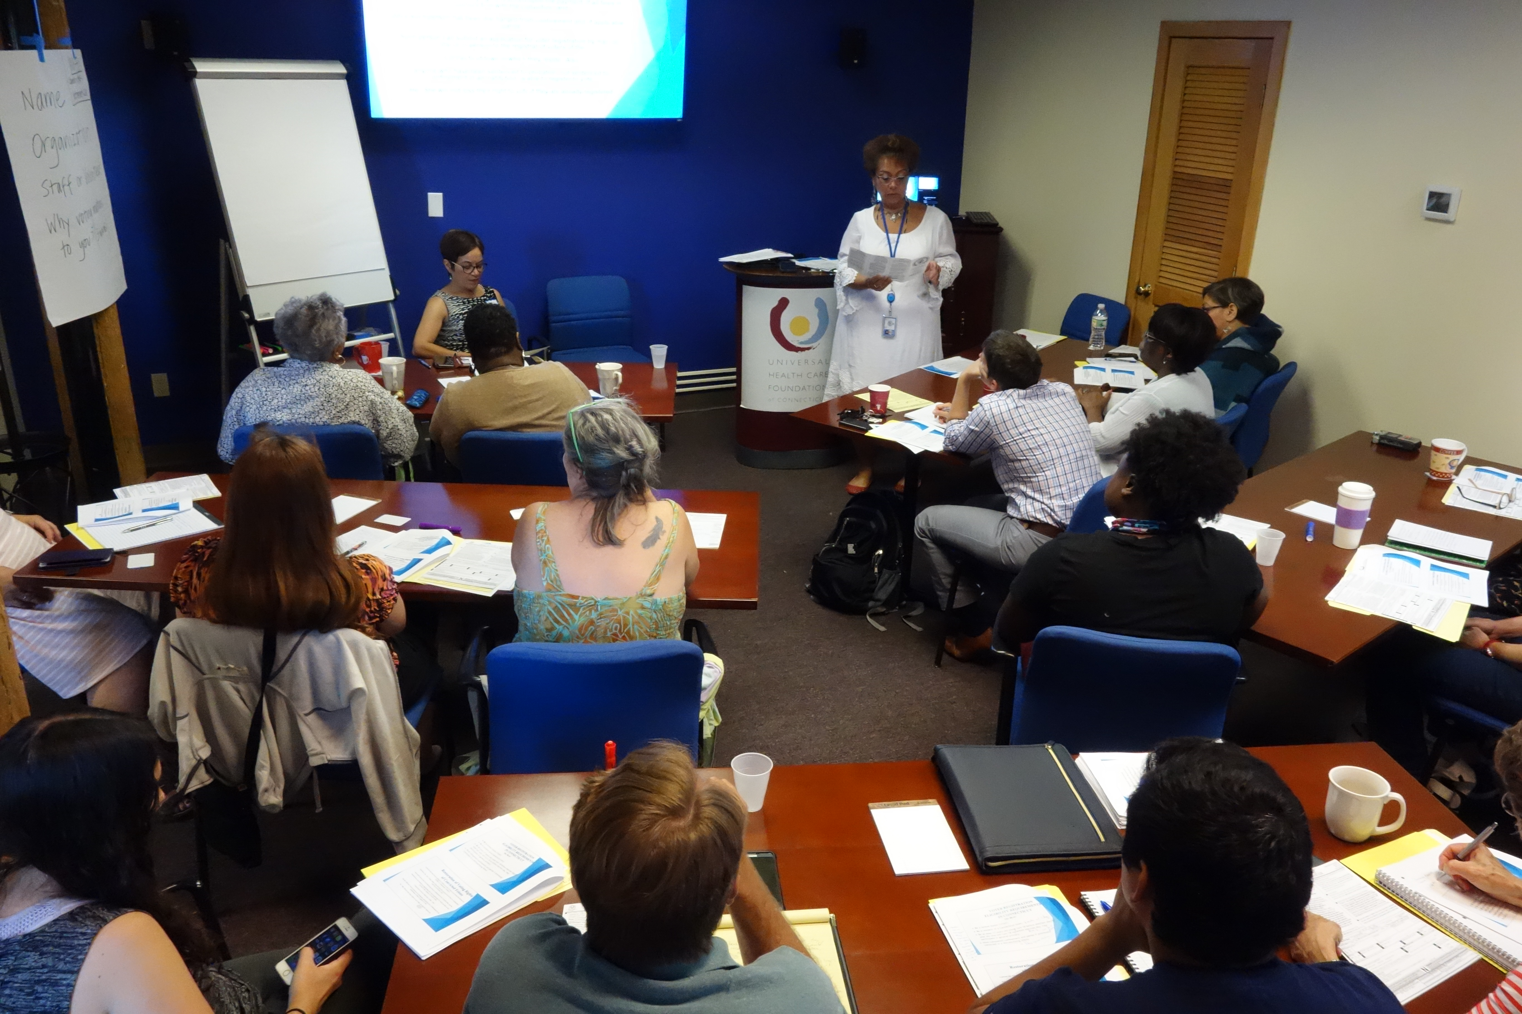
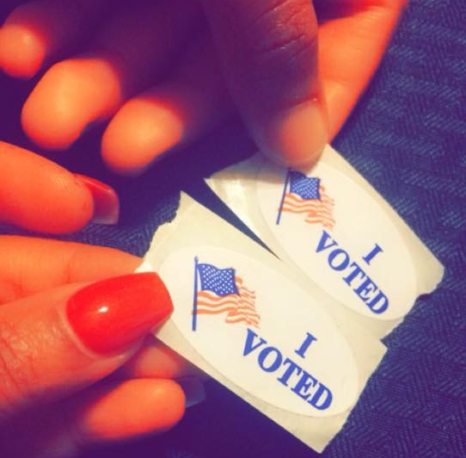
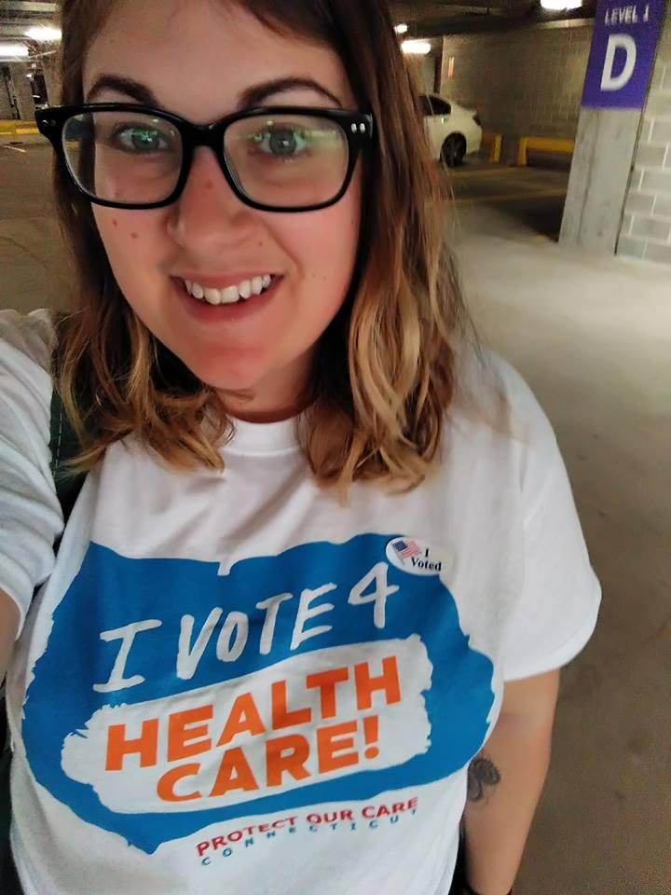
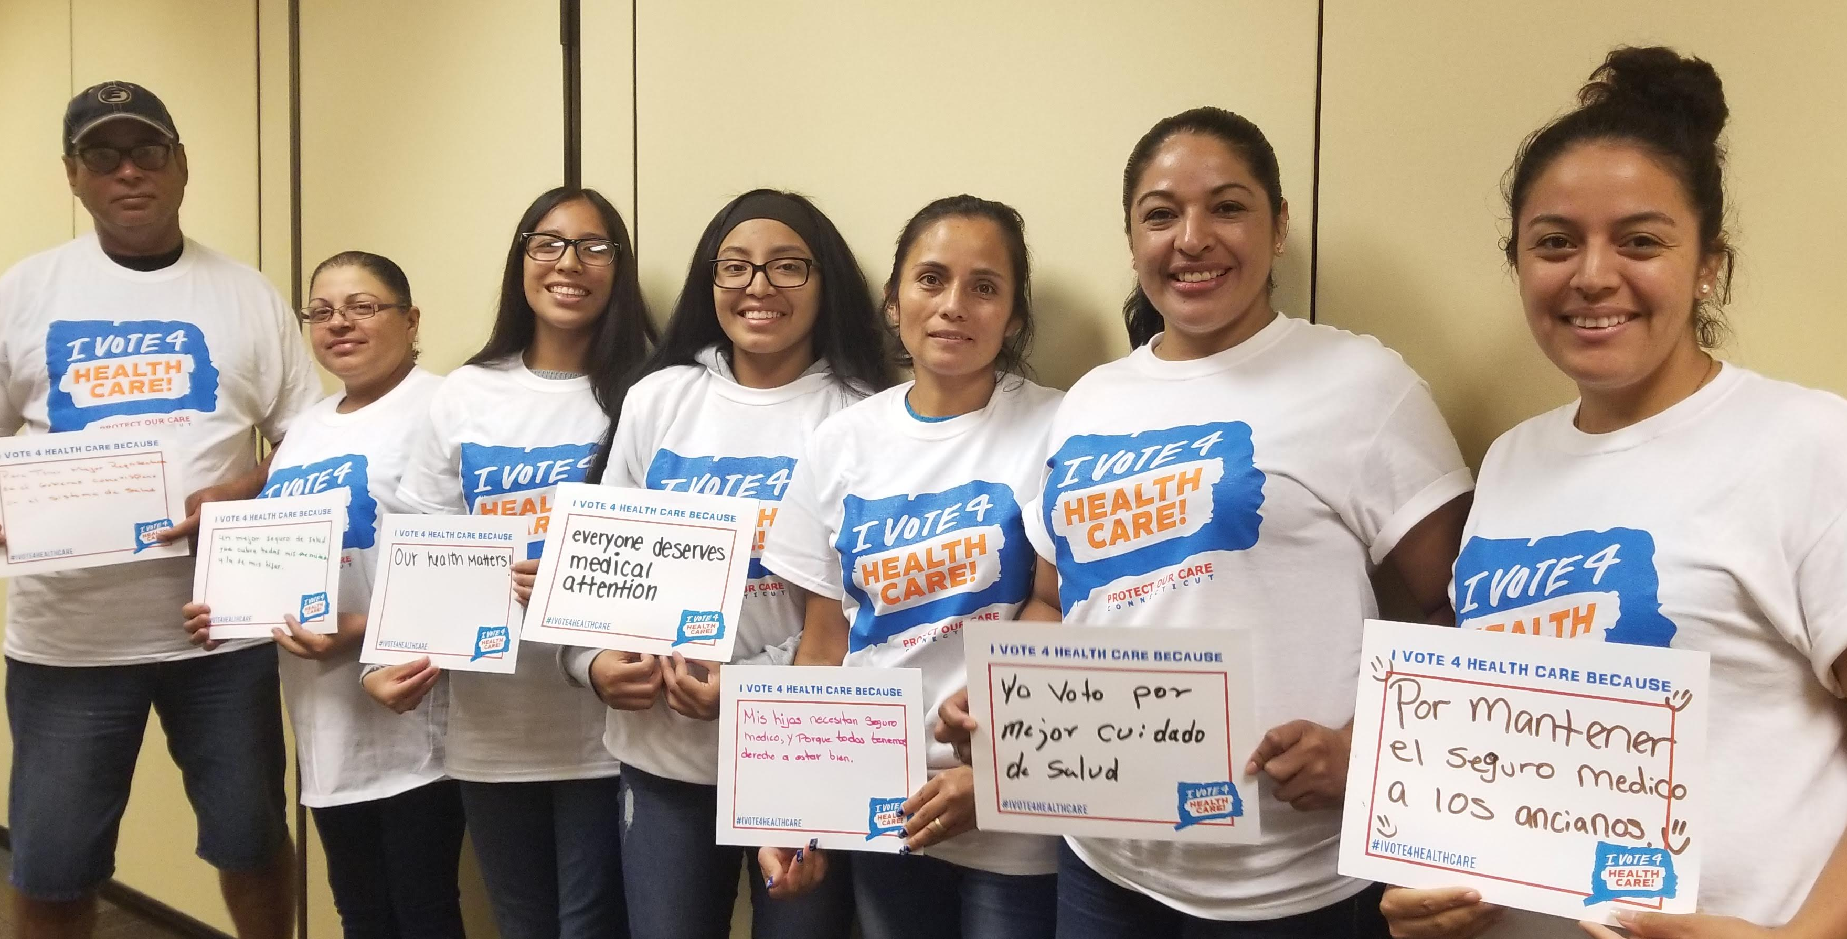
12 grantees
12 unique communities (some shared between grantees)
Focus on communities traditionally left out of the health care conversation
Voter registration & I Vote 4 Health Care pledge cards

Slide 4
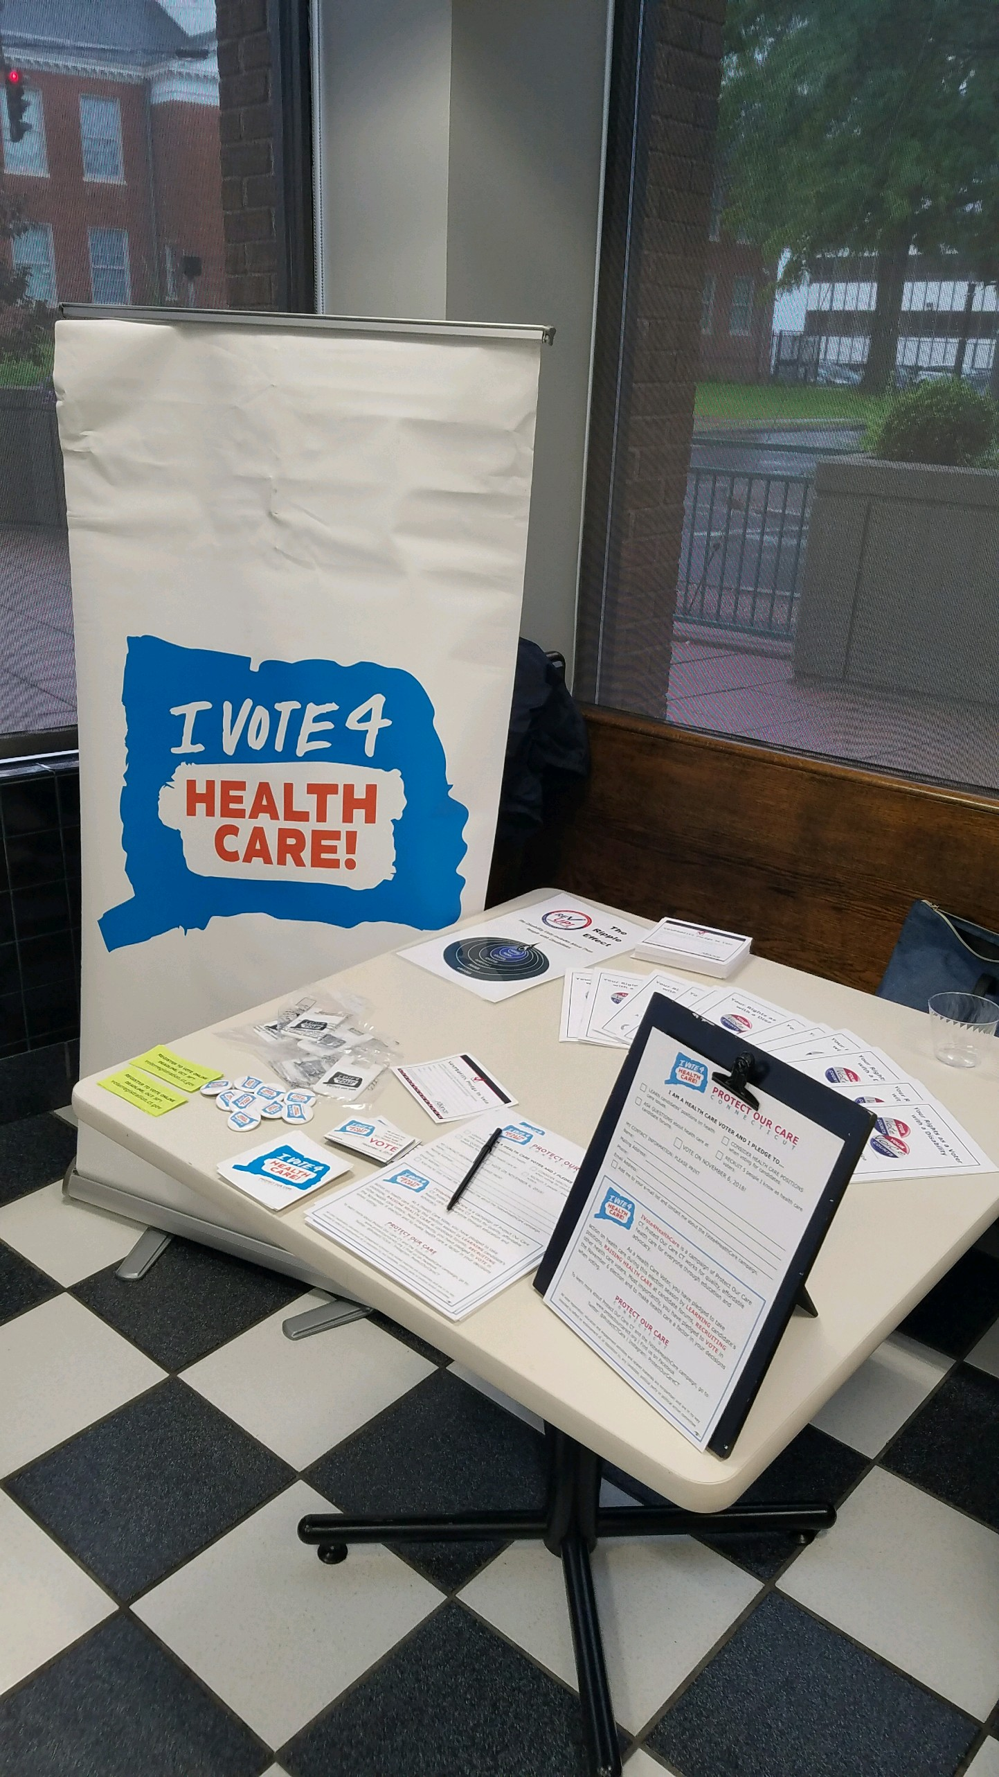
501(c)3’s & Non-partisan Voter Work:
NOT oil and water
Funding voter engagement
Partnerships & Relationships
The health care message
Campaign: Only the beginning

