Slide 1
Fight Power with Power: Organizing Campaign Strategy Tips
January 24, 2019
Notes:
NOTE: Make sure that the Title slide does not have footer information (sources, FUSA logomark and page number). To turn off on this page, go to Insert > Headers&Footers and deselect Footer and Page number options > Apply to this page only. Also, select start page numbers at 0.

Slide 2
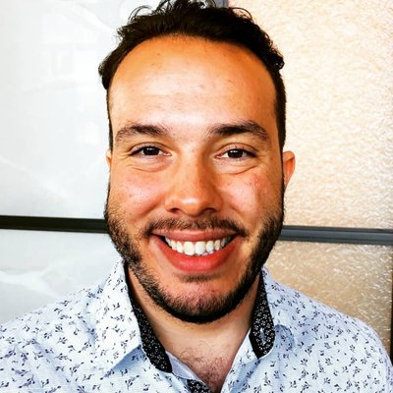
Fight Power with Power
Justin Mendoza, MPH
State Partnerships Manager,
Families USA
@justindmendoza

Slide 3
“Strategy is how actors translate their resources into power to get more bang for the buck” – Marshal Ganz
Fight Power with Power
Today’s Agenda
Quick Introduction
Health care narratives in Florida
Engaging voters in Connecticut
Base-building in New York
Discussion

Slide 4
Fight Power with Power
Types of Power
Derived from a formal position – the boss.
- Examples include governors, Secretary of state, Vice President, etc.
Authority Power
Influential Power
Market Power
Money Power
People Power
The ability to persuade or influence people w/ other forms of power.
- Examples include friends of leaders, family members, etc.
Power to create economic value through sales of goods/services.
- Examples: hospital groups, employers, insurers, drug manufacturers.
Individual purchasing power.
- Examples include organized consumers through boycotts.
The value of human lives and the opinions of individuals:
- Examples of those with these powers include unions, patient groups, mobilization groups.

Slide 5
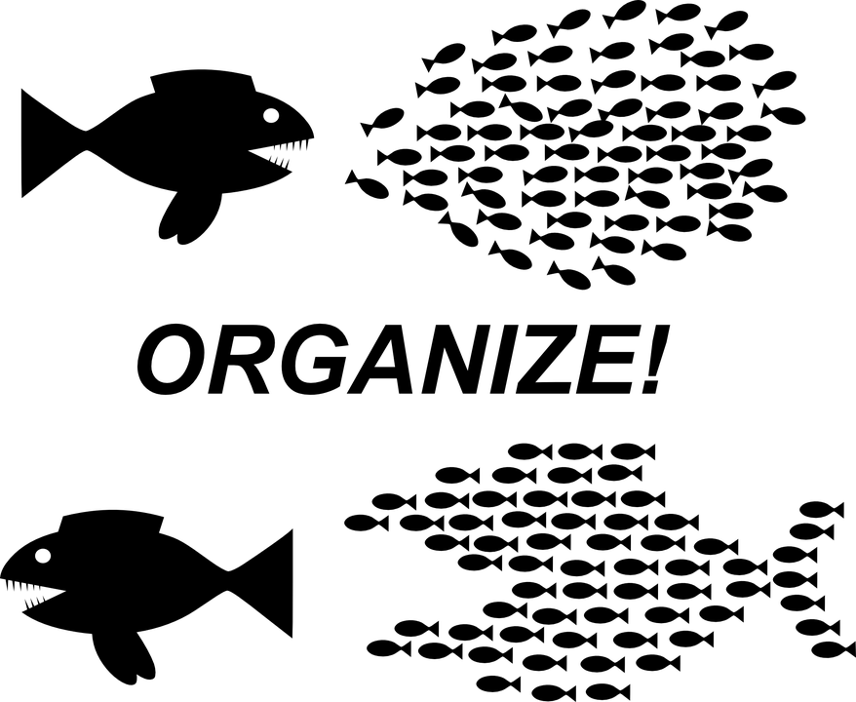
Fight Power with Power

Slide 6
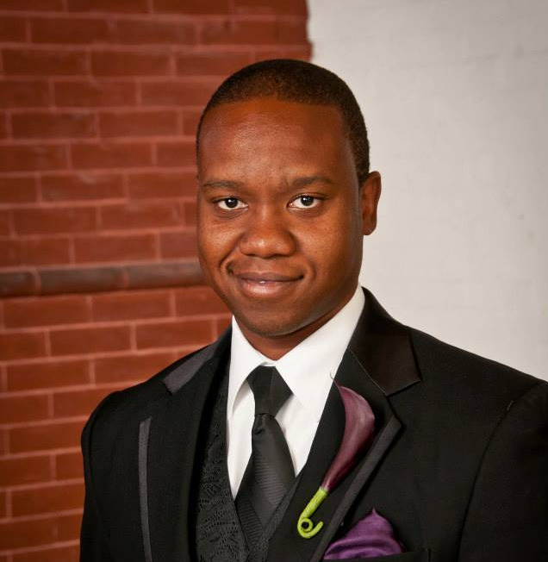
Fight Power with Power
Scott Darius, J.D.
Executive Director,
Florida Voices for Health

Slide 7
Fight Power with Power
Avanthi Jayaweera
Education & Advocacy Fellow, American Medical Student Association (AMSA)

Slide 8
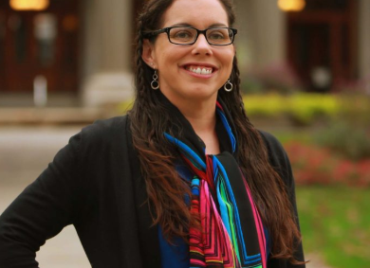
Fight Power with Power
Rosana Ferraro, MSW
Policy & Program Officer, Universal Health Care Foundation of Connecticut

