Slide 1
Medicare: Risks and Opportunities for 2019
Jennifer Goldberg
Deputy Director
January 25, 2019

Slide 4
The Medicare Population

Slide 5
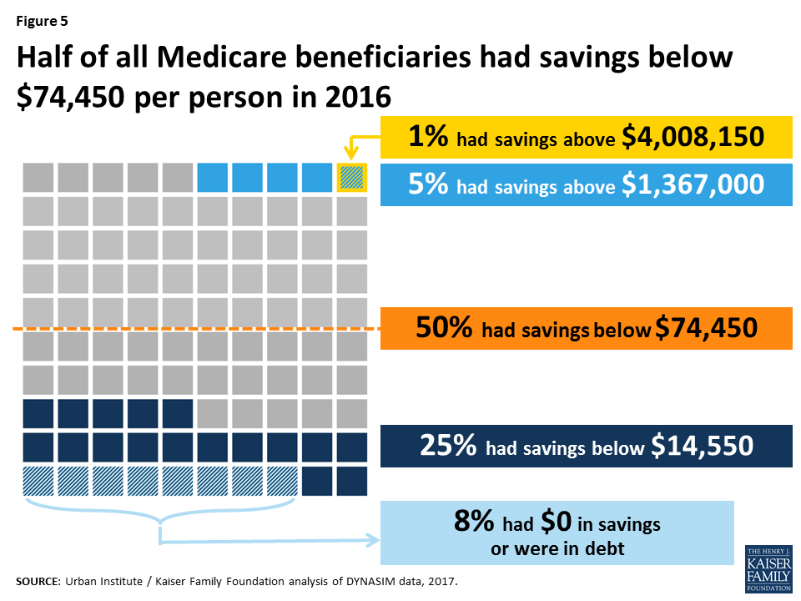
Most Medicare Beneficiaries have very limited income & assets

Slide 6
Even with Medicare, beneficiaries spend almost half of Social Security income on out-of-pocket health care costs

Slide 7
Oral Health

Slide 8
Oral Health and Medicare
Routine dental care is excluded
Medicare Advantage
Some MA plans cover limited dental benefits as supplemental benefits
Traditional Medicare
Coverage for any dental care is extremely narrow

Slide 9
An Oral Health Benefit in Medicare Part B

Slide 10
Medically Necessary Dental Care
CMS has authority to cover medically necessary oral health care
E.g., oral infection before surgery, dental treatment of damage from chemotherapy
Watch for upcoming advocacy opportunities

Slide 11
Hot Topics for Duals

Slide 12
Who is a dual eligible?
A person who has both Medicare & Medicaid
Two types:
“Full Duals” are individuals who receive full Medicaid benefits (e.g., “QMB plus”)
“Partial Duals” only receive assistance with Medicare premiums and/or cost sharing through Medicare Savings Programs (e.g., “SLMB only”)

Slide 13
D-SNPs on the rise
Dual Eligible Special Needs Plans
Chronic Care Act gives permanent authorization for D-SNPs
Expect significant growth
CMS reviewing comments now on proposed regulations re:
Minimum integration contracts with states
Integrating Medicare and Medicaid appeals for D-SNP members

Slide 14
Issue: D-SNP look-alikes
Designed to only appeal to duals
Not subject to D-SNP rules
Significant enrollment

Slide 15
Supplemental benefits: New developments
As of 2019- CMS increased flexibility for MA plans by expanding definition of “primarily health-related”
Chronic Care Act also gives MA plans new flexibility with supplemental benefits
Allows benefits that are NOT primarily health related as long as the benefit has a reasonable expectation of improving or maintaining the health or overall function of the chronically ill individual
Starts in 2020

Slide 16
Issue: MA supplemental benefits and Medicaid
Vision, oral health, hearing, etc.
Need to use MA benefits first
Provider networks do not align
Navigation nightmare
QMB protection issues

Slide 17
Example: Mrs. Smith
She belongs to Super Healthy Medicare Advantage Plan
Super Healthy gives free cleanings and oral exam.
Mrs. Smith uses a Super Healthy dentist for cleanings
Super Healthy covers crowns with 30% co-pay and with dental benefit cap of $2000
Super Healthy dentists don’t take Medicaid
Medicaid covers crowns, must use dentist contracted with Medicaid MCO

Slide 18
Issue: Change to SEP
Previously: Duals can change Part D or MA plans in any month effective the first of the next month
Applies to Part D plans for those with LIS only.
January 1, 2019 forward:
One change per quarter
In quarters 1-3, effective the following month
In 4th quarter, participate in Annual Enrollment Period, effective Jan 1
Other SEPs continue to be available
Need your feedback on impact of changes

Slide 19
Low-income Medicare programs

Slide 20
Medicare Savings Programs – A Summary
Medicare Savings Program | Income Limit | Financial Assistance
Qualified Medicare Beneficiary | 100% FPL | Medicare Part A and B premiums, deductibles, and co-payments
Specified Low-Income Medicare Beneficiary | 120% FPL | Medicare Part B premiums
Qualified Individual | 135% FPL | Medicare Part B premiums
Qualified Working Disabled Individual | 200% FPL | Medicare Part A premiums

Slide 21
MSP Eligibility—Resources
Resource limits for QMB, SLMB, QI are the same
In 2018, beneficiary cannot have more than $7,560/single or $11,340/couple.

Slide 22
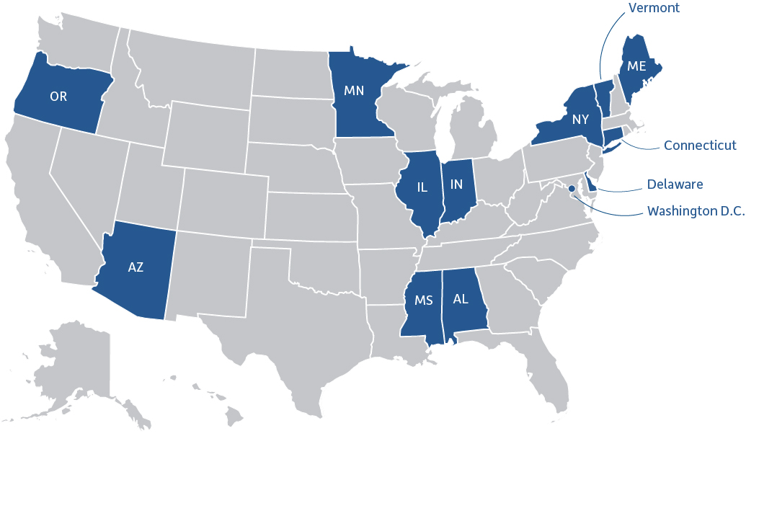
States Can Change MSP Eligibility Rules!
13 states have raised income or assets levels
*Connecticut reverted back to the federal limits in 2018.

Slide 23
Part D Low Income Subsidy

Slide 24
Improving affordability
Expanding eligibility for MSPs
Income levels
Asset levels
Expanding eligibility for Part D LIS (Extra Help)
Out of pocket cap on costs
Easing transitions from ACA to Medicare

Slide 25
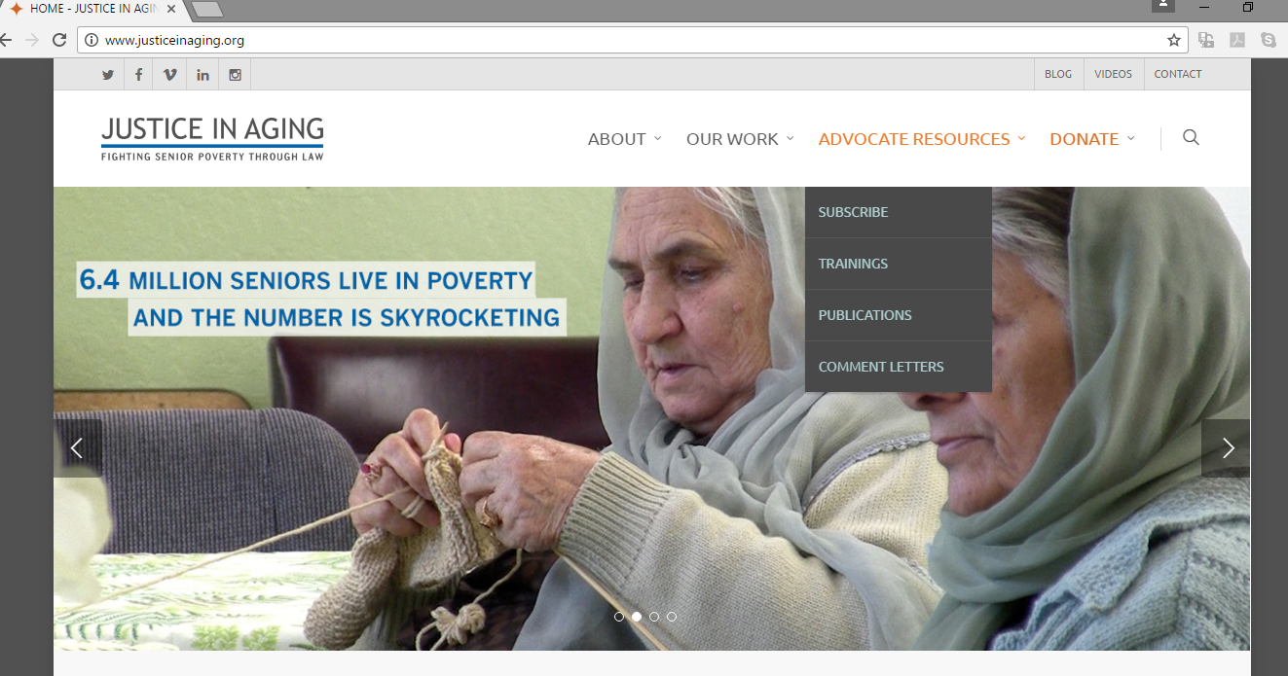
www.justiceinaging.org
To sign up for alerts, text 4JUSTICE to 51555

Slide 26
More Resources

Slide 27
Questions?
Jennifer Goldberg
jgoldberg@justiceinaging.org
@justiceinaging
@goldberg_ja

