Slide 1
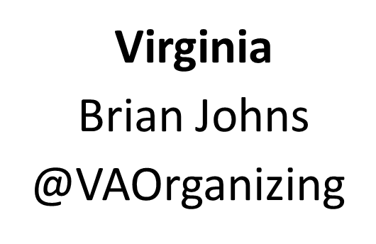
Medicaid Expansion:
Getting it and protecting it against attacks
Utah
Matt Slonaker
@UHPP
Minnesota
Susie Emmert
@ThisIsMedicaid

Slide 2
Notes:
Question #1

Slide 3
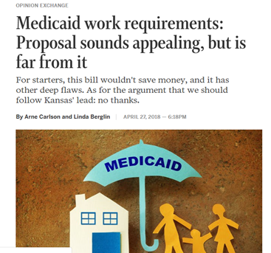
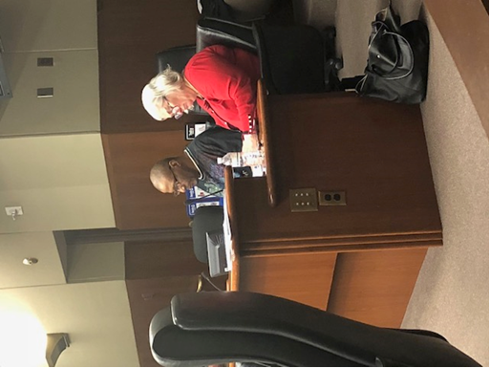
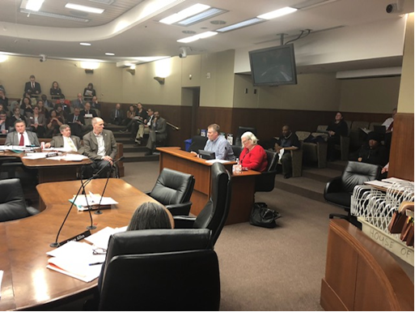

Notes:
Question #2

Slide 4
Notes:
Question #3

Slide 5
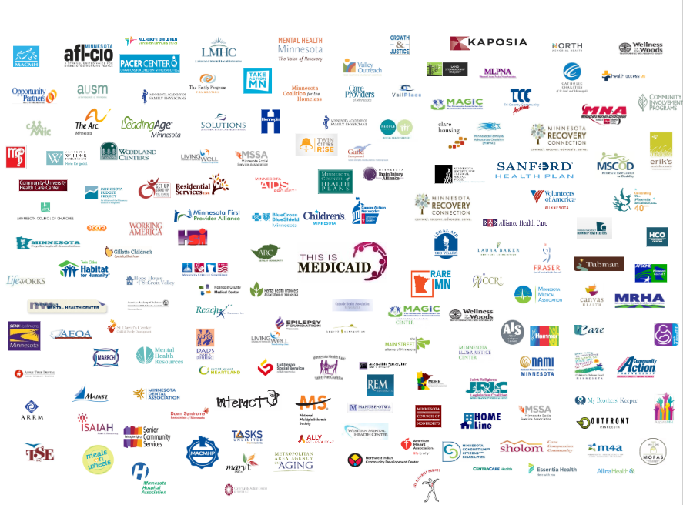
Notes:
Question #3

Slide 6

Notes:
Question #4
What would you say were the most important elements in your campaign? What were the tactics that worked best?

Slide 7
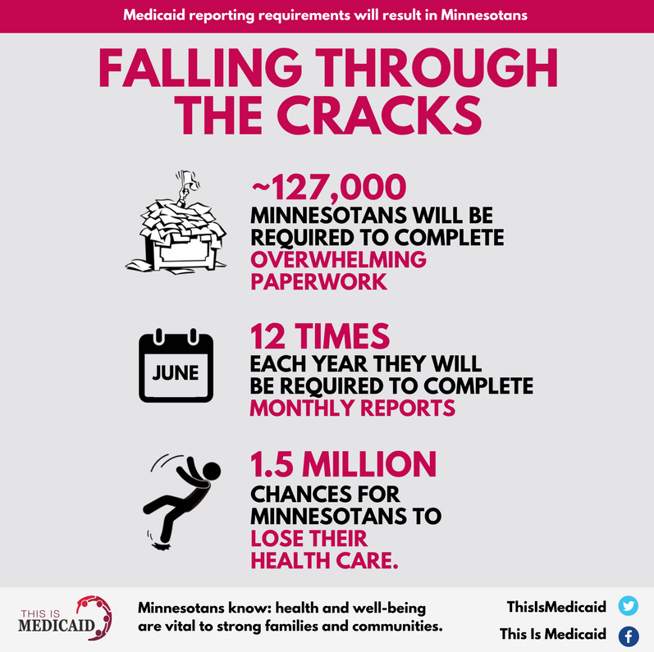
Notes:
Question #4
What would you say were the most important elements in your campaign? What were the tactics that worked best?

Slide 8
Notes:
Question #4
What would you say were the most important elements in your campaign? What were the tactics that worked best?

Slide 9
Notes:
Question #4
What would you say were the most important elements in your campaign? What were the tactics that worked best?

Slide 10
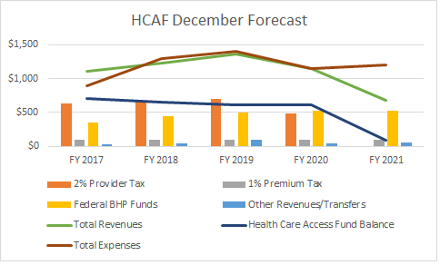
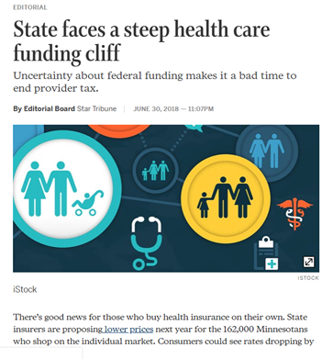
Health Care Access Fund
Notes:
Question #5
What are your biggest challenges this year?

Slide 11
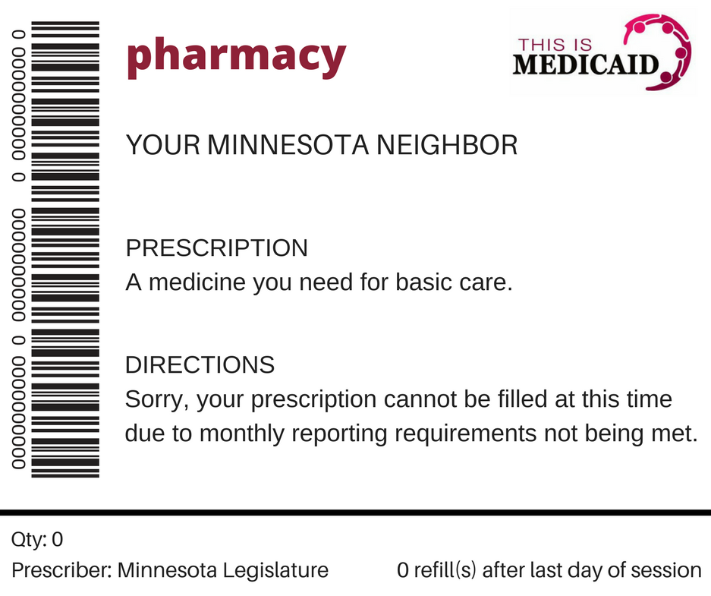

Notes:
Question #6

Slide 12
Notes:
Question #6

Slide 13
Medicaid Expansion:
Getting it and protecting it against attacks
Utah
Matt Slonaker
@UHPP
Minnesota
Susie Emmert
@ThisIsMedicaid

