Slide 1
LGBTQ Health Equity and Section 1557 of the ACA

Slide 2
LGBT Health Disparities
Tobacco and other substance use
Mental health concerns, such as depression and suicide attempts
Certain cancers, such as breast cancer
Experiences of bullying and violence
HIV/AIDS
Source: The Health of Lesbian, Gay, Bisexual and Transgender People (Institute of Medicine, 2011), Healthy People 2020

Slide 3
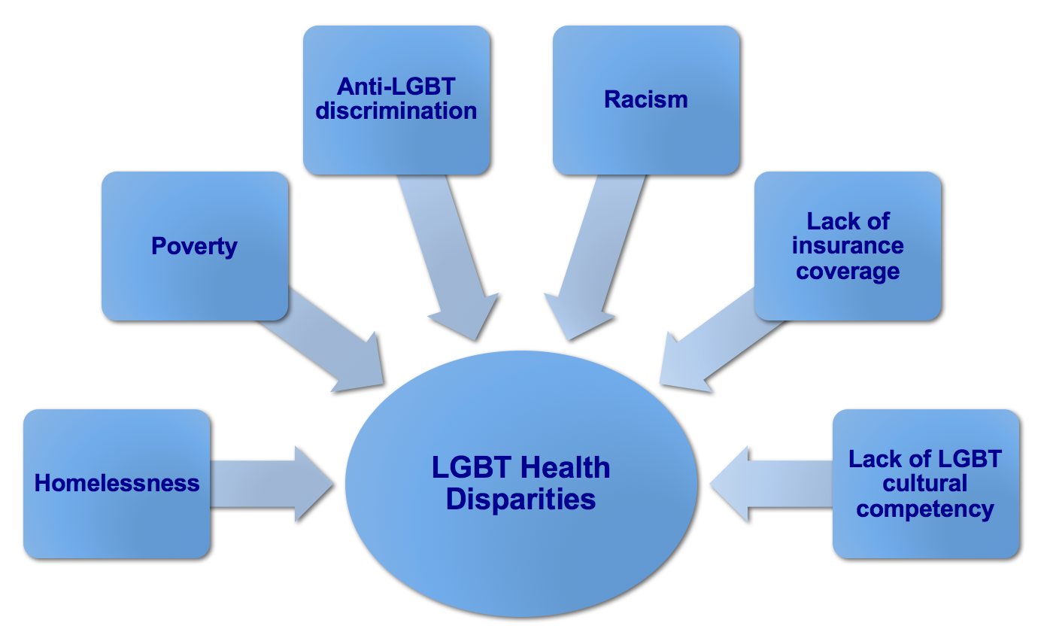
Source: The Health of Lesbian, Gay, Bisexual and Transgender People (Institute of Medicine, 2011), Healthy People 2020

Slide 4
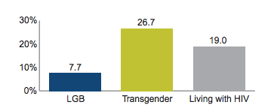
Health care professionals refused to touch me or used excessive precautions.
I was refused needed health care.
Health care professionals used harsh or abusive language.
Health care professionals were physically rough or abusive.
Source: Lambda Legal “When Health Care Isn’t Caring”

Slide 5
Key Health Findings: U.S. Trans Survey
U.S. Trans Survey (USTS) conducted by the National Center for Transgender Equality in summer 2015 → over 6,400 respondents
Physical & Mental Health
8X serious psychological distress than U.S. population (39% versus 5%)
9X attempted suicide in lifetime than U.S. population (40% versus 4.6%)
Health Insurance and Health Care → in the past year:
25% had trans-related health insurance problem
23% didn’t seek health care for fear of being mistreated
33% didn’t seek health care because they could not afford it
33% had at least one trans-related negative experience with a health care provider
HIV
1.4% of all respondents were living with HIV → 5X higher than the U.S. population (0.3%)
Among Black trans women, the rate was 19%
Among American Indian trans women, the rate was 4.6%
Among trans Latinas, the rate was 4.4%
Notes:
27,715 respondents
50 states, DC, American Samoa, Guam, Puerto Rico,
and U.S. military bases overseas
Adults 18+
English and Spanish, online
1/3 non-binary

Slide 6
Source: Center for American Progress

Slide 7
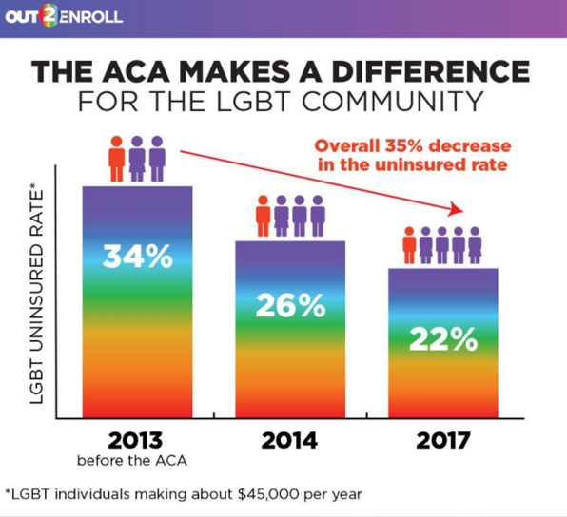

Slide 8
Section 1557 of the ACA
42 U.S.C. § 18116 – Applies existing federal civil rights laws to health care
ACA Section 1557
Civil Rights Act
HIV/AIDS status
Age Discrimination Act
Title IX
Sex
Gender identity and sex stereotyping
Rehabilitation Act
Race, color, national origin
Disability
Age

Slide 9
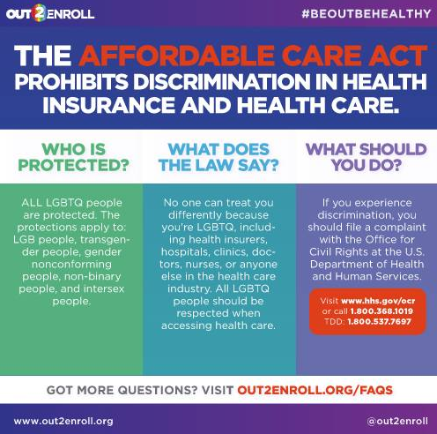
Section 1557: Who Is Protected?
Section 1557 prohibits discrimination based on gender identity and sex stereotyping, including:
LGB people
Transgender people
Gender nonconforming people
Non-binary people
Intersex people

Slide 10
Section 1557: What Does It Mean? (Insurance)
Marketplace plans and Medicaid coverage cannot:
Have transgender exclusions that deny all services related to transition
Deny coverage solely because an enrollee is transgender
Limit access to “sex-specific” services (e.g., hysterectomy, prostate exam, etc.) based on sex assigned at birth, gender identity, or recorded gender
BUT there is no affirmative requirement to cover any particular procedure or treatment so DETAILS MATTER!

Slide 11
Transgender Coverage is Better Than Ever
2019 marketplace analysis: 622 silver plan options in 38 states
Good (Great!) News
Only 8 insurers in 5 states (6%) had trans exclusions
41% of plans had affirmative coverage language
Bad News
25% had broad cosmetic exclusions
10% had no info available
Consistent with similar analyses from 2017 and 2018

Slide 12
Section 1557: What Does It Mean? (Providers)
Health care facilities and providers cannot:
Refuse to treat or harass an LGBTQ person because of how they look, act, or have a relationship with
Persistently and intentionally refuse to use a trans person’s correct name and pronoun
Assign an LGBTQ person to a room or other facility based on sex assigned at birth or recorded gender

Slide 13
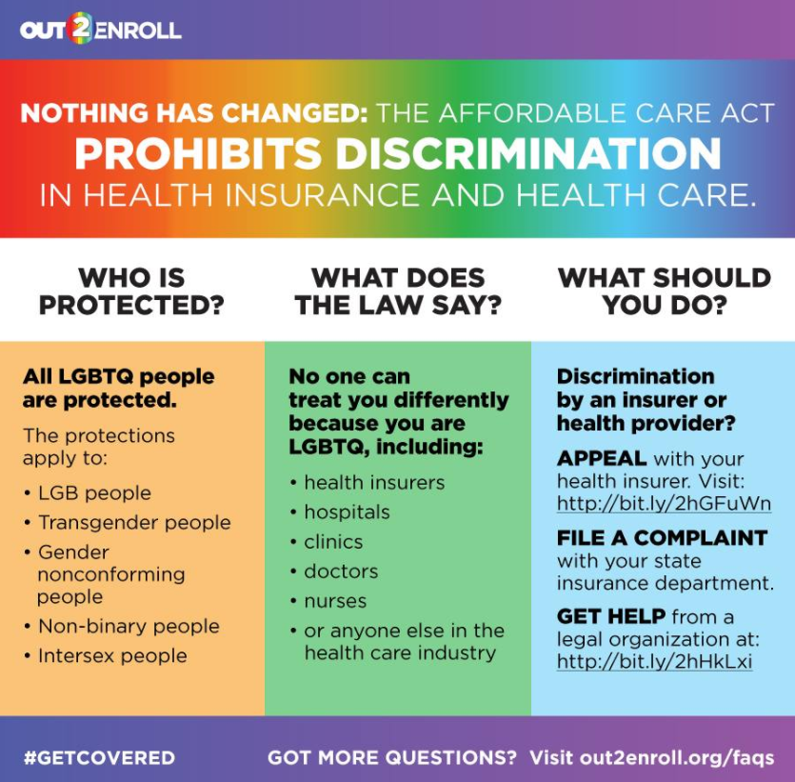
Updates on Section 1557
Aug. 2016: Legal challenge in Texas re: termination of pregnancy and gender identity protections
Dec. 2016: Preliminary injunction issued on Dec. 31, 2016 in Franciscan Alliance v. Burwell2
Q1 2017: HHS changes enforcement status on termination of pregnancy and gender identity protections
Aug. 2017: HHS/DOJ status report indicating HHS intent to reconsider the Section 1557 rule
Apr. 2018: Proposed rule is awaiting clearance at the White House – date of release is TBD

Slide 14
Updates on Section 1557
Sept. 2017: Court in CA concludes that 1557 protects transgender people
Summer/Fall 2018: Court in WI rules against trans exclusions in WI state employee health plan and Medicaid program
Sept. 2018: Court in MN concludes that 1557 protects transgender people
Dec. 2018: Parties jointly ask court in TX to lift the stay, rule on whether ACLU can intervene, and continue with the lawsuit

Slide 15
Section 1557: What Does It Mean?
Section 1557: ACA nondiscrimination provision that protects LGBTQ people in health insurance and health care
Bad News
Nationwide injunction on Dec. 31, 2016 (gender identity, abortion)
HHS intends to re-open rulemaking process and rescind guidance
HHS has proposed broad religious/moral exemptions for health care workers
Good News
Injunction only applies to HHS
Sec. 1557 has “private right of action” → insurers, providers, Medicaid agencies, etc. can still be sued
Many more courts find that Section 1557 protects transgender people – Prescott v. Rady Children’s Hospital (2017), etc.

