Slide 1


Improving the Evidence Base to Advance Health Equity
Efforts to improve the evidence base at San Ysidro Health: All of Us Research Program
Fatima Munoz
Director, Research and Health Promotion
PI of the All of Us Research Program - San Ysidro Health
Families USA Health Action 2019 Conference
January 24, 2019
#joinallofus

Slide 2
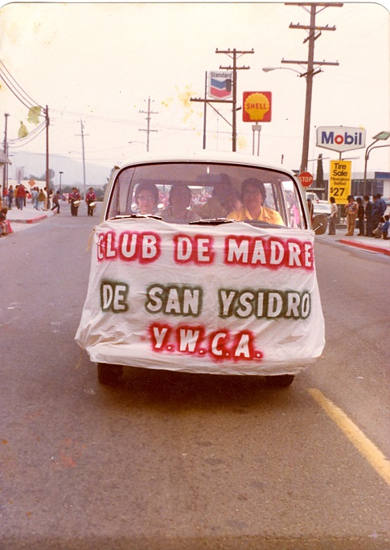
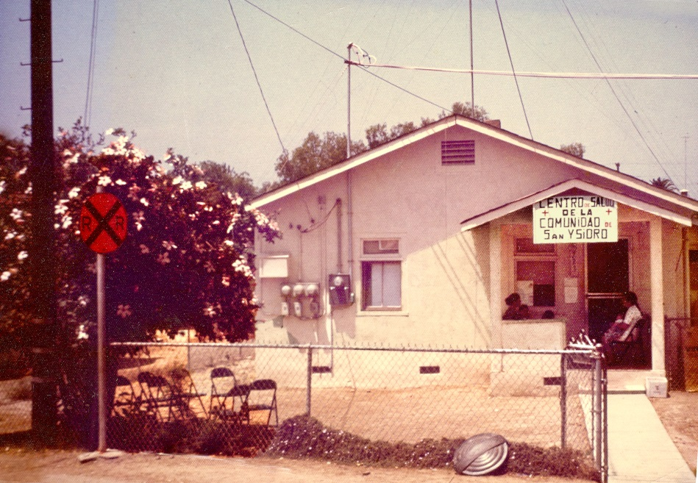
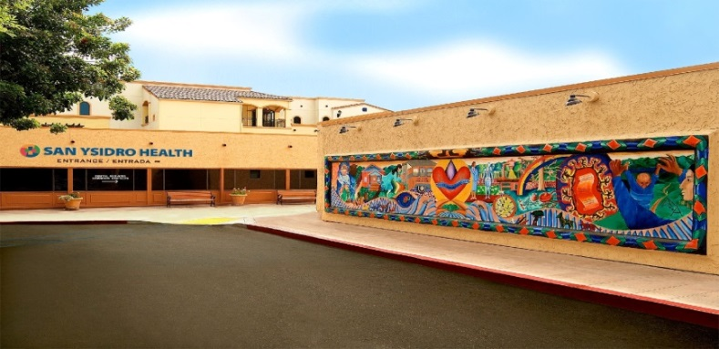
San Ysidro Health Overview
Founded in 1969 by a group of committed community members.
Federally Qualified Health. Center (FQHC) and non-profit.
Second largest community clinic network in San Diego Region.
Over 1,300 employees.
In 2017, over 95,000 patients are provided care annually.
Patient population:
  Predominately Latino with high rates of poverty
  - uninsured individuals and families
  - low education levels
  - non-English speaking heads of households
Notes:
The mission of San Ysidro Health is to improve the health and well-being of the communities we serve, with access for all.

Slide 3
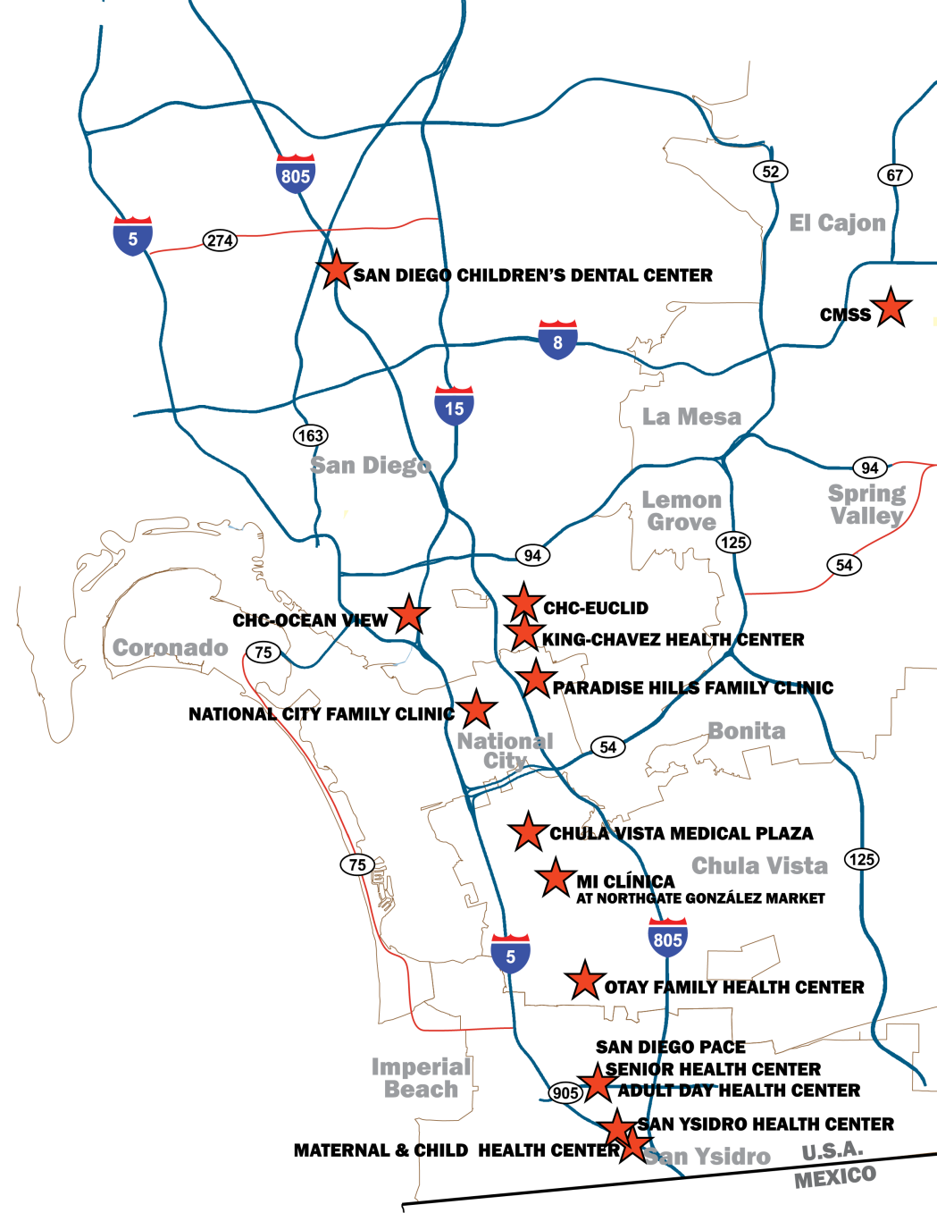
Service Delivery Sites
Excellent healthcare staff and state of the art facilities providing comprehensive care for all patients.
14 Medical Clinics
7 Dental Clinics
6 Behavioral Health Centers
3 Mobile Clinics
4 School-based Clinics
Research and Health Promotion Department
5 WIC Program Sites
2 HIV/AIDS Program Sites
2 Residency Programs
PACE: Program of All-Inclusive Care for the Elderly
Notes:
Integrated services:
Patient Care consists of clinical treatment for patient:
Medical
Behavioral Health
Dental
Specialty Care
Testing/Screening Services
Pharmacy
Patient Experience consists of clinical support for patients:
PACE (Program for All Inclusive Care for the Elderly)
Health Insurance Application Assistance
Case Management
Outreach & Education
Nutrition/WIC Services
HIV/AIDS
Teen Health
Family Support Programs
Transportation Services

Slide 4

Spectrum of Projects: to incorporate evidence-based practices into the current organizational patient care model and create an environment that values diversity and inclusion in research.
Service Oriented
Little or no evaluation
All pts eligible
e.g. PODER, Geriatric Workforce Enhancement Program, Health Education, Adolescent & Reproductive Health
Science/Research Oriented
Strict eligibility criteria and evaluation
Often randomized
Evidence-based
e.g LUNA (Diabetes), CRC screening, Avocado,
All of Us Research Program: SYHealth
Notes:
The existence of the DRHP at SYHC provides the scientific environment and the capacity to facilitate the All of Us Research Program. DRHP serves the SYHC patient population and surrounding community to research health conditions and risk factors, and corresponding culturally-appropriate health promotion and disease prevention interventions. DRHP currently houses 11 grant-funded projects and 3 initiatives – most focused on Spanish speaking populations; the department also manages SYHC’s Health Education Program.
San Ysidro health’s Research and Health Promotion department has been working in collaboration with San Diego State University and University of California San Diego in the development and implementation of grant funded research projects.
All the research projects at SYH are approved by the Institutional Review Board (IRB) Committee. They also should consider all SYH clinic sites, and demonstrate a benefit for patients, community, and San Ysidro Health programs.

Slide 5
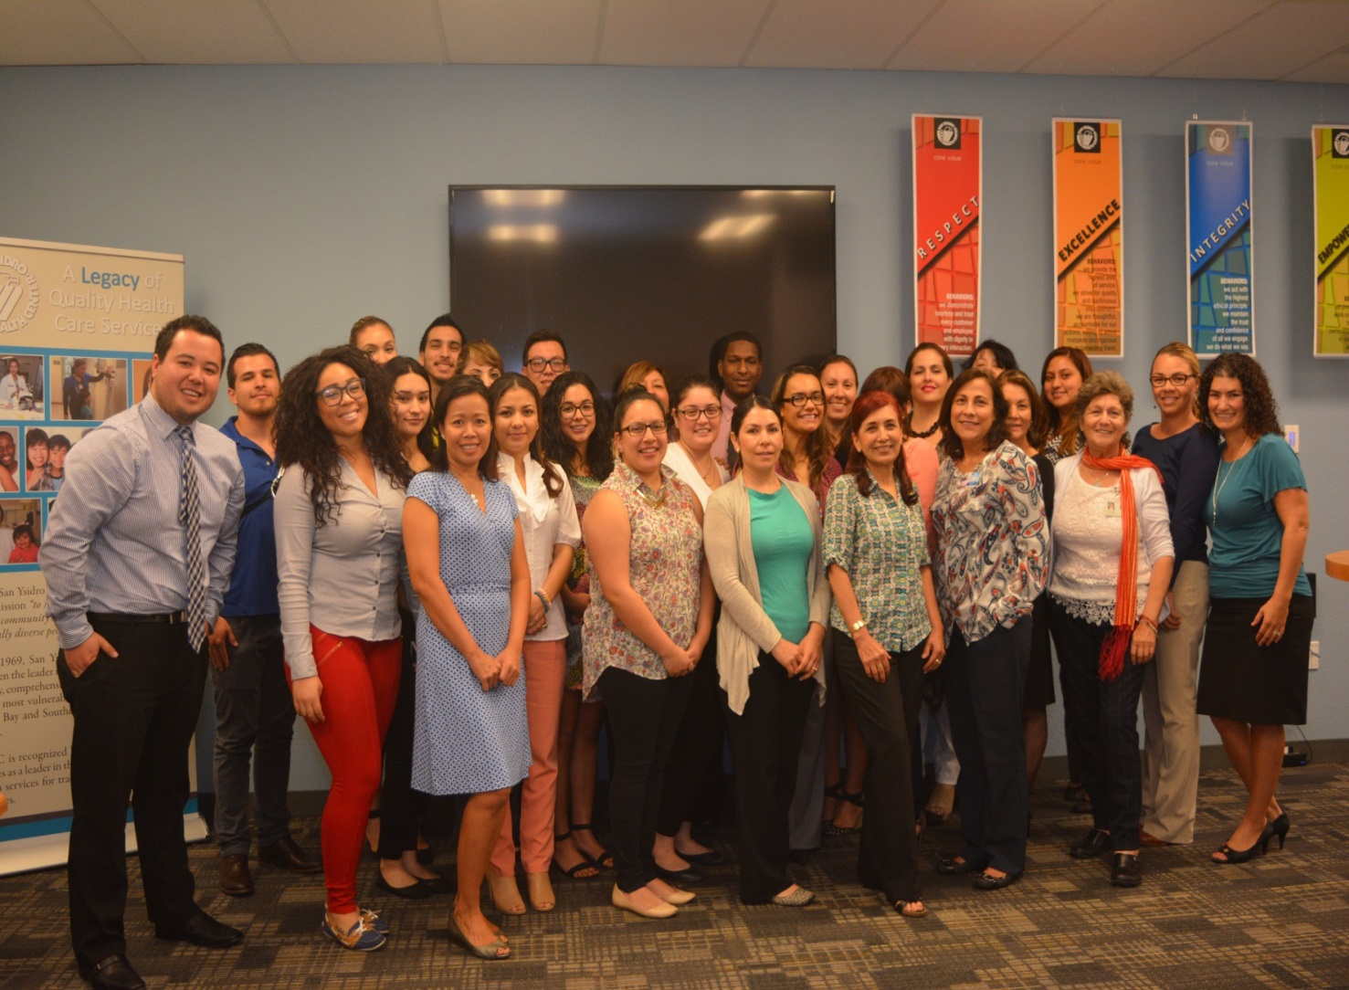
Infrastructure:
Research and Health Promotion Staff
Notes:
Diverse staff : All staff are representative of the community we are recruiting, they are bilingual and bicultural, and they also span generations.
The Department of Research and Health Promotion (DRHP) was created in 2003. Since that time most of its grant-funded health promotion and research projects have targeted the Hispanic/Latino community. DRHP has strengths in reaching and recruiting patients and engaging them in health promotion research employing culturally-and linguistically appropriate methods. The staff has extensive experience in community outreach and engagement, program implementation, data collection, and research methods. They are well trained to deliver culturally and linguistically appropriate services for Hispanic/Latino populations.

Slide 6

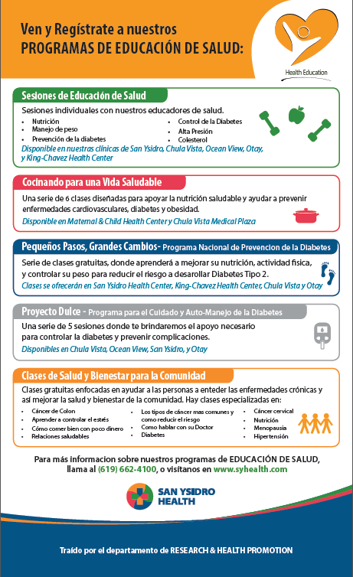
Health Promotion Programs using Evidence-Based curriculum
Service Oriented Programs and Projects
  One on One Clinic based Health Education/Nutrition
    Adults, Youths, Children
  National Diabetes Prevention Program (NDPP)
  https://www.cdc.gov/diabetes/prevention/lifestyle-program/curriculum.html
  Project Dulce
  https://pnap.scrippshealth.org/Whittier
  Outreach and Community Presentations
  Cooking Classes
Notes:
Diverse staff : All staff are representative of the community we are recruiting, they are bilingual and bicultural, and they also span generations.
The Department of Research and Health Promotion (DRHP) was created in 2003. Since that time most of its grant-funded health promotion and research projects have targeted the Hispanic/Latino community. DRHP has strengths in reaching and recruiting patients and engaging them in health promotion research employing culturally-and linguistically appropriate methods. The staff has extensive experience in community outreach and engagement, program implementation, data collection, and research methods. They are well trained to deliver culturally and linguistically appropriate services for Hispanic/Latino populations.

Slide 7
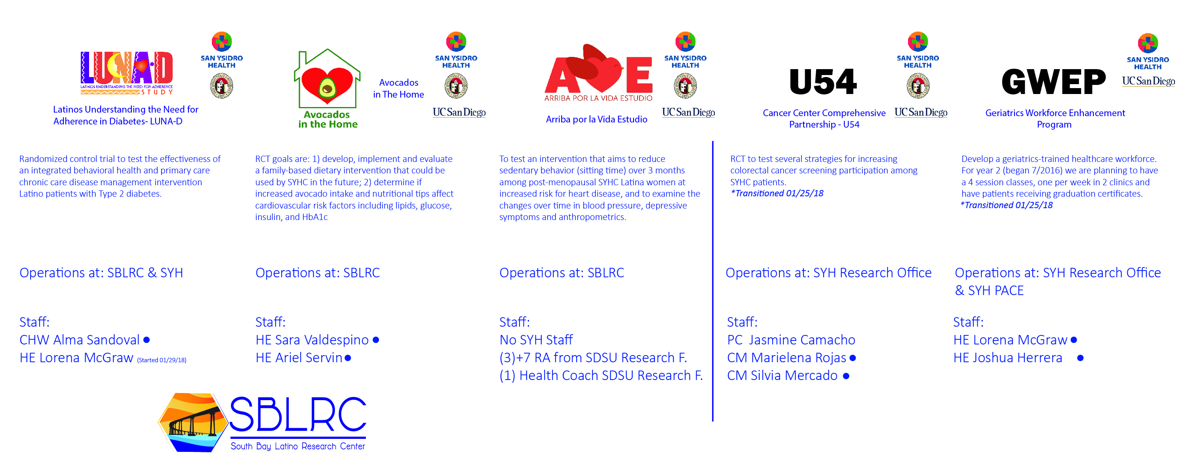

Slide 8





Evidence-based successful practices
SYH is involved in the planning and structure of grants and leads to great outcomes
Improve communication and support from clinical affairs department
SYH upper management ensures the resources available for multiple projects are for the benefit of our patients
Bridge of partnership between SDSU-UCSD projects at SBLRC
Staff developed their communication skills thru SYH trainings (Dealing with difficult patients, Communication skills, EHR system (Nextgen), Presentation skills...
Great awareness and readiness of the Community Health Workers/promotoras to work outside SYH clinics
Patient participation results in better adherence to SYH overall services

Slide 9
All of Us Research Program
Federally Qualified Health Center Pilot:
San Ysidro Health Pilot and Phase II

Slide 10


FQHC PILOT SITES
Hudson River Health Care
Peekskill, NY
Community Health Center, Inc.
Middletown, CT
Cherokee Health Systems
Knoxville, TN
Eau Claire Cooperative Health Center
Columbia, SC
Jackson-Hinds Comprehensive Health Center
Jackson, MS
Initial sites selected July 2016
Notes:
CHC; 21% Hisp/Lat, 21% AfAm - 326
Cherokee; 56% White - 300
Eau Claire; 44% AfAm, 36% Hisp/Lat - 423
HRH; 37% Hisp/Lat, 25% Black - 214
Jackson; 93% AfAm - 318
SYHealth; 67% Hisp/Lat, 12% Af/Am – 575
African American population = 13.2% of US population
5% of clinical trial participants nationwide
Hispanic population = 17% of US population
7.6% of NIH clinical trial participants
1% of clinical trial participants nationwide
Underrepresented in biomedical research populations include ethnic minorities, as well as age, sex, gender, sexual orientation, income, education, geography, access to care and disability
Minority enrollment in clinical trials? ~10%
Minority populations to rise to over 56% of overall population

Slide 11
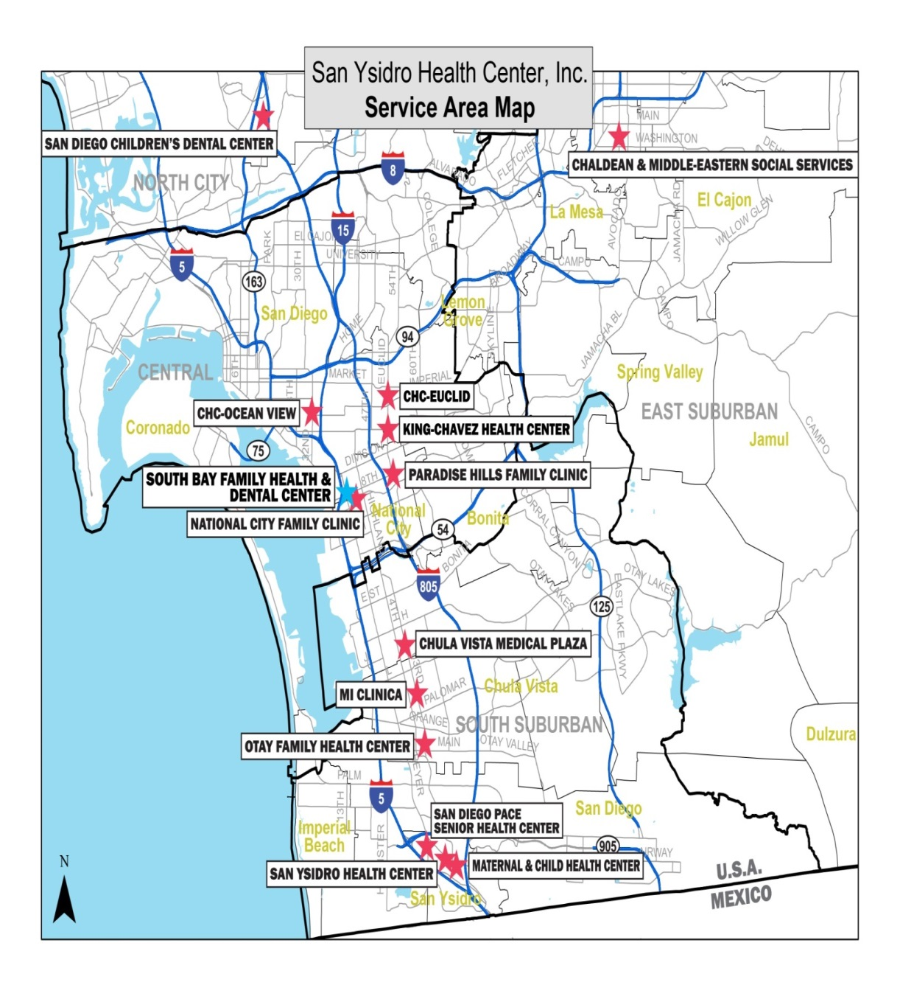
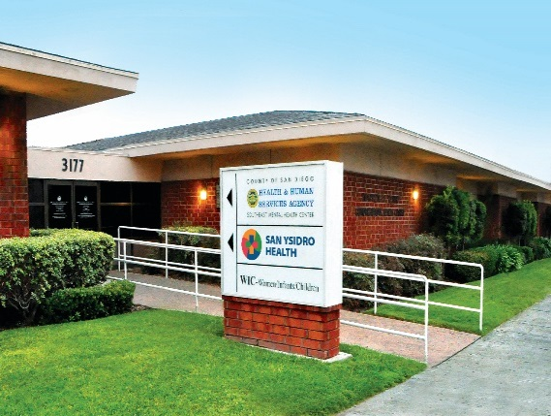
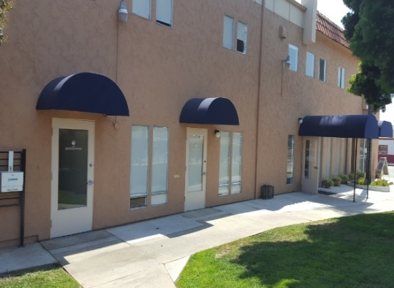
San Ysidro Health – All of Us sites
Comprehensive Health Center –
Ocean View
Precision Medicine Initiative, PMI, All of Us, the All of Us logo, and
“The Future of Health Begins with You” are service marks of the U.S. Department of Health and Human Services.
Otay Family Health Center
Notes:
These sites were selected in an effort to represent SYHC’s diverse geographic catchment area, and to increase the probability of engaging multiple diverse populations
OFHC is most (88%) are Hispanic/Latinos. DRHP is co-located at this site and has offices and resources that facilitate the engagement and assessment of potential participants.
CHC OV is 63% Hispanic/Latinos, 17% African-American, 9% White and 1% Asian. This northern site offers a more diverse demographic which includes significant numbers of African-Americans and Asian ethnicities.
In addition, these two clinics were also selected for the convenience of their infrastructure and room/space availability for the recruitment and the implementation of the study activities.

Slide 12
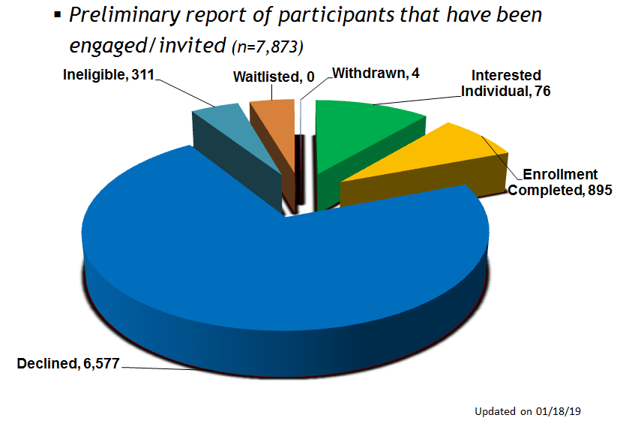
NIH Precision Medicine Initiative All of Us Research Program 07/05/16 – 09/08/19
Alpha Phase 6/27 – 7/11
Spanish language portal and assets available
Pilot Extension 02/24/18 – 09/07/18
Quarter I 09/10/18 – 11/30/18
Preparation & Planning: Develop LPs
Training, Dry Run, Dress Rehearsal
Beta Phase 7/24/17 – 02/23/18
GOAL
1,566
Aug – Dec 2016 | Jan – Apr 2017 | May – Aug 2017 | Sep – Dec 2017 | Jan – Feb 2018 | Mar – May 2018 | June – Sept. 7th 2018 | Sept-Jan 2018
n=100
n=10
n=208
n=616
n=887
Reasons to Participate | Reasons to Decline
Benefit to personal/family health | Time commitment
Helping their community | Don’t see value in participating
Educational value | Transportation
Contributing to a greater good | Too many requirements
Notes:
Participate: Benefit to personal or family health (307, 50.2%), Educational value (188, 30.8%), Learning about personal ancestry (124, 20.3%), Monetary incentives and reimbursements(75, 12.3%), Being included in research (97, 15.9%), Helping the community (251, 41.1%), Contributing to a greater good (178, 29.1%), Provider recommendation for participation (4, 0.7%), Other (11, 1.8%), Unknown/Not reported/Prefer not to answer (11, 1.8%)
Decline: Language barrier (461, 11.1%), Time commitment (2206, 53.3%), Lack of childcare (254, 6.1%), Mistrust of research (156, 3.8%), Mistrust of government (16, 0.4%), Mistrust of technology (47, 1.1%), Privacy or security concerns (53, 1.3%), Fear of discrimination (3, 0.1%), Do not understand what is asked (20, 0.5%), Lack of provider support (0, 0.0%), Not comfortable providing information requested for participation (49, 1.2%), Too many requirements to participate (42, 1.0%), Not motivated to continue with participation (35, 0.8%), Small monetary incentive (74, 1.8%), Transportation (175, 4.2%), Do not see value in participating (275, 6.7%), Do not have internet or smart phone access (29, 0.7%), Other (286, 6.9%), Unknown/Not reported(155, 3.7%), Prefer not to answer (233, 5.6%)
7,872 Records in REDCap. Total of the Pie is 7,863, 10 records have no status.
144 have completed surveys 4 OR 5
135 have completed 4 AND 5
75 Have completed either 4,5, or 6
Most participants have found the enrollment and consent process easy/very easy.
One third of the participants mentioned that th
It was easy because the participant is young and understands technology.
It was good and easy.
Everything was explained in detail. Process was extremely easy and informative
This is a great program for research
Things were explained multiple times and very clearly.
Very easy even for me who has no computer experience
The process is helpful, as well as others to help with overall health
Videos were very helpful.
It is a lot of reading. Too long
Could be done in one visit, not two!
The $25 incentive is too low for 4-5 tubes of blood.
I would like to know any future published results from this study
ey would continue with the All of Us Research Program for over 3 yrs

Slide 13
San Ysidro Health – All of Us participants
Reasons for Participation
Benefit to personal or family health
Helping the community
Educational value
Contributing to a greater good
Monetary incentives and reimbursements
Learning about personal ancestry
Being included in research
Provider recommendation for participation
Participant Feedback
“It is a lot of reading”
“Everything was explained in detail. Process was extremely easy and informative”
“very informative and nice”
“The $$ incentive is too low for 4-5 vials of blood”.
“to understand the consent form, too long [participant who found the process ‘difficult’]”
“This is a great program for research; Great way to stay healthy”
“Things were explained multiple times and very clearly”
“I would like to hear about breakthroughs from my participation”
Notes:
Most participants have found the enrollment and consent process easy/very easy.
One third of the participants mentioned that they would continue with the All of Us Research Program for over 3 yrs

Slide 14
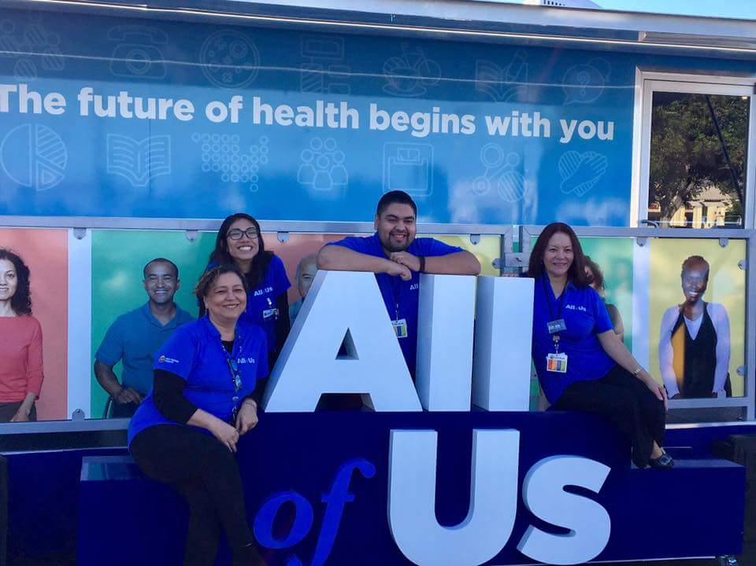
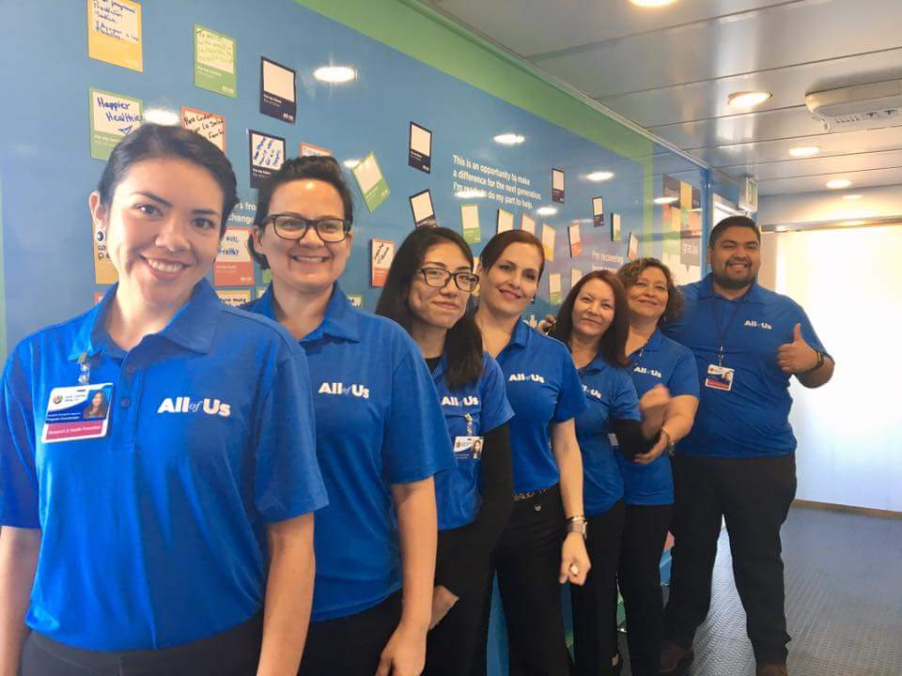
Outreach & Engagement successful practices
Cross training staff to recruit, enroll and biospecimen process.
Staff (promotoras & Health Educators) had previous training and experience in outreach and research (recruitment, enrollment).
Participants in our community respond most positively to personal connections.
Bilingual and bicultural staff with extensive experience in community outreach and engagement, program implementation, data collection, and research methods.
Staff well trained to deliver culturally and linguistically appropriate services for Hispanic/Latino populations.
Trust and relationship with our community and patients

Slide 15
Evidence-based program and successful practices
Patient participation results in better adherence to SYH overall services
Help underserved/disadvantaged Latino population
Build infrastructure for future opportunities: Community alliances (local groups, community resource centers)
Recognition and sustainability of our programs
Improve the quality of service for SYH patients and our community
Data platforms for publications
Create the infrastructure to integrate evidence-based practices from research projects to the actual health care model of SYH.
Patient participation results in better adherence to SYH overall services

Slide 16


Wondros: If possible, we would love the rest of the slides to have the look & feel of this slide. Realize this may be too difficult in time allotted, but would love to move in this direction with this particular deck.

Slide 17

Thank you

