Slide 1
Patient-centered Outcomes Research: Evidence-based Research to Address Disparities
Ayodola Anise, MHS
Senior Program Officer
Healthcare Delivery and Disparities Research Program
January 24, 2019
Families USA
Health Action 2019 Conference

Slide 2
Our Mission and Strategic Goals
PCORI helps people make informed healthcare decisions, and improves healthcare delivery and outcomes, by producing and promoting high-integrity, evidence-based information that comes from research guided by patients, caregivers, and the broader healthcare community.
Our Strategic Goals:
Increase quantity, quality, and timeliness of useful, trustworthy research information available to support health decisions
Speed the implementation and use of patient-centered outcomes research evidence
Influence research funded by others to be more patient-centered
Notes:
Cost effectiveness analyses
Disease-processes and –causes
Studies lacking comparative nature or foundation
Efficacy trials
Pilot studies
Cost-effectiveness: PCORI will not answer questions related to cost-effectiveness, costs of treatments or interventions. However, PCORI will consider the measurement of factors that may differentially affect patients’ adherence to the alternatives, such as out-of-pocket costs.
Medical billing: PCORI will not address questions about individual insurance coverage or about coverage decisions from third-party payers.
Disease processes and causes: PCORI will not consider questions that pertain to risk factors, origin, and mechanisms of diseases or questions related to bench science.
Lacking comparative nature or foundation: PCORI will not consider questions that lack any comparative aspect.

Slide 3
Key Components of the Research We Fund
Key Components of the Research We Fund
COMPARATIVE EFFECTIVENESS RESEARCH
Compares 2 or more treatments, drugs, health system practices, screening practices, or methods for delivering care
PATIENT & STAKEHOLDER ENGAGEMENT
Engages scientists, patients, and other stakeholders in an active and meaningful way throughout the entire study
PATIENT CENTEREDNESS
Answers questions or examines outcomes that matter to patients and caregivers

Slide 4
Who Are Our Stakeholders?
Clinician
Caregiver/ Family Member of Patient
Patient/ Caregiver Advocacy Org
Hospital/ Health System
Purchaser
Payer
Industry
Policy Maker
Training Institution
Patient/ Consumer
PCORI Community

Slide 5
What Happens When Patients and Other Stakeholders Are Actively Engaged?
Research is influenced to be patient-centered, relevant, and useful
There is the establishment of trust and a sense of legitimacy in the research findings
There is successful uptake and use of research results.

Slide 6
National Priority Areas of Research
Assessment of Prevention, Diagnosis, and Treatment Options
Improving Healthcare Systems
Addressing Disparities
Accelerating PCOR and Methodological Research
Communication & Dissemination Research

Slide 7
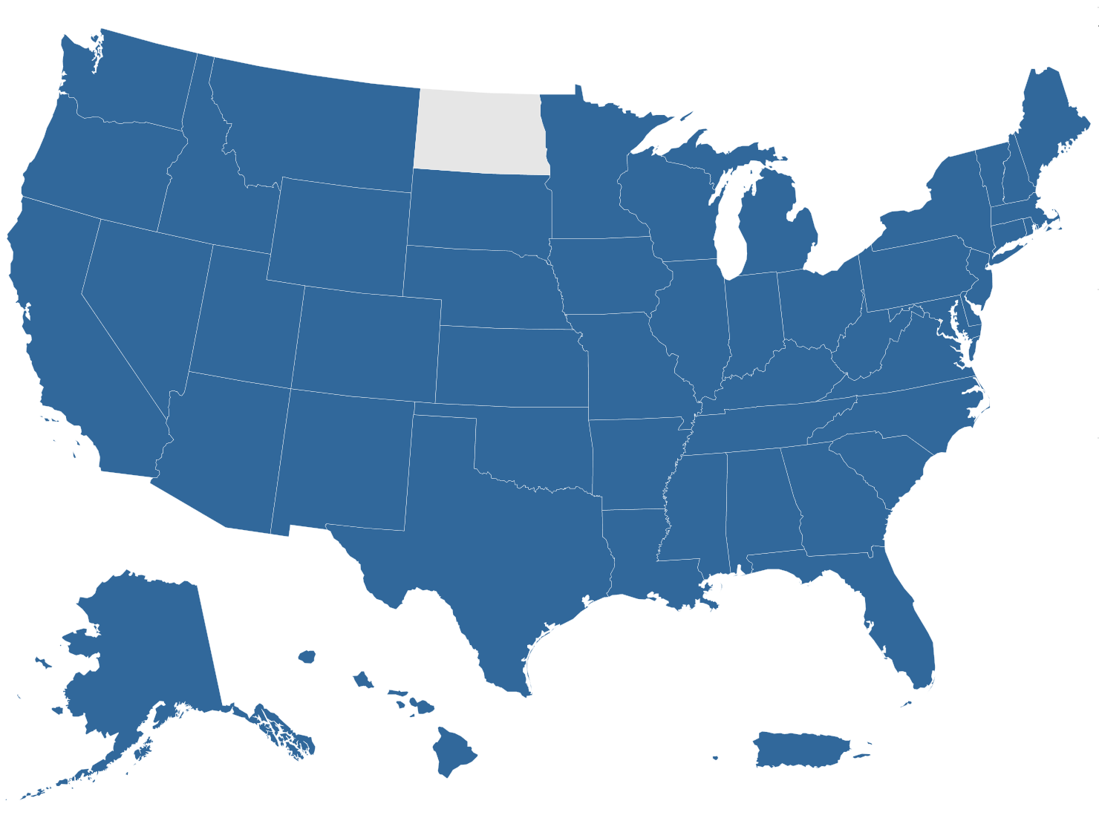
Snapshot of Funded Projects
Number of funded awards:
More than 1,300
Amount awarded:
More than $2.2 billion
Number of states where we are funding projects:
49 (plus the District of Columbia and
Puerto Rico)
AS OF JULY 2018
All awards
Notes:
Includes ALL AWARDS ever funded by PCORI as of July 2018, namely:
CER studies
D&I awards
Methods studies
Pilot projects
PCORnet awards
Engagement awards
State WITHOUT any funding awarded is North Dakota.
Data source: E&A Portfolio data, QC’d July 23, 2018

Slide 8
PCORI Studies Engage with Partners from Many Communities
Communities engaged in PCORI research projects:
(by percent of projects, N=412)
91%
PATIENTS
66%
ADVOCACY ORGS
63%
CAREGIVERS
91%
CLINICIANS
64%
HEALTH SYSTEMS
95% of projects engage with at least 1 of these communities
PCORI projects also engage with subject matter experts (55%), community-based organizations (27%), training institutions (25%), policymakers (23%), payers (22%), industry (9%), and purchasers (6%)
Note: Data from awardee reports collected through 3/31/18; N=412 awardees
Notes:
This slide demonstrates the engagement of our stakeholder communities. True to our patient centered approach, analysis of PCORI awardee reports and the information they share with us indicate that
Nearly all PCORI projects engage with patients, caregivers, and/or patient/caregiver advocacy organizations, and over 90% of projects engage with clinicians.
Nearly all PCORI projects engage with partners from more than one stakeholder community, and over 80% of projects engage with partners from at least 4 different communities.
There are other stakeholders listed at the bottom that we are actively seeking to improve our engagement with, such as payers and employers.
Source: E&A, QC’d July 2018
PCORI projects engage with a variety of partner types, using a variety of methods.
More than 90% engage with a patient, and >90% engage with a clinician. More than half engage with caregivers, and more than half engage with health systems.
Projects also engage with other key stakeholder groups like industry, policymakers, payers, and purchasers.
Overall, projects engage with a lot of different types of stakeholders- the vast majority (>80%) have at least 4 different types of stakeholders represented on the project

Slide 9
PCORI Studies Engage Partners During All Study Phases
Research topics and/or research questions
Sharing study information
Interventions and/or comparators
Project Life Cycle
Data analysis and/or results review
Outcomes and/or measurement
Data collection
Other aspects of study design
Note: Data from annual awardee reports collected through 6/30/17. N=305 awardees (134 projects at project year 1, 205 projects at project year 2, 119 projects at project year 3)
Recruitment and/or retention

Slide 10
The Addressing Disparities Research Priority Area

Slide 11
Addressing Disparities Research Priority Area Mission Statement
Program’s Mission Statement
To reduce disparities in healthcare outcomes and advance equity in health and healthcare
Program’s Guiding Principle
To support comparative effectiveness research that will identify best options for reducing and eliminating disparities
PCORI’s Vision, Mission, Strategic Plan

Slide 12
Addressing Disparities Research Priority Area Goals
Identify Research Questions
Identify high-priority research questions relevant to reducing and eliminating disparities in health and healthcare outcomes
Fund Research
Fund comparative effectiveness research with the highest potential to reduce and eliminate health and healthcare disparities
Disseminate Promising/Best Practices
Disseminate and facilitate the adoption of promising/best practices to reduce and eliminate health and healthcare disparities
Notes:
Targeted funding for Treatment options for AA and H/L with uncontrolled asthma, Multi-level interventions to improve blood pressure control in minority racial/ethnic, low SES, and/or rural populations, obesity treatment options set in primary care for underserved populations, Management of care transitions for emerging adults with sickle cell disease
Dissemination strategies may need to be different to …

Slide 13
Snapshot of Addressing Disparities Research Priority Area Projects
Number of projects:
84
Amount awarded:
$256 million
Number of states where we are funding research:
25 (plus the District of Columbia)
2
1
11
11
8
1
4
1
12
3
2
2
1
1
1
5
District of Columbia
3
2
1
3
2
1
3
1
1
1
AS OF SEPTEMBER 2018

Slide 14
Addressing Disparities Populations
of Interest
*not mutually exclusive
Notes:
Mental/Behavioral Health – 17
Respiratory Diseases – 11
Nutritional and Metabolic Disorders – 11
2 new large trials around $10 million each looking at smoking cessation – which is bigger and impacts more people than the opioid epidemic

Slide 15
The Potential Impact of Evidence-Based Asthma Research

Slide 16
1.
How is PCORI driving
evidence-based, patient- centered asthma research?
2.
How can this research help to reduce disparities?

Slide 17
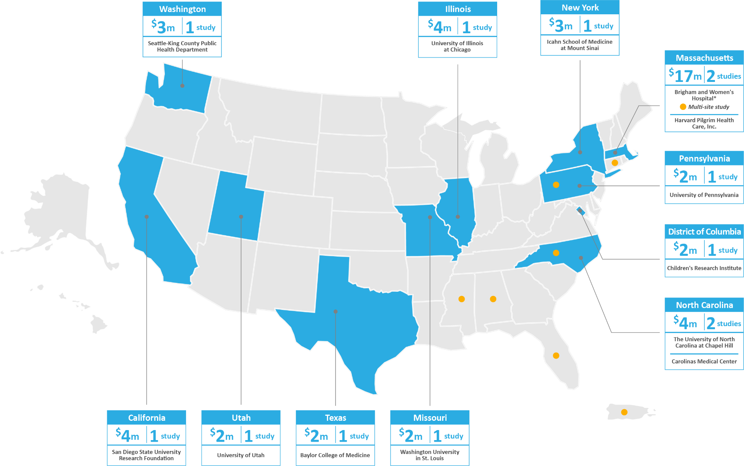
PCORI asthma portfolio to date:
$53m Investment in 13 Comparative Effectiveness Research Studies

Slide 18
PCORI asthma portfolio to date:
8 Studies ( ) Aim to Improve Patient/Clinician Adherence to Guidelines and Reduce Disparities
Notes:
$39M on 8 Studies

Slide 19
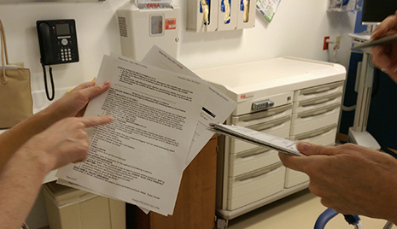
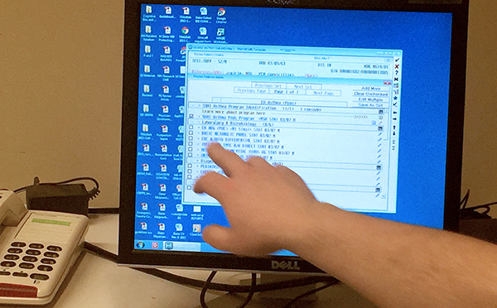
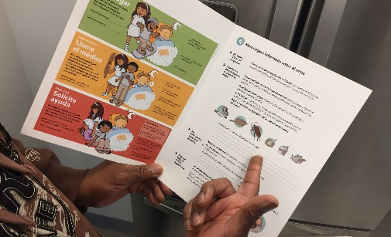
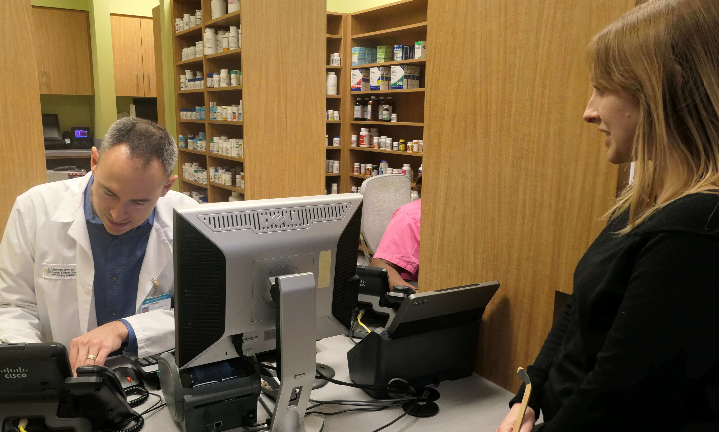
PCORI’s asthma portfolio targets
Evidence-based, Patient-centered Interventions…
MedicationS + Treatment
patient/CAREGIVER education
Provider education
EHR/decision support tools
Community health workers
patient tools
Health plan coverage
environmental Assessments

Slide 20
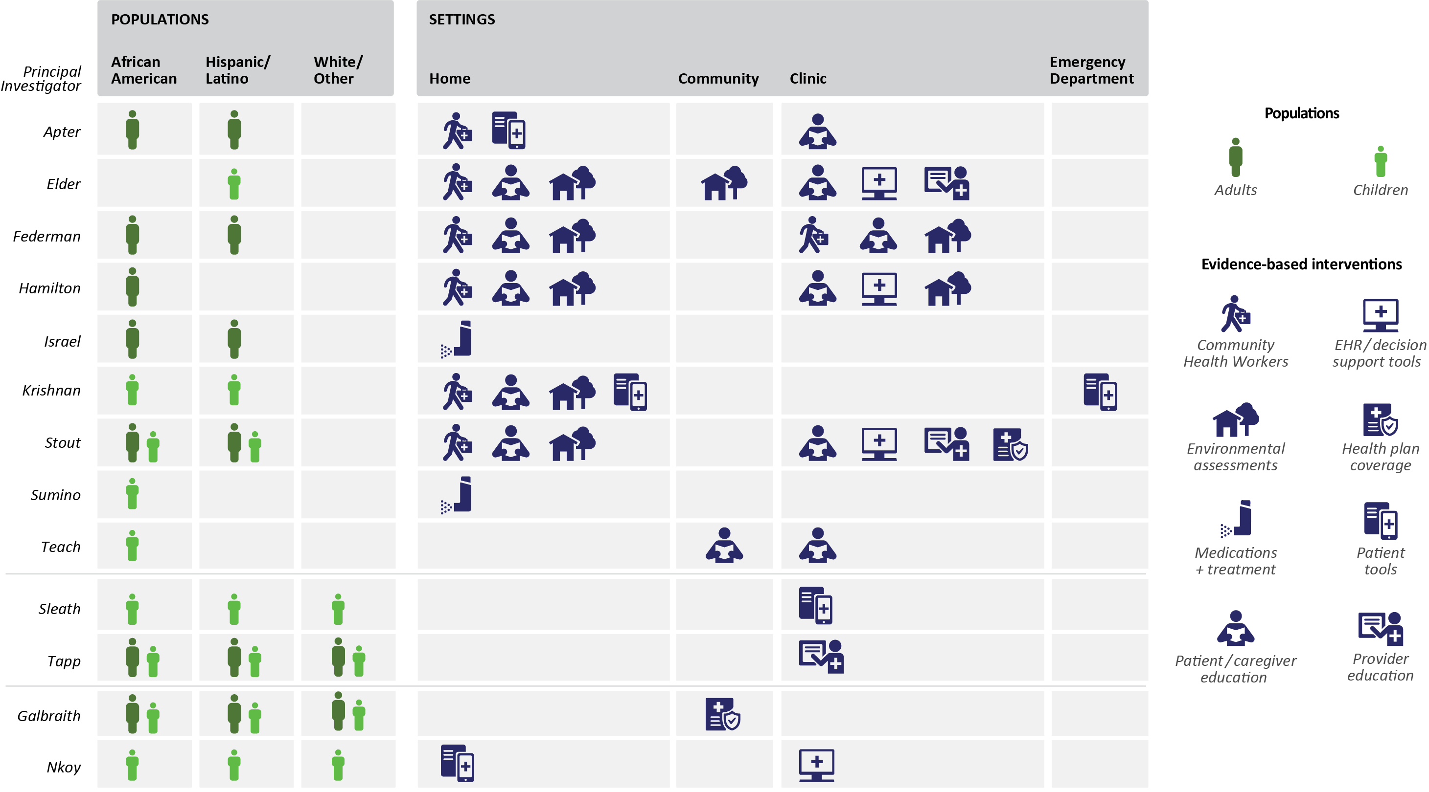
PCORI’s asthma portfolio addresses
Which Interventions Work for Whom, and In Which Setting?

Slide 21
PCORI’s asthma portfolio addresses
Which Interventions Work for Whom, and In Which Setting?

Slide 22
PCORI’s asthma portfolio addresses
Which Interventions Work for Whom, and In Which Setting?

Slide 23
PCORI’s asthma portfolio addresses
Which Interventions Work for Whom, and In Which Setting?

Slide 24
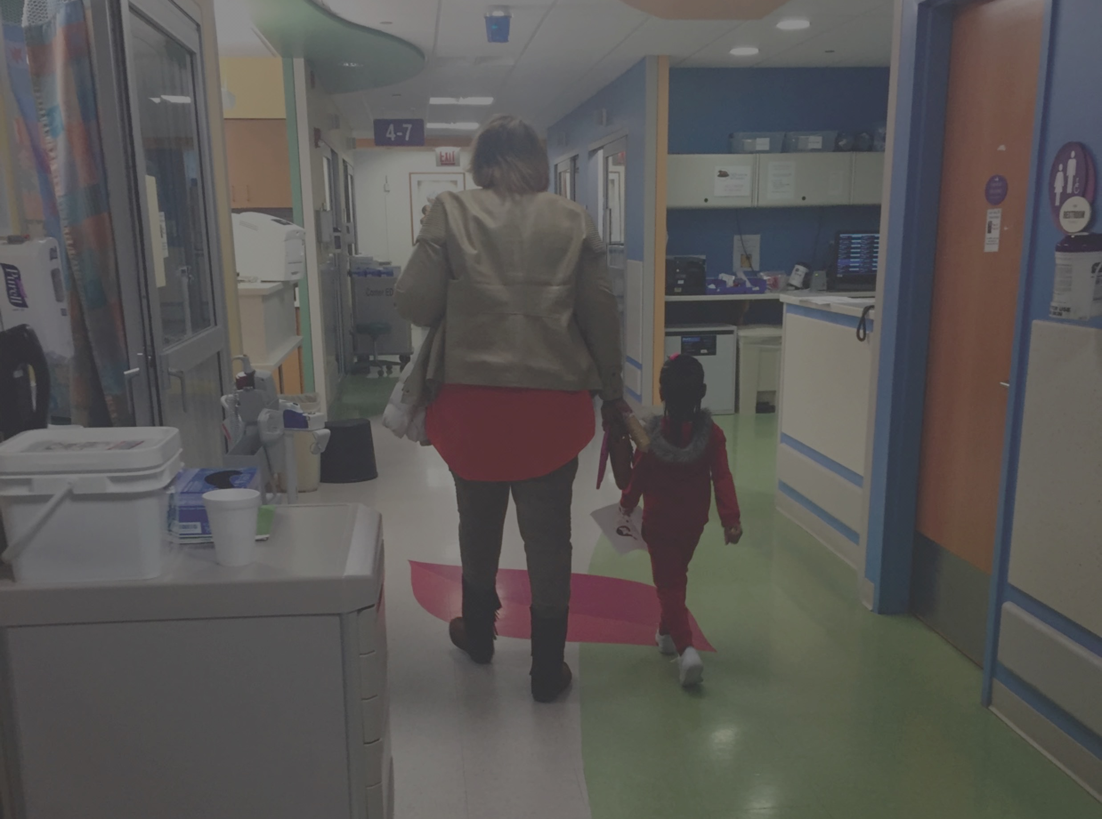
Community health workers address what works for whom, and in what settings

Slide 25
Knowledge gaps being addressed:
Community Health Workers
WHAT WE KNOW
CHWs bridge the healthcare system and community
CHWs provide self-management support and assist with home environmental asthma trigger remediation
Evidence suggests that for children and racial/ethnic minorities, CHWs improve asthma outcomes
Community health workers

Slide 26
Knowledge gaps being addressed:
Community Health Workers
WHAT WE KNOW
CHWs bridge the healthcare system and community
CHWs provide self-management support and assist with home environmental asthma trigger remediation
Evidence suggests that for children and racial/ethnic minorities, CHWs improve asthma outcomes
WHAT WE DON’T KNOW, YET
How much more do CHWs improve asthma outcomes compared to other interventions?
For which populations are CHWs more effective?
Can CHWs be used effectively to serve as liaisons with clinical staff?
What elements of CHW training and certification work best?
Community health workers

Slide 27
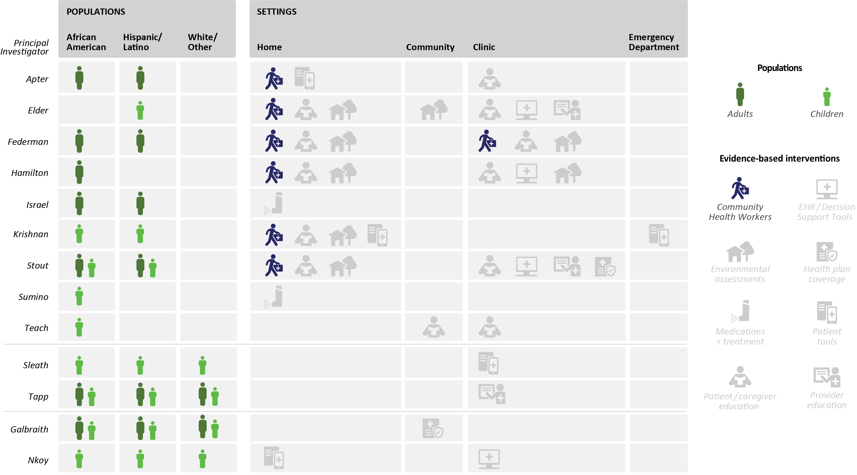
PCORI’s asthma portfolio addresses
How Do Community Health Workers Influence Asthma Outcomes?
Notes:
6 studies use CHWs with 5 using CHWs to also address environmental triggers of asthma.
Most of the studies look at CHWs in the home setting, but one study is comparing CHWs in the home to those in the clinic.

Slide 28
Targeting a knowledge gap
What We Now Know about “Prescribing” a CHW from the PCORI Asthma Portfolio?
CHWs, when prescribed to provide patient education and address environmental triggers, improve asthma control and quality of life compared to comparators
Several studies show improvements in medication adherence/ prescription refills
Along with provider education and provider support tools, CHWs may have an even greater impact on outcomes
I would say 70% [of my clients] have issues that are more urgent: housing, finances, food. They are more apt to be conscious of those things, as opposed to asthma, until it flares up.
Community Health Worker
“

Slide 29
Implementing findings from patient-centered, evidence-based research to reduce disparities

Slide 30
Lessons Learned
Using Evidence-based Patient-Centered Outcomes Research to Reduce Disparities
Engagement of patients and other stakeholders (including communities) is necessary for the development and implementation of evidence that can eliminate disparities
Clinical comparative effectiveness studies that address social determinants of health and intersectionality are critical to reducing disparities
One study is not enough to change practice
Drivers of practice change should be taken into consideration and serve as the link between research evidence and impact
Stakeholder Buy-in & Advocacy
Quality Measures
Guideline Adherence
Technology
Coverage and Payment Policy
Sustainability
Feasibility of Implementation
Notes:
Effectiveness of interventions does not lead to implementation and use of research evidence
Next steps: continuing to fund research and collecting lessons learned and working with other stakeholders to disseminate our findings.

Slide 31
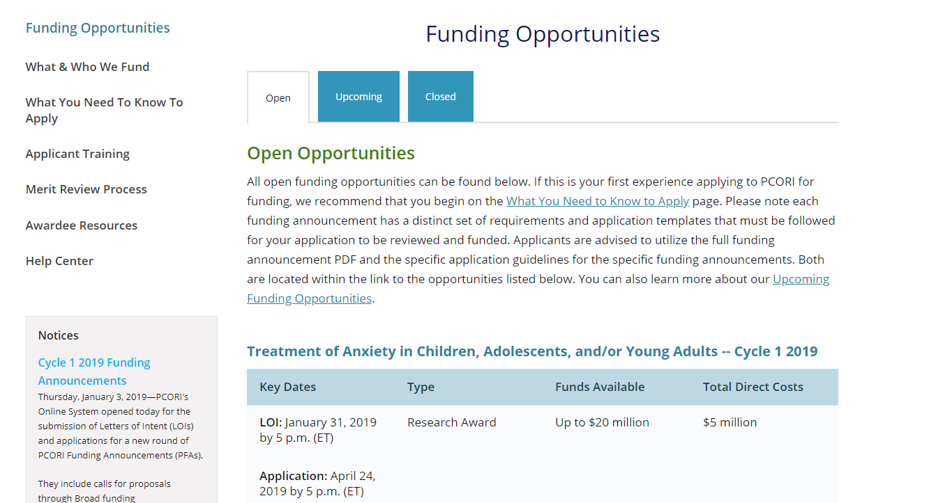
Apply to PCORI: Research and Engagement Funding Opportunities
Contact PCORI
CER Programmatic Inquires: Email: sciencequestions@pcori.org Phone: 202-627-1884 Research Inquiry Form: http://www.pcori.org/PFA/inquiry
CER Administrative, Financial, or Technical Inquiries: Email: pfa@pcori.org Phone: 202-627-1885
_ _ _ _ _ _ _ _ _ _ _ _ _ _ _ _ _ _ _ _ _ _ _ _ _ _
Engagement Awards:
Email: ea@pcori.org
Phone: 202-370-9312
https://www.pcori.org/funding-opportunities

Slide 32
Ayodola Anise, MHS
Senior Program Officer
Healthcare Delivery and Disparities Research
aanise@pcori.org

