Slide 1
Listen to Us! How Racial and Gender Bias Undermine Women’s Health
Rachel R. Hardeman, PhD, MPH
Notes:
My role today is to offer some of the historical context that has created and perpetuated the health inequities faced by WOC in our society.
But before I do that, I just want to remind us what’s at stake…

Slide 2
What’s at Stake?
Notes:
Whats at stake here is the lives of black women and other women of color

Slide 3
Maternal Mortality Rate
Source: Health Resources and Services Administration
Notes:
Black mothers in the US are 3-4 TIMES more likely to Die during or immediately after pregnancy than their white counterparts. And have the greatest risk of death of any racial/ethnic minority group.
This is one example of many, we can talk about infant mortality, preterm birth, heart disease, infectious diseases like HIV and AIDS…the inequities are there.

Slide 4
Root Cause
Notes:
So we need to understand the root cause…specifically why is it that those who have been historically marginalized and oppressed in the United States suffer from the worst outcomes. I would offer that its certainly not a coincidence…That our system is working just as it was designed.

Slide 5
Structural Racism
A confluence of institutions, culture, history, ideology, and codified practices that generate and perpetuate inequity among racial groups
Normative, sometimes legalized, and often manifests as inherited disadvantage.
Notes:
Understanding structural racism and moving forward with achieving health equity does not leave room for an ahistorical approach. We have to understand the history of how the system was designed if we are going to figure out how to dismantle it.

Slide 6
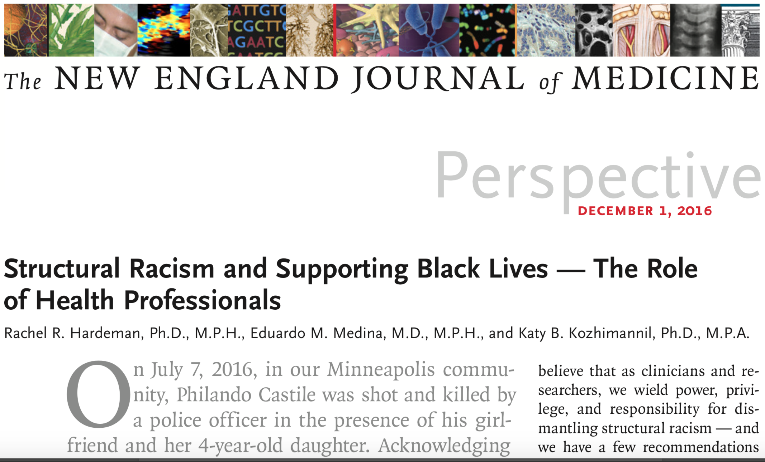
Notes:
So in the summer of 2016 just after Philando Castile, a Black man from St.Paul MN was shot and killed by a police officer in front of his girlfriend and her young child, my colleagues and I were left thinking about what it all meant for us, for our work as health services and policy researchers and as clinicians who serve vulnerable communities. And this is what came from those conversations, deliberations and frankly the pain of sitting with that event…
So, as we think about the big questions and the path forward towards achieving reproductive health equity, my colleagues and I offer 5 steps we think clinicians and health researchers and health leaders should consider….and I’ll take the last bit of my time to talk about the 5 items but only briefly as I look forward to a discussion

Slide 7
Learn about, understand and accept the United States’ racist roots
Structural racism is born of a doctrine of white supremacy that was developed to justify mass oppression involving economic and political exploitation. In the United States, such oppression was carried out through centuries (245 years) of slavery premised on the social construct of race.

Slide 8
A History of Racist Ideas
Discriminatory actions, wrought by self-interest, come first.
Then racist ideas are developed to justify them, and they spread.
Racist ideas date back to 15th century
Multiplied in the colonial era and early slave-holding republic
Notes:
Race was socially constructed to support racist ideas and discriminatory actions
In Ibram Kendi’s book Stamped from the beginning he suggests that discriminatory actions wrought by self interest come first, then racist ideas are developed to justify them and they spread.
Racist beliefs were created to prop up the institution of slavery and justify the poor treatment of black people
Rationales for black oppression multiplied in the colonial era and the early slave-holding republic — Africans were cursed, biologically and unalterably, rendering them natural slaves; th”e idea that they were “hardy” made for work, couldn’t feel pain, had thiker skin all were constructed to justify slavery

Slide 9
Racist Ideas
After 1808, when a federal ban on importing slaves from other countries took effect, the perpetuation of American slavery became dependent on domestic slave births.
Aligned the economic interests of slave owners — who wanted to promote the healthy births of slave children
As historian Deirdre Cooper Owens has observed, those economic incentives drove medical innovation.
Notes:
After 1808, there was a federal ban on importing slaves from other countries which took effect.
As a result, the perpetuation of American slavery became dependent on domestic slave births.
This aligned the economic interests of slave owners — who wanted to promote the healthy births of slave children — and the interests of white physicians — who portrayed themselves as helping slaves but also reaped professional benefits because they could experiment on slaves without their consent.
Gynecological examinations of black women influenced the country’s slave markets, and “slavery, medicine and medical publishing formed a synergistic partnership” in the establishment of gynecology as a medical specialty in the United States.

Slide 10
Racist Beliefs become Racist Actions
James Marion Sims is credited as the “father of modern gynecology
Sims’ research was conducted on enslaved black women without anesthesia
Notes:
Racist beliefs associated with slavery also provided perceived ethical justifications for conducting repeated invasive experiments like those Sims performed.
Sims carried out his experiments on women’s genitalia from 1845 to 1849 without anesthesia, which had recently been introduced.
In addition to their status as enslaved people, black women were considered appropriate subjects for such experiments based on the widespread belief that black people experienced less pain than white people.

Slide 11
After 30 operations on one woman, a 17-year-old enslaved woman named Anarcha who had had a very traumatic labor and delivery, Sims finally “perfected” his method—after four years of experimentation on her
Notes:
from the perspective of slave owners, this development was more notable because the new treatment meant that healed slaves could retain their economic value.
Indeed, a 1950 biography of Sims suggested that slave women endured his VVF experiments “with amazing patience and fortitude — a grim stoicism which may have been part of their racial endowment.”
Such ideas had helped rationalize the enslavement of black Americans
Such racist beliefs about pain tolerance permeated American society and persisted well beyond the institution of slavery.
But the racist views that underpinned his achievements are no mere relic of the past.

Slide 12
In 2016…
Survey found that about half of white medical students and residents in the sample endorsed false beliefs about biological differences between black and white patients.
For example, 25 % of medical residents agreed that blacks have thicker skin than whites.
Participants who endorsed more false beliefs about biological differences between blacks and whites showed a racial bias in the accuracy of their treatment recommendations.
Notes:
These beliefs persist today, they just perpetuate themselves in different racist actions

Slide 13
“I Was Pregnant and in Crisis. All the Doctors and Nurses Saw Was an Incompetent Black Woman”
Notes:
You all may have read or heard about Dr. Tressie McMillian Cottom’s story published in Time Magazine recently
One example of many modern day Anarcha’s where racist belifs were embraced and perpetuated to render her incompetent and to treat her inhumanely
“When the medical profession systematically denies the existence of black women’s pain, underdiagnoses our pain, refuses to alleviate or treat our pain, healthcare marks us as incompetent bureaucratic subjects.”

Slide 14
Rachel R. Hardeman, PhD, MPH
Assistant Professor
hard0222@umn.edu
Notes:
The persistence of racist medical beliefs, and their association with ongoing racial disparities in treatment and patient outcomes, represents a major challenge for 21st-century American medicine. Part of the process of addressing these ongoing disparities will involve reexamining incomplete or misleading historical narratives that contributed to their development. For example, for more than a century, American medical societies, literature and textbooks have celebrated Sims’s achievements while largely ignoring the racist assumptions and institutions that made them possible.

