Slide 1
The Future of Children’s Coverage
Elisabeth Wright Burak
Families USA Health Action Conference
January 24th, 2018

Slide 2
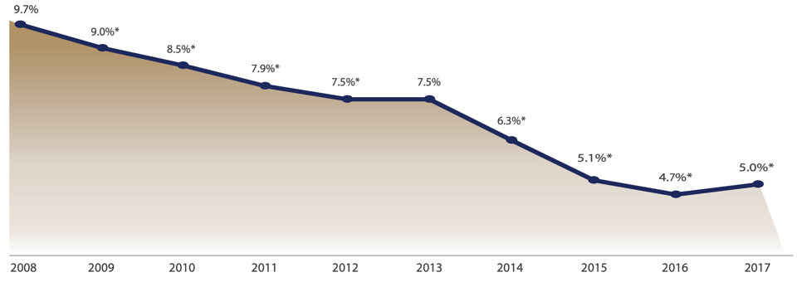
Nation’s Progress on Children’s Health Coverage Reverses Course
Source: J. Alker and O. Pham, “Nation’s Progress on Children’s Coverage Reverses Course” (Washington: Georgetown University Center for Children and Families, November 2018), available at https://ccf.georgetown.edu/2018/11/21/nations-progress-on-childrens-health-coverage-reverses-course/.
* Change is significant at the 90% confidence level

Slide 3
Sources of Children’s Coverage
Source: J. Alker and O. Pham, “Nation’s Progress on Children’s Coverage Reverses Course” (Washington: Georgetown University Center for Children and Families, November 2018), available at https://ccf.georgetown.edu/2018/11/21/nations-progress-on-childrens-health-coverage-reverses-course/.

Slide 4
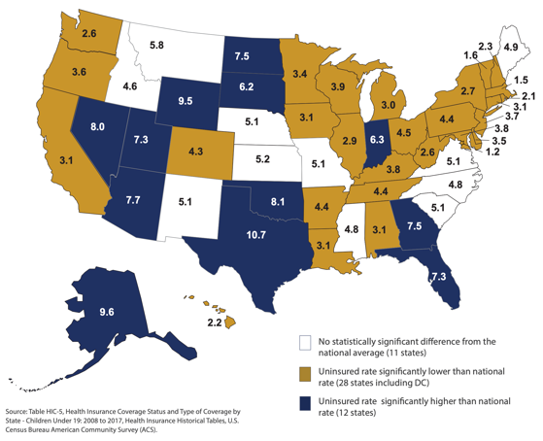
Rate of Children’s Uninsurance by State, 2017
Source: J. Alker and O. Pham, “Nation’s Progress on Children’s Coverage Reverses Course” (Washington: Georgetown University Center for Children and Families, November 2018), available at https://ccf.georgetown.edu/2018/11/21/nations-progress-on-childrens-health-coverage-reverses-course/.
* Change is significant at the 90% confidence level

Slide 5
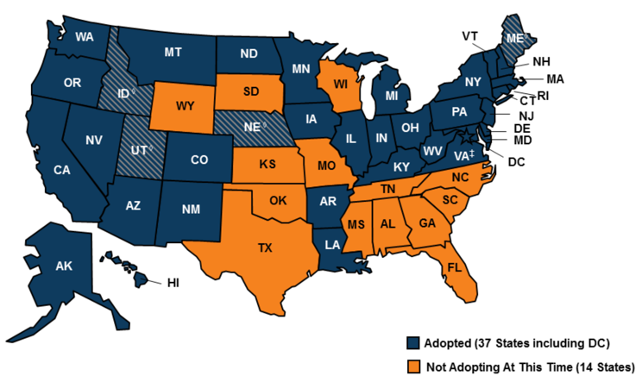
Medicaid Expansion: Covering Parents Helps Kids
Notes:
Starting on a positive note – might more states expand coverage?
Blue = expansion state
Yellow = thinking about it (caveat – just my guesses)
If election had gone differently, would have seen a couple of states expand in 2017.
Instead, a lot of debate about…
UPDATE

Slide 6
Children’s Uninsured Rate by Medicaid Expansion Status
Source: J. Alker and O. Pham, “Nation’s Progress on Children’s Coverage Reverses Course” (Washington: Georgetown University Center for Children and Families, November 2018), available at https://ccf.georgetown.edu/2018/11/21/nations-progress-on-childrens-health-coverage-reverses-course/.
* Change is significant at the 90% confidence level

Slide 7
This!
(Not this.)

Slide 8
Public Coverage for Children, 2017
CHIP
9.5 million
Medicaid
36.9 million
Marketplace
1 million
Sources: Georgetown CCF analysis of SEDS FY 2017 Ever-Enrolled in Medicaid/CHIP.
CMS state-level public use data as of 4/17.

Slide 9
The Potential of Medicaid’s Pediatric Benefit: Early Periodic Screening Diagnostic and Treatment (EPSDT)
Notes:
For ALL CHILDREN in Medicaid under 21, including HCBS waivers.
Comprehensive array of preventive and ameliorative care for children – focus on PREVENTION
Covers all appropriate and medically necessary services needed to correct and ameliorate health conditions, even if such services are not included in the Medicaid state plan
States are required to inform all Medicaid-eligible individuals under age 21 that EPSDT services are available and of the need for age-appropriate immunizations
PUTS DOCTORS, NOT POLICYMAKERS IN THE DRIVER’S SEAT RE: WHAT CHILDREN NEED.
“The program’s origin can be traced to a government study…titled ‘One Third of a Nation: A Report on Young Men Found Unqualified for Military Service.’ The report revealed that half of the young men drafted into military service in 1962 were rejected due to preventable and treatable physical, mental, and developmental health conditions. This discovery demonstrated the need for children and adolescents’ access to preventive medical services starting from an early age, eventually leading up to one of the hallmarks of the Medicaid program, the EPSDT benefit.”

Slide 10
Moving Children’s Coverage Forward: Marketplace
In the Marketplace:
Define pediatric services
Define medical necessity to include services critical to healthy development
Strictly enforce the ACA’s antidiscrimination rules

Slide 11
Moving Children’s Coverage Forward: Medicaid/CHIP
Maintain continuous, consistent health coverage for children and their families.
Realize the full potential of EPSDT (especially the T!).
Prioritize the health of parents and caregivers as key players in children’s healthy development.
Prioritize and elevate children’s needs in any health reforms (e.g. value-based payment)

Slide 12
Moving Children’s Coverage Forward: Dental
Adopt a dental periodicity schedule for Medicaid/CHIP programs
Refine Medicaid/CHIP policies to encourage and incentivize the use of oral health risk assessments and fluoride varnish by pediatricians.

Slide 13
More Opportunities
Expand school-based services (“free care rule”)
Improve Medicaid’s Drug Rebate Program
Report Child Core Set for Medicaid/CHIP (mandatory in 2024)
Support Tribal Children and Youth (forthcoming paper)
Notes:
)

Slide 14
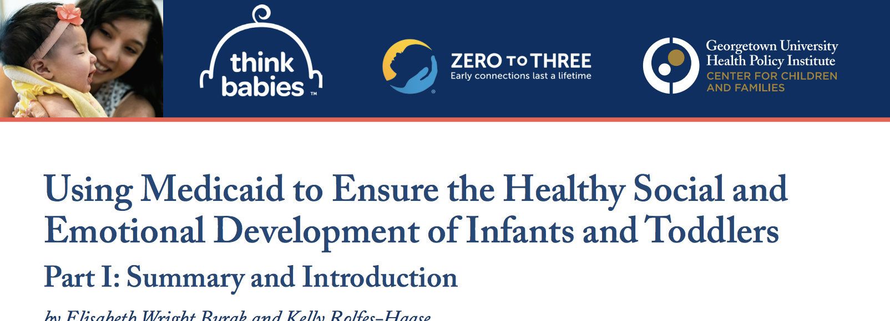
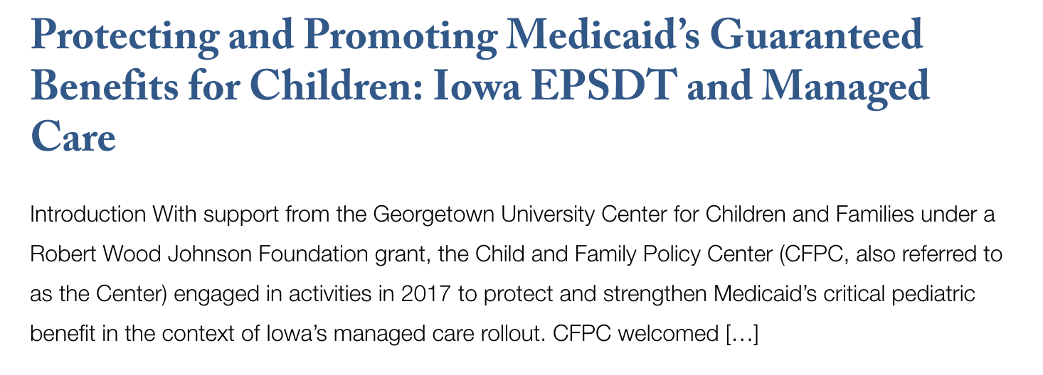
More Ideas…

Slide 15
For More Information:
Future of Children’s Health Coverage Series
https://ccf.georgetown.edu/2016/08/09/the-future-of-childrens-health-coverage/
Check Out Our Website:
ccf.georgetown.edu
Follow Us on Twitter:
@georgetownccf
@ewburak

