Slide 1





Ensuring Health Care for North Carolina’s Children
Ciara Zachary, MPH, PhD | Health Program Director | NC Child

Slide 2

About NC Child
www.ncchild.org | NC CHILD | 2

Slide 3

OUR MISSION
NC Child builds a strong North Carolina by advancing public policies to ensure all children – regardless of race, ethnicity, or place of birth – have the opportunity to achieve their full potential.
www.ncchild.org | NC CHILD| 3

Slide 4





NC Child focuses on policy areas that support children’s development and ensure the future prosperity of our state.
Family Economic Security
A Strong Start
Healthy Children
High-Quality Education
Nurturing Homes and Communities
www.ncchild.org | NC CHILD | 4
Notes:
Research tells us that the best predictors of success for children are a healthy start at birth and healthy development in the early years;
Being raised by two married parents; having adequate family income; doing well in school, graduating high school and completing postsecondary education or training; and young people avoiding teen pregnancy and substance abuse, staying out of trouble and becoming connected to work and to opportunity

Slide 5
Medicaid Expansion
www.ncchild.org | NC CHILD | 5
Notes:
DISCUSSION: Closing the coverage gap has the potential to strengthen families economically
Health insurance is one of the largest expenses that many families pay each month
Insuring parents provides economic security to the whole family; medical debt is a leading cause of bankruptcy.
When one member of the family is uninsured, the entire family is at risk of financial ruin. It is only by covering the whole family that children are protected from this vulnerability.
In states like North Carolina that have not expanded Medicaid coverage, studies have shown that more low-income adults struggle to afford their medical bills, and health outcomes for children suffer as well

Slide 6
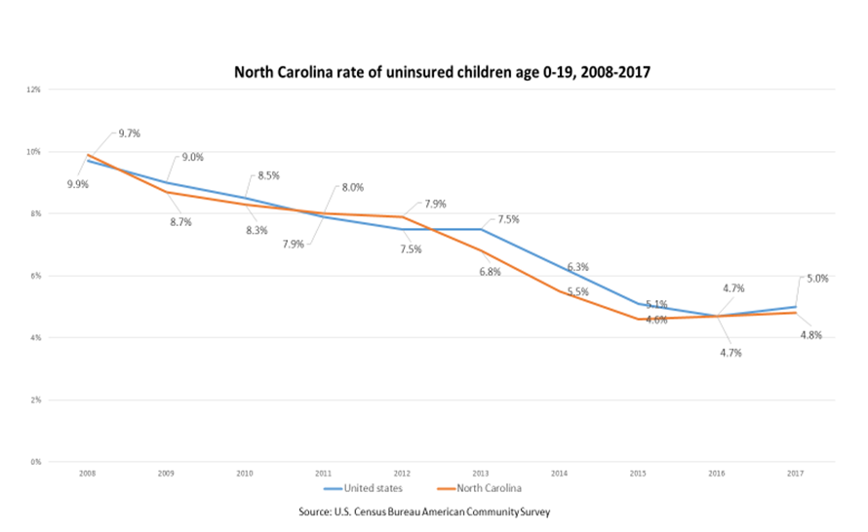
Child Health Coverage:
Health and Wellness
More than 2,300,000 children under age 18 live in North Carolina.
Like most states, North Carolina had an uptick in the number of uninsured children.
119,000 children lack coverage
www.ncchild.org | NC CHILD| 6
Notes:
Children without health insurance coverage are less likely than insured children to have a regular health care provider and to receive care when they need it.

Slide 7
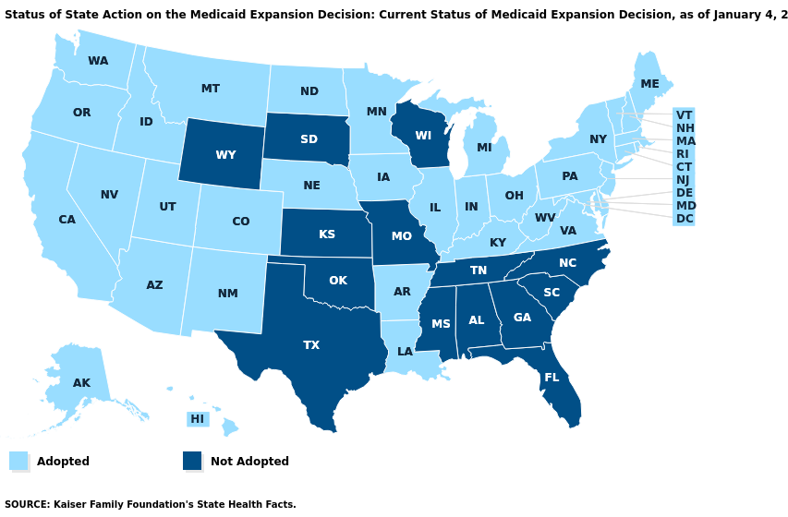
Medicaid Expansion:
How does Medicaid Expansion help children?
Reduces infant mortality.
Children with Medicaid coverage have higher educational attainment, get better jobs, and contribute to their communities.
Reduces crippling family medical debt.
www.ncchild.org | NC CHILD| 7
Notes:
NOTE: County name needs to be changed in the text to the left
---
Nearly all children (96%) in the state now have health insurance coverage
Enrollment expansion, outreach, and increased parental coverage have contributed to near-total child health insurance coverage in the state, and closing the health insurance coverage gap could get us to a total child coverage.

Slide 8

When parents have health insurance: they have healthier babies,
are better able to stay healthy and care for their children,
their kids are more likely to have and use health coverage.
www.ncchild.org | NC CHILD | 8

Slide 9

Child Care Providers
Tara’s Story:
Tara is a preschool teacher in Harnett County
Tara’s children have Medicaid coverage
Tara and her husband are self-employed and lack coverage
Tara closed her daycare to seek a job with health benefits
www.ncchild.org | NC CHILD| 9
Notes:
Tara was the owner and operator of a 5 star home daycare. Her children had Medicaid but her and her husband largely went without. She has been mostly healthy, however her husband who was also self employed was less fortunate. He broke his leg and was unable to get the occupational therapy necessary without insurance. In addition to the burden of being uninsured she also found it difficult to obtain her dream of home ownership since both her and her husband were small business owners. In 2017 Tara closed her daycare to go work in the public school system so that she could have access to health insurance and other benefits. She states that she would have stayed in the field if providers had access to health insurance. Tara charged $150 per week for her 5-star center which was substantially less than most other 5 star facilities.

Slide 10
Medicaid Transformation
www.ncchild.org | NC CHILD | 10
Notes:
Children thrive when they grow up in safe, stable, and nurturing environments.

Slide 11

Transformation Opportunity #1: Fold CHIP Into Medicaid
Approximately 90,000 children are enrolled in NC Health Choice
Four ways CHIP provides inferior care to Medicaid:
  Inpatient services
  Services outside the US
  ESPDT
  Restricted dental services
www.ncchild.org | NC CHILD| 11
Notes:
---
Inpatient/long-term care services
Services for beneficiaries living or traveling outside of the US
Early and Periodic Screening, Diagnosis and Testing (ESPDT)
Dental services are restricted according to criteria adopted by Department of Health and Human Services to implement this subsection.

Slide 12

Transformation Opportunity #2:
Care for the youngest children
Standard Plan – medical home is keyed to physical health needs and other mental health/ behavioral health services may be provided as needed
Tailored Plan – medical home is keyed mental health/ behavioral health needs and physical health services may be provided as needed
  LME/ MCOs are the sole provider
www.ncchild.org | NC CHILD| 12

Slide 13
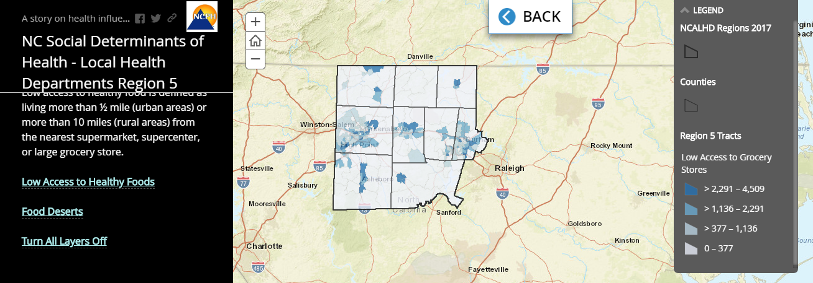
Transformation Opportunity #3:
Healthy Opportunities
Children without health insurance coverage are less likely than insured children to have a regular health care provider and to receive care when they need it.
www.ncchild.org | NC CHILD| 13
Notes:
Social Determinants of Health
Housing
Interpartner Violence
Transportation
Food Insecurity
Toxic Stress
1115 Waiver
CMS approved up to $650 million
Lead Pilot Entities

Slide 14

Medicaid Transformation
Advocacy in Action
Children without health insurance coverage are less likely than insured children to have a regular health care provider and to receive care when they need it.
Prepaid Health Plan (PHP) Outreach
  Meetings with offerors pre-RFP submission
    Will restart more focused engagement following contract awards
  Submitted letters to PHPs during RFP comment period
    NC Child’s priorities for Medicaid managed care for children and families
NC DHHS Engagement
  Meetings with key staff
    Offer research and assistance
    Comments
Advocacy with Partner Groups
  Monthly meetings with the Child Advocacy Network Health Work Group
Advocacy with Parents and Caregivers
  Parent Advisory Council
www.ncchild.org | NC CHILD| 14

Slide 15
Questions?
www.ncchild.org | NC CHILD | 15

Slide 16
Contact NC Child for research, data, and analysis of the latest policy issues affecting children and families:
NC CHILD
Staff
Ciara Zachary, Health Program Director
ciara@ncchild.org
@CiaraZachary
@ncchild
www.facebook.com/ncchildorg
Michelle Hughes, Executive Director
michelle@ncchild.org
Rob Thompson, Deputy Director
Rob@ncchild.org
Whitney Tucker, Research Director
whitney@ncchild.org
Adam Sotak, Public Engagement Director
adam@ncchild.org
www.ncchild.org | NC CHILD | 16

