Slide 1
Regulating Short Term Plans: The Illinois Experience Graciela Guzman, Coalition Manager Prepared for Families USA Health Access Conference January 24, 2019

Slide 2
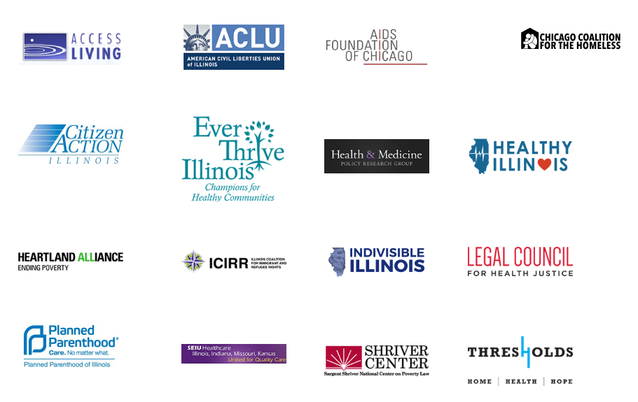
About Protect Our Care Illinois
Steering Committee
Notes:
Protect Our Care – Illinois is a statewide coalition of health care advocates, providers, consumers, and workers, joining together to prevent the repeal of the Affordable Care Act (ACA), prevent disastrous changes to Medicaid, and protect and expand access to quality affordable health care. We know the crusade to undermine the ACA is not over whether there is a repeal vote this week, next week, or next year, so Protect Our Care – Illinois invites you to join Illinoisans across the state to defend access to quality affordable health care for all.
All members of POCIL sign on to the following principles: We are committed to ensuring eligibility, coverage and access to affordable, comprehensive, and quality health insurance and will oppose and fight any proposal or policy that reduces them.
Any ACA replacement plan must provide health insurance coverage that is as comprehensive, or better than the current existing provisions under the ACA, to as many or more people.
Block grant/per capita limits are bad policies because they would severely cut Medicaid and thus block healthcare access for Illinois’ Medicaid consumers, harm the state budget, and destabilize health providers. We will oppose and fight all proposals and policies to block grant or add per capita limits to the Medicaid program.
Elected officials must be held accountable for voting against these principles. Reductions to healthcare access will harm people’s health, and elected officials have a responsibility to protect the health of the public.

Slide 3
Background
VERY short timeframe
Political landscape
Negotiated bill
Bipartisan support
☺
Industry interest
Vetoed
☹
Existing Coalition and Grassroots Operation
Notes:
Useful context
March-May
FFM with 4 carriers, med ex, some counties have one carrier, no bare counties, double digit premium increases on exchange for two years in a row
Approached by BCBSIL with concerns about pending rule and rumors they heard that United and Life Insurers were preparing to expand STLD business
We had an existing ACA defense coalition, Protect Our Care Illinois, with a pretty well established grassroots operation that we could tap
Dem legislature, Rep Governor, DOI is super hands off---NOT a liberal bastion,but definitely some appetite among legislature to fight against ACA sabatoge in some way
Introduced a STRONG bill (see the link at end) that would have limited STLD to 3 months, applied all ACA consumer protections, forced STLD to meet same filing and regulatory standards as individual coverage, prohibits recsissions, and enacted extremely strong disclosure requirements. In essence, we believe that the bill would have resulted in no STLD plans being sold in IL.
We had to negotiate the bill in order to get any regulation of STLD. Final bill gave regulator authority to DOI, limited coverage period and renewals, and provided for strong consumer disclosures. Negotiation removed all opposition.
The negotiated bill was approved with bipartisan support in both chambers and vetoed by our Governor.

Slide 4
Why Regulate Short-Term Plans?
Proposed rule
Demonstrated interest in STLD plans from industry
Time spent reviewing an actual plan
Proposed rule
Notes:
Useful context
March-May
FFM with 4 carriers, med ex, some counties have one carrier, no bare counties, double digit premium increases on exchange for two years in a row
Approached by BCBSIL with concerns about pending rule and rumors they heard that United and Life Insurers were preparing to expand STLD business
We had an existing ACA defense coalition, Protect Our Care Illinois, with a pretty well established grassroots operation that we could tap
Dem legislature, Rep Governor, DOI is super hands off---NOT a liberal bastion,but definitely some appetite among legislature to fight against ACA sabatoge in some way
Introduced a STRONG bill (see the link at end) that would have limited STLD to 3 months, applied all ACA consumer protections, forced STLD to meet same filing and regulatory standards as individual coverage, prohibits recsissions, and enacted extremely strong disclosure requirements. In essence, we believe that the bill would have resulted in no STLD plans being sold in IL.
We had to negotiate the bill in order to get any regulation of STLD. Final bill gave regulator authority to DOI, limited coverage period and renewals, and provided for strong consumer disclosures. Negotiation removed all opposition.
The negotiated bill was approved with bipartisan support in both chambers and vetoed by our Governor.

Slide 5
Key Questions We Had to Ask
Were there consumers who could derive even minimal protection from a STLD plan?
How many people had STLD plans in IL?
Who was selling STLD plans?
Were we comfortable with actually limiting these plans?
What was our actual goal?

Slide 6
Lessons Learned: Messaging
Pre-ex and consumer protections
Fine print & rescissions
ACA SEPs
STORIES STORIES STORIES
Marketplace stability
Proposed rule
Notes:
Useful context
March-May
FFM with 4 carriers, med ex, some counties have one carrier, no bare counties, double digit premium increases on exchange for two years in a row
Approached by BCBSIL with concerns about pending rule and rumors they heard that United and Life Insurers were preparing to expand STLD business
We had an existing ACA defense coalition, Protect Our Care Illinois, with a pretty well established grassroots operation that we could tap
Dem legislature, Rep Governor, DOI is super hands off---NOT a liberal bastion,but definitely some appetite among legislature to fight against ACA sabatoge in some way
Introduced a STRONG bill (see the link at end) that would have limited STLD to 3 months, applied all ACA consumer protections, forced STLD to meet same filing and regulatory standards as individual coverage, prohibits recsissions, and enacted extremely strong disclosure requirements. In essence, we believe that the bill would have resulted in no STLD plans being sold in IL.
We had to negotiate the bill in order to get any regulation of STLD. Final bill gave regulator authority to DOI, limited coverage period and renewals, and provided for strong consumer disclosures. Negotiation removed all opposition.
The negotiated bill was approved with bipartisan support in both chambers and vetoed by our Governor.

Slide 7
Fine Print and Rescissions
Proposed rule
Notes:
Useful context
March-May
FFM with 4 carriers, med ex, some counties have one carrier, no bare counties, double digit premium increases on exchange for two years in a row
Approached by BCBSIL with concerns about pending rule and rumors they heard that United and Life Insurers were preparing to expand STLD business
We had an existing ACA defense coalition, Protect Our Care Illinois, with a pretty well established grassroots operation that we could tap
Dem legislature, Rep Governor, DOI is super hands off---NOT a liberal bastion,but definitely some appetite among legislature to fight against ACA sabatoge in some way
Introduced a STRONG bill (see the link at end) that would have limited STLD to 3 months, applied all ACA consumer protections, forced STLD to meet same filing and regulatory standards as individual coverage, prohibits recsissions, and enacted extremely strong disclosure requirements. In essence, we believe that the bill would have resulted in no STLD plans being sold in IL.
We had to negotiate the bill in order to get any regulation of STLD. Final bill gave regulator authority to DOI, limited coverage period and renewals, and provided for strong consumer disclosures. Negotiation removed all opposition.
The negotiated bill was approved with bipartisan support in both chambers and vetoed by our Governor.

Slide 8
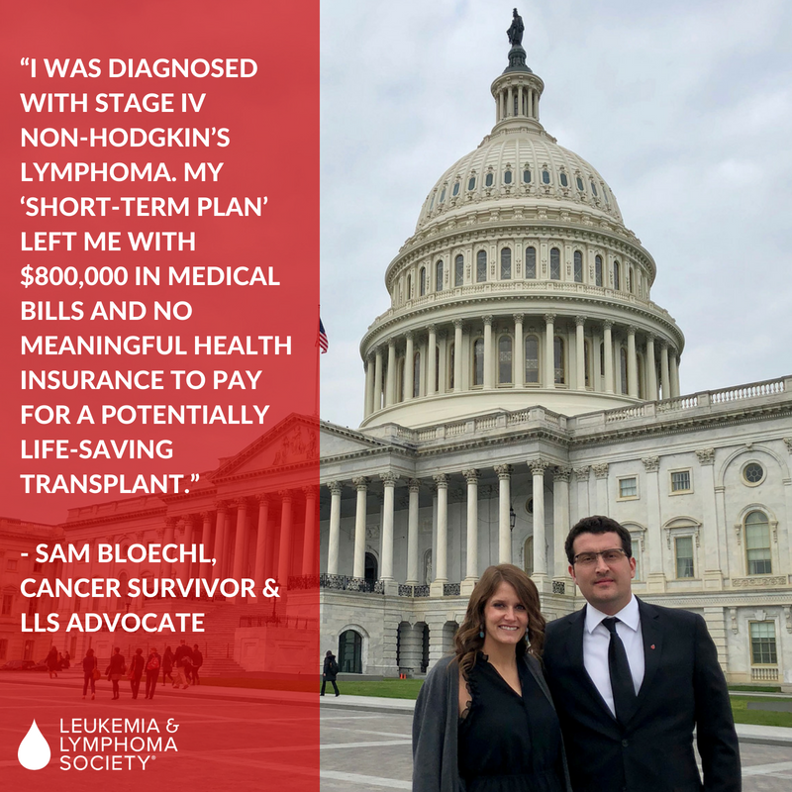
Stories
Proposed rule
Notes:
Useful context
March-May
FFM with 4 carriers, med ex, some counties have one carrier, no bare counties, double digit premium increases on exchange for two years in a row
Approached by BCBSIL with concerns about pending rule and rumors they heard that United and Life Insurers were preparing to expand STLD business
We had an existing ACA defense coalition, Protect Our Care Illinois, with a pretty well established grassroots operation that we could tap
Dem legislature, Rep Governor, DOI is super hands off---NOT a liberal bastion,but definitely some appetite among legislature to fight against ACA sabatoge in some way
Introduced a STRONG bill (see the link at end) that would have limited STLD to 3 months, applied all ACA consumer protections, forced STLD to meet same filing and regulatory standards as individual coverage, prohibits recsissions, and enacted extremely strong disclosure requirements. In essence, we believe that the bill would have resulted in no STLD plans being sold in IL.
We had to negotiate the bill in order to get any regulation of STLD. Final bill gave regulator authority to DOI, limited coverage period and renewals, and provided for strong consumer disclosures. Negotiation removed all opposition.
The negotiated bill was approved with bipartisan support in both chambers and vetoed by our Governor.

Slide 9
Stories
Proposed rule
Notes:
Useful context
March-May
FFM with 4 carriers, med ex, some counties have one carrier, no bare counties, double digit premium increases on exchange for two years in a row
Approached by BCBSIL with concerns about pending rule and rumors they heard that United and Life Insurers were preparing to expand STLD business
We had an existing ACA defense coalition, Protect Our Care Illinois, with a pretty well established grassroots operation that we could tap
Dem legislature, Rep Governor, DOI is super hands off---NOT a liberal bastion,but definitely some appetite among legislature to fight against ACA sabatoge in some way
Introduced a STRONG bill (see the link at end) that would have limited STLD to 3 months, applied all ACA consumer protections, forced STLD to meet same filing and regulatory standards as individual coverage, prohibits recsissions, and enacted extremely strong disclosure requirements. In essence, we believe that the bill would have resulted in no STLD plans being sold in IL.
We had to negotiate the bill in order to get any regulation of STLD. Final bill gave regulator authority to DOI, limited coverage period and renewals, and provided for strong consumer disclosures. Negotiation removed all opposition.
The negotiated bill was approved with bipartisan support in both chambers and vetoed by our Governor.

Slide 10
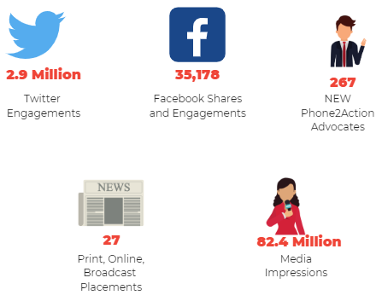
Campaign Impact

Slide 11
Tactics
Stakeholder/Field calls
Phone 2 Action/Days of Action
Social Media
Earned Media
Letters and Witness Slips

Slide 12
Influencers
Allies
Disease Groups
Opposition
Life insurers
Department of Insurance (at first)
Consumers Advocates
Carriers
Neutral?
Providers
Associations
Carriers
Brokers and agents

Slide 13
Veto Session VICTORY

Slide 14
Resources
HB2624 Action Toolkit
The bill language we started with (HB1337 SA1)
The bill language that we passed (HB2624 SA3)
United Golden Rule Short Term Plan document we worked from
Sam’s story Part 1 and Part 2
LA Times story on fine print
Chicago Tribune coverage of bill passing

Slide 15
QUESTIONS?
Graciela Guzman
ggguzman@heartlandalliance.org
773.270.2611

