Slide 1





Health Action 2019
Consumer Assistance is Still Mission Critical: Where We’ve Been, Where We’re Going
Notes:
Summary: Ongoing changes to the health care landscape mean that consumers and patients need continual help navigating coverage and care. Panelists will discuss new efforts they’re implementing to continue meeting essential needs of their communities.
Speakers:
Molly Moffett, Community Health Council of Wyandotte County
Shelli Quenga, Palmetto Project
Lisa Chan-Sawin, MHA, Transform Health
Moderator: Heather Bates, Transform Health

Slide 2



How We’re Different
Full-Service
Mission-Driven
Customized Solutions
Outcomes- Based
Nationally certified women and minority owned business (MWBE).
Notes:
Lisa, Who is Transform Health (brief, 20 seconds)
We are nationally certified as women and minority owned full service health care consulting firm
We work with leaders in the public and private sectors to drive solutions that promote efficiency, value, and access to care, in order to address key social determinants of health to improve health outcomes

Slide 3
Agenda
Overview of Federal Landscape
A Look Back and a Look at OEP
Lessons From Texas
Lessons from Kentucky

Slide 4


Slide 5
Leading Up to Open Enrollment
Cuts to Marketing and Advertising
Cuts to Enrollment Assistance Programs
Expansion of Non-QHP/Marketplace Plans
Elimination of Individual Mandate Penalty
Rhetoric Around the 2018 Election
Lack of Awareness of Open Enrollment Dates
Focus on Privatization

Slide 6
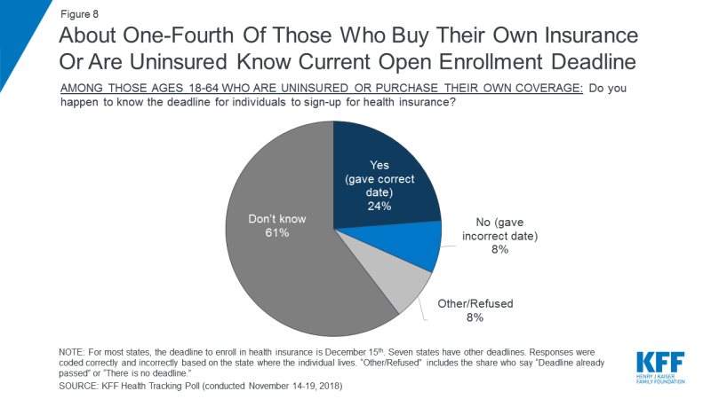
Lack of Awareness Abounds….

Slide 7
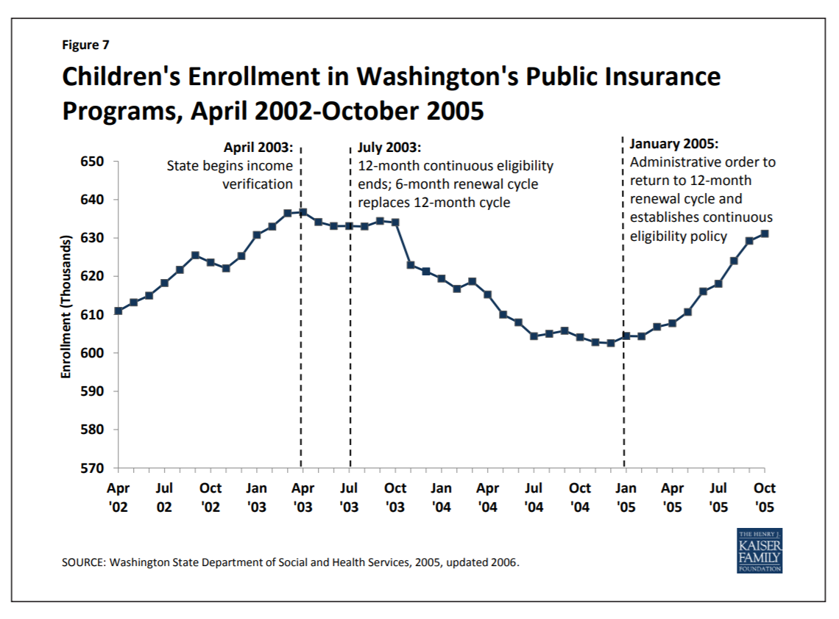
Outreach and Enrollment Practices Matter!

Slide 8
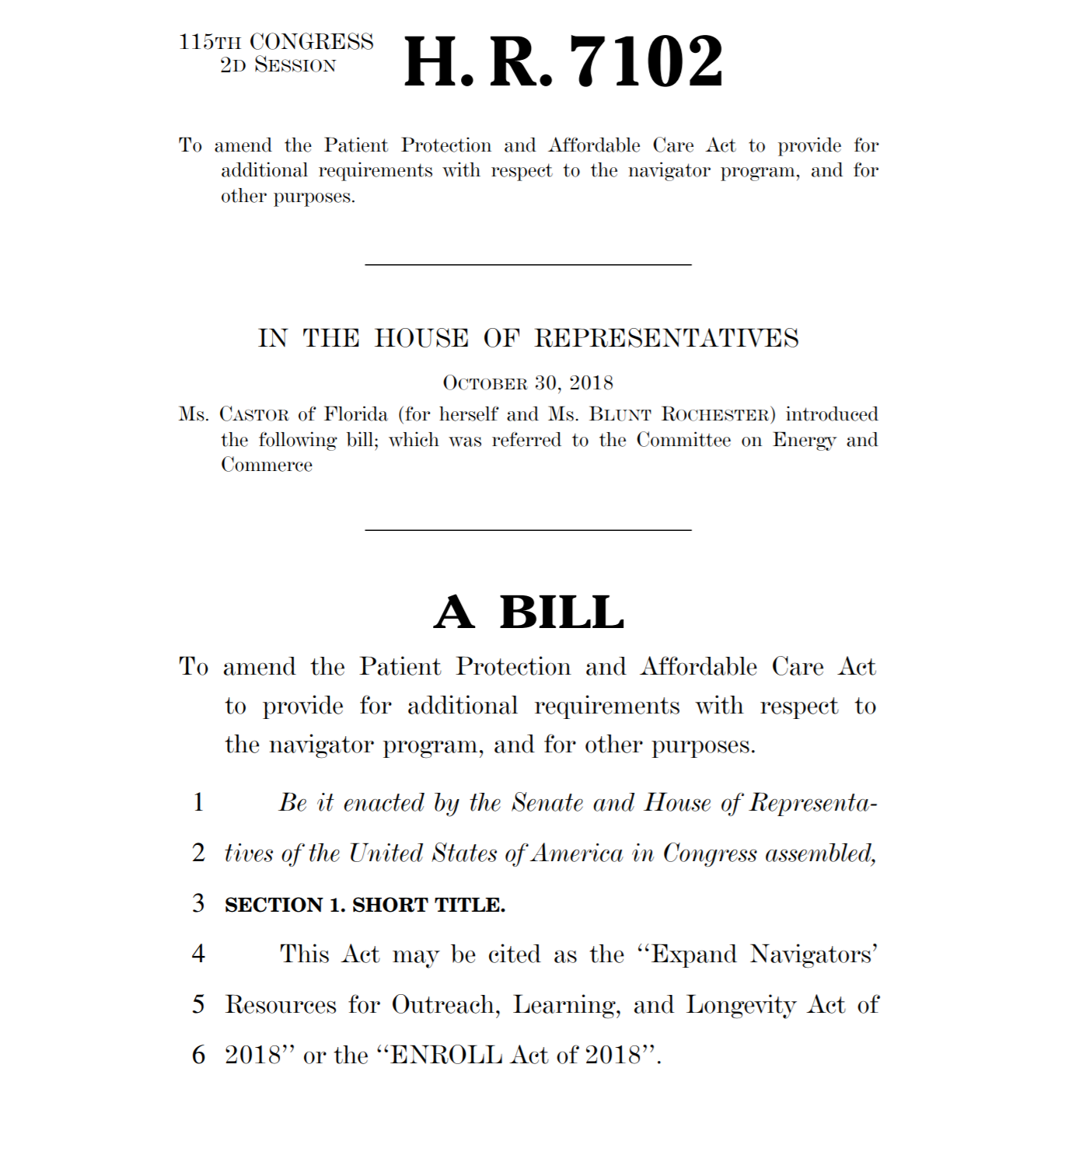
Congressional Action Around Consumer Assistance

Slide 9
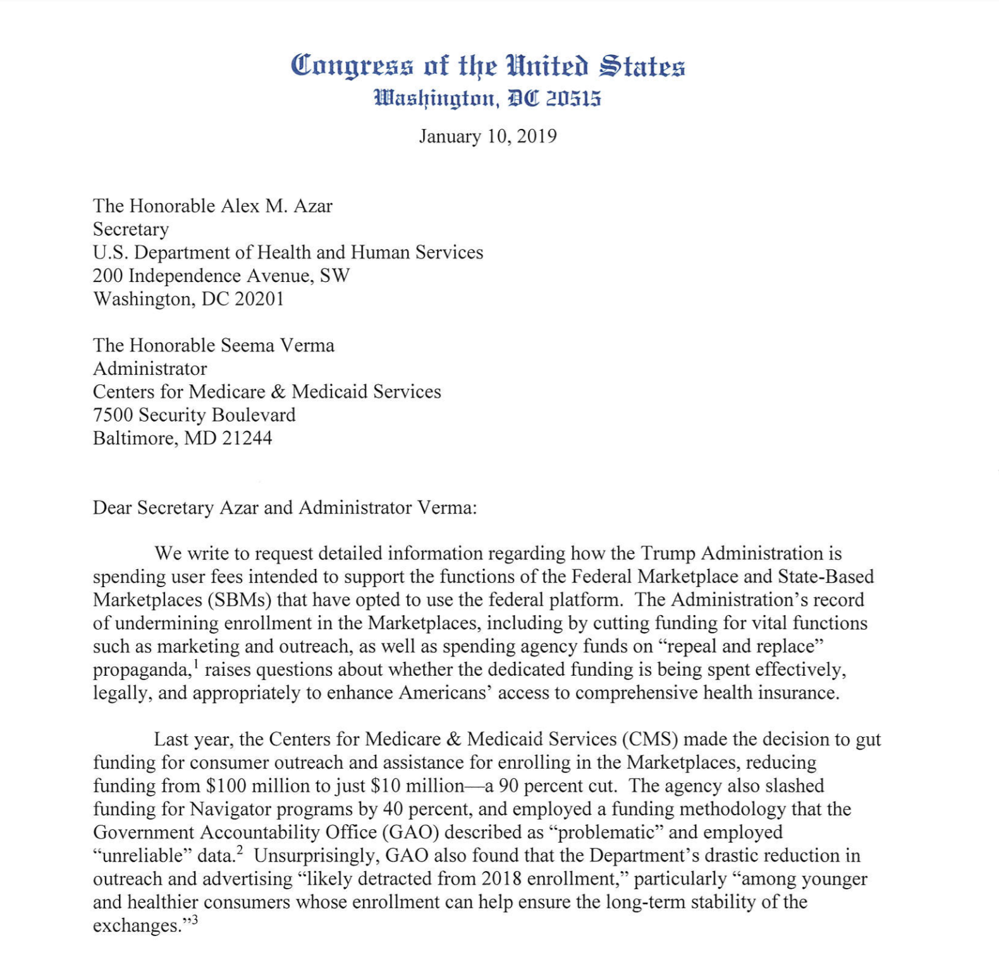
Recent Congressional Action

Slide 10
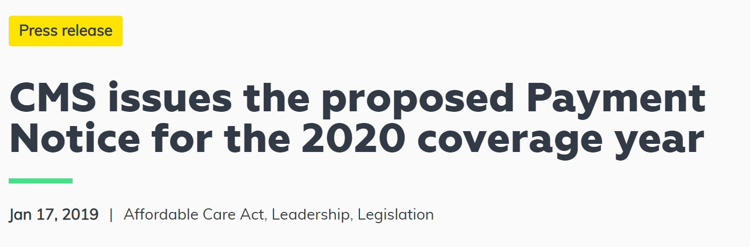
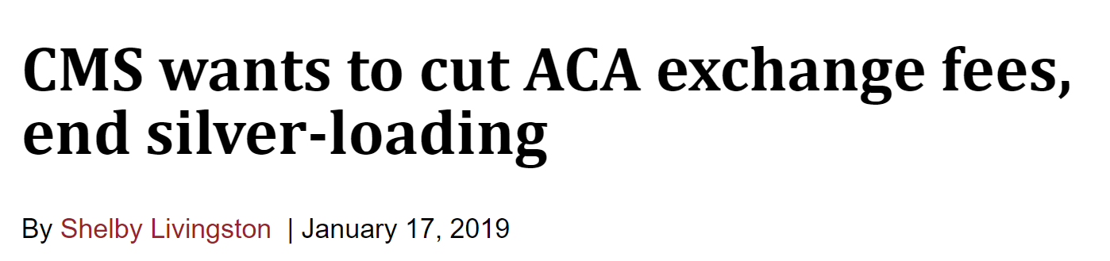
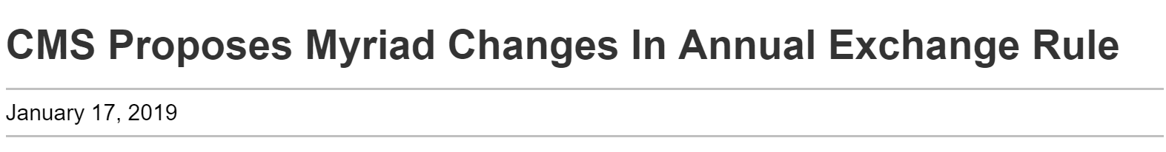

NEW: Notice of Benefit and Payment Parameters

Slide 11
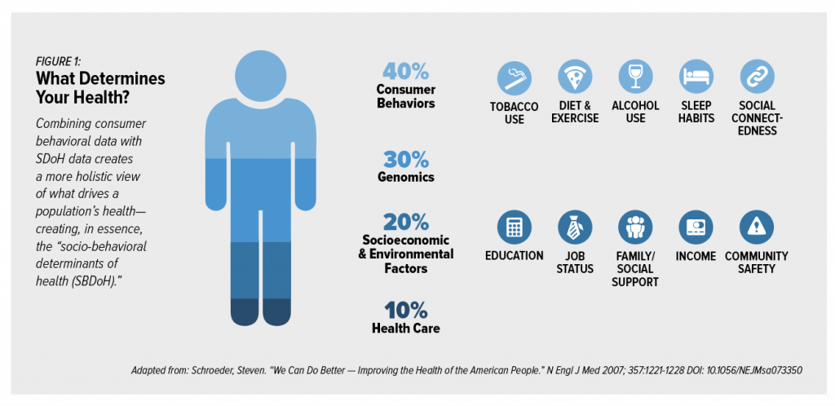
Enrollment and Health Care Are Only One Piece of the Larger Puzzle

Slide 12
Consumer Assistance in Health Insurance: Issues Following Open Enrollment 2019
2019 Health Action Conference
January 25, 2019
Karen Pollitz, Senior Fellow
Kaiser Family Foundation

Slide 13
Affordable Care Act Established New Permanent Capacity for Consumer Assistance
Inspired by predecessors:
  State health insurance ombudsman programs (e.g., CA, CT)
  Health advocacy units established by State Attorneys General (e.g., MD)
  Independent, nonprofit consumer assistance and advocacy programs (eg, ME, Medicare Rights Center)
  Medicare SHIP
  FQHC and public health department community health workers
  Connecting Kids to Coverage outreach and enrollment campaign
Intended to create a new, permanent capacity within the health coverage system to:
  Help consumers understand health coverage options, rights, responsibilities
  Help consumers enroll in coverage, financial assistance
  Help consumers resolve post-enrollment problems and questions
  Help regulators monitor consumer experiences and improve oversight

Slide 14
State-wide Ombudsman/Consumer Assistance Programs (CAPs)
State independent offices of health insurance consumer assistance/ombudsman (CAPs)
  Permanently authorized (§1002)
  Initial appropriation of $30 million
  Serve all state residents (group and non-group coverage and uninsured)
  Duties:
    Public education and outreach
    Enrollment assistance
    Post enrollment assistance, including help filing grievances and appeals, resolve problems obtaining premium tax credits
    Collect data on consumer problems; Secretary shall use such data to identify enforcement priorities and share data with other state/federal regulators
Established in 2010; 36 operating as of January 2018

Slide 15
In-Person Assisters in the Marketplace
Marketplace enrollment assisters (Navigators)
  Permanently authorized, required by law in every marketplace (§1311(i))
  Funded through Marketplace operating revenue
  Duties:
    Public education and outreach
    Enrollment assistance
    Refer consumers to CAPs for help filing grievances and appeals
    Provide information in a manner culturally and linguistically appropriate
Additional in-person assister programs established by regulation and federal contract:
  Certified Application Counselors (CACs)
  Federal Enrollment Assistance Program (FEAP)

Slide 16
Types of Marketplace Assister Programs, 2016
SOURCE: Kaiser Family Foundation, 2016 Survey of Health Insurance Marketplace Assister Programs and Brokers, June 2016.
Notes:
Reflects respondents.
Number Checked!

Slide 17
Distribution of Marketplace Assister Programs and Consumers Helped by Program Caseload Size
Assister Programs
Consumers Helped
Total Number of Assister Programs = 5,094
Total Number of Consumers Helped = 5.3 million
SOURCE: Kaiser Family Foundation, 2016 Survey of Health Insurance Marketplace Assister Programs and Brokers, June 2016.
Notes:
Q41 and Q45

Slide 18
Reasons Consumers Sought Help, 2014 - 2016
Share of Assister Programs reporting “most” or “all or nearly all” consumers sought help for the following reasons:
* Reasons that have statistically significant changes between 2014 to 2016.
SOURCE: Kaiser Family Foundation, 2016 Survey of Health Insurance Marketplace Assister Programs and Brokers, June 2016.
Notes:
Q23
NUMBER CHECKED

Slide 19
Consumers Needing Help Understanding Basic Insurance Concepts, 2015-2016
Among your Program’s clients who considered or purchased QHPs, how many needed help understanding basic insurance terms, such as “deductible” or “in-network service”?
*Significantly different from 2016 at the 95% confidence level.
NOTE: Data may not sum to 100% due to rounding.
SOURCE: Kaiser Family Foundation, 2016 Survey of Health Insurance Marketplace Assister Programs and Brokers, June 2016.
Notes:
Q28
NUMBER CHECKED

Slide 20
Post-Enrollment Problems Assister Programs Encountered, 2016
SOURCE: Kaiser Family Foundation, 2016 Survey of Health Insurance Marketplace Assister Programs and Brokers, June 2016.
Notes:
Q36
Number Checked!

Slide 21
Average Time Assister Programs Spent Helping New and Renewing Consumers, 2016
New Consumers
Renewing Consumers
SOURCE: Kaiser Family Foundation, 2016 Survey of Health Insurance Marketplace Assister Programs and Brokers, June 2016.

Slide 22
Marketplace assister programs and brokers tend to serve different populations with different needs
 | % of Assister Programs | % of Brokers
Few or no clients required language translation help | 54% | 85%
Few or no clients lacked internet at home | 24% | 60%
Helped Latino clients | 76% | 48%
Most or nearly all clients were uninsured when sought help | 56% | 30%
Most or nearly all clients could qualify for Medicaid | 42% | 8%
Source: Kaiser Family Foundation 2016 Survey of Health Insurance marketplace Assister Programs and Brokers

Slide 23
Federal funding for in-person marketplace consumer assistance (Navigator and FEAP), 2014-2019
$84 million
Notes:
I’m just going to provide a quick update on how the Fifth ACA Open Enrollment is going
What’s happening?
Why?
What it may mean going forward
Recall that at end of 4th open enrollment, we had 12.2 million people who selected non-group health plans through the marketplace for the 2017 coverage year. That was a slight decline from the number of signups at the end of the 3rd Open Enrollment.
Everyone’s waiting to see what the total will be for Open Enrollment 5

Slide 24
Share of FQHCs Experiencing Reductions in Navigator Funding and Actions Taken in Response
Note: * Significantly different from health centers in Medicaid expansion states (p=0.014).
Source: GW/KFF 2018 Health Center Survey

Slide 25
Changes in FQHC Staffing for Enrollment Assistance During the 2018 Open Enrollment Period
Compared to the last open enrollment period, how has the number of FTE paid staff at your
at your health center changed?
Average number of staff
employed during 2018
open enrollment
period – 4.5 FTE
Source: GW/KFF 2018 Health Center Survey

Slide 26
Marketplace Trends: Open Enrollment Plan Selections
(Plan Selections in millions)
Source: Health Insurance Marketplace Open Enrollment Reports for 2014, 2015, 2016, and 2017, Office of the Assistant Secretary for Planning and Evaluation (ASPE), Department of Health and Human Services (HHS).
Notes:
Values correct. Need help with data labels to align, make parallel

Slide 27
Enrollment changes 2018-2019 varied by state
State | Plan Selections OE5 (#) | Plan Selections OE5 (#) | Change (#) | Change (%)
Healthcare.gov Total | 8,743,642 | 8,411,614 | -332,028 | -3.8%
Florida | 1,715,227 | 1,783,304 | +68,077 | +4%
Mississippi | 83,649 | 88,542 | +4,893 | +5.8%
Oklahoma | 140,184 | 150,759 | +10,575 | +7.5%
Utah | 194,118 | 194,570 | +452 | +0.2%
South Carolina | 215,983 | 214,956 | -1,027 | -0.5%
North Carolina | 519,803 | 501,271 | -18,532 | -3.6%
Texas | 1,126,838 | 1,087,240 | -39,598 | -3.5%
Indiana | 166,711 | 148,404 | -18,307 | -11%
Louisiana | 109,855 | 92,948 | -16,907 | -15.4%
New Hampshire | 49,573 | 44,581 | -4,992 | -10.1%
West Virginia | 27,409 | 22,599 | -4,810 | -17.5%
Virginia | 400,015 | 328,020 | -71,995 | -18%

Slide 28
Future challenges may lie ahead
Trump Administration proposed regulation for 2020 plans and Open Enrollment signals further challenges
Changing role of healthcare.gov exchange
  Reduce federal exchange user fees from 3.5% to 3%
  Promote use of private web-broker sites
    Streamline requirements
    Permit marketing of non-QHP products: “Convenience in being able to purchase additional products as part of single shopping experience outweighs potential for consumer confusion…”
Changing role of Navigators
  No longer require certain duties: post-enrollment assistance, help filing appeals and exemptions; help understanding insurance and how to use it; help understanding APTC tax reconciliation and referral to tax assisters
    More flexibility to Navigators in light of limited resources
  No longer require Navigator training on these topics
  Allow Navigators to use private web-broker sites to enroll consumers, subject to certain standards
Change ACA formulas for premium tax credits, OOP limit
  Will increase premiums, cost sharing for consumers

Slide 29


Consumer Assistance is Still Mission Critical
Where we’ve been and where we’re going…
Trilena Amos
Director of Patient Access & Outreach | Legacy Community Health
Tamos@legacycommunityhealth.org

Slide 30
Our Legacy

Slide 31
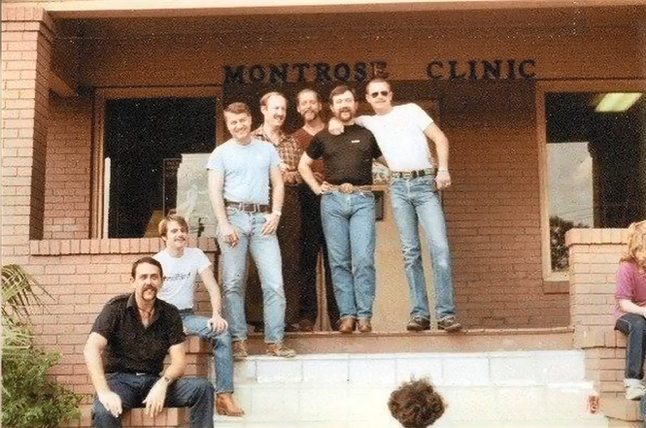
1
9
8
1
At the height of the AIDS crisis, Montrose Clinic, a clinic that provided screening, diagnosis, treatment and prevention of sexually transmitted diseases (STD) for gay men, is established as a 501(c)(3)

Slide 32
The Montrose Clinic begins offering Primary Care medical services
Legacy opens a clinic in greater Fifth Ward and is granted full status as a Federally Qualified Health Center
Legacy partners with KIPP Academy to provide primary care and behavioral health services in school
Legacy opens 12,000 sq. ft. state of the art clinic in the Greater Fifth Ward area
1988
2005
2006
2011
2012
2013
2017
The Montrose Clinic and the Assistance Fund merge to become Legacy Community Health
Legacy Montrose Clinic opens 40,000 sq. ft. clinic in the heart of Montrose
Legacy expands services to Beaumont community
Legacy opens it’s own full-service pharmacy

Slide 33

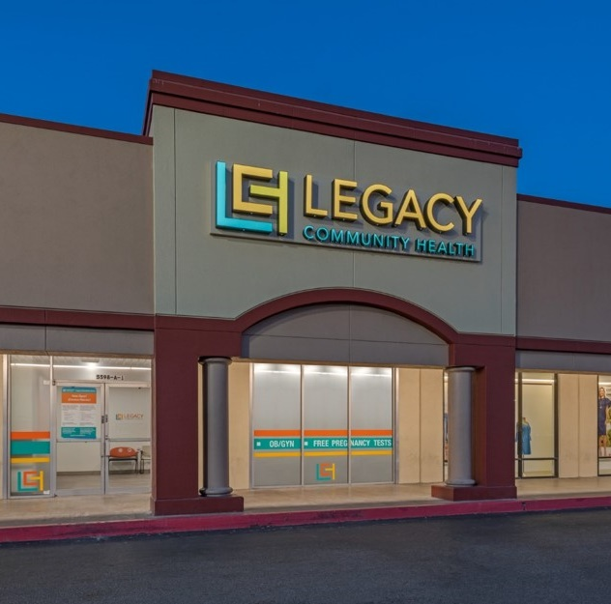
2
0
1
8
34
Locations across Baytown, Beaumont, Deer Park and Houston
1000+
Legacy employees serving the community
More than 160,000 patients served annually and over
1 Million
community members served over our near 40 year history
Notes:
HIGHLIGHT SCHOOL BASED CLINICS – started with KIPP Charter Schools several years ago, a couple of years after that YES Prep loved what we were doing and started a relationship with us, now on 20 school campuses offering pediatrics and BH services (therapy). MANY pros to school-based model for improved access to care. Discuss challenges that some have, parent and child missing half to whole day of work/school to get to a clinic for an appt vs seeing the kid at school efficiently. Takes a lot to set up a small clinic in a school, though.

Slide 34
Our Continuum of Care – PCMH Model
Additional Services
Adolescent Care
Cancer Screening & Prevention
School Based Health Care
Public Health Services
Health Promotion and Patient Education
Social Services
Patient Navigation & Linkage to Care
Public Affairs & Government Relations
Adult Primary Care
Pediatrics
OB/GYN & Maternity
HIV/STD Screening & Treatment
Vision
Vaccines & Immunizations
Dental
Behavioral Health
Pharmacy
LGBTQ Health Services
Geriatrics
Family Medicine

Slide 35
The Game Plan

Slide 36
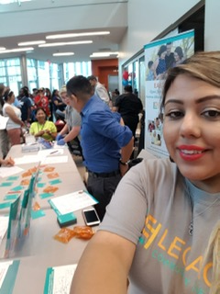
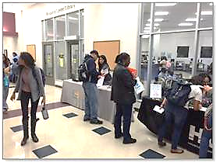
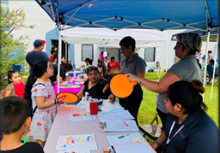
We meet patients where they are!
OE Triage Desks
Late Nights with Legacy
ACA Saturdays - opportunity for in-person assistance outside of standard work hours
Trusted Community Resources - schools & apartments communities
Town Halls - Ryan White Grantees

Slide 37
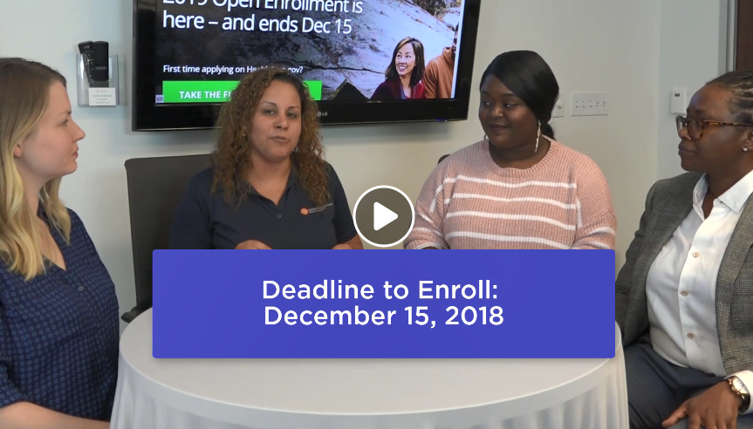
Twitter & Facebook Live Sessions

Slide 38
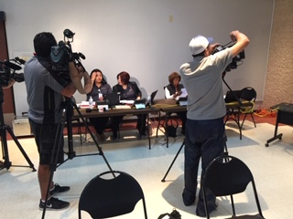
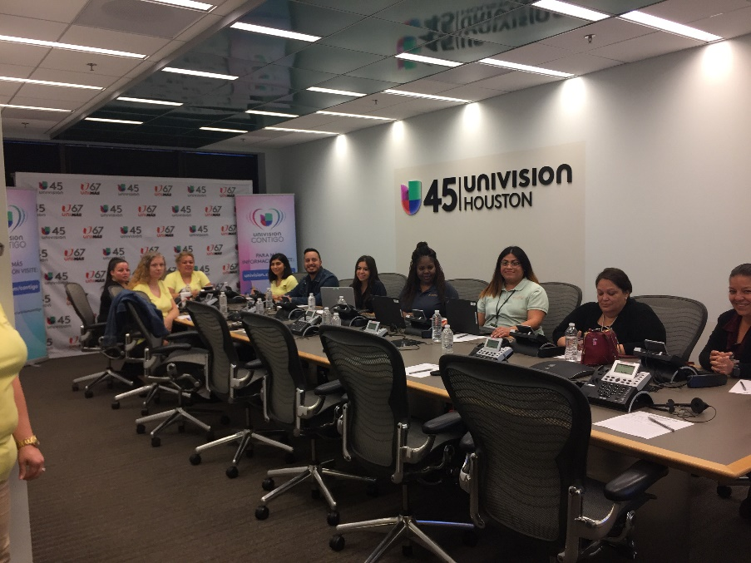




Media outlets, radio and local news stations

Slide 39
The Mantra

Slide 40

THERE’S NO

Slide 41



Collaboration is Key!
National
Statewide
Out2Enroll Advisory Committee
Local
Get Covered Statewide Advisory (Center for Public Policy Priorities)
Enroll Gulf Coast Collaborative

Slide 42

The power of collective efforts…

Slide 43
The Numbers

Slide 44


Slide 45
ACA by the Numbers
49
Certified Application Counselors
30,000+
3,149
+ 20%
Dedicated hours from volunteers & staff in 2018
Legacy ACA Webpage views
Increase in webpage engagement from 2017
2018 Total
5 year Total (2013-2018)
2,118
9,568
Estimated enrollment (HRSA)
Estimated enrollment (HRSA)
1,444
15,838
Assists provided
(HRSA)
Assists provided
(HRSA)

Slide 46

Eric’s Story…
"Acquiring marketplace insurance has been more difficult than previous years... Legacy can help you find an appropriate plan based on income and other factors{...} They got me all squared away!"

Slide 47
The Future

Slide 48
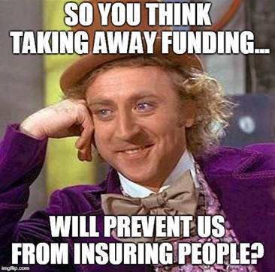

Slide 49








What’s the next level of work?
Debrief with Volunteers & Organizations
Partner with Community Health Workers
Marketing & Story banking Platform
Increase in-person assist opportunities
Eligibility/linkage to health care
Report to C-Suite to gain future buy-in
Educate parents at schools/PTAs
Create community ambassadors
Lessons learned

Slide 50

Texas Priorities in Patient Navigation
Encouraging enrollment
Retention of Staff
Continuation of collaborative efforts
Removing fear (uninsured, undocumented population)
Providing enrollment assistance for grants
Apply for grant funding

Slide 51


Enrollment in KY:
Where We’ve Been and Where We’re Going
Whitney Allen, MPH

Slide 52
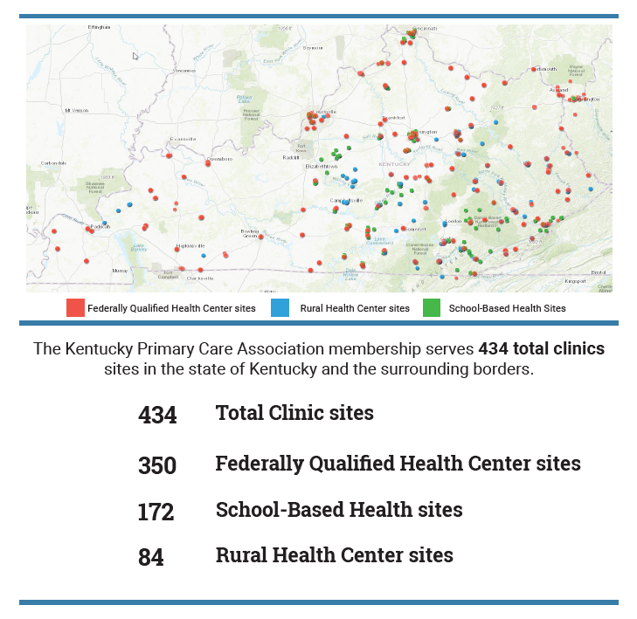
Notes:
90 KY counties with KPCA clinic locations
1,501 KPCA billable Medical Providers
embody approximately 20% of Kentucky Medicaid’s total patient population

Slide 53



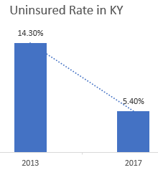



Notes:
Began as State Based Marketplace
integration of Medicaid and marketplace coverage in a single eligibility system, known as kynect
Well organized interface
User friendly
Strong marketing campaign
In person help via KYNECTORS
More than 413,000 enrolled during OE1

Slide 54

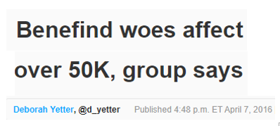
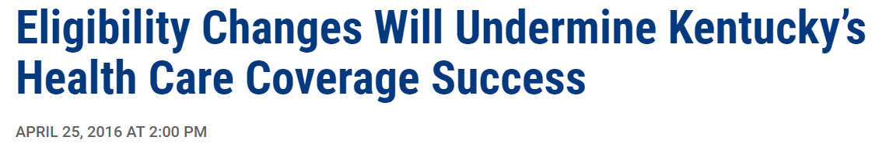
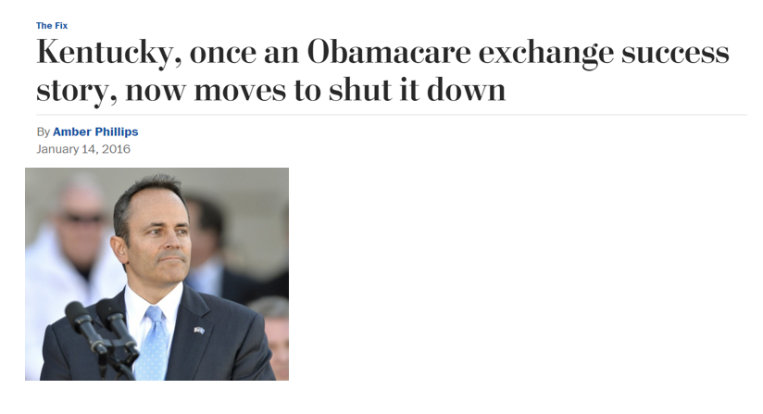
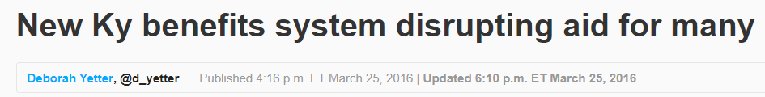
Notes:
- In February 2016, Kentucky launched Benefind, a new online portal for enrollment in Medicaid, SNAP and other public benefit programs.
- Benefind wasn’t originally designed to replace kynect, but the state has shifted Medicaid eligibility determinations to the system
- bumpy transition
disrupted “health coverage for scores of Kentuckians who use kynect,”
SBM-FP

Slide 55
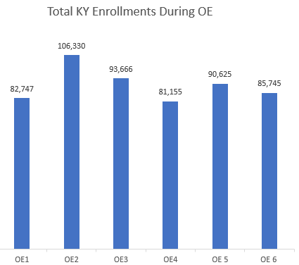
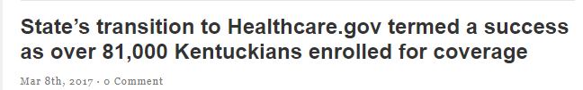

Despite all the noise…
2014 2015 2016 2017 2018 2019
Notes:
Although hurdle after hurdle- numbers show there is STILL A NEED for enrollment work.

Slide 56
Leveraging Community Relations
Application Assisters are trusted members of the community
July-December 2018:
# Hours Spent addressing Kentucky HEALTH (waiver) Questions
= 1,348 hours
Local Outreach
Convenience marts
Fast food
Grocery stores
Libraries
Festivals/Community Events
Schools
Clinics/urgent care/hospitals
Community Partnerships
Health coalitions
Chamber of Commerce
Reentry coalitions
Community event planning
State Partnerships
KY Health Benefit Exchange
Dept Medicaid Services
KY HEALTH Advisory Board
Notes:
Alongside changes, Application Assisters have been regarded as trusted members of the community
When consumers have concerns/questions, assisters are usually the first they call is Assisters
leverage partnerships to drive change/improvements
Benefind screen changes/UAT testing
Reentry efforts = more people enrolled

Slide 57
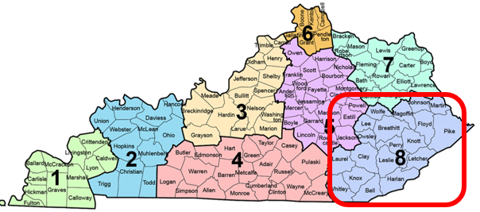
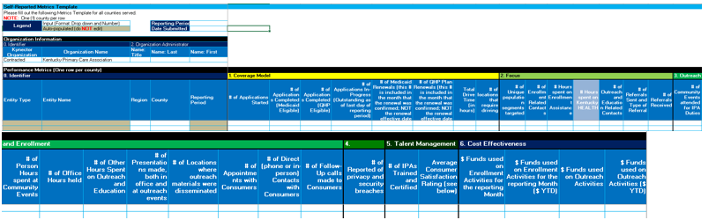
Show Your Value!
Total Completed Applications: 24,046
Number of Enrollment Related Contacts: 77,543
> Assisters experienced an average of
3 interactions per year with each household enrolled
> Average Interaction Time:
around 50 min
Notes:
- Program Operations report to measure effectiveness

Slide 58
2018 Metrics Report: Region 8 Contracted
Jan-Dec 2018
13.7 FTEs
Total Outreach Hours: 5,704
Total Enrollment Hours: 20,589
Total Applications Completed: 3,589 >>> CASE WORK!!
Invoice/Total Hours Worked: $31.46
Saving TIME & MONEY:
State operated call center, Dept Community Based Services
Dept Medicaid Services, + consumers spending less time on phone holding!

Slide 59
Where are Kentucky Assisters going?
Social Determinants of Health
CMS Accountable Health Communities Project
Use of Assisters to screen/navigate patients with health related social needs
Community Health Workers
Cross-trained at clinics to follow-up with patients post-ER visit, provide tailored health education, address health related social needs, etc.
Kentucky HEALTH 1115 Medicaid Waiver
Implementation 4/1/19
Use of Assisters to help Medicaid beneficiaries navigate the system
Notes:
transportation, food insecurity, safety, housing, utilities, family/social support
Built upon past years work, Assisters recognized as trusted source in community and cost effective means to do work

Slide 60

Whitney Allen, MPH
Coordinator of Community Development & Outreach
Kentucky Primary Care Association wallen@kypca.net

Slide 61
Intersection of Work
Outreach and Enrollment
Navigation

Slide 62

Questions and Discussion

Slide 63



Contact Us
Lisa Chan-Sawin, CEO
Transform Health
lisa@transformhc.com
Heather Bates, COO
Transform Health
heather@transformhc.com
Liz Hagan, Federal Policy Consultant
Transform Health
liz@transformhc.com
@TransformHC
www.transformhc.com

