Slide 1

Engaging Consumers in Regional
Affordability Efforts
Ellen Gagnon, Executive Director, Healthcare Affordability
Network for Regional Healthcare Improvement
Barbra Rabson, President & CEO
Massachusetts Health Quality Partners
©NRHI 2019

Slide 2
We have an unsustainable problem.
Harder choices are coming.
Between 2006 to 2016 premiums are up 77%
Healthcare costs will consume
half of household income by 2021
2016
Premiums and out-of-pocket expenses
2006
2021
Household
income
Source: Henry J Kaiser Family Foundation, September 19, 2017. Premiums and Worker Contributions Among Workers Covered by Employer Sponsored Coverage. https://www.kff.org/interactive/premiums-and-worker-contributions/
Source: Young RA, DeVoe JE. Who Will Have Health Insurance in the Future?
An Updated Projection. Am Fam Med 2012; 10(2): 156-162. PMCID: PMC3315130.
©NRHI 2019

Slide 3
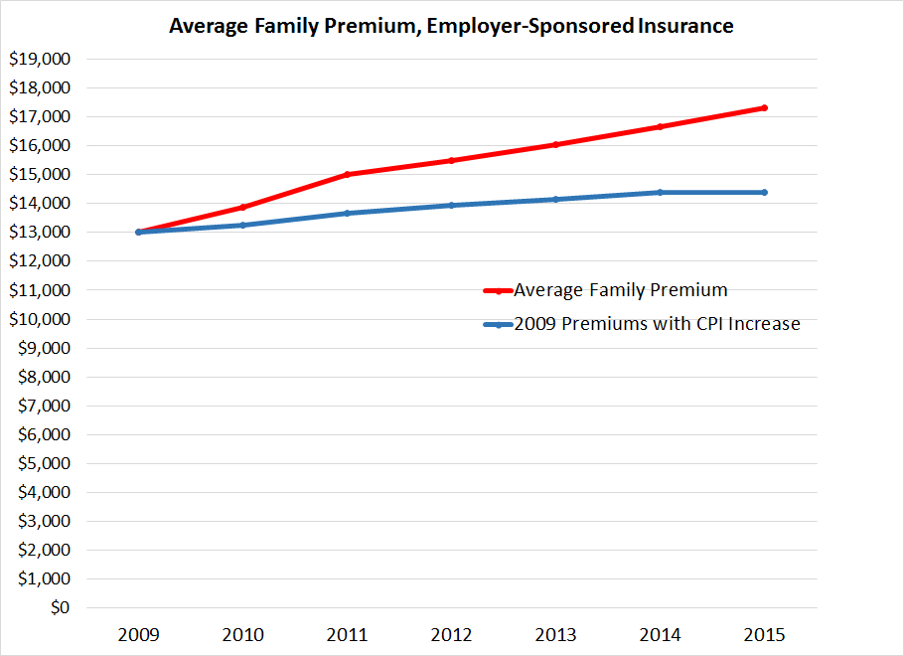
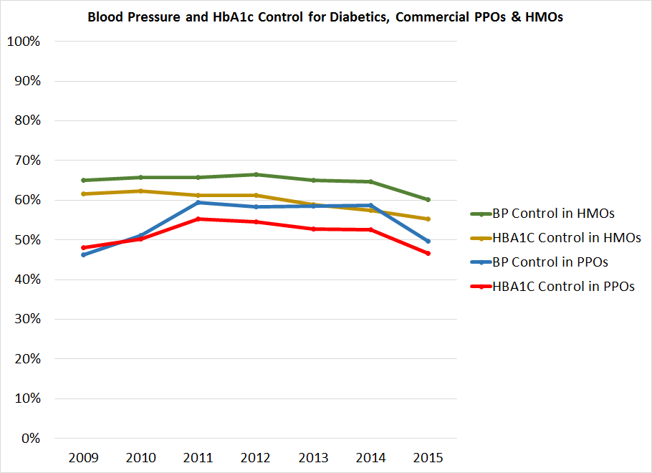
Value is LOWER today than six years ago.
Higher cost
Poorer quality
Source: National Council of State Legislatures
©NRHI 2019

Slide 4
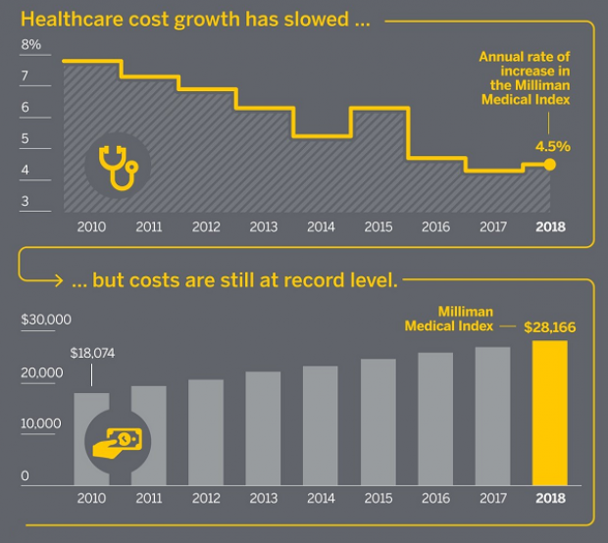
Healthcare costs for typical American family hit record high.
Source: Fiscal Times, Health Care Costs for Typical American Family Hit Record High , May 23, 2018
©NRHI 2019

Slide 5
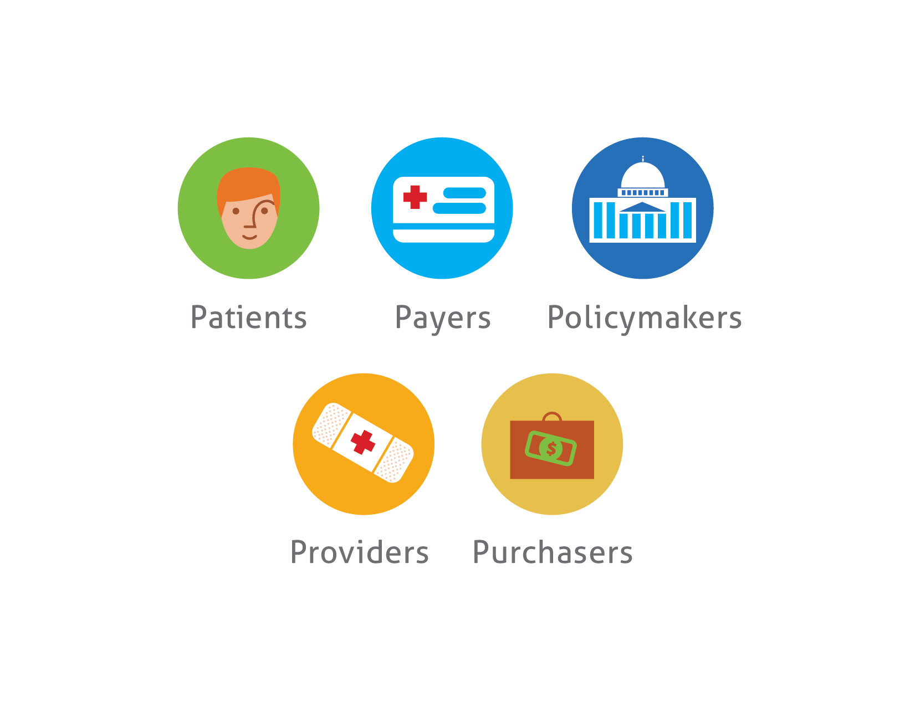
We ALL created this problem.
We ALL need to be part of the solution.
Patients
Payers
Providers
Purchasers
Policymakers
©NRHI 2019

Slide 6
Understanding the problem
©NRHI 2019

Slide 7
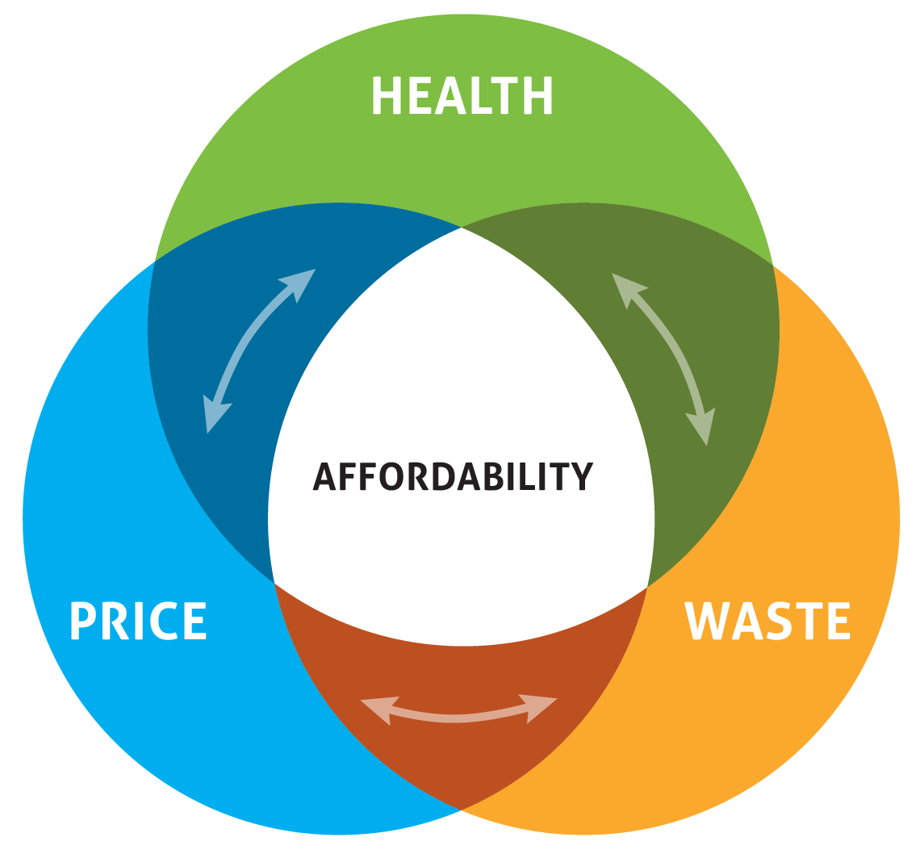
Solving one issue in isolation does not achieve the goal.
The major drivers of affordability.
Health
Price
Waste
©NRHI 2019

Slide 8
Addressing the drivers of affordability has systemic benefits — in addition to the positive economic impact.
+ HEALTH
- WASTE
- PRICE
Healthier populations:
• use fewer resources
• increase productivity
• enhance communities
Unnecessary clinical procedures:
• increase clinical harm
• cause emotional distress
• incur financial harm
Administrative burden:
• increases cost
• is burning out providers
High prices:
• don’t correlate with quality
• incentivize waste
• misallocate resources
©NRHI 2019

Slide 9
What would it take to fix all this?
Transparency
Data & Information
Aligning Incentives
Community Engagement
Collaboration Across Sectors
New Payment Models
Informed Consumers
Who could do all this?
©NRHI 2019

Slide 10
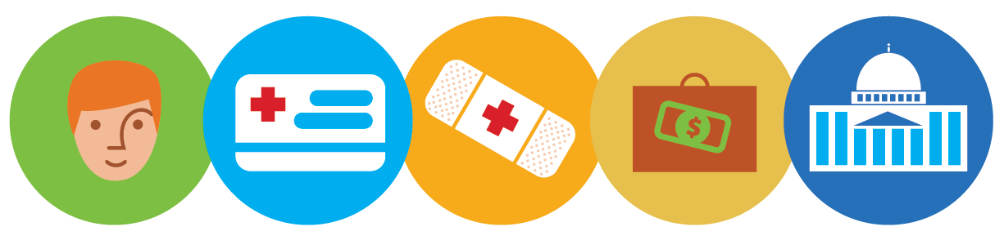
There is hope.
Patients
Payers
Providers
Purchasers
Policymakers
In many regions across the country we are coming together to untangle complexities and find a path to affordability.
©NRHI 2019

Slide 11
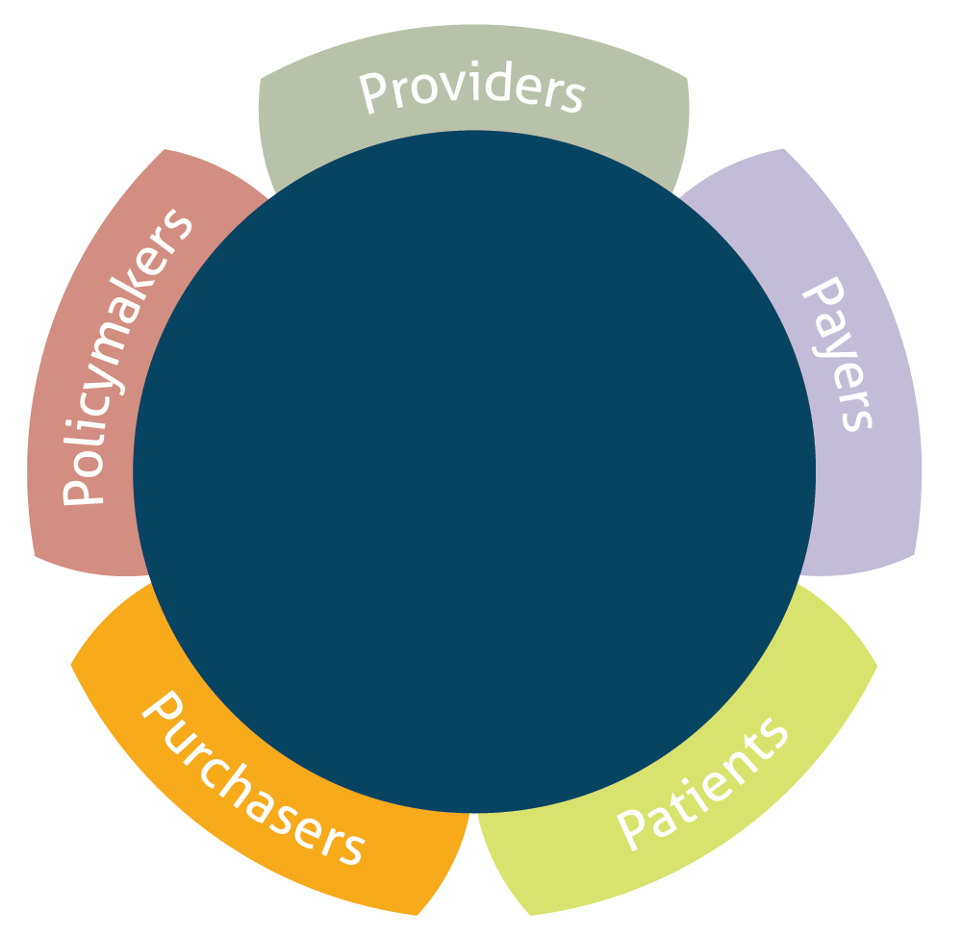
Regional Health Improvement Collaboratives (RHICs)
Regional Focus
Neutral Conveners
Non-Profit
©NRHI 2019
11

Slide 12

They’re bringing together all parties for safer, higher quality, more affordable care that works better for everyone.
©NRHI 2019
12

Slide 13
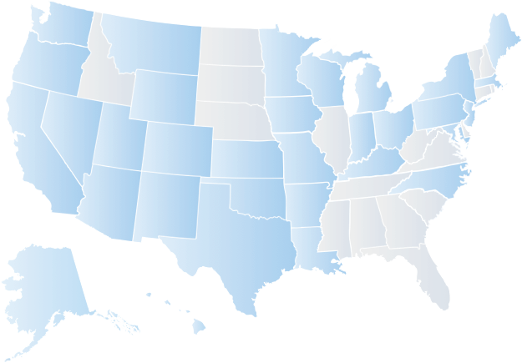

RHICs currently work in many regions across the U.S.
NRHI Members
NRHI State Affiliates
©NRHI 2019
13

Slide 14
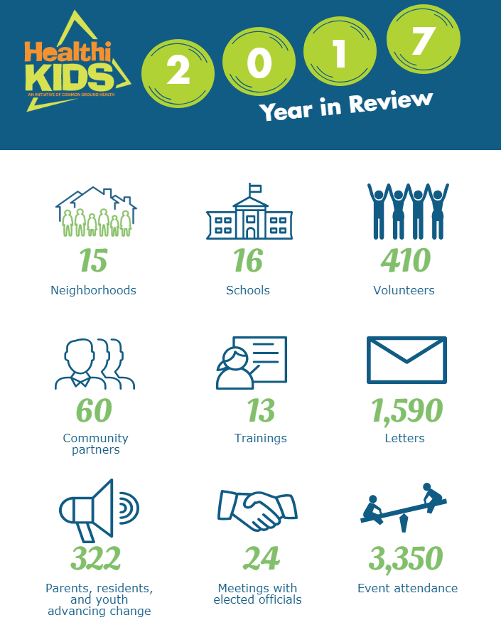

Blazing the path for healthier, more active children
Health
Working for the last decade with multi-sector leaders to advocate for policy, system, and environmental changes in Monroe County, NY.
Agenda:
better school food
safer play areas
60+ mins of in-school physical activity
healthy food in neighborhoods
walkable, bikeable & accessible communities
Addressing root causes of childhood obesity
©NRHI 2019

Slide 15


Making cost and quality information public
Price
Wear the Cost campaign provides cost and quality information for consumers.
Goals:
Patients/providers become more aware of variation among hospitals statewide
reduce costs
help patients make high-value choices.
Empowering consumers to get involved in their own healthcare, with numerous ways to take action.
Empowering consumers
©NRHI 2019

Slide 16


Shining a light on waste in
Washington state
Waste
Overuse of low-value services introduces the unnecessary risk of adverse physical and financial harm for patients, drives up costs for purchasers and insurers, and strains the system.
Outcomes:
This report examined 47 common treatment approaches known by the medical community to be overused
More than 45% of the healthcare services examined were determined to be low value
Approximately 1.3 million individuals received one of these
47 services; among these individuals, almost one-half (47.9%) received a low value service
36% of spending on the healthcare services examined went to low value treatments and procedures - this amounts to an estimated $282 million in wasteful spending
Understanding clinical waste
©NRHI 2019

Slide 17
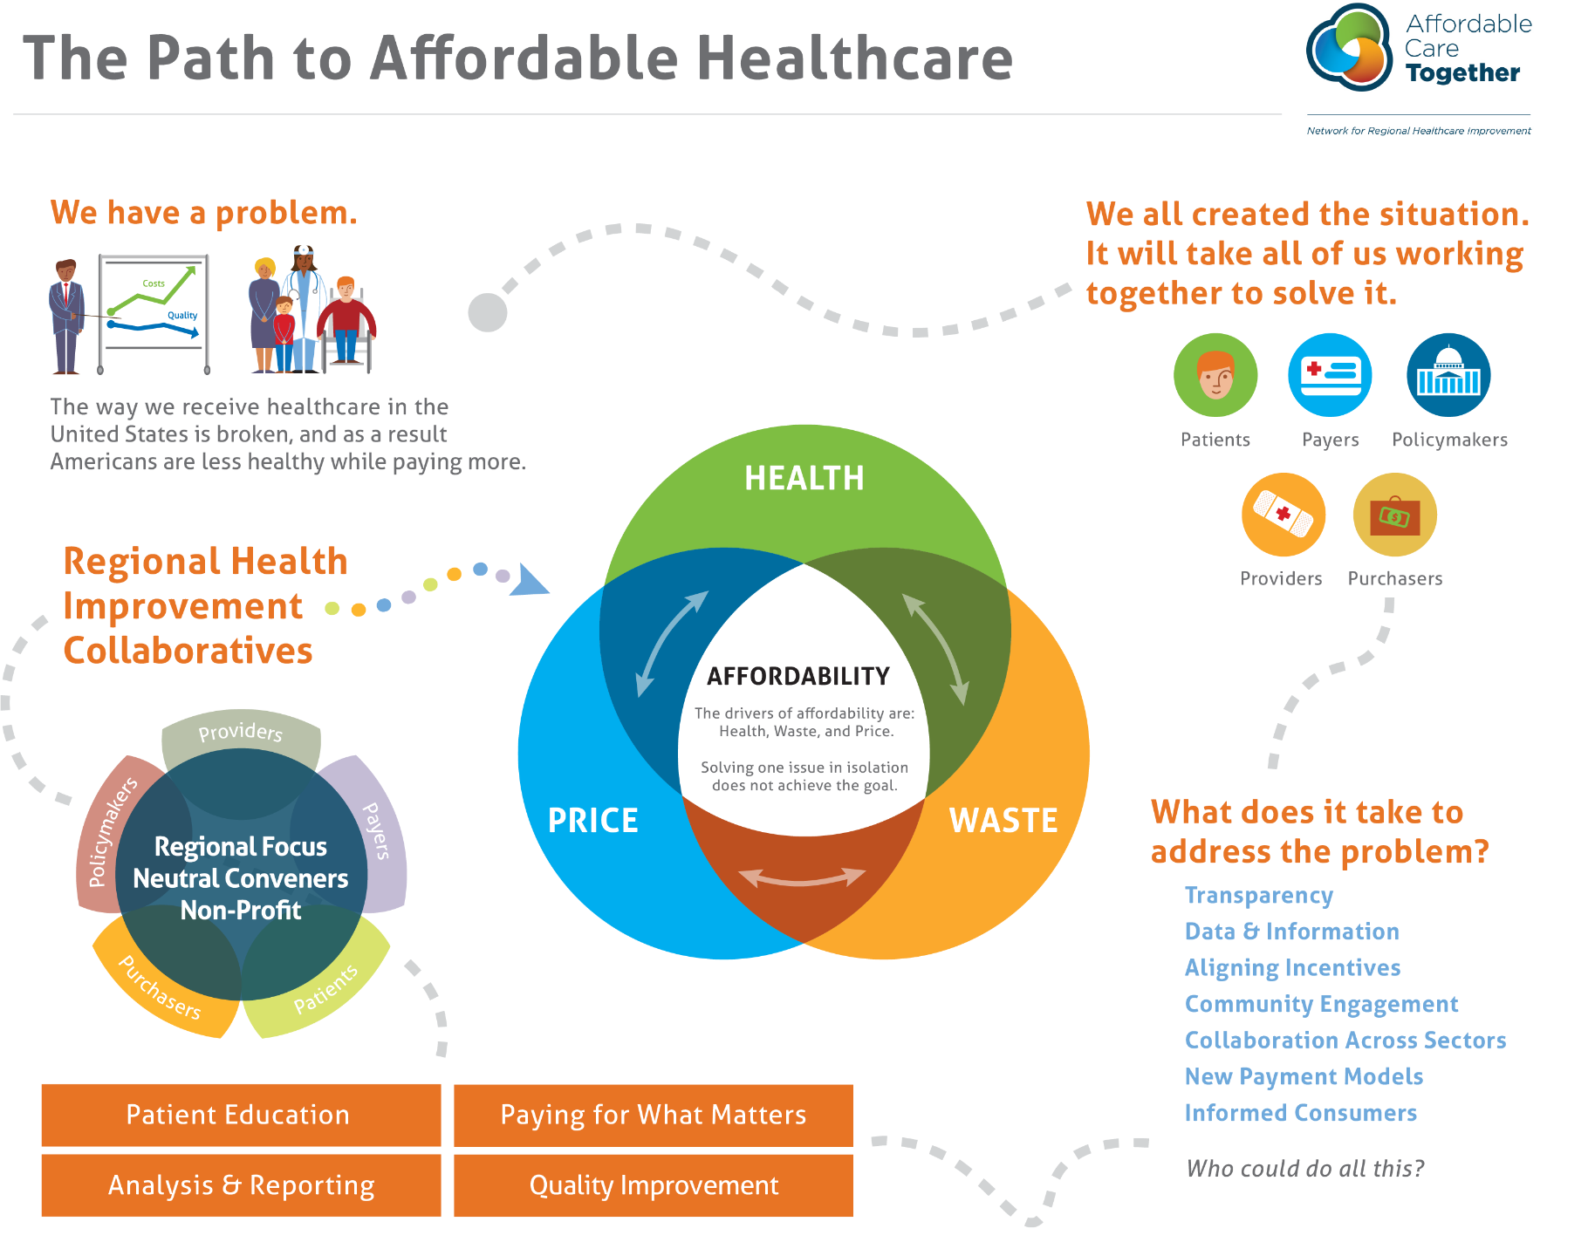
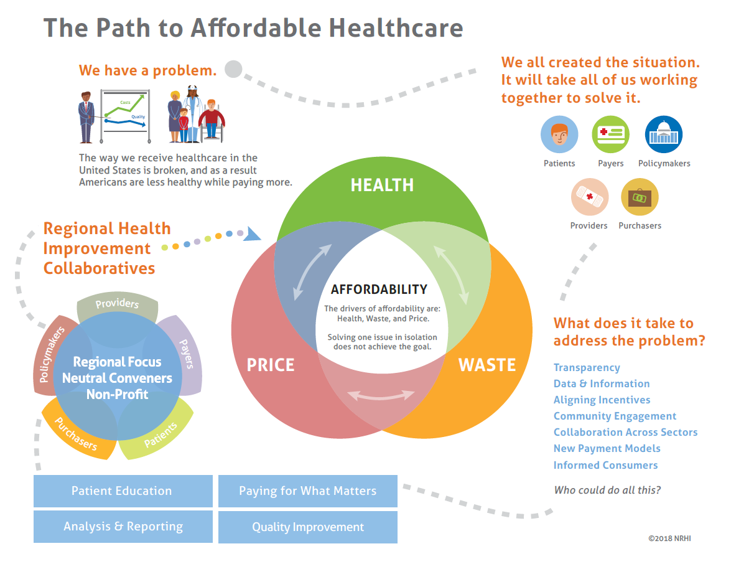
17
#AffordHC18
©NRHI 2019

Slide 18

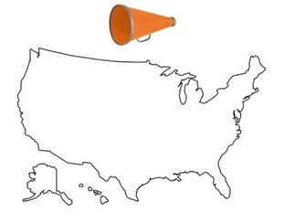
Partnering for greater reach
NRHI is recruiting national partners
to join forces and reach a broader
public audience with the message
of why affordability matters and
what we can do about it.
Regional Efforts Price
Regional Efforts Health
Regional Efforts Waste
NRHI
National Partner
National Partner
©NRHI 2019

Slide 19

Do your part to make healthcare more affordable
©NRHI 2019

Slide 20
For more information
Ellen Gagnon, Executive Director Healthcare Affordability
egagnon@nrhi.org

Slide 21
Creating a Path to Affordable Care with Increased Consumer Engagement
Families USA Health Action Conference
Barbra G. Rabson, President and CEO
January 24, 2019

Slide 22
MHQP Background and Governance
Established in 1995, MHQP is an independent coalition of key stakeholder groups in Massachusetts working to improve the quality of patient care experiences through collaboration.
MHQP
Board of Directors
Physician
Council
Established 2002
Health Plan
Council
Established 2008
Consumer Health Council
Established 2011

Slide 23
Together for Good Measure
MHQP helps MA provider organizations, health plans and policy makers improve the quality of patient care experiences by:
  Measuring and publicly reporting non-biased, trusted and comparable patient experience data
  Sharing tools, guidelines and best practices to help support improvement efforts
  Catalyzing collaboration to find breakthrough solutions to shared challenges.
MHQP’s work is driven by and organized around the principle that the challenges facing healthcare can only be solved through collaboration and innovation across key stakeholder groups – including patients, whom we believe are the most underutilized resources in the healthcare system.

Slide 24
Affordability Summary Slide
MHQP held an all day multi-stakeholder roundtable discussion on December 5th to advance affordability focused on the role patient engagement can play in affordability. The meeting was funded by RWJF and supported by NRHI.
We identified 5 barriers that exist that routinely prevent patients from engaging with the health system to obtain high value affordable care. We believe we must address these issues in order to help patients be agents for affordability.
We prioritized 4 areas for possible next steps that cut across the different barriers identified.

Slide 25
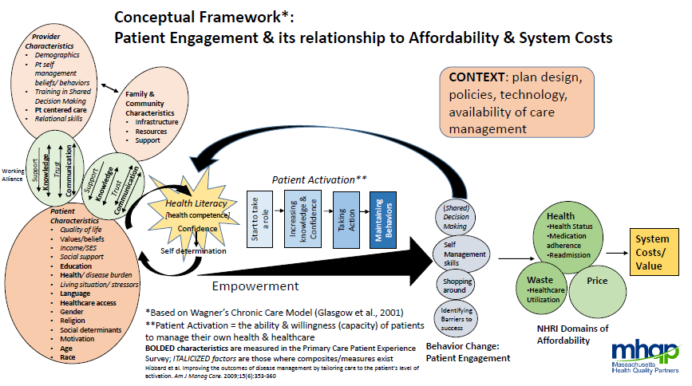

Slide 26
Barriers to Affordability
Barriers exist that routinely prevent patients from engaging with the health system to obtain high value affordable care. We believe we must address these issues in order to help patients be agents for affordability:
  Trust in the healthcare system (providers, plans, system, and information)
  Health literacy about our own conditions, about navigating the system, about our health benefits eligibility and coverage, about best value providers
  Capacity to balance competing priorities and/or having limited energy, time, and/or resources
  Access to providers, to choice of treatments, to generic drugs, to information
  Transparency of health quality and costs information

Slide 27
Trust
Trust in the healthcare system (providers, plans, system, and information)
  “We need time to have the conversation – time for the patient to be able to process the information given and pause for the provider to make a connection with the patient.”
  “Trust is a cognitive short cut for information gathering.”
  “When providers and patients talk about costs, it leads to distrust and anger.”
  “We trust clinicians too much – patients are so confused by the system then need to turn to someone.”
  “Trust between patient and provider is essential – and lost in complexity of the system.”

Slide 28
Health Literacy
Health literacy about our own conditions, about navigating the system, about our health benefits eligibility and coverage, about best value providers
  “We blame patients for lack of literacy – the blame should be on the complicated, non intuitive system we have created.”
  “Complexity, capacity and literacy all go together - the less complex things are the less need for literacy.”
  “Barriers for literacy include training for teach backs, also capacity for the team to have time to do this.”
  “We need to focus on financial health literacy – there is a lack of action oriented knowledge at the right time.”
  “We need differentiated learning for literacy – some populations have cognitive decline as they age, different from young adults; 15% of whom are on individual learning education plans.”

Slide 29
Capacity
Capacity to balance competing priorities and/or having limited energy, time, and/or resources
  “When patients’ capacity is low, it drives up healthcare costs.”
  “Stress limits your cognitive capacity to process information.”
  “Providers also have capacity issues because of competing priorities.”
  “Physicians are confronted every day with: does this patient have the capacity to make decision about themselves – what’s the capacity risk assessment about whether they are safe at home – this is an enormous population.”

Slide 30
Access
Access to providers, to choice of treatments, to generic drugs, to information
  “We need to explore other ways of trying to get things done because relying on these conversations that are incredibly complex for long periods of time in a doctor’s office just doesn’t work very well.”
  “The traditional model of the patient-doctor encounter in the office is an access barrier in that we really have to get to virtual care models that are really sustainable and supported.”
  “We should define access [as] not just [getting] access to the service to begin with, but also how you continuingly engage with and communicate with it and what the experience is, everything else stems from there.”
  “People I work with in the communities I’m very familiar with, they don’t have access to transportation.”

Slide 31
Transparency
Transparency of health quality and costs information
  “Transparency barriers fall into two categories 1) we don’t have the information; 2) we know the answers but [are] maliciously not sharing them.”
  “Docs are not trained to talk about costs – there is still a stigma. But we have to talk about costs, because affordability is a factor in managing health.”
  “Transparency should be fluid and continuous.”
  “Cost transparency is about political will.”
  “Nobody understands economic transparency – not even providers understand it.”

Slide 32
Some Takeaways
A lot of things people think they need they don’t need, and a lot of things doctors are telling them they need they don’t need.
The cost of care overwhelms every discussion and gets us further away from what we want to be doing as physicians and what patients want to be thinking about.
Costs are not intuitive. Example: A colonoscopy costs more in outpatient setting than in the hospital because of anesthesia – patients have no way to know ahead of time.
There is an opportunity to collaborate with patients to find out what the patient values and what they are willing to pay for.
There needs to be a drastic change in commitment towards simplification, starting from square one.
Need to focus on financial health literacy – there is a lack of action oriented knowledge at the right time.
All the system “solutions” break down the patient/doctor relationship foundation. We need to focus on a solution that will benefit the patient.
We have siloed community resources – are we ready to collaborate and delegate?
There are risks of having patients practice cost control without having a dialogue between providers, social workers and patients about the “right” way to ration.
We should develop principles for changes we can all agree to
The Connector was successful with a literacy push – developed videos, comic books, all kinds of materials and they worked

Slide 33
Possible Next Steps
Explore ways to make understanding health benefits easier for patients and providers
  Standardize communications across plans and providers to reduce complexity
  Create training/tools for patients to better understand their healthcare benefits
Explore ways to better inform patients and providers about healthcare costs and financial health literacy
  Promote uniform public service messaging and educational materials across multiple channels
  Create training/tools for providers and care teams around communicating with patients about costs/care decisions
  Participate in the Massachusetts Employer Health Coalition initiative to reduce unnecessary emergency department visits

Slide 34
Possible Next Steps
Explore ways to increase patient-provider collaboration in healthcare decision making
  Create incentives for patient co-production of care to:
    Improve trust
    Improve a shared sense of patient preferences and goals
  Measure patient engagement to drive improvements
Explore ways to expand healthcare settings beyond individual office visits
  Explore how to offer healthcare in non-medical venues to increase access to care without destabilizing primary care
    Focus on vulnerable populations
  Expand availability of community venues
  Change payment systems to align incentives

Slide 35
Discussion
What resonates most with you in terms of how we can reduce these barriers?
What are you doing already that works?
What others suggestions do you have to bring stakeholders together to reduce barriers?

Slide 36
Our Ask to You
Leverage existing forums to advance affordability
Be inclusive and invite everyone who can take action
Work across sectors to create and use consume friendly language

Slide 37
Thank you!
For more information about MHQP:
Barbra G. Rabson brabson@mhqp.org

