Slide 1
HealthySteps: Transforming the Promise of Pediatric Care
Rahil D. Briggs, PsyD
National Director, HealthySteps

Slide 2
Agenda
Model Overview
Evaluation & Evidence
Policy & Finance
Growth & Scale

Slide 3
Model Overview

Slide 4
HealthySteps Video
https://www.youtube.com/watch?v=wJIhYBcAs78&t=18s

Slide 5
What is HealthySteps?
An evidence-based, interdisciplinary primary care program that integrates a child development professional, known as a HealthySteps Specialist, into the pediatric team to promote nurturing parenting and healthy development for babies and toddlers.
Notes:
We want to acknowledge that it’s a big deal to pull away so many essential staff from their important work for a few hours. We are so appreciative of you all being here and we think it’s quite important.
In order implement HS well, we need everyone to play their part. We’ll talk more about what that looks like later this morning.

Slide 6
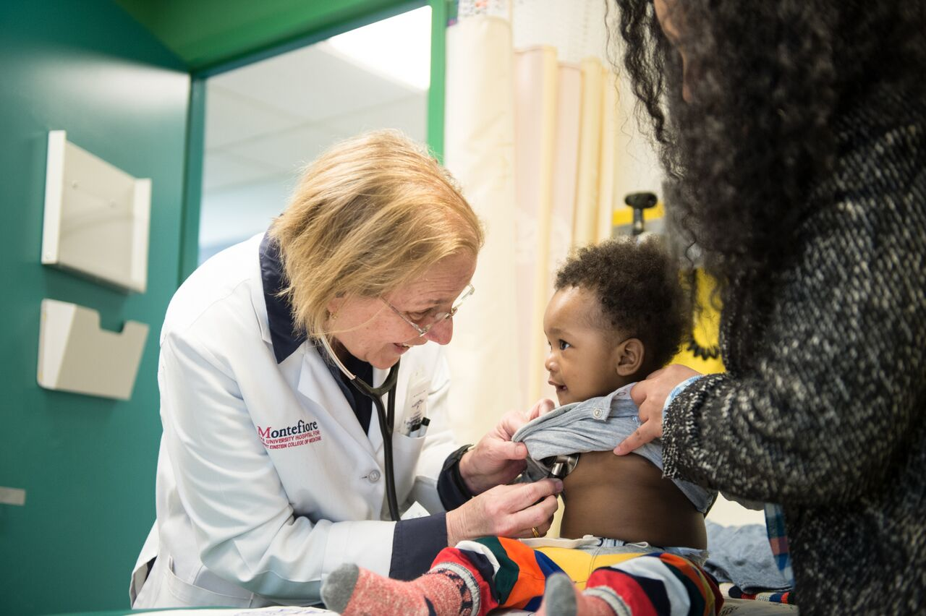
Pediatrics Setting
Universal access - almost all families take their babies to see a pediatrician
Parents trust their pediatricians
Non-stigmatizing setting
Frequency of well-child visits schedule offers a perfect opportunity for parental learning and a point of entry for additional services
Notes:
More than 90 percent of low-income families visit pediatricians.
12 visits in the first 3 years
7 well child visits in the first year
In particular - those first several months, parents are captive audiences and welcome the opportunity to learn all they can about how they can be the best parents possible. There is a window of humility and awe inspired by childbirth.

Slide 7
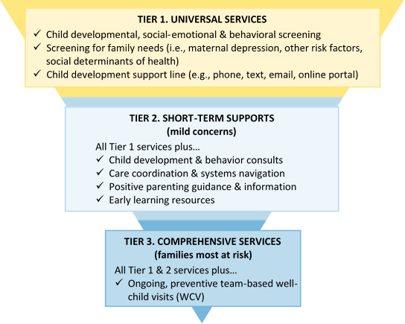
Tiers of Service Delivery

Slide 8
Core Components
Child Developmental, Social-Emotional & Behavioral Screenings
Screenings for Family Needs (i.e., PPD, other risk factors, SDOH)
Child Development Support Line (e.g., phone, text, email, online portal)
Child Development & Behavior Consults
Care Coordination & Systems Navigation
Positive Parenting Guidance & Information
Early Learning Resources
Ongoing, Preventive Team-Based Well-Child Visits

Slide 10
Evaluation & Evidence

Slide 11
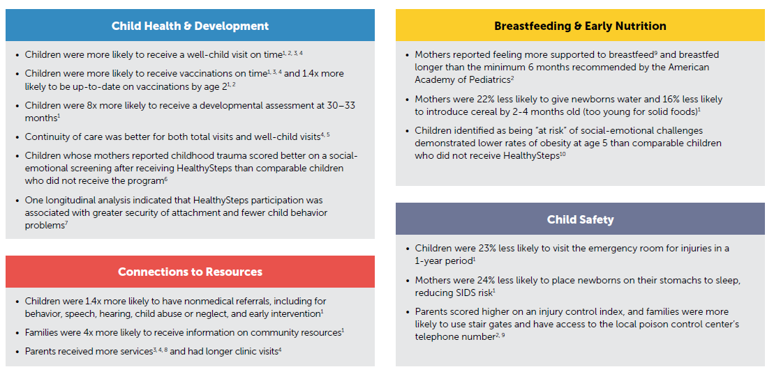
Evidence Summary
Notes:
NOTE: Use box around page number to “circle” items of most interest to the audience; otherwise, delete box.
These next two slides summarize key results from past research on HealthySteps. These are drawn from the original National Evaluation, as well as several subsequent site-level studies.

Slide 12
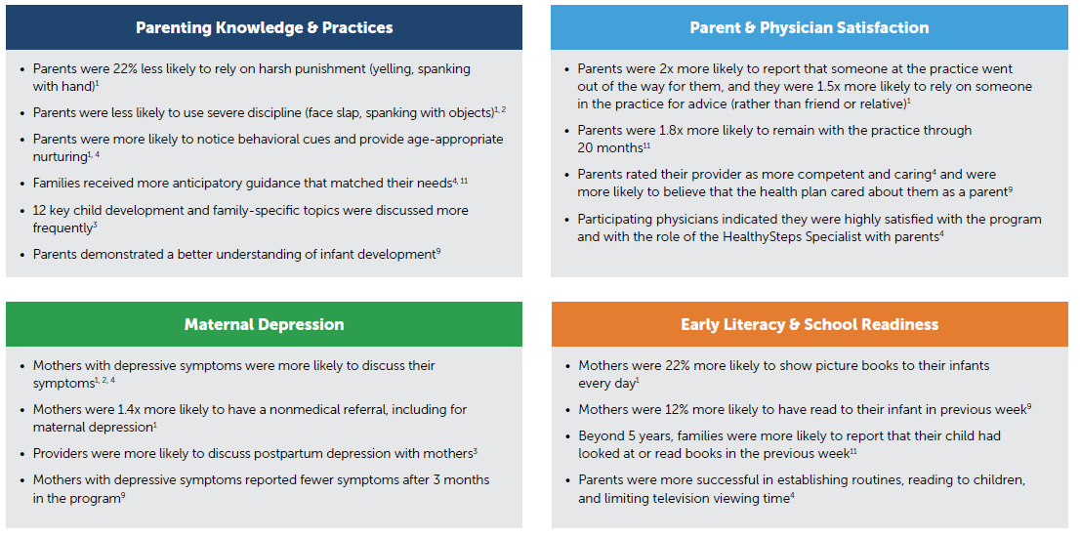
Evidence Summary (continued)
Notes:
NOTE: Use box around page number to “circle” items of most interest to the audience; otherwise, delete box.

Slide 13
Priority Outcome Areas
The National Office has selected three Pilot Sites in Arizona, Illinois, and New York to demonstrate key outputs and outcomes in one or more of the six priority areas noted below. All of these priority areas are important to pediatrics and healthcare financing.
Priority Outcome Area | Ultimate Outcome of Interest*
Child social-emotional development | Number/percentage of children connected to services who show improvements in areas of concern over time based on screening data
Breastfeeding | Number/percentage of mothers who continued breastfeeding (exclusive or non-exclusive) until their child was at least 6 months old
Early childhood obesity | Number/percentage of children exhibiting age-appropriate Body Mass Index or skin-fold measurements at 2/3 years of age
Maternal depression | Number/percentage of mothers connected to services who show improvement in depression symptoms over time based on screening data
Family needs | Number/percentage of parents connected to services to address key needs who show reduction in at least one need within one year of identification
Parent-child relationships | TBD (e.g., parental sensitivity or parent-child attachment)
* Sites will also report data on outputs (e.g., number of screenings completed, number of referrals) and proximal outcomes (e.g., number of families connected to needed services) for applicable priority outcome areas.
Notes:
For each of the 6 priority outcome areas, the National Office identified the ultimate outcome that we are interested in assessing through the Outcomes Pilot Study. Importantly, each ultimate outcome is linked to a number of specific outputs and proximal outcomes that will also be examined. We are currently working with sites to assess their capacity to collect and report data for these areas. This will allow us to develop a full data collection plan that obtains consistent data across all the sites while still being responsive to each site’s current capacity. We will be working very closely with each site to fill gaps in their current data collection (either by modifying their existing data systems or using a tool we provide) and engage them in CQI cycles intended to improve their performance in one or more of the outcome areas. This will help us go beyond just assessing whether HealthySteps impacts a given area to understand how the greatest impacts can be achieved.
As is the case for all our other learning efforts, the results from the Outcome Pilot Study will be used to identify potential changes to the model that should be disseminated across all sites in the network.

Slide 14
Healthy Steps at Montefiore Design
Quasi-experimental longitudinal follow up of children enrolled in a HealthySteps (HS) program at their primary care pediatric setting and a comparison group (CG) from a matched clinic who met enrollment criteria, but did not receive the intervention
Objective: Determine the relationship between maternal ACES (abuse and neglect only) and maternal report on the ASQ:SE at 36 months

Slide 15
HealthySteps @ Montefiore – Impact of Intervention on 36 month ASQ:SE scores, by maternal ACEs
Briggs, et al. (2014). Healthy Steps as a Moderator: The Impact of Maternal Trauma on Child Social-Emotional Development. Clinical Practice in Pediatric Psychology (2, 2), 166–175
Notes:
Differences in mean ASQ-SE scores between children of mothers with and without ACES were more apparent in the CG (90.4 vs 28.3) than in HS (44.5 vs 28.2); this interaction was significant (p<.001).
Limitations: Significant attrition
Small sample size
Only have maternal report of child SE functioning
Conclusions:
A strong relationship between maternal ACES and child social emotional development is suggested in this multi-ethnic urban sample of mothers and children and participation in the HS program may buffer against these effects.
Despite increased risk at baseline within the intervention group, children have improved SE development.
Missing data require that we view these results as exploratory.

Slide 16
Policy & Finance

Slide 17
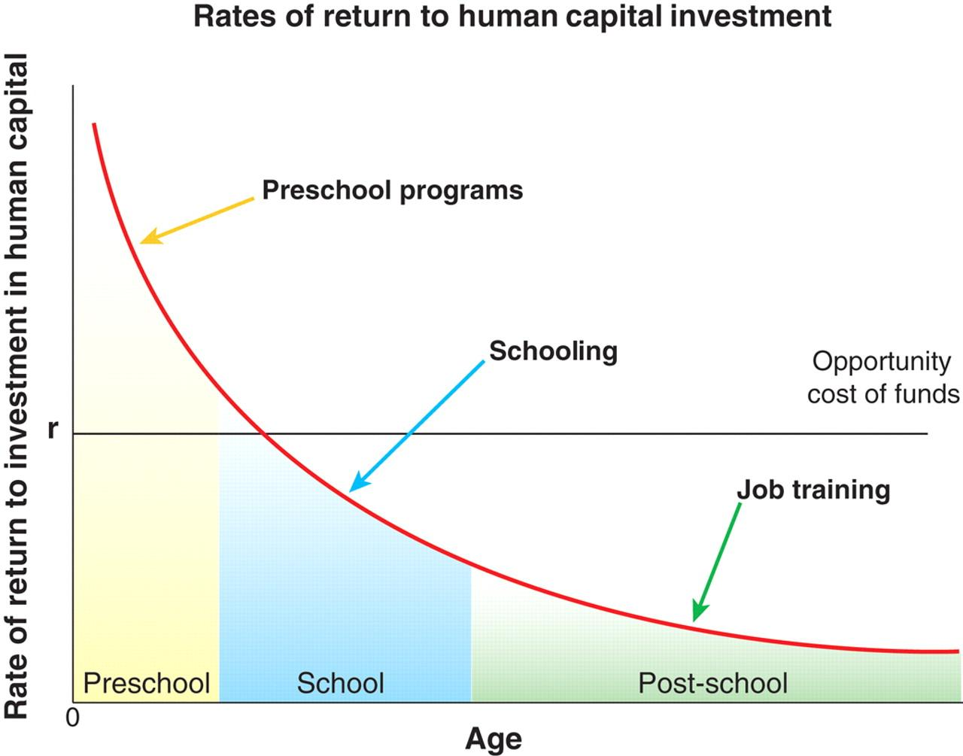
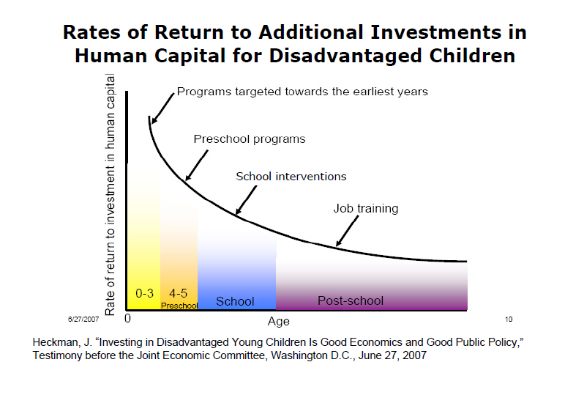
Early Investments, Greatest Gains
Benefits of Early Investment
Reductions in:
Juvenile and adult crimes
Cases of abuse and neglect
Intimate Partner Violence
Welfare dependency
Special education
Increases in:
Children’s cognitive and social-emotional development
Educational performance and graduation rates
Parental involvement
Job training and earnings
Ability to impact brain development decreases with time, while costs to change behavior increase
Copyright © 2018 HealthySteps. All rights reserved.
Notes:
Important to touch upon why it is important to intervene and work with young children and families from the earliest years possible.
Research has consistently shown that the earliest investments provide the greatest gains.
Beyond the known medical outcome benefits from positively impacting the long term health trajectory of children into adulthood, there are other savings to be had when we invest early including reductions in criminal justice involvement, decreases in reliance on public programs, and reductions in the need for special education.
We also know that early investments improve children’s social-emotional development, educational attainment and in society, how do we define productive adults? As those that contribute to the economy and PAY TAXES!
Many of you may be familiar with Jim Heckman’s work, but if not, his research illustrates that the greatest rates of return for investments in human capital, particularly for disadvantaged children, occur within the first 3 years of life. As you can see from the chart, as children age and we move along to the right on the graph, we see the ROI decrease. In fact, by school age, the ROI is almost half of that for the first three years of life. Heckman has estimated that for every $1 invested early, society sees about a $14 to $17 in return. These findings make the case for investing as early as possible.
Depending on the audience: Critical for all of us to understand these points in order to better educate policymakers, payers, and stakeholders since the importance of the early years and the brain science is relatively new to most people.

Slide 18
HealthySteps is a Cost Effective Model
Employing one FTE HS Specialist enables a practice to deliver the following services, for as low as $450 per Tier 3 child per year:
Tier 1 services to approximately 2,000 children and families
Tier 2 services to approximately 300 children and families
Tier 3 services to an additional 300 children and families
Cost for on-site, two-day group training, for all practice employees, is approximately $18,000 plus trainer expenses
Includes six one-hour technical assistance calls during first year of implementation and an array of National Office supports
Tier 1:
Universal
HealthySteps
Services
Tiers 2 and 3:
Intensive Services
18
Notes:
HS is a cost effective evidence-based model.
By employing one FTE HS Specialist, a practice can deliver universal Tier 1 services up to 2000 children annually. The HS Specialist can then provide Tier 2 services (ad hoc consultants) to approximately 300 children/families a year and then provide Tier 3 services to an additional 300 children.
The annual cost per child to provide the most intensive level of services, Tier 3, can be as low as $450.
Depending upon the audience or questions asked on this slide: The NO is currently working on quantifying data to calculate annual cost per child for Tier 2 and Tier 1 services.
Depending upon the audience: May want to delete the training cost bullets if not relevant.
Also, SLT should determine with Laura/Rahil what we want to include on training based on upcoming revisions to training costs.

Slide 19
National Office Sustainability Site Supports
Supporting sites with billing for HealthySteps services
Understanding impacts of current policy environment
Developing the HS Business Case
Preparing sites for strategic dialogues with payers
Generating annualized HealthySteps cost savings
Notes:
The NO is here to support the HS sites and this includes providing a range of technical assistance activities to address ongoing questions and concerns.
First and foremost, this includes supporting sites with billing for HealthySteps services. While every state has different billing requirements, No resources can provide an introduction for many of our sites to begin thinking about initial billing opportunities.
We also work with sites to help translate the shifting policy environment and what impacts it may or may not have on HealthySteps. In thinking about sustainability for HealthySteps sites, it is essential to think about major health care delivery and payment trends and how they set the context for site programs and potential funding opportunities. Policy impacts that we are currently tracking include (option to highlight a few below):
The ongoing debate about children’s insurance coverage and spending, including historically high rates of children’s health insurance coverage and an increasing percentage of children enrolled in public programs;
The focus on adult versus pediatric populations and the fact that, on average, pediatric health care is far cheaper than adult health care, often making it difficult to find opportunities or make the case for short-term savings and in turn, many policymakers and payers choose to focus on adult populations with multiple comorbidities and chronic conditions (although we are starting to see more interest at the federal level in pediatric interventions);
Shifting payer dynamics from paying for volume to paying for value and quality care;
Increasing attention to metrics and outcomes;
A growing recognition of the critical role of social determinants of health on overall health outcomes and the need for our health care system to address them for families
Changing role of the pediatrician, who is now more likely than ever to be an employee of a larger health system and is being asked to do more with less time (including addressing the social determinants of health);
Impact of the current Administration at both the state and federal levels
And the continued question about how will children’s coverage be impacted and coverage for their families?
Our team is also excited to announce a HealthySteps Business Case Webinar Series that we will launch in the coming year. The Business Case can help sites with initiating and leading strategic discussions with payers on paying for HealthySteps services, and our office can provide assistance and tips for structuring these types of discussions in the most effective way possible.
Finally, our team has also developed annual cost savings from several key HealthySteps interventions that sites can leverage in furthering discussions with payers. We share a little more about that in the next slide.

Slide 20
Short-Term Medicaid Cost Savings
Interventions Driving Short-Term Medicaid Cost Savings
Child-Focused Interventions | Adult-Focused Interventions
Well-child visit and immunization rates Oral health Inappropriate use of care for ambulatory sensitive conditions | Breastfeeding Postpartum maternal depression Intimate partner violence Unhealthy birth spacing Smoking cessation
A recent single-state analysis conducted by the HealthySteps National Office, in conjunction with Manatt Health, demonstrated annualized savings to Medicaid of up to $1,150 per family, for an annual return on investment of 83%.*
* Smoking cessation short-term savings not included in single-state analysis.
Copyright © 2018 HealthySteps. All rights reserved.
20
Notes:
HS has the ability to generate short-term cost savings for state Medicaid agencies. These cost savings are realized within a year’s time and are customized for each site and type of interventions provided by the HS Specialists, as well as draw upon state-specific data points.
Our NO worked closely with Manatt Health to identify 8 HS interventions that drive these cost savings. Three on the child side and 5 on the adult side. Not surprisingly, the greatest cost savings to Medicaid accrue on the adult side because children for the most part are healthy and low cost. These dual savings opportunities also speak to the dyadic nature of the HS model and the fact that our HS Specialists not only focus on children, but their families as well.
Child focused interventions include cost savings derived from the work our HS Specialists do around increasing the timeliness of well child visits and improving immunization rates, particularly the influenza vaccine. We also see savings from the education we provide to parents on the importance of earlier dental visits (including education on wiping the teeth down after feedings, referrals to dental services, etc.) and therefore converting children to earlier “dental starters.” Our HS Specialists also often times field questions, texts and calls from anxious parents asking if they should take their child to the emergency room or urgent care for a particular concern. Our HS Specialists can work closely with the site’s medical team to triage these questions and help direct care for ambulatory sensitive conditions to the most appropriate source.
On the adult side, our HS Specialists drive increased cost savings around increased support for breastfeeding (including longer duration and referrals for support) and screening, referrals, and follow up for maternal depression, IPV, unhealthy birth spacing, and smoking cessation.
For unhealthy birth spacing, our HS Specialists may often times be the only providers that moms see (particularly moms with Medicaid coverage) after their babies are born – some states, moms are dropped from Medicaid coverage 6 weeks after birth and may no longer have a routine source of care). Because of their strong relationships with families, HS Specialists are in a unique position to speak with mothers and parents about plans for future children and their desire for family planning assistance/referrals. In co-located sites (such as FQHCs), HS Specialists often walk moms over to receive family planning services on the same day as the well child visit, therefore preventing additional Medicaid costs associated with a future Medicaid birth, etc. (tailor this last sentence depending upon the audience).
Point out the ROI box….we can share it was for Colorado in 2016. And that we are working to replicate this same analysis in other states currently.
Also working to quantify additional short term cost savings based on other HS interventions as the research supports.

Slide 21
Long-Term Cost Savings
Long-Term Cost Savings Across Sectors
Physical and Behavioral Health: Direct relationship between the number of adverse childhood events (ACEs) and likelihood of having heart disease, cancer, and other chronic conditions
School Readiness and Educational Attainment: Strongly linked to healthy social and emotional development, and for children who experience ACEs, school readiness and educational attainment are often negatively impacted
Juvenile Justice Involvement: ACEs contribute to juvenile delinquency, increasing children’s risk of juvenile arrests and felony charges
State Spending: Failing to address infant and childhood mental health disorders in early childhood increases the need for intervention across multiple state programs over the life of a child and into adulthood
Copyright © 2018 HealthySteps. All rights reserved.
Notes:
We know HS also generates longer term cost savings across a variety of sectors.

Slide 22
Growth & Scale

Slide 23
HealthySteps State Presence 137 Sites in 20 States, December 2018
Washington
Maine
Montana
North
Dakota
Vermont
New
Hampshire
Oregon
Minnesota
New
York
Massachusetts
Idaho
South
Dakota
Wisconsin
Michigan
Connecticut
Rhode
Island
Wyoming
Iowa
Pennsylvania
New
Jersey
Nebraska
Illinois
Indiana
Ohio
Maryland
Delaware
Nevada
Utah
West
Virginia
Virginia
California
Colorado
Kansas
Missouri
Kentucky
North
Carolina
Tennessee
South
Carolina
Arizona
New
Mexico
Oklahoma
Arkansas
Mississippi
Alabama
Georgia
Texas
Louisiana
Florida
Alaska
Hawaii
HealthySteps also has sites in Puerto Rico and Washington DC.
© FreePowerPointMaps.com

Slide 24
1 Million Children by 2032!
HealthySteps’ long-term vision is to lift the life prospects of low-income children and their families by transforming the promise of pediatric primary care.
Blue Meridian Partners invested $39 million in the first phase of a long-term growth plan.
We plan to double the number of families and young children served over the next 5 years and ultimately reach over 1 million children by 2032, focusing on those most at-risk.
Zero To Three

Slide 25
Discussion & Next Steps

Slide 26
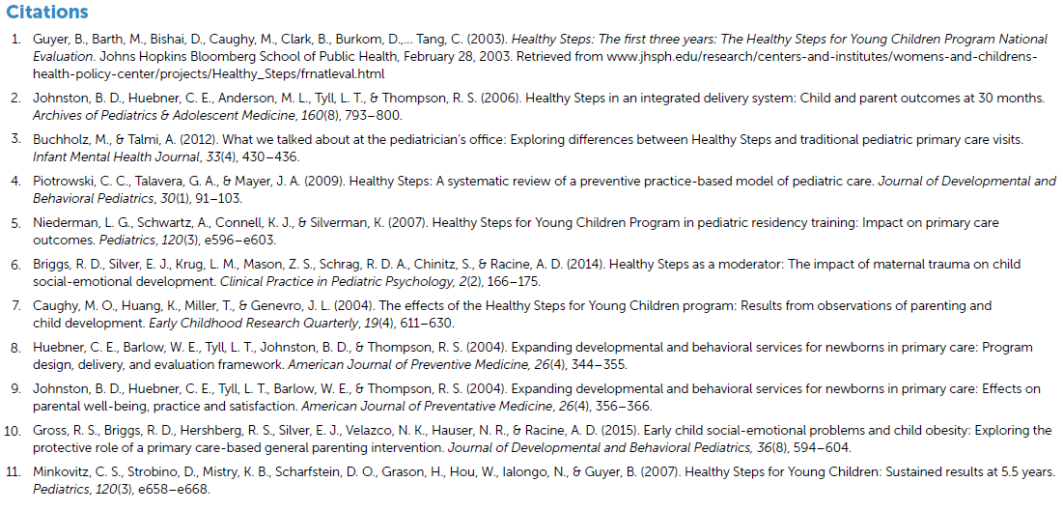
Evidence Summary Citations

