Slide 1
Addressing the Substance Use Disorder
Nationally and in States
Families USA Health Action Conference
Vermont’s Experience
January 25, 2019
Beth Tanzman, Director Vermont Blueprint for Health
Beth.Tanzman@Vermont.Gov
Blueprintforhealth.Vermont.Gov

Slide 2

The Opioid Epidemic
Resources and Attention for Substance Use Disorders
Opportunity to implement clear standards of care
Health and medical provider community engagement
Opioids aren’t the only concern
State Medicaid Plans are essential
Historic under-investment in Alcohol and Substance Use Disorders – new investments
Notes:
Increasing rates of opioid dependence
Overdose, or poor health and high health care expenditures
Families and communities struggling
Criminal activity
Inadequate Treatment Capacity
Key health care providers not participating
Program and funding silos
Isolation, stigma, and lack of voice for community with addiction

Slide 3
Vermont’s Story
“All Hands on Deck”
Leadership
Partnership & collaboration
Harm reduction & overdose prevention
Education & Prevention
Treatment & recovery

Slide 4
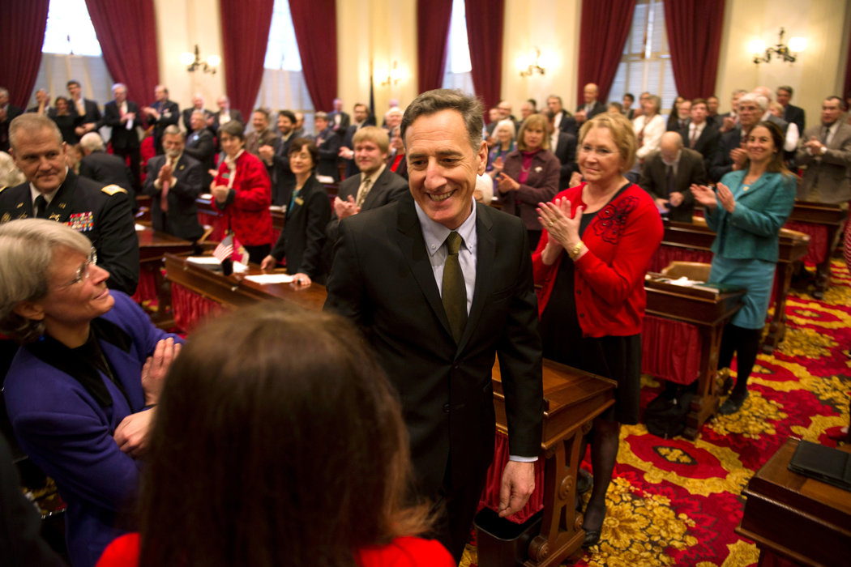
In Annual Speech, Vermont Governor Shifts Focus to Drug Abuse By Katharine Q. Seelye January 8, 2014 New York Times
Notes:
Leadership

Slide 5

Project Vision
Project VISION is a diverse coalition of over 300 social and health service agencies, schools, colleges, business organizations, the City of Rutland, local, county, state and federal probation, parole and law enforcement agencies, faith based groups, volunteers and neighbors.
We have united to address the drug related challenges facing our community with the goal of making Rutland one of the healthiest, safest and happiest communities in America.
Outcomes
Reduction in crime
Cleared blighted housing, improved neighborhoods
Increased treatment
Cross sector collaboration to address big problems
Notes:
In 2013, The former Chief of Police for the City of Rutland, Vermont, James Baker, organized our coalition with the enthusiastic support of Mayor Christopher Louras and the Board of Aldermen.
We came together based on the belief that the challenges facing our community and in particular those challenges arising from substance abuse, were not going to be resolved simply by making more arrests.
More specifically, we believed that we needed to address the issues underlying substance abuse and the related criminal activity and that our efforts needed to include our broader community. We also believed that meaningful change would require a new, comprehensive and more integrated collaboration among the many agencies and organizations serving our City.
To facilitate our efforts we have formed three teams, each focusing on a major area of concern. Those three areas are: treating addiction and substance abuse, reducing crime and building great neighborhoods.

Slide 6
City of Burlington Vermont Opioid Principles
Prescription opioids can be as dangerous as heroin - and should be treated as such.
Opioid addiction is a public health crisis with a law enforcement component.
City governments play a unique and vital role in addressing the opioid challenge.
People struggling with opioid addiction need access to treatment without delay.
Police should give amnesty to users seeking help for their addictions and send them to treatment.
Heroin dealers who knowingly destroy communities should receive the full penalties they deserve.
The community needs the medical profession to fully embrace its role as one of the most important partners in solving the opioid crisis.
All institutions engaged in resolving the opioid crisis should embrace data collection, data-sharing, analysis, and transparency.
The pharmaceutical industry has a role in resolving the crisis it helped create.
Treatment for opioid addiction should not end upon arrest.
Naloxone must be available to the people abusing opioids, their friends and family, and their emergency service providers.

Slide 7
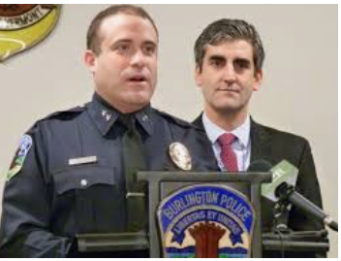


City of Burlington “Com Stat”
Monthly data-driven meeting to prevent overdose deaths and get people into treatment

Slide 8
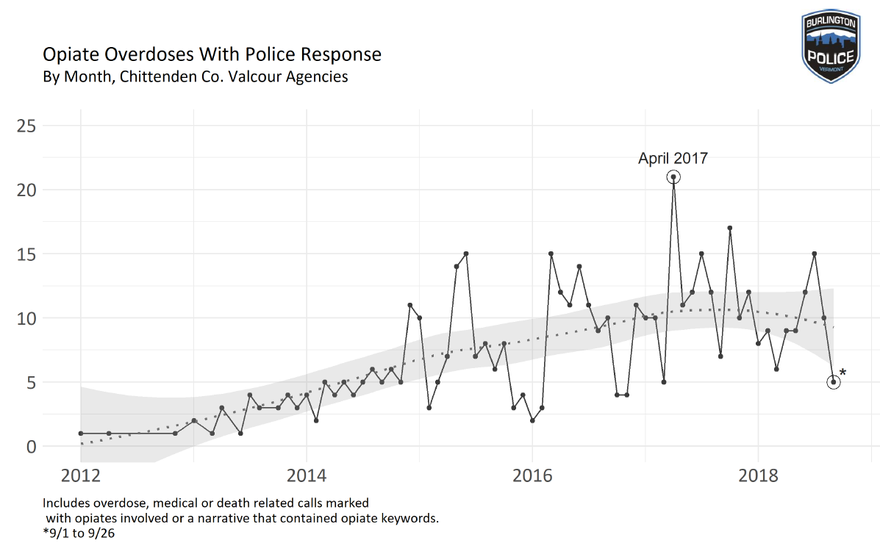
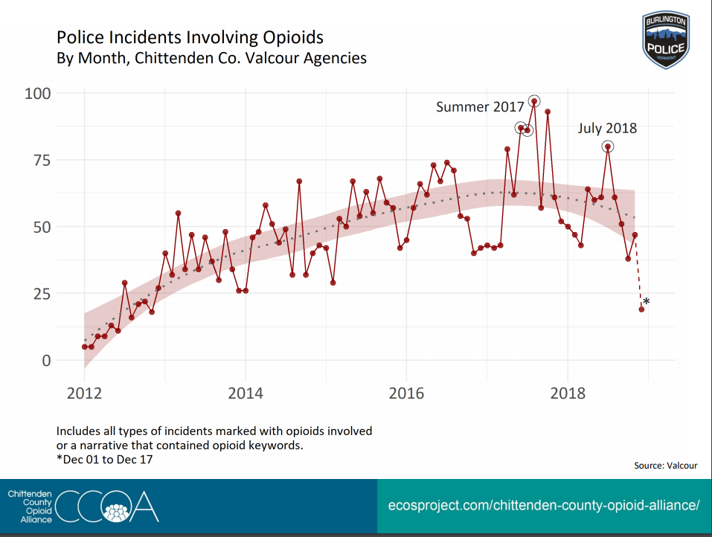
December 2018

Slide 9
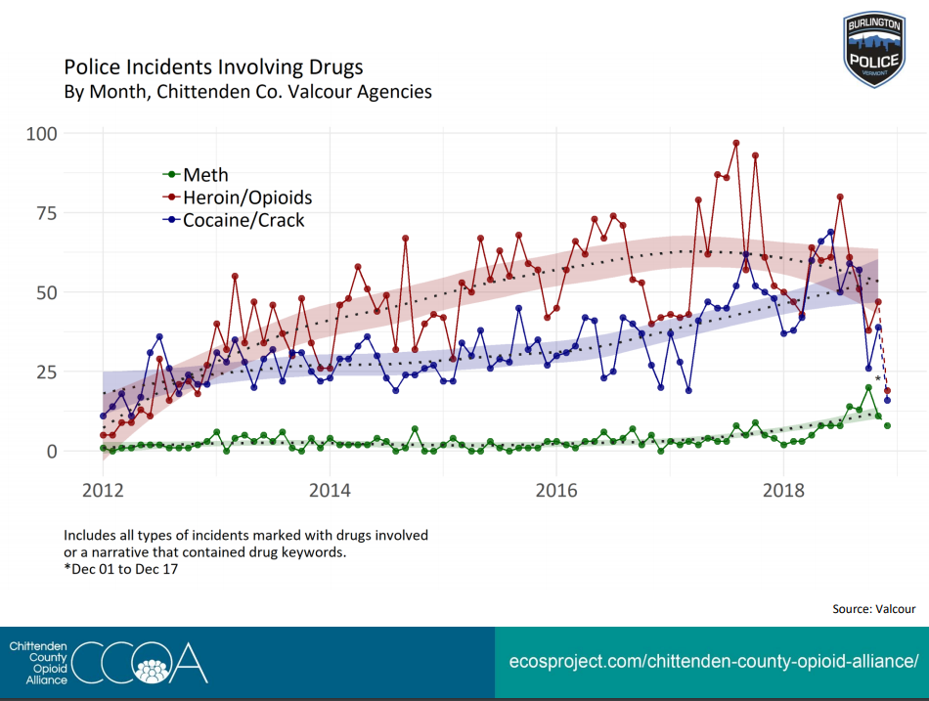
City of Burlington, Vermont
December 2018

Slide 10
Medicaid Plan Options
Health Homes
State Plan Amendments
SUD 1115 Waivers
Other State Opportunities
State Targeted Response (STR) Grants
State Opioid Response (SORS) Grants
Notes:
State Targeted Response (STR) begin May 2017 appropriation out of the CURES act, has been renewed to 2023
State Opioid Response started in Oct 2018 – different federal appropriation
Both focus on opioids, can be used for prevention, intervention, treatment, and recovery. As of now, time limited
1115 SUD waiver – Virginia did a great waiver, VT limited waiver
Requires stringent clinical / service criteria based on the ASAM levels of Care Framework across the system of care
Allow for expenditure authority for IMD services (limited) but must demonstrate budget neutrality
Extensive evaluation, 5 yr independent evaluation of required and recommended measures.
States having difficulty meeting the requirements of the waivers

Slide 11
Health Homes
Section 2703 Affordable Care Act
Comprehensive Care Management
Care Coordination
Individual and Family Support Services
Health Promotion
Comprehensive Transitions of Care
Referral to Community and Social Support Services
6 Core Services
10 quarters of “90-10” Medicaid Matching rate

Slide 12
Health Home for Opioid Addiction
Addictions Program
OTP
Hub
Medical Office
OBOT Spoke
PCMH
Community Health Team

Slide 13
Care for Opioid Use Disorder – the “Hub”
“HUB”
A Hub is a specialty addictions regional treatment center responsible for coordinating the care of individuals with complex opioid use disorder across the health and substance abuse treatment systems of care. All Medications are dispensed. A Hub is designed to do the following:
Provide comprehensive assessments and treatment protocols.
Provide medication (methadone, buprenorphine, and/or vivitrol) treatment and supports.
For clinically complex clients, initiate medication treatment and provide care for initial stabilization period.
Coordinate referral to ongoing care.
Provide specialty addictions consultation and support to ongoing care.
Provide ongoing coordination of care for clinically complex clients.
5 Programs Operate 9 Sites Across Vermont

Slide 14
Care for Opioid Use Disorder – the “Spoke”
“SPOKE”
A Spoke is general medical office with a prescribing MD, APRN, or PA and collaborating RN and Counselor who monitor adherence to treatment, coordinate access to recovery supports, and provide counseling, contingency management, and case management services. Spokes can be:
Primary care offices
Outpatient substance abuse treatment programs
Pain clinics
OB-GYN offices
Independent psychiatry practices
Spoke Teams include the prescribing provider and 1 FTE RN + 1FTE MH/SU Counselor for every 100 patients
88 different practices / programs are Spoke sites in Vermont

Slide 15
Access to Medication Assisted Treatment for Opioid Use Disorder

Slide 16
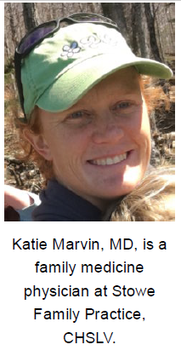
Addictions Medicine: Just Part of the Job
You are trusted and local
The MAT Team helps you
Other mentors will help you
You can control who you see
Treating addiction reduces stigma
Patients with opioid addiction are already in your waiting room
Embrace risk reduction
Addiction is a common condition, build MAT into routine care
“I believe most doctors would find this practice surprisingly enjoyable. To watch a patient transition from using to working and parenting over a matter of months is uplifting.”
Notes:
Mention Elizabeth Bradley’s work in talking about social determinants? Maybe even show graph from her key slide?

Slide 17
New England - Any Drug Overdose Deaths
2017 Data are provisional – Fatalities (NCHS data accessed 8/1/18), Population (Census Bureau 2017 accessed 8/1/18)
Source: CDC/ NCHS
Notes:
Source: NCHS Data Brief No 294 Dec 2017
2017 Estimates: Ahmad FB, Rossen LM, Spencer MR, Warner M, Sutton P. Provisional drug overdose death counts. National Center for Health Statistics. 2018. https://www.cdc.gov/nchs/nvss/vsrr/drug-overdose-data.htm
Drug Overdose Deaths in the United States, 1999–2016
Holly Hedegaard, M.D., Margaret Warner, Ph.D., and Arialdi M. Miniño, M.P.H.
Data table: https://www.cdc.gov/nchs/data/databriefs/db294_table.pdf#4
And
Drug Overdose Data. Source: http://blogs.cdc.gov/nchs-data-visualization/drug-poisoning-mortality/ Deaths per 100,000
Includes all drug overdoses, not just opioids.
During 2015, drug overdoses accounted for 52,404 U.S. deaths, including 33,091 (63.1%) that involved an opioid.

Slide 18
MAT and Non-MAT per Capita Rate of
Total Inpatient Days

Slide 19
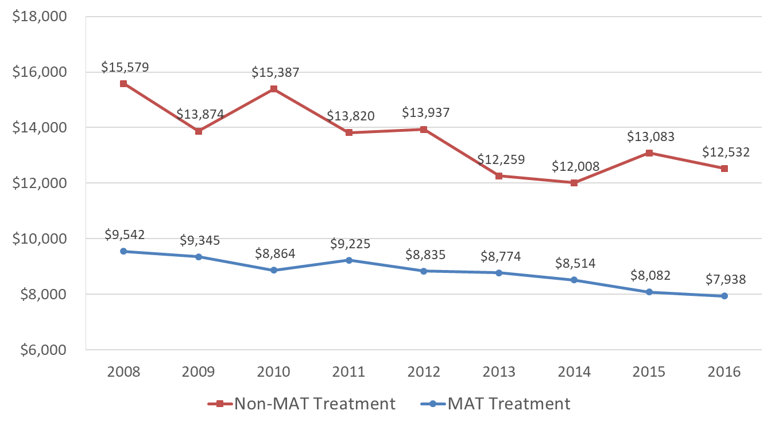
MAT and Non-MAT per Capita Rate of Health Care Expenditures, Excluding OUD Treatment Costs

Slide 20
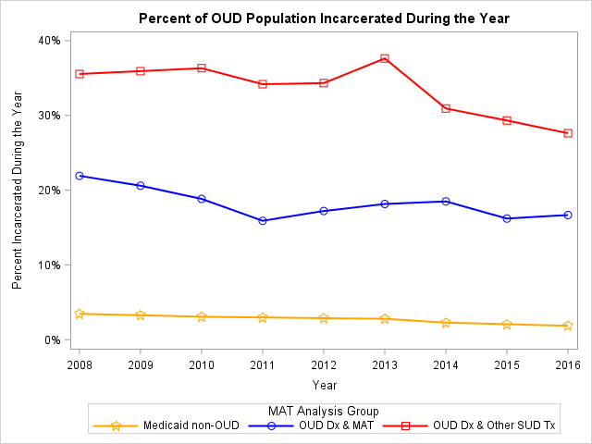
Linking Health Care Claims and Incarceration Data
***Preliminary ****
Notes:
Data Linkage Process
Data sources
DOC’s Offender Management System
All payer claims database -- VHCURES
Identifying information is hashed
First Name
Last Name
Middle Initial
SSN
Gender
DOB
Link on hashed values and destroy identified data

Slide 21
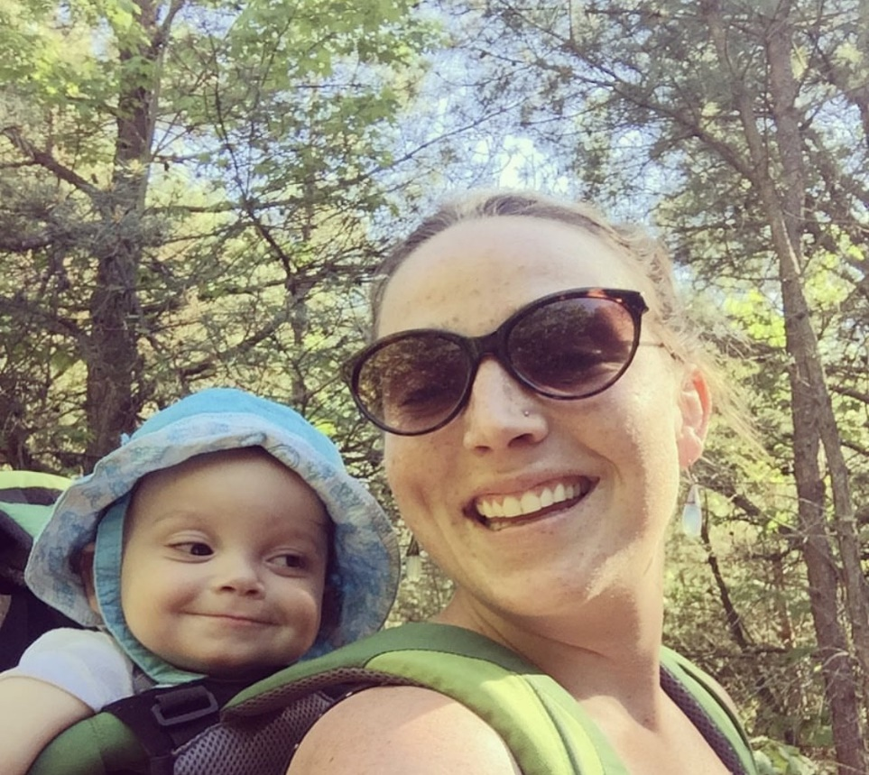
Obituary: Madelyn Linsenmeir, 1988-2018
October 2018, Seven Days
It is impossible to capture a person in an obituary, and especially someone whose adult life was largely defined by drug addiction. To some, Maddie was just a junkie — when they saw her addiction, they stopped seeing her. . . . In a system that seems to have hardened itself against addicts and is failing them every day, she befriended and delighted cops, social workers, public defenders and doctors, who advocated for and believed in her 'til the end. . . During the past two years especially, her disease brought her to places of incredible darkness, and this darkness compounded on itself, as each unspeakable thing that happened to her and each horrible thing she did in the name of her disease exponentially increased her pain and shame.
If you yourself are struggling from addiction, know that every breath is a fresh start. Know that hundreds of thousands of families who have lost someone to this disease are praying and rooting for you. Know that we believe with all our hearts that you can and will make it. It is never too late.
If you are reading this with judgment, educate yourself about this disease, because that is what it is. It is not a choice or a weakness. . .
If you work in one of the many institutions through which addicts often pass — rehabs, hospitals, jails, courts — and treat them with the compassion and respect they deserve, thank you.
If instead you see a junkie or thief or liar in front of you rather than a human being in need of help, consider a new profession.

