Slide 1
Arkansas Work Requirements
Kevin De Liban, Attorney, Legal Aid of Arkansas

Slide 2
The “Beautiful Road Map” Dilemma
“We have a beautiful road map of how not to do it.”
  Dr. Jennifer Walthall, Secretary, Indiana Family and Social Services Administration (Indianapolis Star, 1/22/19)

Slide 3
Features
  80 hours of work/”volunteer”/job search OR exemption (self-attested)
  Any three months of non-compliance=termination
  Online-only reporting (as of 12/19/18, limited phone is possible)
  Reporting website closed 9 p.m. to 7 a.m.
  Linking accounts through reference number
  County office kiosks, but no additional staff/workers
  Auto-exemptions through data matching

Slide 4
Key Number-Based Data Points
57% of recipients work; 23% have a disability; 12% caretakers
18,164 terminated in five months
  23.4% of the 77,617 people subject to work requirements
  For every 1 person who may not be working or have an exemption, state is terminating 2 people who do
~80-90% of people who must report (i.e. not auto-exempted) do NOT
In any given month, just 2% of all people subject to WR report compliance

Slide 5
Key Number-Based Data Points
Fewer than 1% of people subject to the work requirements have newly reported work hours
  Nothing suggests they did so in response to work requirements
Only 966 of the 18,000+ terminated have signed back up
Data gaps: administrative costs, county-level, tracking individuals, pre-WR data on individuals, lack of evaluation plan
No additional money spent on (1) DHS staff; (2) job training; (3) work supports (childcare, transportation, etc.)

Slide 6
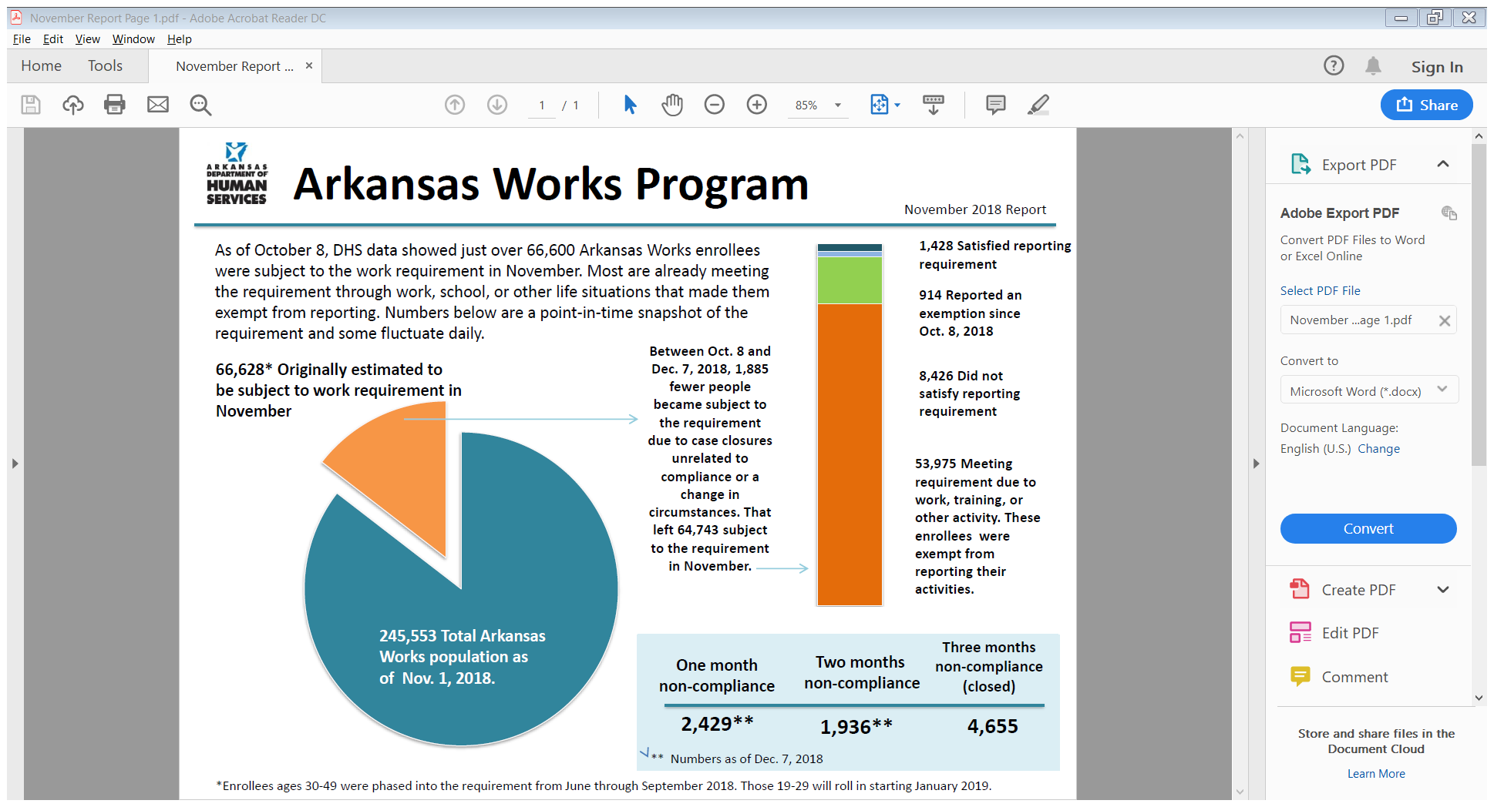

Slide 7
Other Data Points (experience is evidence)
Have to be healthy to work, be involved in community/family, etc.
Lack of knowledge of WR
Difficulty complying
Inconsistent low-wage work; meaningless job training
Frustration—long wait times, rudeness, DHS worker limits
Other hoops—increased verification and churn

Slide 8
Outreach and Education
Community meetings and events
Client database (letters, neighborhoods, etc.)
Libraries, gas stations, convenience stores, churches
Front-line providers
  Community health clinics and rural doctors’ offices
  Mental health clinics; substance use treatment facilities
  Homeless service providers
  Pharmacists
Provider groups or associations
Colleges and campus groups (with 19-29 year olds)

Slide 9
Outreach and Education
Electronic
  Boosted Facebook posts with videos
  E-mails/updates to interested parties
  IG/Snapchat (?); direct texts (?)
Media
  Lets clients know about the issue and help available
  Explains real-life impact

Slide 10
Working with Media
What do clients or affected individuals want to do?
What are your goals?
What is the story? What is your angle on the story?
What are reporter deadlines?
How to manage competing outlets?
  In-state or national
  Print or visual
  Expertise
  Track record

Slide 11
Working with Other Organizations
How does this fit with larger org goals?
Identify each org’s strengths and unique capabilities
Understand limitations and political realities
Joint presentations and speaking opportunities
Consider media interaction/roles
Discuss data, stories, developments; regular feedback
Think of nat’l orgs (CBPP, KFF, Georgetown CCF, YI, etc.)

Slide 12
Working with Legal Aid Orgs
Federal funding comes with some limitations. We CANNOT:
  “Attempt to influence” legislation/rulemaking or do grassroots lobbying
  Participate in class action lawsuits
  Initiate the formation of coalitions
  Represent immigrants without status (in most situations)
WE CAN: talk to media, analyze and explain impact, offer public comments, inform clients, educate public, testify at legislature, sue in a meaningful way
Resources—1 attorney for every 18,000 financially eligible people
Possibility of political reprisal (especially if org receives state funds)

Slide 13
Parting Considerations
Is there a way work requirements can work?
  1/10/19 CBPP publication explains why not
  PBS Newshour, 11/19/18 (Catherine Rampell)
  https://www.arktimes.com/arkansas/when-arkansas-works-doesnt/Content?oid=25890378
Will lack of work requirements threaten program future?
Will organizations change positions as time goes on in response to pressures or other goals? How to manage?

Slide 14
Happy to Help
Kevin De Liban, Attorney, Legal Aid of Arkansas
800-967-9224 x 2206
kdeliban@arlegalaid.org

