Slide 1
MEDICAID 1115 WAIVERS: What’s Happening this Year

Slide 2
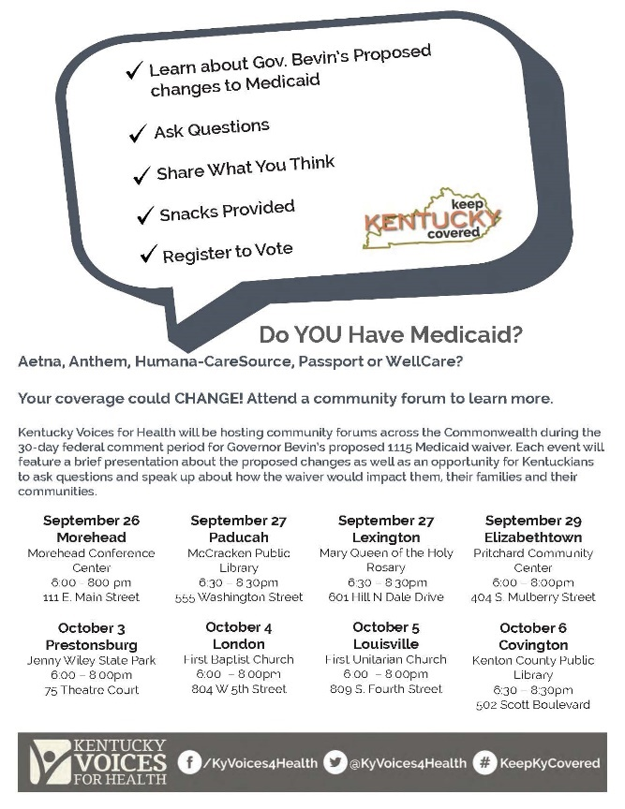
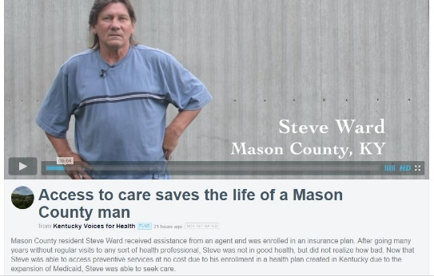
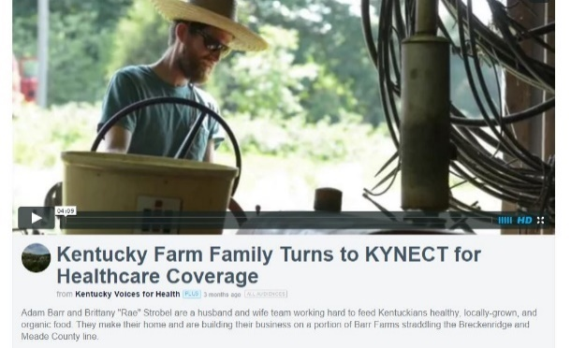
WHAT WE DO
KVH is a coalition of individuals and organizations working together to improve the health of ALL Kentuckians.
Conduct policy analysis
Provide public education
Facilitate collaborative partnerships
Raise the voices of Kentuckians to inform responsive health policy

Slide 3
DEFEATING KENTUCKY HEALTH
Implications for Kentucky and beyond
Strategies for mobilizing opposition
Challenging the re-approval
Lessons learned for state advocates

Slide 4
IMPLICATIONS FOR KENTUCKY
Changes coverage for more than 1.2 MILLION Kentuckians
Threatens coverage for 500,000 Medicaid expansion members
More than 100,000 eligible Kentuckians are estimated to lose coverage in 1st year
Reduces access to medically necessary services
Adds penalties, barriers & complexity for consumers
Strains the healthcare safety-net
Increases administrative cost & red tape

Slide 5
IMPLICATIONS BEYOND KENTUCKY
Fundamentally rewrites Medicaid law
Creates an unwelcome mat effect
Introduces new eligibility criteria
Introduces harsh penalties
Reduces enrollment

Slide 6
STRATEGIES TO MOBILIZE OPPOSITION
“Drumbeat” messaging
Impact analysis
Waiver task force
Plain language materials
Community forums
Speakers bureau
Press conferences
Comment collection
Story-banking
Earned media

Slide 7
CHALLENGING CMS RE-APPROVAL
Bolster the administrative record with public comments
Roll out online “report a barrier” tool for consumers, outreach workers, and providers
Conduct focus groups with consumers, assisters & CHWs
Continue story-banking and community forums to put a face to each new requirement and penalty
Build a public dashboard to measure the impact of barriers to care and administrative red tape

Slide 8
COMMENT COLLECTION

Slide 9
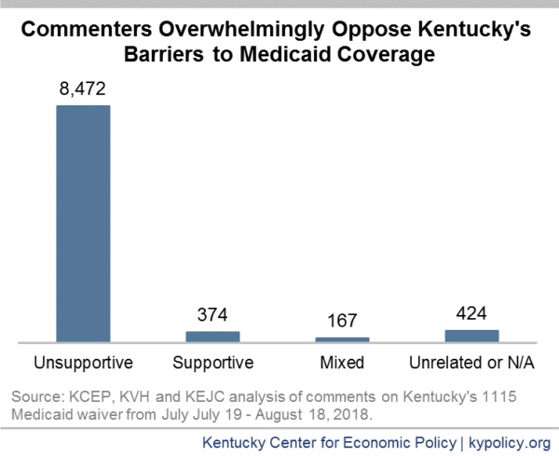
COMMENT ANALYSIS
2017
2018

Slide 10
MESSAGES THAT RESONATE
No one is exempt from the confusion or complexity
This is not a debate over the merits of work
You have to be healthy to work, keep or find a job
We’re creating big government to cover fewer people
People doing everything right will fall through the cracks
When parents lose coverage, children lose coverage

Slide 11
MESSAGING DOs & DON’Ts
DON’T
Use “work requirement” or “community engagement”
Reinforce the claim that work requirements only affect “able-bodied adults”
Challenge the value that people who can work should work
DO
Call it what it is: a reporting requirement that trips people up with red tape
Define who will be hurt – directly and indirectly
Provide estimates of coverage losses by county, if possible
Make the case that when people lose coverage, it raises healthcare costs for everyone and hurts our economy

Slide 12
LESSONS LEARNED: WHAT WORKS
Create a positive drumbeat to promote the value of Medicaid
Raise awareness and change the narrative
Make it easy for people to comment and share their stories
Let policymakers know you’re watching
County-level data gets noticed
Make it relevant by combining data and stories
Be ready to adapt and pivot

Slide 13
LESSONS LEARNED: TRADE-OFFs & CHALLENGES
Compromise won’t make a bad waiver less bad
The work requirement can’t be fixed
Exemptions are not guaranteed
Redirecting already scarce resources hurts the larger safety-net
Winning comes with casualties and presents new obstacles
State funders see our work as too controversial
Allies face pressure to stay silent or support the waiver
With each setback to implementation, new barriers are created
Autonomy has been key to our success
Fewer funding opportunities, but no political strings attached
It instills trust in the consumers we serve

Slide 14
Questions?
emily.beauregard@kyvoicesforhealth.org

