Slide 1

1115 Waivers—What’s Happening This Year?
Dee Mahan
Director, Medicaid Initiatives
January 2019
Presentation Name
Presented by Presenter Name, Title

Slide 2
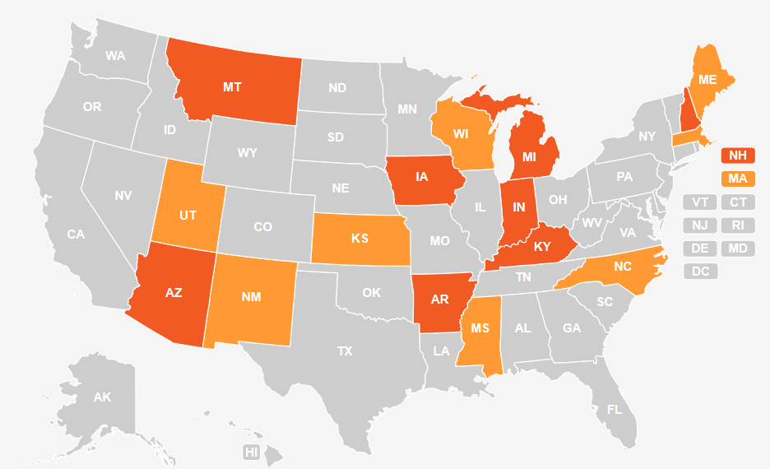
Waiver Map: January 2018

Slide 3
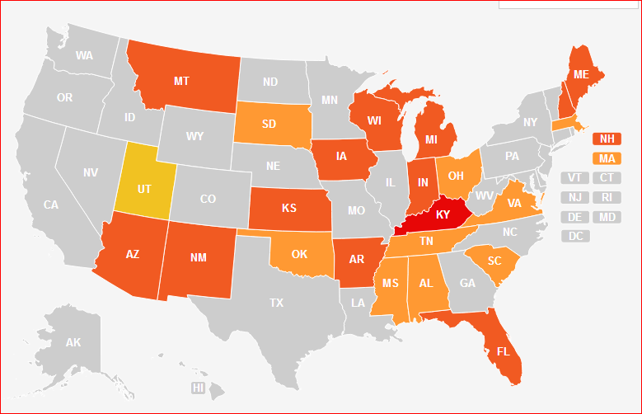
Waiver Map: January 2019

Slide 4
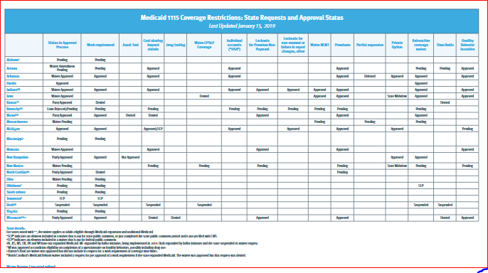
It isn’t just the number of waivers & states
Work reporting, other paperwork requirements, premiums, excluded benefits, time limits, asset tests, partial expansion. . . .

